Slide 1

ECE2050 Digital Logic and Systems Tutorial 6
Wangqian Chen
Contact: wangqianchen@link.cuhk.edu.cn
Office Hour: 16:00-17:00 Wed., ZX305

Slide 2
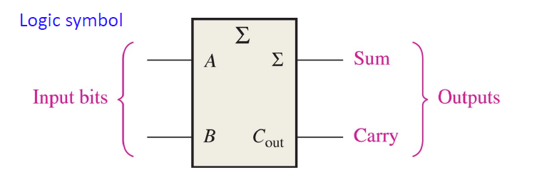
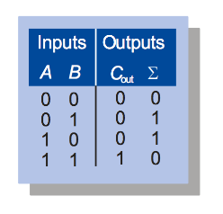
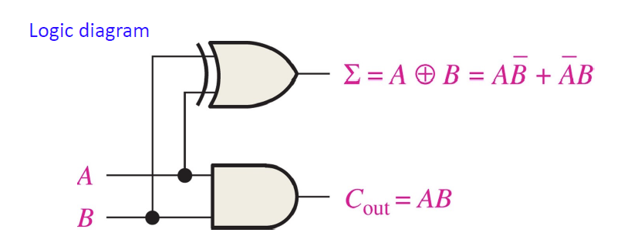
Combinational Building Blocks
Half Adders
Basic rules of binary addition are performed by a half adder, which has two binary inputs (A and B) and two binary outputs (Carry out and Sum).

Slide 3
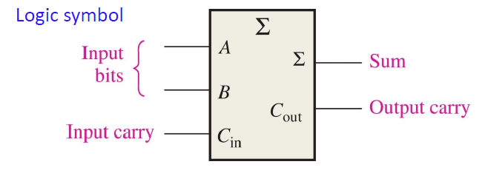
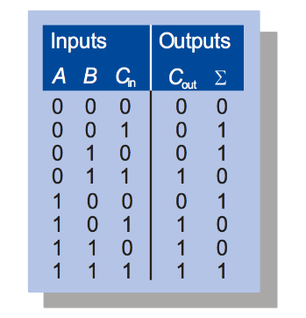
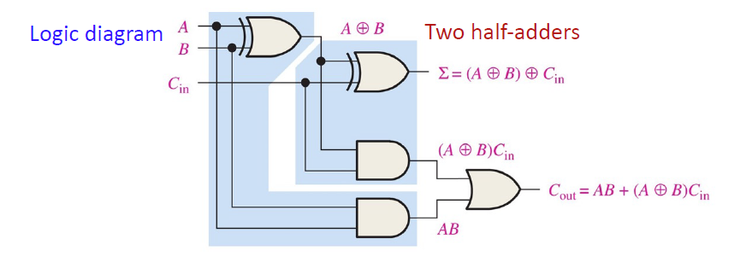
Combinational Building Blocks
Full Adders
By contrast, a full adder has three binary inputs (A, B, and Carry in) and two binary outputs (Carry out and Sum). The truth table summarizes the operation.

Slide 4
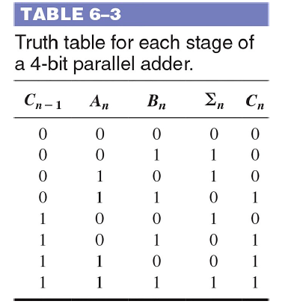
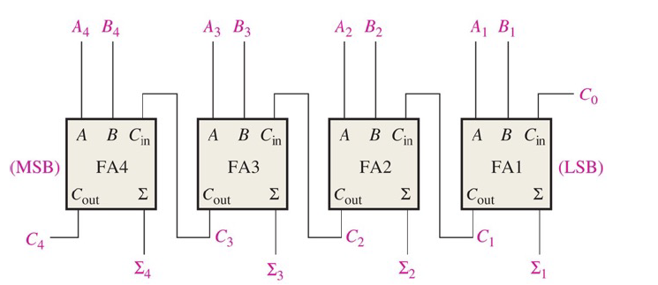
Combinational Building Blocks
Parallel Adders
Full adders are combined into parallel adders that can add binary numbers with multiple bits.

Slide 5
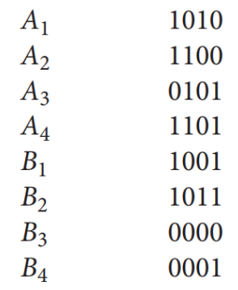
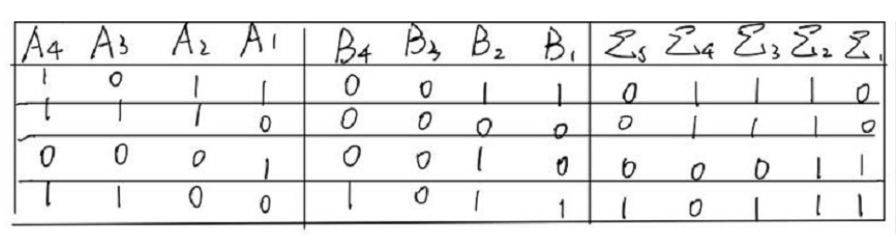
Combinational Building Blocks
Q1. The following sequences of bits (right-most bit first) appear on the inputs to a 4-bit parallel adder. Determine the resulting sequence of bits on each sum output.

Slide 6
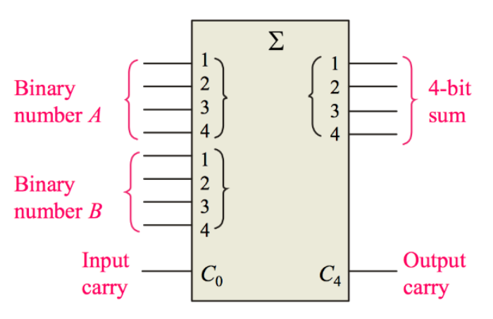
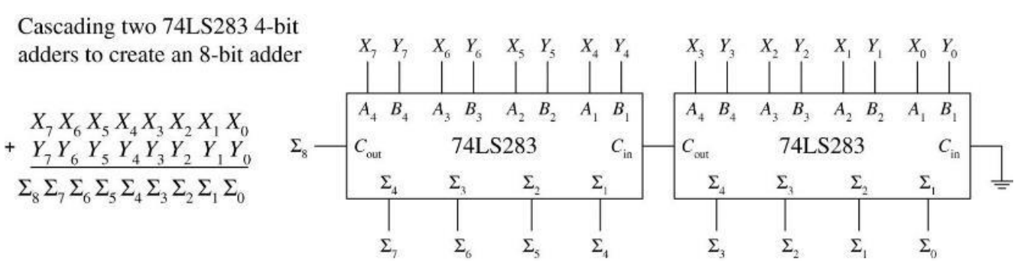
Combinational Building Blocks
74LS283
Q2. How to combine 74LS283 into a 8-bit parallel adder？

Slide 7
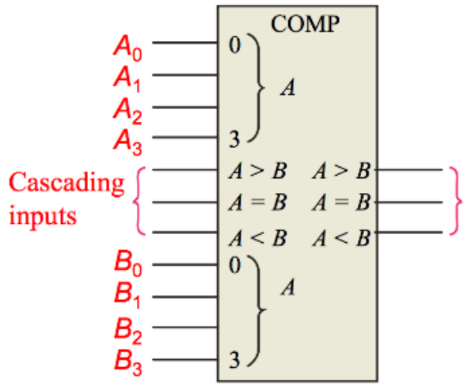
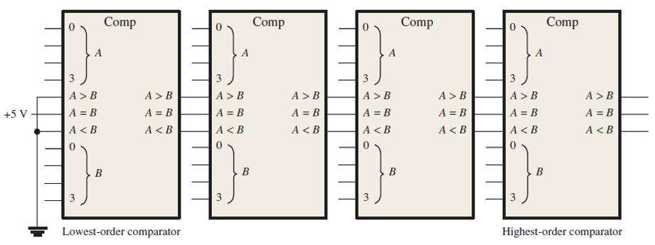
Combinational Building Blocks
Comparator
Comparators provide outputs to indicate which of the numbers is larger or if they are equal.
Cascading inputs are provided to expand the comparator to larger numbers.
74LS85
Q3. How to combine 74LS85 into a 16-bit comparators？

Slide 8
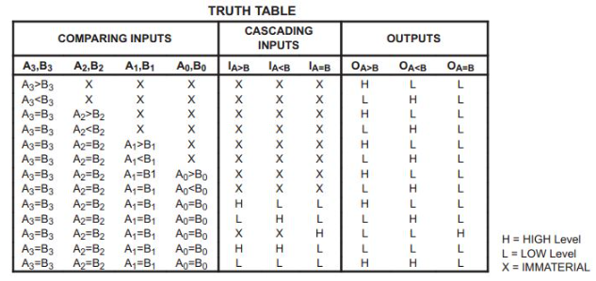
Combinational Building Blocks
Q3. How to combine 74LS85 into a 16-bit comparators？

Slide 9
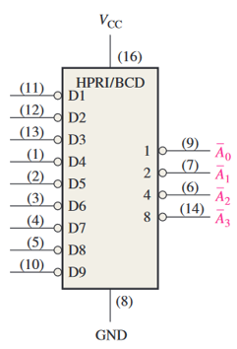
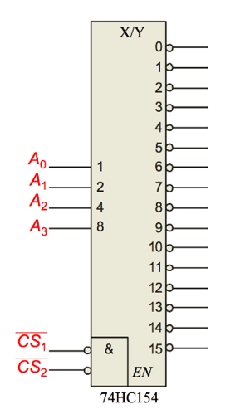
Combinational Building Blocks
Encoder & Decoder
An encoder accepts an active logic level on one of its inputs and converts it to a coded output, such as BCD or binary.
An decoder has multiple outputs to decode any combination of inputs. For example, the binary-to-decimal decoder shown here has 16 outputs – one for each combination of binary inputs.
Decoder
Encoder

Slide 10
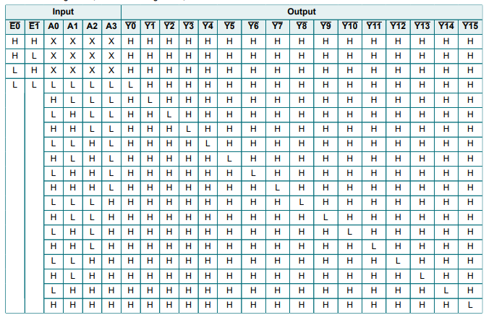
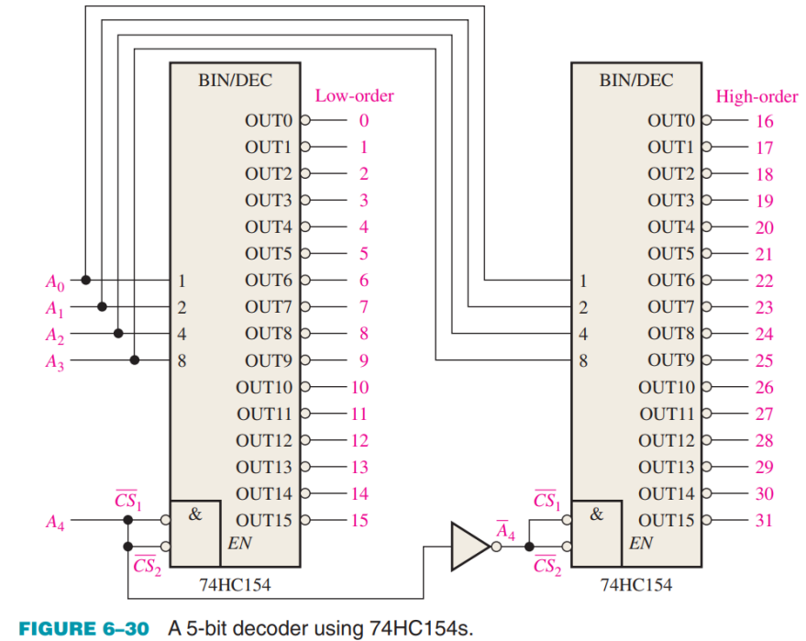
Combinational Building Blocks
Q4. How to combine 74HC154 into a 5-bit decoders？
It includes two active LOW chip select lines which must be at the active level to enable the outputs.
These lines can be used to expand the decoder to larger inputs.

Slide 11
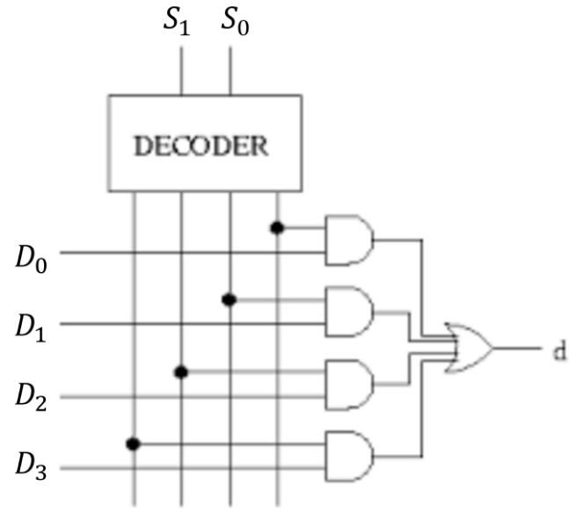
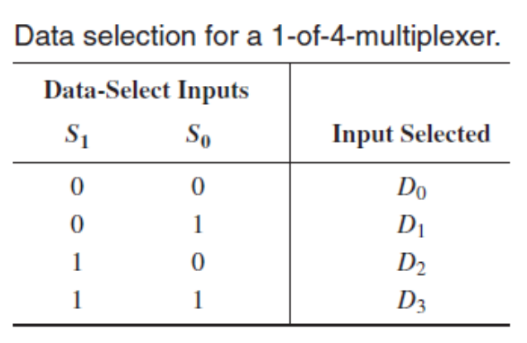
Combinational Building Blocks
Q5: Implement 4 to 1 Multiplexer using a Decoder.
Multiplexer

Slide 12
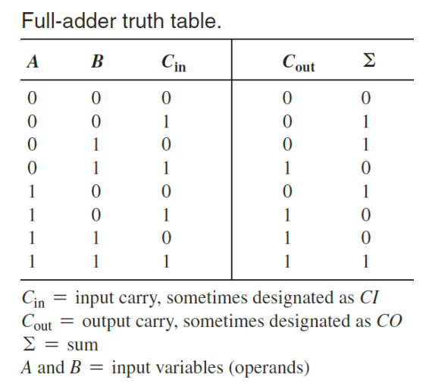

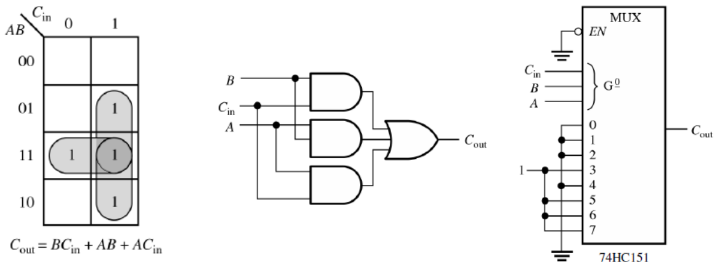
Combinational Building Blocks
Q6: Using the truth table, write the SOP expressions for the ∑ and Cout of a full-adder. Use a
Karnaugh map to minimize the expressions and then implement them with inverters and AND_x0002_
OR logic. Show how you can replace the AND-OR logic with 74HC151 data selectors.

Slide 13
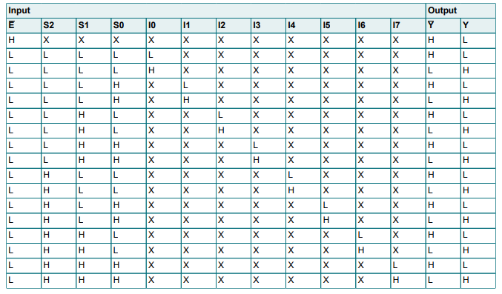
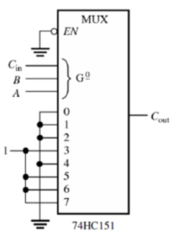
Combinational Building Blocks

Slide 14
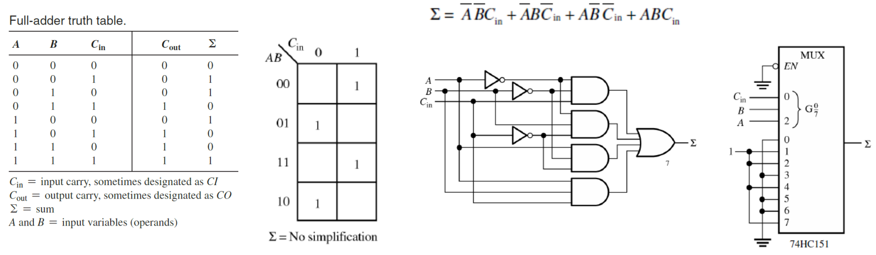
Combinational Building Blocks

Slide 15
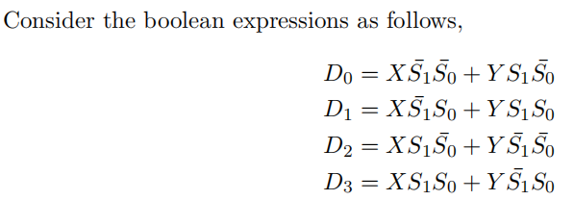
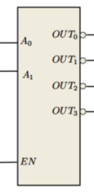
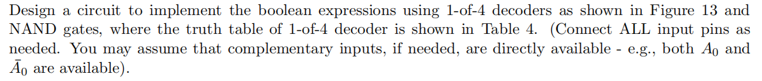
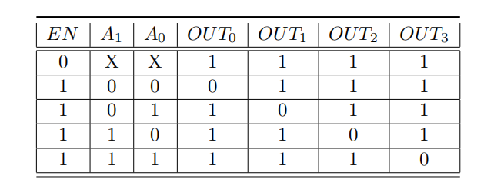
Combinational Building Blocks
Q7:

Slide 16
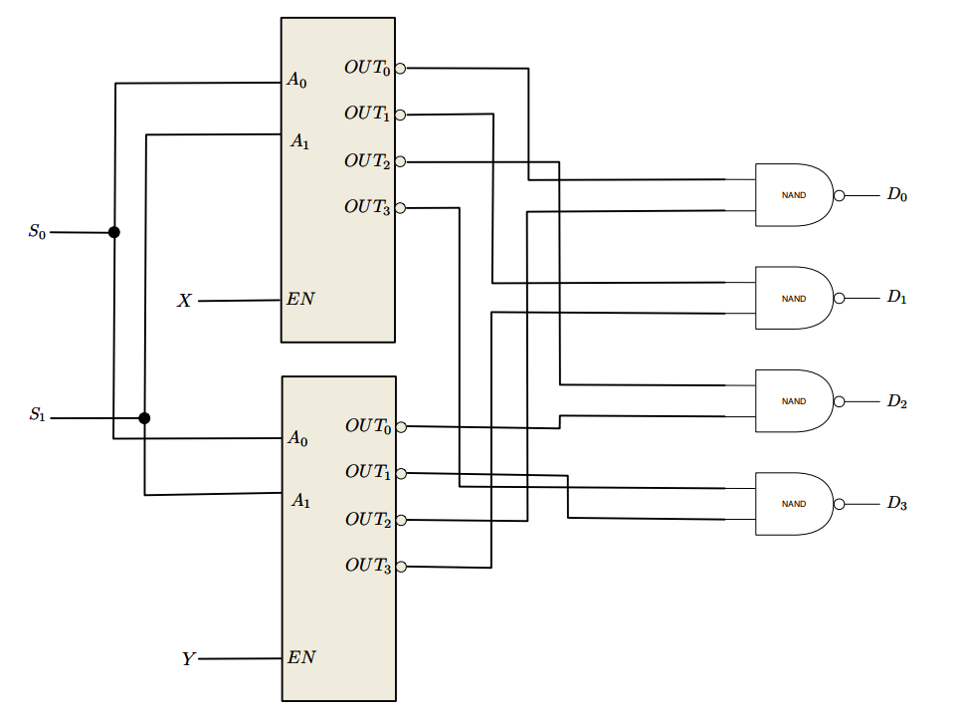
Combinational Building Blocks
Q7:

Slide 17
Thank You!

