Slide 1




ECE 2050 Digital Logic and Systems
VHDL tutorial

Slide 2
Basic Structure of a VHDL Module
A VHDL file
1) Library Declaration
library IEEE; use IEEE.std_logic_1164.all;
use IEEE.std_logic_arith.all;
use IEEE.std_logic_unsigned.all;
2) Entity Declaration
Define the signals that can be seen outside externally (I/O pins)
3) Architecture Body
Define the internal signals and operations of the desired function

Slide 3
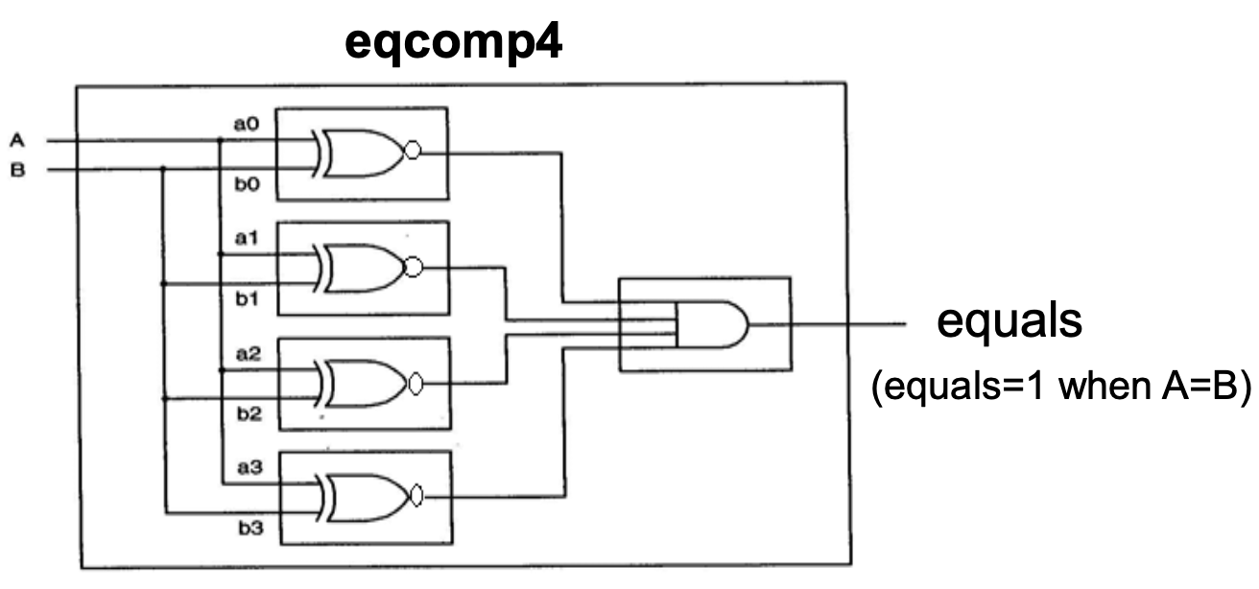
Example: 4-bit Comparator in VHDL
eqcomp4.vhd
1 --the code starts here, “a comment”
2 library IEEE; 3 use IEEE.std_logic_1164.all;
4 entity eqcomp4 is 5 port (a, b: in std_logic_vector(3 downto 0); 6 equals: out std_logic); 7 end eqcomp4;
8 architecture arch_eqcomp4 of eqcomp4 is 9 begin 10 equals <= '1' when (a = b) else '0’; 11 -- “comment line” 12 end arch_eqcomp4;

Slide 4
Identifiers
Identifiers: Used to name any object in VHDL
Naming Rules:
1) Made up of only alphabets, numbers, and underscores
2) First character must be a letter
3) Last character CANNOT be an underscore
4) Two connected underscores are NOT allowed
5) VHDL-reserved words are NOT allowed
6) VHDL is NOT case sensitive
• Txclk, Txclk, TXCLK, TxClk are all equivalent

Slide 5
External Signals (I/O Pin)
• An external signal (or I/O pin) is a physical wire that can carry logic information.
• Many logic types are eligible for external signals, e.g.,
– bit: can be logic ‘1’ or ‘0’ only
– std_logic: can be logic ‘U’, ‘X’, ‘0’, ‘1’, ‘Z’, ‘W’, ‘L’, ‘H’, or ‘-’
• 9-valued standard logic (IEEE standard 1164)
• E.g., equals:outstd_logic;
– std_logic_vector: a group of wires (i.e., a signal bus)
• E.g., a, b: in std_logic_vector(3 downto 0);
– Each of a(3), a(2), a(1), a(0) is a std_logic signal.
• VHDL is strongly-typed language.
– Signals of different base types CANNOT to assigned to each other without the use of type-conversion.

Slide 6
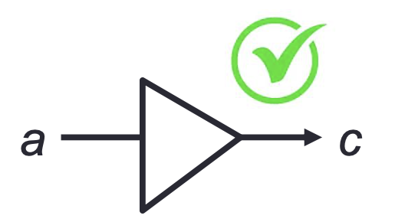
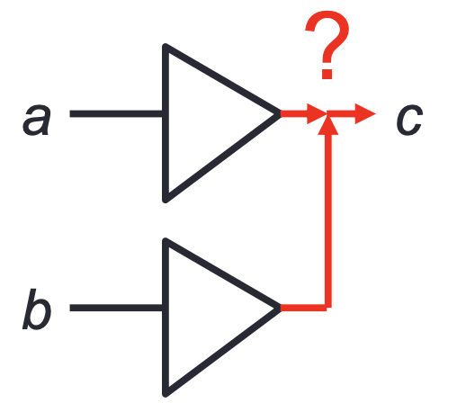
Resolved Logic Concept
Resolved Logic (Multi-value Signal): Multiple outputs can be connected together to drive a signal.
The resolution function is used to determine how multiple values from different sources (drivers) for a signal will be reduced to one value.
Single-value Signal Assignment:
signal a, c: bit;
c <= a;
Multi-value Signal Assignment:
signal a, b, c: bit;
c <= a;
c <= b;

Slide 7
std_logic vs. std_ulogic
std_logic: a type of resolved logic, which means a signal can be driven by 2 inputs.
std_ulogic (“u” means unresolved): a type of unresolved logic, that means a signal CANNOT be driven by 2 inputs.

Slide 8
Modes of I/O Pins
Modes of I/O pin must be explicitly specified in port of entity declaration:
Example:
entity eqcomp4 is port (a, b: in std_logic_vector(3 downto 0);
equals: out std_logic);
end eqcomp4;
There are 4 available modes of I/O pins: 1) in:Dataflowsinonly 2) out: Data flows out only (cannot be read back by the entity)
3) inout: Data flows bi-directionally (i.e., in or out)
4) buffer: Similar to out but it can be read back by the entity

Slide 9
Architecture Body
Architecture Body: Defines the internal of the chip Example: the architecture body of the entity eqcomp4
architecture arch_eqcomp4 of eqcomp4 is begin
equals <= '1' when (a = b) else '0’;
-- “comment line”
end arch_eqcomp4;
– arch_eqcomp4: the architecture identifier (entered by the user) – equals, a, b: I/O pins designed by the user in the entity declaration
– begin ... end: define the internal operation – equals <= '1' when (a = b) else '0’;
• <= here means “signal assignment” not “less than or equal”.
• when-else is a concurrent design construction.
– --: comment on a line

Slide 10
Built-in Operators
• Logical Operators: and, or, nand, nor, xor, xnor, not have their usual meanings.
• Relation Operators (result is Boolean)
= equal /= not equal < less than
<= less than or equal > greater than >= greater than or equal
• Logical Shift and Rotate
– sll shift left logical, fill blank with 0
– srl shift right logical, fill blank with 0
– rol rotate left logical, circular operation
E.g., “10010101” rol 3 is “10101100”
– ror rotate right logical, circular operation

Slide 11
Internal Signal
• The entity declares the external signals. • The architecture body can also declare signals that
can be used internally.
architecture arch_eqcomp4 of eqcomp4 is -- Internal signals shall be declared here!
begin ... end arch_eqcomp4;
– Signal: Represent physical wires • E.g., signal s1: BIT := '1';
– Constant: Hold unchangeable values
• E.g., constant c1: BIT := '1';

Slide 12
Signal Object
signal SIG_NAME: <type> [:= <value>];
Note: Signals can be declared without initialized values.
• Examples:
– signal SIG_NAME: STD_LOGIC;
• Declared without initialized value
– signal SIG_NAME: STD_LOGIC := ‘1’;
• Signals can be declared – In the “port” of the entity declaration (as external signals);
– Or in the architecture body (as internal signals).

Slide 13
Constant Object
constant CONST_NAME: <type> := <value>;
Note: Constants must be declared with initialized values.
• Examples:
– constant CONST_NAME: STD_LOGIC := 'Z’;
– constant CONST_NAME: STD_LOGIC_VECTOR (3 downto 0) := "0-0-";
• '-' means “don’t care” • Constants can be declared in
– Anywhere allowed for declaration.

Slide 14
Data Flow (Concurrent Statements)
• Data flow design method uses concurrent statements rather than sequential statements.
– Concurrent statements can be interchanged freely.
– There’s no “execution order” for concurrent statements.
1 library IEEE; %Vivado2014.4 tested ok 2 use IEEE.STD_LOGIC_1164.ALL; 3 entity eqb_comp4 is 4 port (a, b: in std_logic_vector(3 downto 0); 5 equals, bigger: out std_logic);
6 end eqb_comp4; 7 architecture dataflow4 of eqb_comp4 is
8 begin
9 equals <= '1' when (a = b) else '0'; --concurrent
10 bigger <= '1' when (a > b) else '0'; --concurrent
11 end dataflow4;
Lines 9 & 10 will be executed whenever signal a or b (or both) changes.

Slide 15
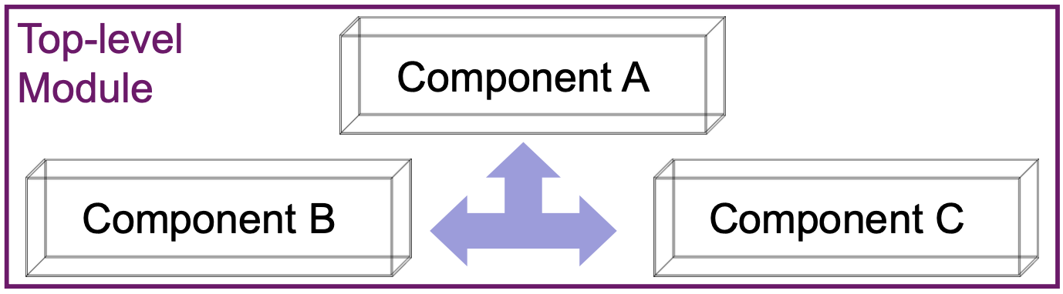
Structural Design (use “port map”)
• Structural Design: Like a circuit but describe it by text.
Connected by port map in the architecture body of the top-level design module
• Design Steps: Step 1: Create entities Step 2: Create components from entities
Step 3: Use “port map” to relate the components

Slide 16
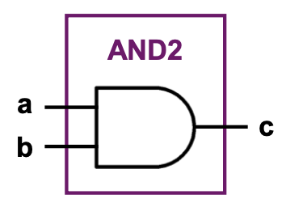
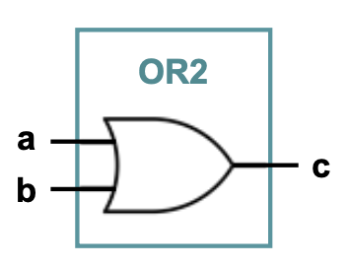
Step 1: Create Entities
1 library IEEE; 2 use IEEE.STD_LOGIC_1164.ALL; 3 entity and2 is 4 port (a,b: in STD_LOGIC; 5 c: out STD_LOGIC ); 6 end and2; 7 architecture and2_arch of and2 is
8 begin 9 c<=a and b;
10 end and2_arch; 11 --------------------------------- 12 library IEEE; 13 use IEEE.STD_LOGIC_1164.ALL; 14 entity or2 is 15 port (a,b: in STD_LOGIC; 16 c: out STD_LOGIC );
17 end or2;
18 architecture or2_arch of or2 is 19 begin 20 c <= a or b;
21 end or2_arch;

Slide 17
Step 2: Create Components
component and2 --create components-- port (a,b: in std_logic; c: out std_logic);
end component;
component or2 --create components-- port (a,b: in std_logic; c: out std_logic);
end component;
signal con1_signal: std_logic; --internal signal--
-- (optional) --

Slide 18
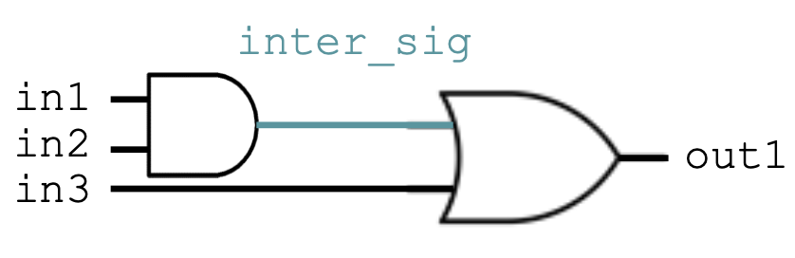
Step 3: Connect Components
begin label1: and2 port map (in1, in2, inter_sig);
label2: or2 port map (inter_sig, in3, out1);
end test_arch;

Slide 19
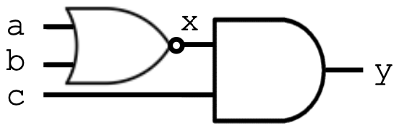
Structural vs. Data Flow
Structural
(“port map”)
architecture test_arch of test is
component and2 port (a,b: in std_logic;
c: out std_logic);
end component;
component nor2 port (a,b: in std_logic;
c: out std_logic);
end component ;
signal x: std_logic;
Begin
label1: nor2 port map (a, b, x);
label2: and2 port map (x, c, y);
end test_arch;
Data Flow
(“concurrent statements”)
architecture test_arch of test is
signal x : std_logic; begin
x <= a nor b;
y <= x and c;
end test_arch;

Slide 20
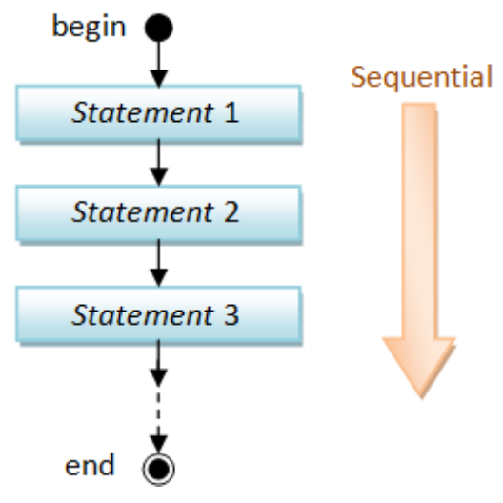
Behavioral Design (use “process”)
• Behavioral design is sequential
– Just like a sequential program
• The keyword is “process”:
– The main character is “process (sensitivity list)”.
– A process is executed when one (or more) of the signals in the sensitivity list changes.
– Statements inside a process are sequentially executed.

Slide 21
Behavioral Design Example
library IEEE; --vivado14.4 use IEEE.STD_LOGIC_1164.ALL; entity eqcomp4 is port (a, b: in std_logic_vector(3 downto 0);
equals: out std_logic);
end eqcomp4;
architecture behavioral of eqcomp4 is
begin
process(a, b) ← Behavioral Design: Sequential in a “process”
begin
if a = b then
equals <= '1’;
else
equals <= '0’;
end if;
end process;
end behavioral;

Slide 22
Concurrent vs. Sequential Statements
• Concurrent Statement 1) Statements inside the architecture body can be executed
concurrently, except statements enclosed by a process.
2) Every statement will be executed once whenever any
signal in the right-hand-side of statement changes.
• Sequential Statement
1) Statements within a process are executed sequentially, and the result is obtained when the process is complete.
2) process(sensitivity list): Whenever any signals in the sensitivity list changes its state, the process executes once.
3) A process can be treated as one concurrent statement in the architecture body.

Slide 23
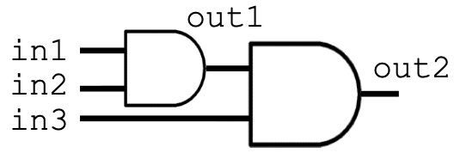
Concurrent with Sequential
1 library IEEE; --vivado14.4 ok
2 use IEEE.STD_LOGIC_1164.ALL;
3 entity conc_ex is 4 port (in1,in2,in3: in std_logic; 5 out1,out2 : inout std_logic); 6 end conc_ex; 7 architecture for_ex_arch of conc_ex is
8 begin
process (in1, in2)
10 begin
11 out1 <= in1 and in2;
12 end process;
13 out2 <= out1 and in3; -- concurrent statement
14 end for_ex_arch;
The process (9-12) and line 13 are concurrent and can be interchanged!

Slide 24
Design Constructions
• Concurrent: Statements that can be stand-alone
1) when-else 2) with-select-when
• Sequential: Statements inside the process
1) if-then-else
2) case-when 3) for-in-to-loop
Concurrent: OUTSIDE process
Sequential – INSIDE process

Slide 25
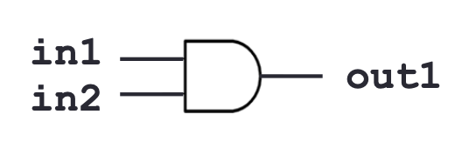
Concurrent 1) when-else
1 library IEEE;
2 use IEEE.STD_LOGIC_1164.ALL;
3 entity when_ex is
4 port (in1, in2 : in std_logic;
5 out1 : out std_logic);
6 end when_ex;
7 architecture when_ex_arch of when_ex is
8 begin
9 out1<='1'whenin1=‘1’ and in2='1'else'0’;
10 end when_ex_arch;
when condition is true then out1 <= ‘1’
otherwise then out1 <= ‘0’

Slide 26
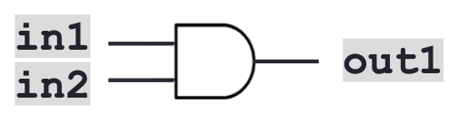
Concurrent 2) with-select-when
library IEEE;
2 use IEEE.STD_LOGIC_1164.ALL;
3 entity when_ex is 4 port (in1, in2 : in std_logic;
5 out1 : out std_logic);
6 end when_ex;
architecture when_ex_arch of when_ex is
begin
9 with in1 select Signal based 10 out1 <= in2 when '1',← when in1='1' then out1 <= in2
11 '0' when others;←when in1 = other cases
12 end when_ex_arch; then out1 <= ‘ 0’

Slide 27
when-else vs. with-select-when
• Concurrent1) when-else: Condition based out1 <= '1' when in1 = '1' and in2 = '1' else '0’;
when in1=‘1’ and in2=‘1’ then out1 <= ‘1’, otherwise out <= ‘0’
• Concurrent2) with-select-when: Signal based
with in1 select
out1 <= in2 when ‘1‘, ←when in1='1' then out1 <= in2
‘0’ when others; ←when in1 = other cases
then out1 <= ‘0’

Slide 28
Design Constructions
• Concurrent: Statements that can be stand-alone
1) when-else 2) with-select-when
• Sequential: Statements inside the process
1) if-then-else
2) case-when 3) for-in-to-loop
Sequential – INSIDE process
Concurrent: OUTSIDE process

Slide 29

Sequential 1) if-then-else
if (cond) then
statement;
end if;
entity if_ex is port(in1,in2: in std_logic;
out1: out std_logic);
end if_ex; architecture if_ex_arch of if_ex is
begin
process(b)
begin
if in1=‘1‘ and in2='1‘ then
out1 <= '1‘;
else
out1 <= '0’;
end if;
end process;
end if_ex_arch;
if (cond) then
statement1;
else
statement2;
end if;
if (cond1) then
statement1;
elsif (cond2) then
statement2;
elsif ...
...
else
statementn;
end if;

Slide 30
Sequential 2) case-when
entity test_case is port ( in1, in2: in std_logic;
out1,out2: out std_logic);
end test_case;
architecture case_arch of test_case is
signal b: std_logic_vector (1 downto 0);
begin
process (b)
begin
case b is
when "00"|"11" => out1 <= '0’;
out2 <= '1’;
when others => out1 <= ‘1’;
out2 <= ‘0’;
end case;
end process;
b<=in1&in2;
end case_arch;
“=>” means “implies” not “bigger”
"00"|"11" means case “00” or “11”

Slide 31
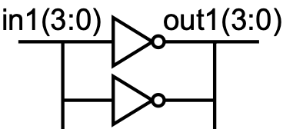
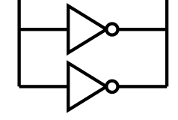
Sequential 3) loop (1/2)
library IEEE; use IEEE.STD_LOGIC_1164.ALL; entity for_ex is port (in1: in std_logic_vector(3 downto 0);
out1: out std_logic_vector(3 downto 0));
end for_ex;
architecture for_ex_arch of for_ex is
begin
process (in1) for-loop
begin
for I in 0 to 3 loop
out1(i) <= not in1(i);
end loop;
end process;
end for_ex_arch;
process (in1) while-loop
variable i: integer:= 0;
begin
i:=0;
while I < 4 loop
out1(i) <= not in1(i);
i:=i+1;
end loop;
end process;

Slide 32
Sequential 3) loop (2/2)
• for-loop
for i in 0 to 3loop
out1(i) <= not in1(i);
end loop;
• while-loop
variable i: integer:=0;
... While I < 4 loop
out1(i) <= not in1(i);
...
end loop;
– No need to declare the loop index (e.g., i).
• It is implicitly declared within the loop.
• It may not be modified within the loop (e.g., i := i-1;).
– for-loop is generally
supported for synthesis.
– The while loop repeats if the condition tested is true.
• The condition is tested before each iteration.
– while-loop is supported
by some logic synthesis tools with restrictions.

Slide 33
Variable Object
variable VAR_NAME: <type> [:= <value>];
Note: Variables can be declared without initialized values.
• Examples:
– variable VAR_NAME: STD_LOGIC;
• Declared without initialized value
– variable VAR_NAME : STD_LOGIC := '1’;
• Variables can only be declared/used in the process.
• Variables are used only by programmers for internal representation (less direct relationship to hardware).

Slide 34
Signal vs. Variable Assignment
• Both signals and variables can be declared without initialized values.
– signal SIG_NAME: <type> [:= <value>];
– variable VAR_NAME: <type> [:= <value>];
• Their values can be assigned after declaration.
– Syntax of signal assignment:
SIG_NAME <= <expression>;
– Syntax of variable assignment:
VAR_NAME := <expression>;

Slide 35
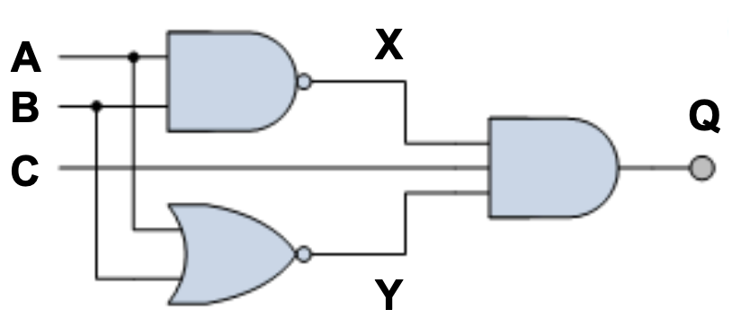
Combinational Circuit
• Logic/Schematic Diagram shows the wiring and connections of each individual logic gate.
architecture com_arch of comb is
signal X, Y: std_logic;
begin
X <= not (A and B);
Y <= not (A or B); Q <= (X and C) and Y;
end com_arch;

Slide 36
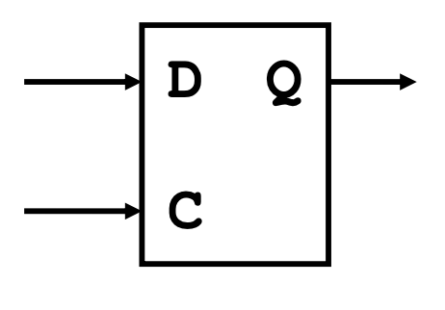
D Latch in VHDL
1 library IEEE;--(ok vivado 2014.4)
2 use IEEE.STD_LOGIC_1164.ALL;
3 entity latch_ex is 4 port (C, D: in std_logic;
Q: out std_logic);
end latch_ex;
7 architecture latch_ex_arch of latch_ex is
8 begin
9 process(C, D) -- sensitivity list
10 begin
if(C='1')then
Q<=D;
end if;
end process;
end process;
end latch_ex_arch;

Slide 37
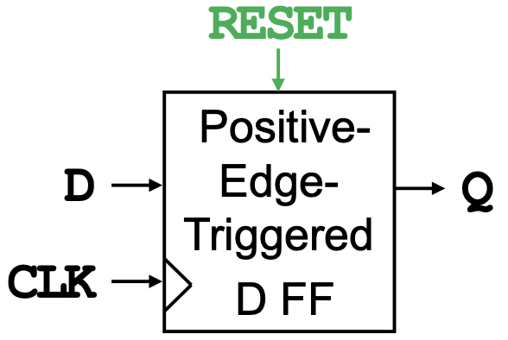
D Flip-flop with Async. Reset in VHDL
library IEEE;
use IEEE.STD_LOGIC_1164.ALL;
entity DFF_ASYNC is
port(D,CLK,RESET: in std_logic;
Q: out std_logic);
end dff_async;
architecture DFF_ASYNC_ARCH of DFF_ASYNC is begin
begin
process(CLK, RESET) -- sensitivity list
begin
if (RESET = '1') then
Q <= '0'; -- Reset Q anytime
elsif CLK = '1' and CLK'event then
Q <= D;-- Q follows input D
end if;
end process;
end DFF_ASYNC_ARCH;
← Positive-edge- triggered

Slide 38
D Flip-flop with Sync. Reset in VHDL
library IEEE;
use IEEE.STD_LOGIC_1164.ALL;
entity DFF_SYNC is
port(D,CLK,RESET: in std_logic;
Q: out std_logic);
end DFF_SYNC;
architecture DFF_SYNC_ARCH of DFF_SYNC is begin
begin
process(CLK)
begin
if CLK = ‘1’ and CLK’event then
if (RESET = '1') then
Q <= '0'; -- Reset Q anytime
else
Q <= D; -- Q follows input D
end if;
end if;
end process;
end DFF_SYNC_ARCH;
← shall we put RESET in the sensitivity list?
← Positive-edge- triggered

Slide 39
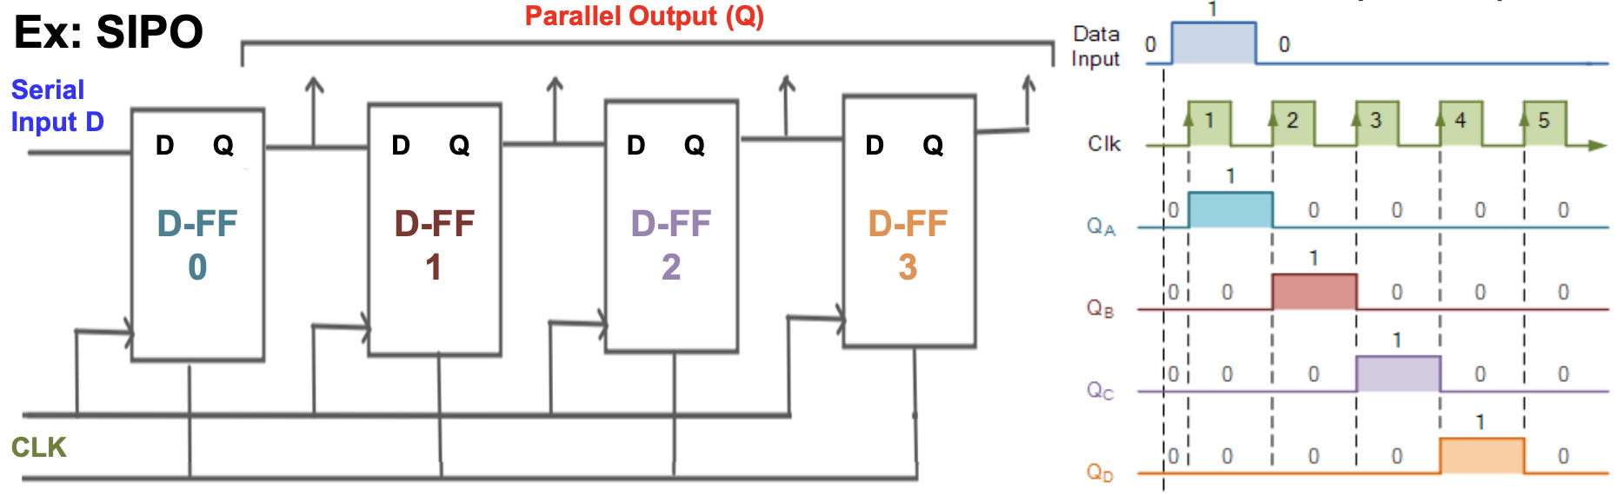
Seq. Circuit Example: Shift Register
A register is a device that can be composed of a group of FFs to store multiple bits of data.
A shift register allows the stored data being moved from one FF to another.
– There are basically four types: 1.Serial-In-Serial-Out (SISO), 2. Serial-In-Parallel-Out (SIPO), 3. Parallel-In-Serial-Out (PISO), and 4. Parallel-In-Parallel-Out (PIPO).

Slide 40
SIPO Shift Register in VHDL
entity SIPO_ASYNC is port (D, CLK, RST : IN STD_LOGIC;
Q : OUT STD_LOGIC_VECTOR(3 downto 0) ); end SIPO_ASYNC;
architecture SIPO_ASYNC_ARCH of SIPO_ASYNC is
component DFF_ASYNC is port(D, clk, reset : in STD_LOGIC;
Q : out STD_LOGIC ); end component;
signal dout : STD_LOGIC_VECTOR(3 downto 0);← necessary?
begin
DFF0: DFF_ASYNC port map(D, CLK, RST, dout(0));
DFF1: DFF_ASYNC port map(dout(0), CLK, RST, dout(1));
DFF2: DFF_ASYNC port map(dout(1), CLK, RST, dout(2));
DFF3: DFF_ASYNC port map(dout(2), CLK, RST, dout(3));
Q <= dout; end SIPO_ASYNC_ARCH;

