Slide 1

Irish Database

Slide 2
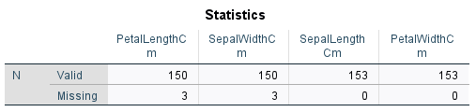
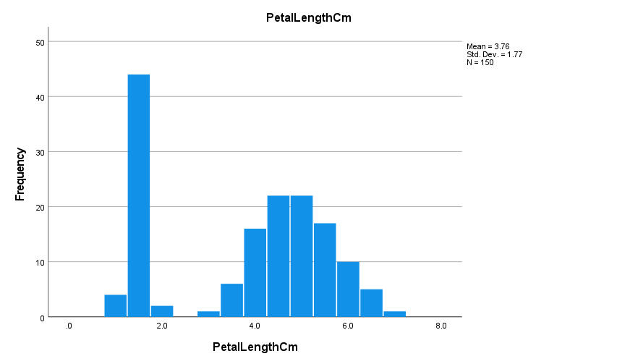
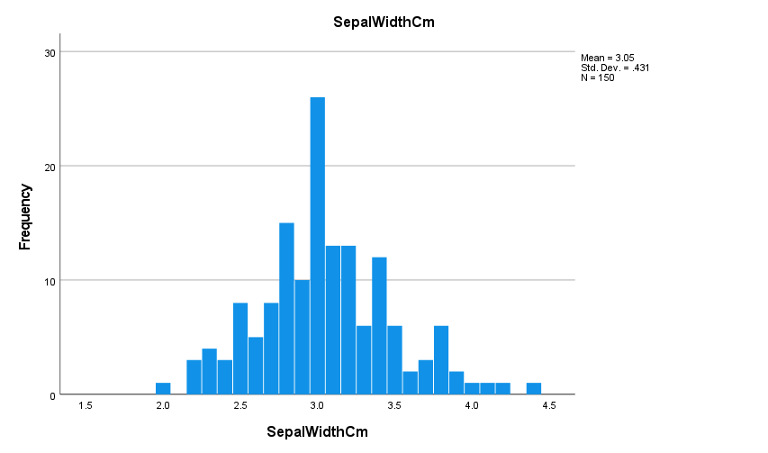
Missing values (Metric variables)
Irish.csv
Evaluated all the variables to know which one has missing values

Slide 3
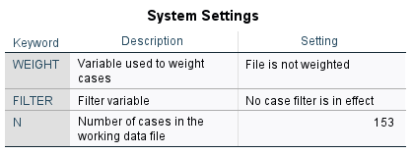
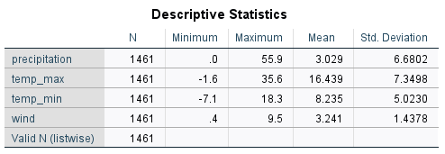
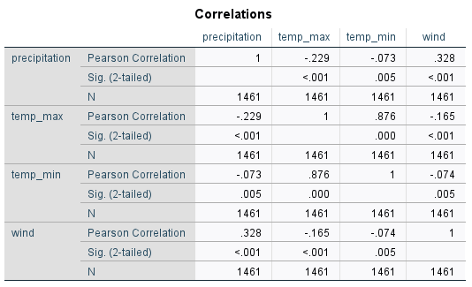
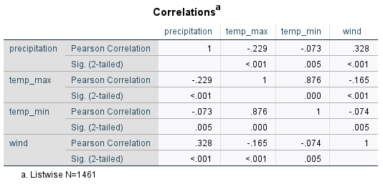
Missing values(Metric variables)
Evaluating If weight and filter are on.
Descriptives: Won’t proceed with listwise exclusion
Correlations between variables
Correlations (Listwise exclusion)

Slide 4
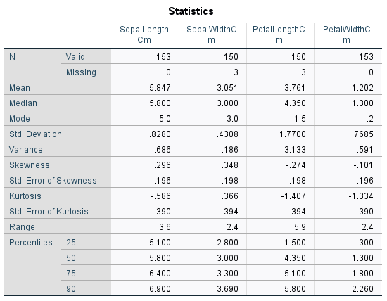
Missing values(Metric variables)
Irish.csv
FREQUENCY ANALYSIS

Slide 5
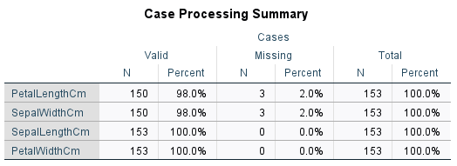
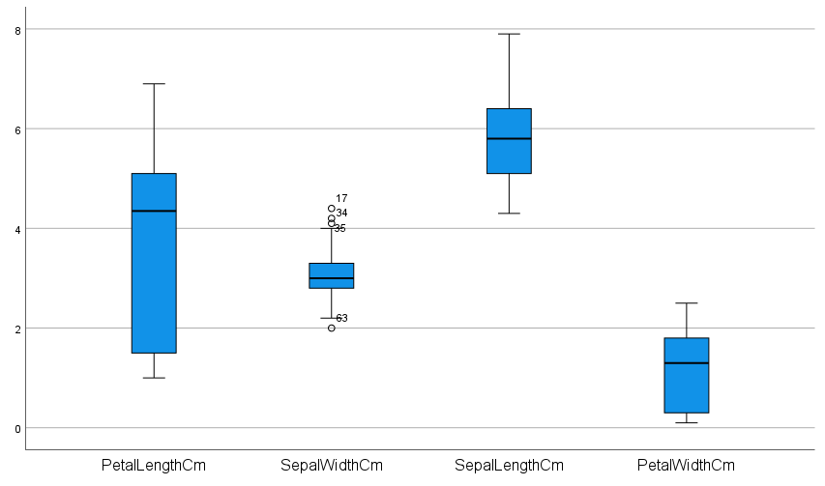
Outliers
Irish.csv

Slide 6

Weather Database
Data cleaning
Data Types
Frequency Analysis
Central Tendency
Dispersion
Distribution
Skewness-Kurtosis
Percentiles
Quartiles
Outliers
Correlation
Regression
Normality test

Slide 7
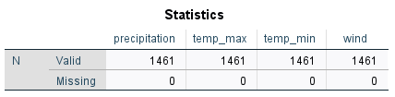
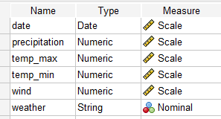
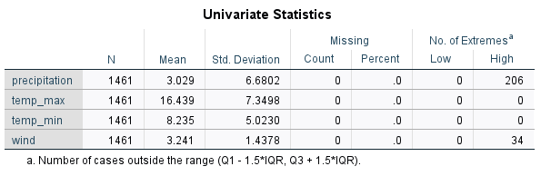
Cleaning (Exploring values)
MISSING VALUES
DATA TYPES
R: We don’t have missing values

Slide 8
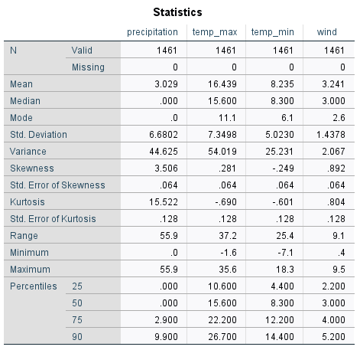
Frequency Analysis
Skewness
Temp.max and min: Symmetric
Wind: Moderately skewed
Precipitation: Highly skewed
Kurtosis:
Wind, Temp.max and min: Platykurtic with lower peak and flatter tail compared to a normal distribution(<3)
Precipitation: Leptokurtic with fatter tail than a normal distribution(>3)

Slide 9
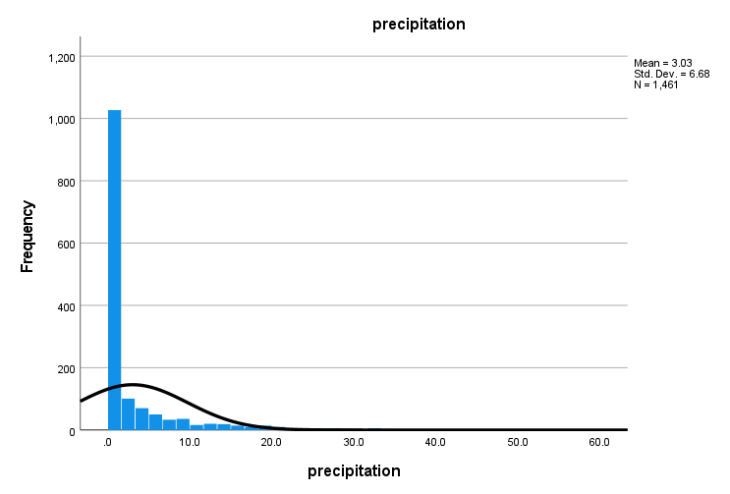
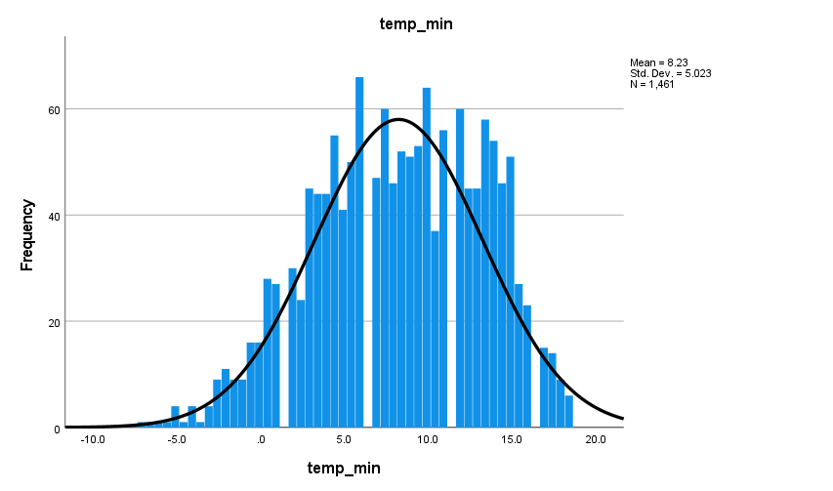
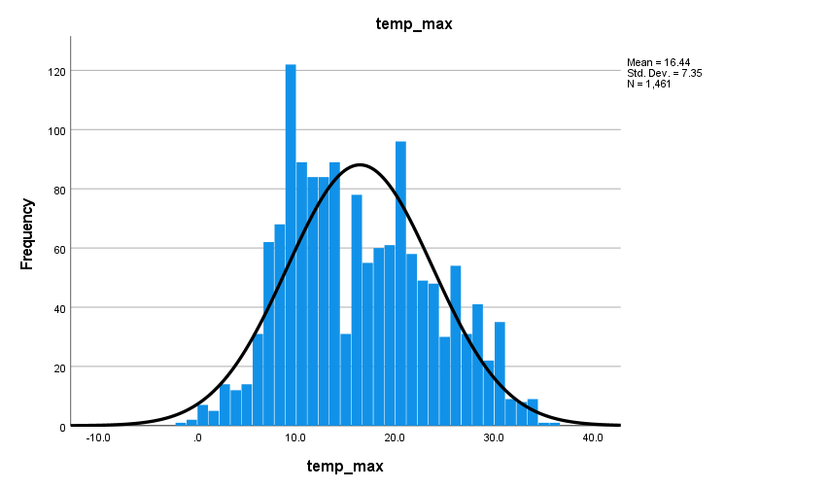
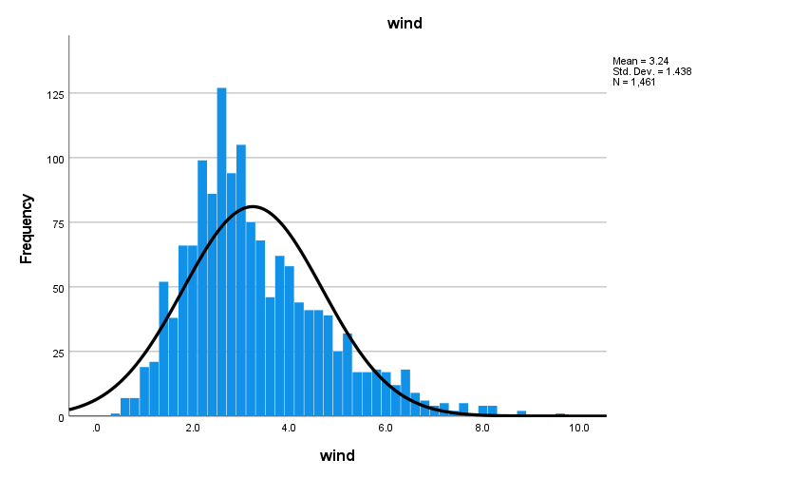
Frequency Analysis (Histograms)

Slide 10
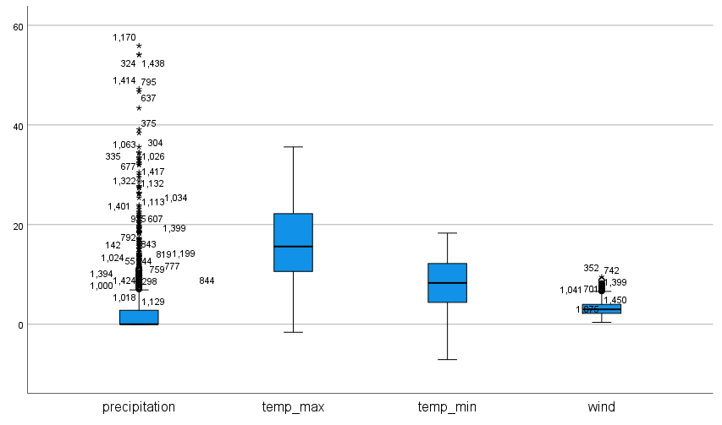
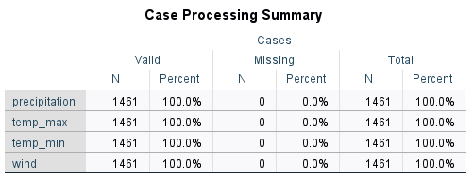
Outliers

Slide 11
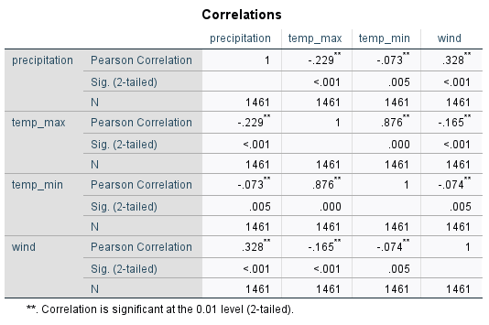
Correlations

Slide 12
Correlations

Slide 13
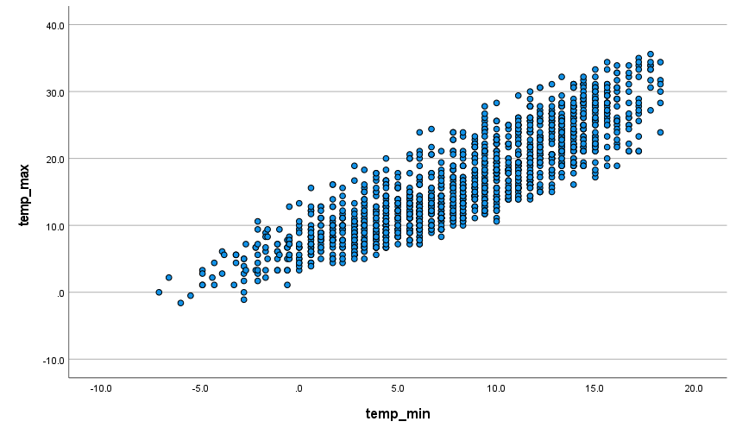
Correlations (Positive correlation)
Temp_min & Temp_max
Significant linear relationship, meaning that these variables tend to increase together.
Wind & Precipitation
These variables tend to change in the same direction. The observed results are very unlikely to have happened by a chance alone.

Slide 14
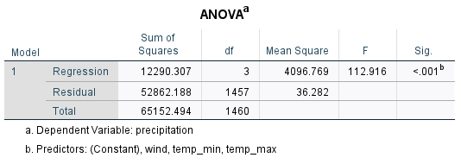
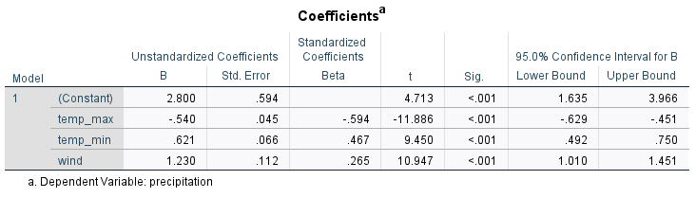
Regression

Slide 15
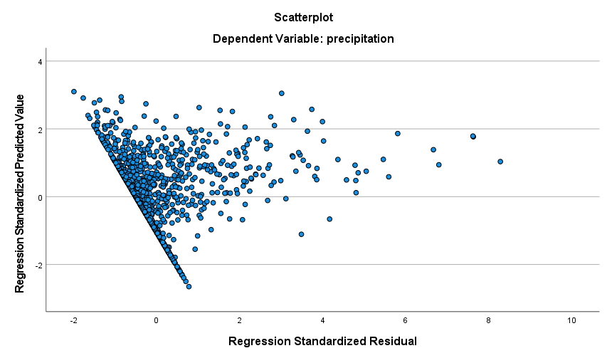
Regression (multiple)

Slide 16
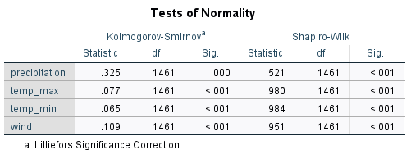
Test of Normality
A variable is not normally distributed if “sig.” < 0.05. So both the Kolmogorov-Smirnov test as well as the Shapiro-Wilk test results suggest that any variable follows a normal distribution in the entire population.

Slide 17
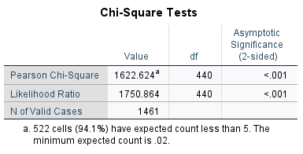
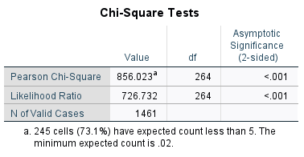
Hypothesis 1
Ho: There is no correlation between Weather and precipitation.
H1: There is correlation between Weather and precipitation.
Ho: There is no correlation between Weather and temp_max.
H1: There is correlation between Weather and temp_max.

Slide 18

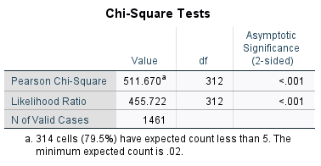
Hypothesis 2
Ho: There is no correlation between Weather and temp_min.
H1: There is correlation between Weather and temp_min.
Ho: There is no correlation between Weather and wind.
H1: There is correlation between Weather and wind.

