Slide 1
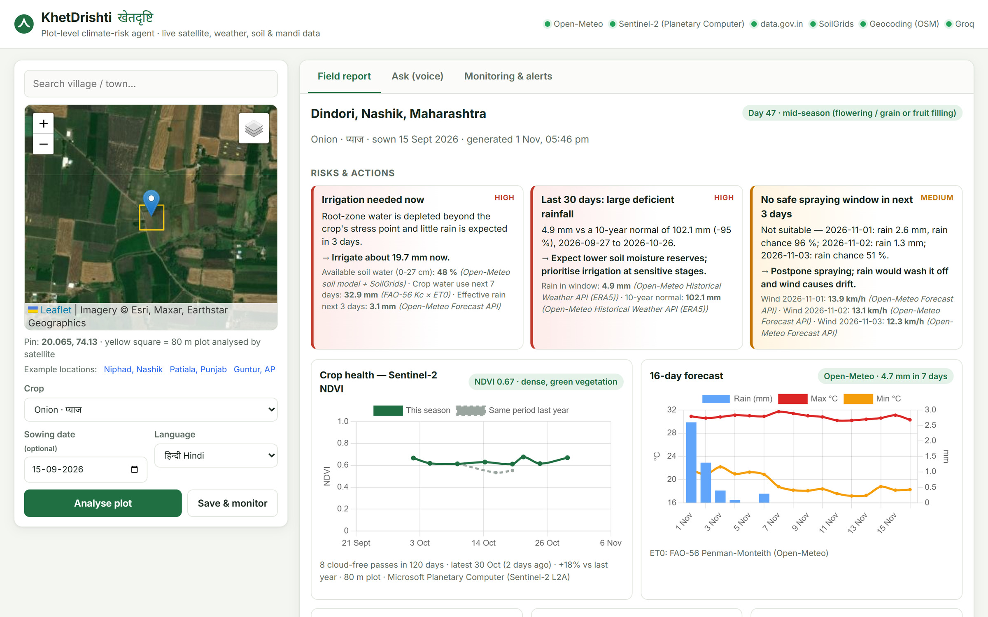
FORGE '26 · THEME 2 · CLIMATE & SUPPLY RESILIENCE
KhetDrishti
खेतदृष्टि · field vision
A plot-level climate-risk AI agent for Indian farmers: live satellite, weather, soil and mandi data, answered by voice in the farmer's language, with every number fact-checked.
10
Indian languages
14
crops
12/12
agent eval passed
Live: https://20-207-206-244.sslip.io · Code: github.com/KrisKeshav/khetdrishti
Team: Kris Keshav · Shivam Bansal (IIT Roorkee)
Notes:
Introduce KhetDrishti: advice for ONE specific farm plot, built only on live public data, spoken in the farmer's language, and every number verified before the farmer hears it. The screenshot is the live app running in Central India.

Slide 2



Weekly farm decisions, made on advice that ignores the field
of Indian farm holdings are small or marginal
Agriculture Census 2015-16
Why generic AI chatbots fail here
86%
They don't know the field
District-level advice; no satellite view of this plot, its soil or its crop stage.
−95%
rain in 30 days vs the 10-year normal near Niphad, Nashik (IMD: large deficient)
Measured live by KhetDrishti, Oct 2026
They make up numbers
Confident mm, °C and ₹ figures with no source — dangerous for water and money.
They wait to be asked
A heat wave at flowering needs an alert, not a chat the farmer never starts.
3
high-stakes decisions every week: irrigate, spray, sell
Wrong call = wasted water, lost crop, bad price
Who we serve: small and marginal farmers, and the KVK extension workers and FPOs who advise hundreds of plots each.
Notes:
86% small/marginal holdings (Agriculture Census 2015-16). The -95% is real: our app measured it for a Niphad plot in late October 2026 against the ERA5 10-year normal. Chatbots fail on three counts: no plot context, made-up numbers, purely reactive.

Slide 3
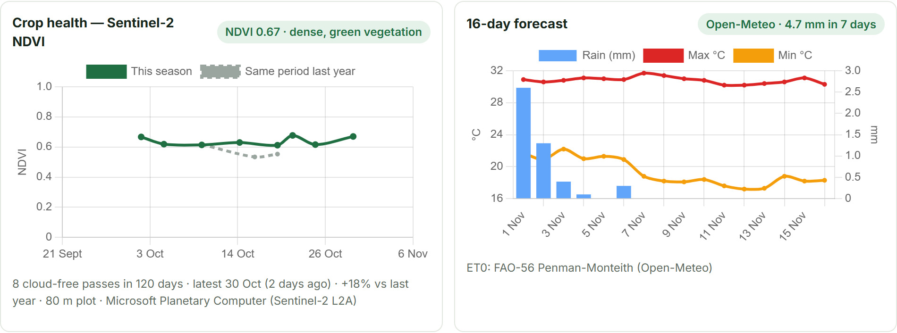




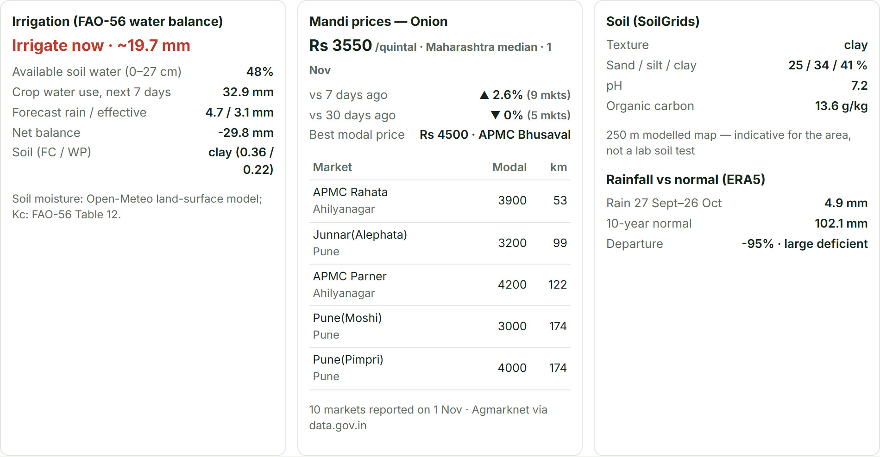


One pin, live data, a verified answer in the farmer's language
Satellite crop health
Irrigation advice
Sentinel-2 NDVI for this exact plot vs last year
FAO-56 water balance: irrigate now / wait for rain / due date + mm
Risk engine
Mandi prices
Heat at flowering, IMD cold wave & heavy rain, dry spell, spray window
Live Agmarknet, nearest markets, like-for-like 7/30-day trend
Voice, 10 languages
Proactive alerts
Speak Hindi, Marathi, Telugu, Tamil…; hear the answer back
Daily monitor re-checks saved plots and raises new risks
Notes:
Target users: farmers and KVK workers. Use cases: should I irrigate, is there a weather risk, should I sell and where, how healthy is my crop. All six features run on live public data; nothing is mocked.

Slide 4






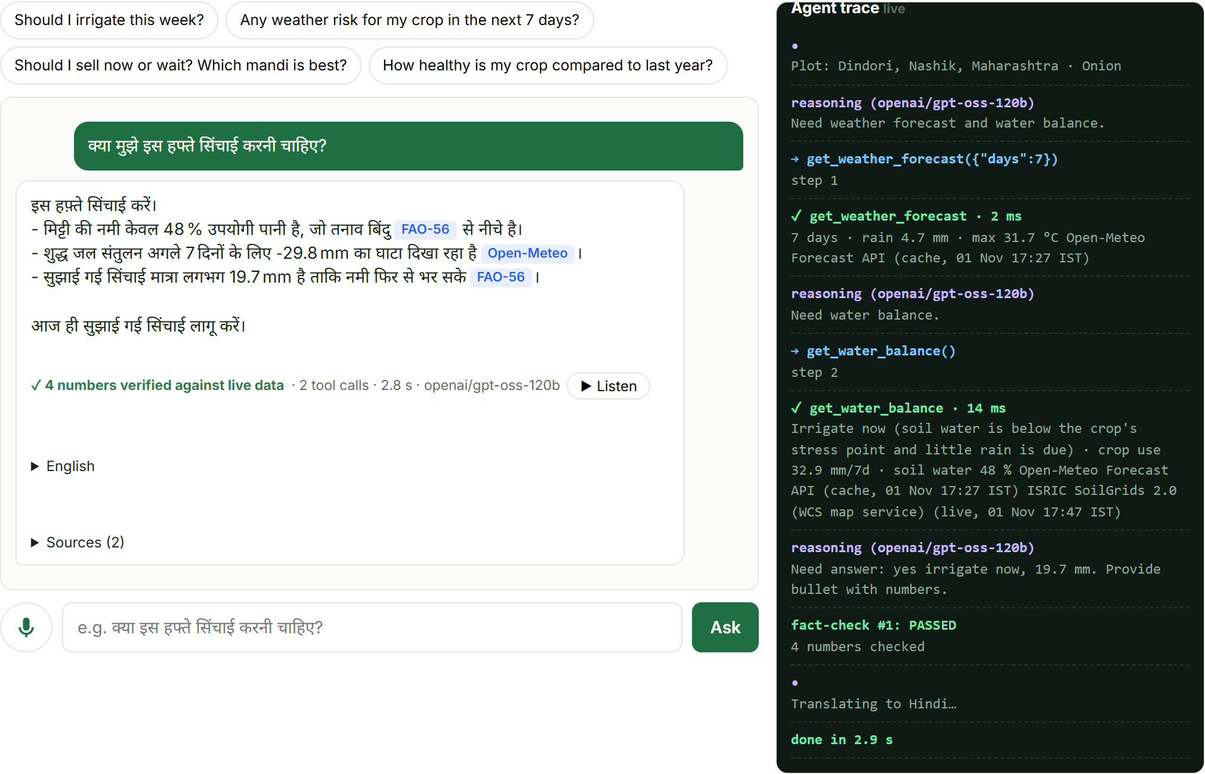




An agent that checks its own work before the farmer hears it
Voice question
Plan
Act
Fact-check
Translate & speak
Whisper STT, any of 10 languages
LLM picks tools (Groq gpt-oss-120b)
9 plot-scoped tools run in parallel
Every number must match a tool output
Numbers re-checked after translation
Fails? The agent is told exactly which number failed and rewrites; anything still unverifiable is removed.
The LLM never does arithmetic FAO-56 and IMD engines compute every number; the LLM plans and explains.
No invented pesticide doses A dose is allowed only if it appears in a retrieved FAO / TNAU document; otherwise refer to the KVK.
Robust to prompt injection Numbers typed by the user never count as evidence.
Self-correcting Bad tool calls, timeouts, failing sources and rate limits are fed back; the agent recovers.
Notes:
Explicit state machine: plan, act (parallel tools), draft, verify, self-correct, translate. The screenshot is a real Hindi answer: 4 numbers verified against live data, 2 tool calls, 2.8 s, with the live trace on the right.

Slide 5
Architecture: live data in, verified advice out, nothing made up
1 · Live data sources
2 · Fetch layer
3 · Engines + agent
4 · Delivery
Sentinel-2 L2A (Planetary Computer / Copernicus / Earth Search)
Open-Meteo forecast + soil moisture
ERA5 10-yr rainfall
ISRIC SoilGrids
data.gov.in Agmarknet (live + history)
OpenStreetMap geocoding
Every call: timeout, retry, cache
Provenance on every number: live / cache / stale + age
Fallback chains: Open-Meteo → MET Norway, ERA5 → NASA POWER, SoilGrids REST → WCS, Nominatim → Photon
Circuit breakers, time budgets
FAO-56 water balance, crop stage (14 crops)
IMD-threshold risk rules
BM25 RAG over FAO-56 + TNAU docs
Groq agent + model fallback & key rotation
Numeric verifier + dose guardrail
FastAPI + Server-Sent Events (live trace)
Leaflet + Chart.js web app
Whisper STT · Sarvam / gTTS voice
Daily monitor → alerts (Telegram-ready)
Docker + Caddy HTTPS on Azure, Central India
Why India hosting: data.gov.in refuses non-Indian servers and shared cloud IPs get rate-limited, so we moved from a US PaaS to an Indian VM and added fallbacks for every provider.
Notes:
Four layers. Every external call goes through one fetch layer that adds timeouts, retries, labelled caching and provenance. Deterministic engines do the maths; the agent plans and explains; the verifier guards the output. Stack: Python, FastAPI, SQLite (WAL), Groq, rasterio, vanilla JS.

Slide 6
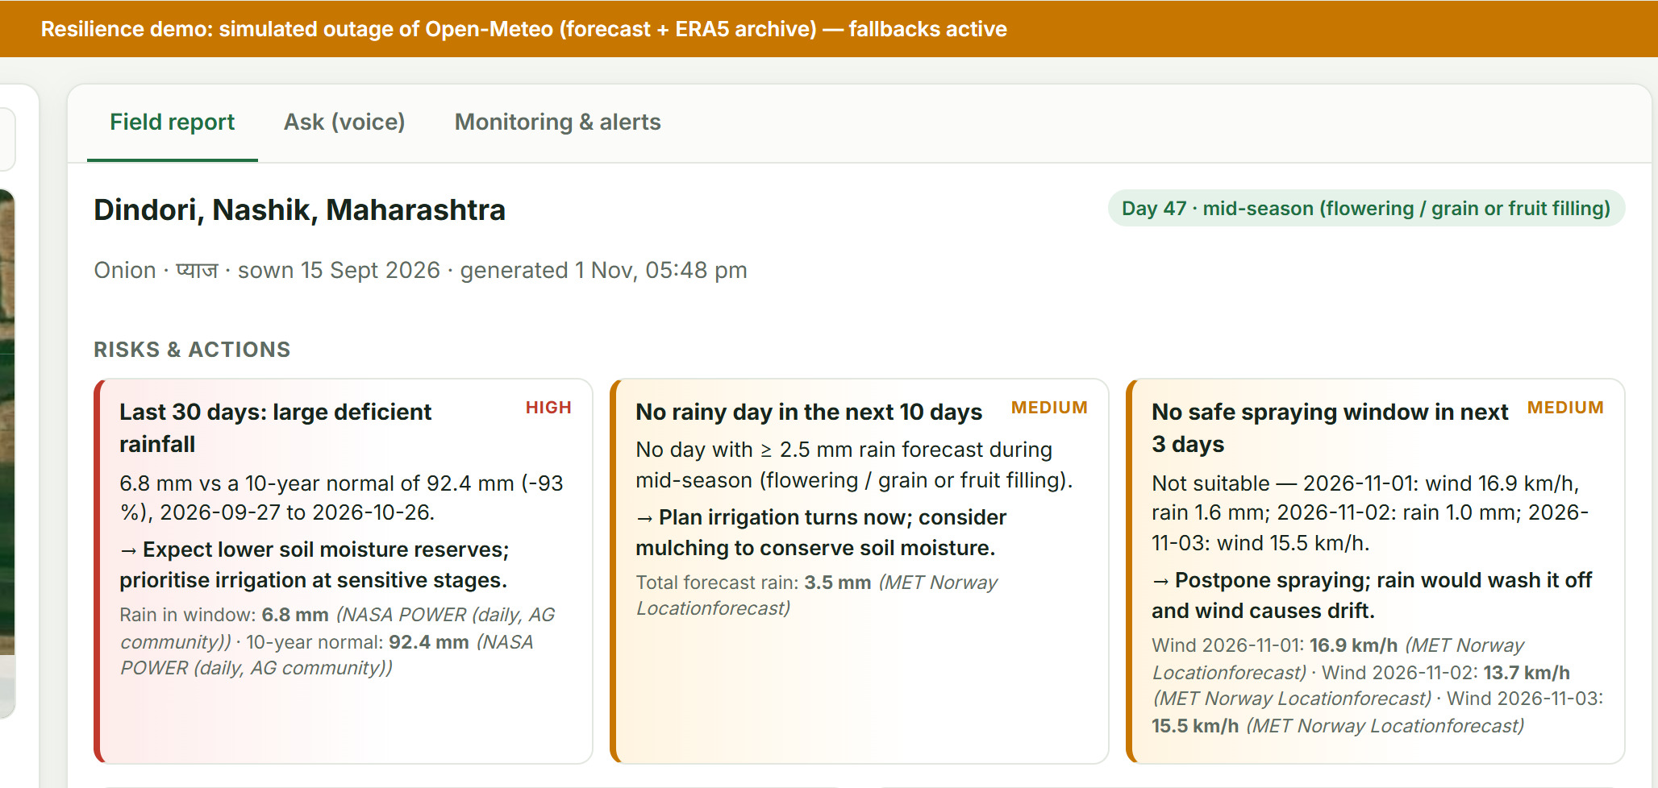
Measured, not claimed: reliability you can check
12/12
100%
3.9 s
69
agent eval scenarios passed
answers fully fact-checked (12/12)
median answer time
automated tests incl. fault injection
Resilience Lab, live: switch off a provider and watch the fallback (here Open-Meteo → MET Norway + NASA POWER, with an amber banner).
Notes:
Every figure here is reproducible from the repo: scripts/eval_agent.py (12 scenarios across 5 languages, plus injection, dose and hallucination traps), pytest (69 tests, including fault injection) and the in-app Resilience Lab. Real production bugs we found and fixed: SQLite locking under load, Nominatim rate-limiting cloud IPs, and a missing native library in the container.

Slide 7


From one field to every KVK
One KVK worker, hundreds of plots
Alerts only where action is needed
NOW · live
NEXT
LATER
Web + voice agent
14 crops, 10 languages
Daily monitor + alerts
WhatsApp + IVR calls for feature phones
Draw exact field boundaries
Sentinel-1 radar for cloudy monsoon weeks
Pest & disease models
FPO / district dashboards
Crop-insurance (PMFBY) triggers
Near-zero cost per extra plot
Every data source is free and national-scale
Built for India
14 crops, 10 languages, IMD + FAO-56 science
Demo summary
Pin a real field → live satellite, weather, soil and mandi report → Hindi voice question → agent plans, calls tools, fact-checks, answers aloud → guardrails refuse invented doses and injected prices → Resilience Lab knocks out a provider live → daily monitor raises alerts.
Live: https://20-207-206-244.sslip.io Code: github.com/KrisKeshav/khetdrishti
Notes:
Scale through KVKs and FPOs; free national data means near-zero marginal cost. Roadmap: WhatsApp and IVR for feature phones next. Close with the demo summary and both links.

