Slide 1

ROS for Engineers – part 1 aka ros without programming

Slide 2
Today’s Goals
Learn what ROS is about
Learn ROS core concepts
Practice with ROS commands on Ubuntu
Learn how to launch an application
Learn how to inspect a running application
Learn how to drive a mobile robot

Slide 3
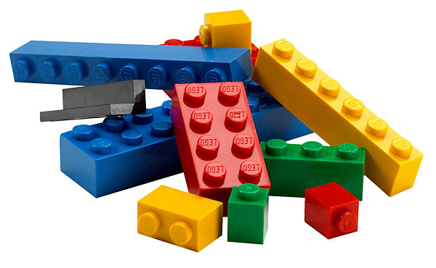
… without programming
just using existing ROS packages

Slide 4
ROS ?
What?

Slide 5
What is ROS?
“The Robot Operating System (ROS) is a set of software libraries and tools that help you build robot applications. From drivers to state-of-the-art algorithms, and with powerful developer tools, ROS has what you need for your next robotics project. And it's all open source.”
ros.org

Slide 6

History
Originally developed in 2007 at Stanford University and continued at Willow Garage
Quigley, M., et. al. (2009). ROS: an open-source Robot Operating System. https://www.willowgarage.com/sites/default/files/icraoss09-ROS.pdf
Since 2013 it is managed by OSRF (Open Source Robotics Foundation)
http://www.osrfoundation.org/

Slide 7

Robot Stack
Robot Applications
Robot Middleware
ROS
Operating System Platform
Ubuntu
Hardware Platform
Sensors
Actuators
Controller

Slide 8
ROS: Robot Operating System
Open-source, meta-operating system
Interproces communication framework
Debugging, Visualization, Simulation tools
Package and Build environment
Federated Network of Repositories
Platform and community for sharing code
“Standing on the shoulder of giants”

Slide 9
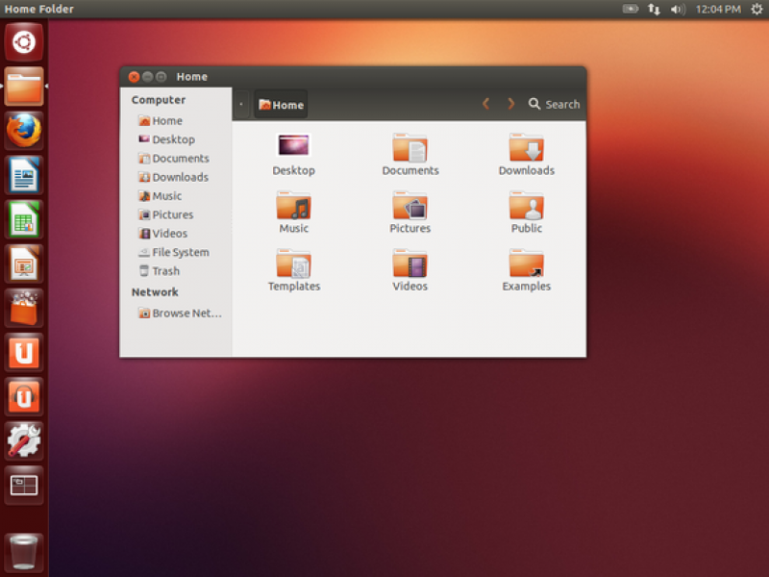
Ubuntu
CTRL-ALT-T to open new Terminal window

Slide 10
Linux File system
Tree of directories, containing files
Absolute and relative paths
/
bin
etc
mnt
dev
home
proc
ls
cp
passwd
joe
mike
../../mike
doc
src
/home/joe/doc/abc.txt
abc.txt
hello.c

Slide 11
Frequently used Linux commands
cd change directory
ls list files and subdirectories
cat print file content
gedit start tekst editor

Slide 12
Core concepts

Slide 13
ROS Core Concepts
http://wiki.ros.org/ROS/Concepts
Code packaging & building
Repositories
Packages
Workspace
Catkin
Computation Graph
Nodes
Topics
Messages, Services
ROS Master, Parameters

Slide 14
Code packaging & building

Slide 15
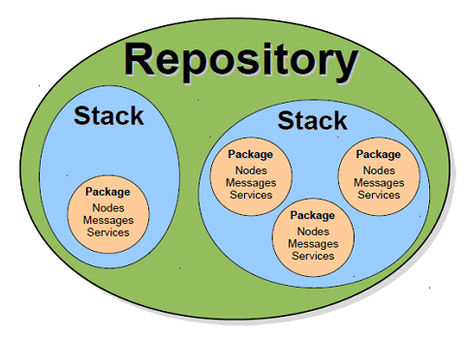
Repositories
2000+ packages
http://www.ros.org/browse/list.php
GitHub

Slide 16
Stacks of Packages
Package
Unit for organizing software in ROS
a collection of nodes, launch files, models, etc.
Stack (Metapackage)
a collection of packages.

Slide 17

Installing a package/stack

Slide 18
Installing packages
Included in Distribution (no download necessary)
Installed in /opt/ros/<distribution_name>/…
Binary downloads (debian packages)
sudo apt-get install ros-indigo-package-name
Source downloads
Usually provided on github.com
Download in your workspace and build there

Slide 19
Workspace
catkin_ws/
src/
CMakeLists.txt
…
my_package/
package.xml CMakeLists.txt
src/
launch/
…
…
build/
devel/
install/

Slide 20
Package
Package.xml
Manifest: metadata about the package (e.g. dependencies).
CMakeLists.txt
Package build information
src, scripts, launch, msg, srv, urdf, …
Node sources, message defs, launch files, models, etc.

Slide 21
Building packages
Catkin
New package build system
Rosbuild
Old package build system
src/
CMakeLists.txt
catkin_make
devel/

Slide 22
Computation graph

Slide 23
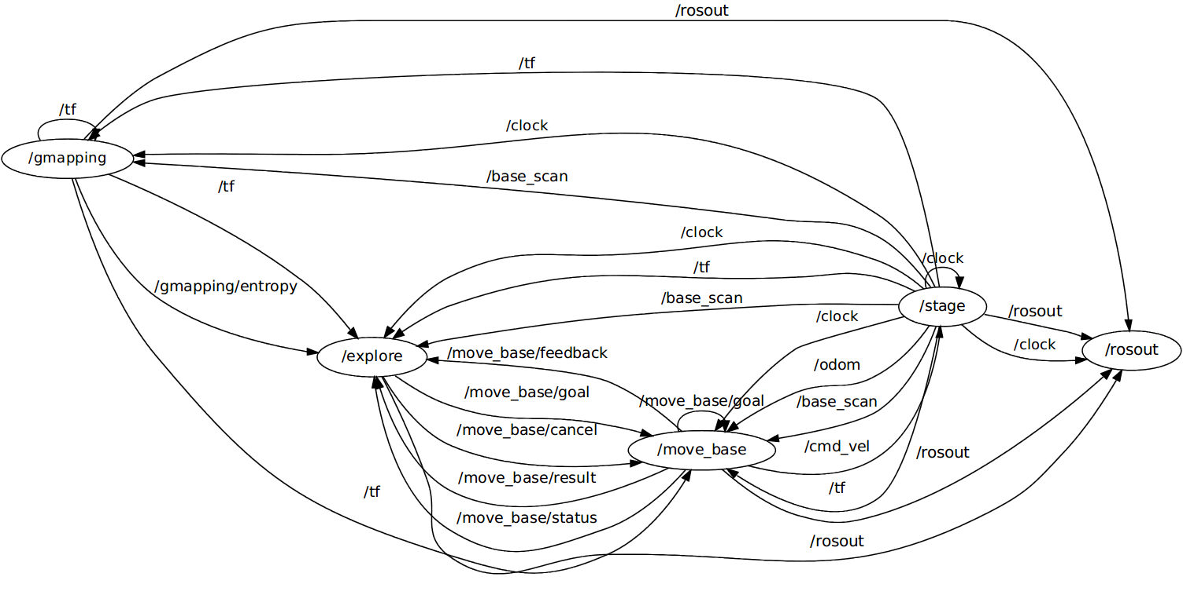
ROS Computation Graph

Slide 24
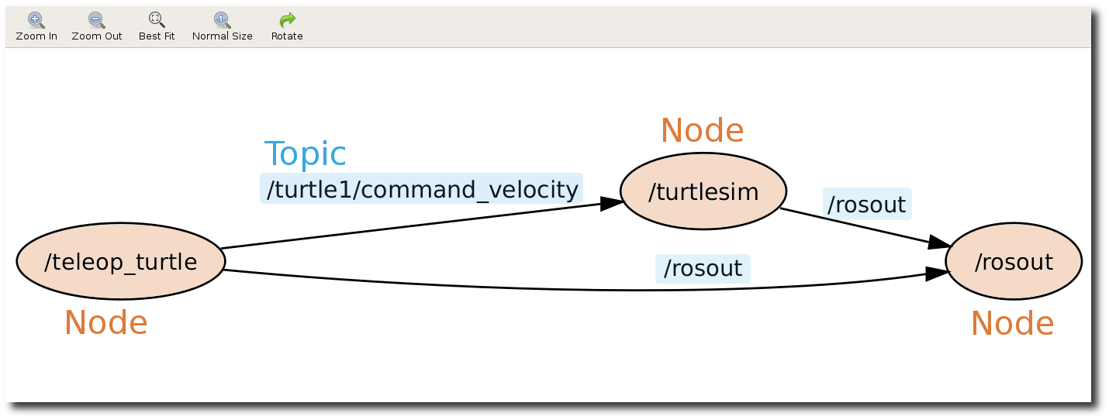
Computation Graph
Network of Nodes, connected via Topics
Publish / Subscribe pattern

Slide 25
Nodes
Sensor
Node = Executable
Performs computation, e.g.
Read a sensor
Compute robot location
Navigate to goal
Drive an actuator
At a moderate Rate (< 100 Hz)
Node
Node
Node
Actuator

Slide 26
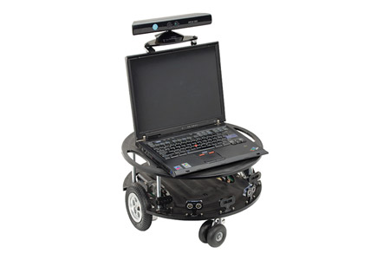
Challenge
Draw a Computation Graph for this situation:
Mobile robot
Has Real-Time Controller
On-board Laptop running ROS, connected to Real-Time Controller
Camera connected to Laptop
Laptop
Connected to robot via Wifi
Supports Mouse control of robot
Robot camera image displayed in window

Slide 27
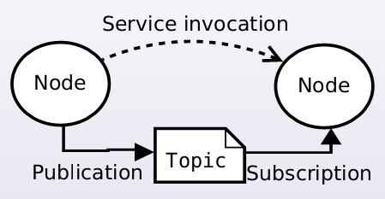
Publishing and Service invocation
Nodes can:
Publish messages on a topic
Subscribe to topic and receive published messages
Invoke a Service on another Node

Slide 28
Message
Syntax
fieldtype1 fieldname1 fieldtype2 fieldname2 fieldtype3 fieldname3 …
geometry_msgs/Vector3 linear
float64 x
float64 y
float64 z
geometry_msgs/Vector3 angular
float64 x
float64 y
float64 z

Slide 29
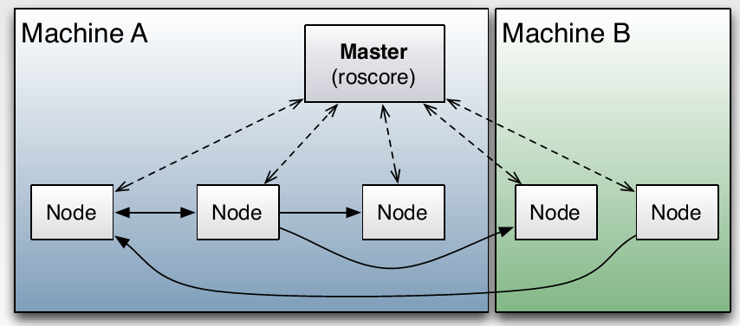
ROS Master
Master: broker (registration and lookup)
roscore command to start it
includes parameter server and rosout
$ROS_MASTER_URI

Slide 30
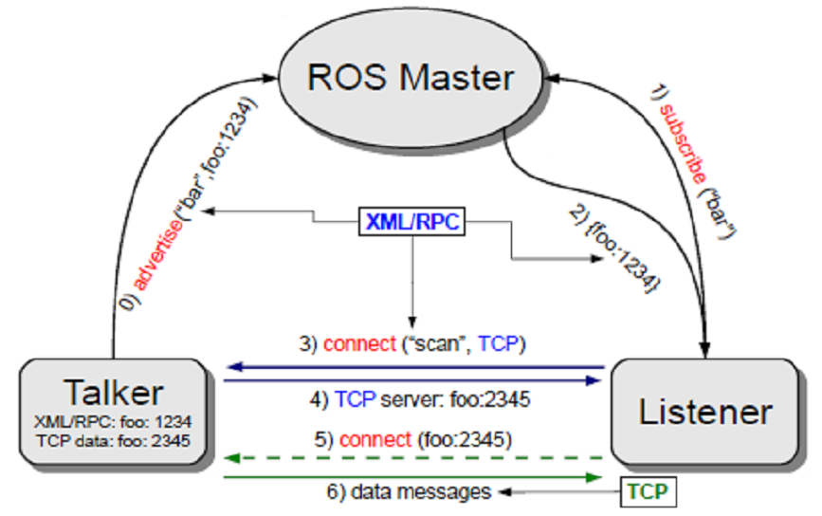
Advertise & Subscribe
“bar”,

Slide 31
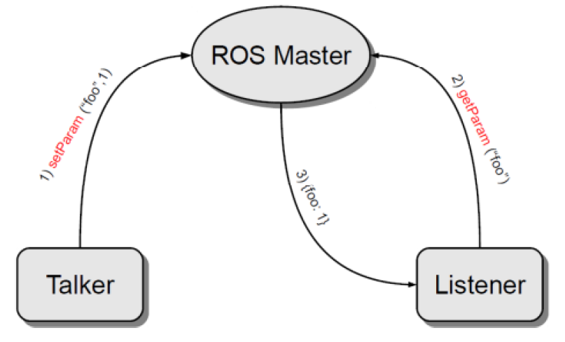
Get & Set Parameters

Slide 32
Running Ros software

Slide 33
ROS Commandline Tools
Lots of commands, e.g.
rospack, roscd, rosls, …
ROS filesystem navigation
rosrun
Run one single node
roslaunch
Launch group of nodes (as specified in launch file)
rosnode, rostopic, rosservice, rosmsg, rosparam
List, set/publish, get/echo/show, call

Slide 34
Running a ROS node
source ~/<workspace>/devel/setup.bash
set workspace
roscore
start the ROS Master
rosrun <package> <node_name>
start the node (and its topics)

Slide 35
How ROS searches packages
rosrun <package> <node_name>
your_workspace
/opt/ros/<distribution>/…

Slide 36
parameters

Slide 37
Parameters
YAML
Commandline parameters
Config files (.yaml)
foo:
bar:
- name: john
- value: 1234.5
{ foo: { bar: [ { name: john }, {value: 1234.5} ] } }
rostopic pub … {linear: {x: 1.0, y: 0.0, z: 0.0}, angular: {x: 0.0 ,y: 0.0, z: 0.0}}

Slide 38
Launching a bunch of nodes

Slide 39
Launch file
XML
<tag attribute=“…” />
<tag attribute=“…”> … </tag>
<!-- comment -->
<launch>
<node name="talker" pkg="chat_pkg" type="talker" output="screen"/>
<node name="listener" pkg="chat_pkg" type="listener" output="screen"/>
</launch>

Slide 40
Example Launch file
<launch>
<arg name="model" default="$(find robot_urdf)/robot.urdf"
<arg name="gui" default=“True" /> <param name="robot_description“ textfile="$(arg model)"/> <param name="use_gui" value="$(arg gui)"/>
<node name="joint_state_publisher"
pkg="joint_state_publisher"
type="joint_state_publisher" >
</node>
<node name="robot_state_publisher"
pkg="robot_state_publisher" type=“robot_state_publisher" />
<node name="rviz" pkg="rviz" type="rviz"/>
</launch>

Slide 41
Launching
roslaunch <package> <launchfile_name>

Slide 42
How to drive a mobile robot

Slide 43
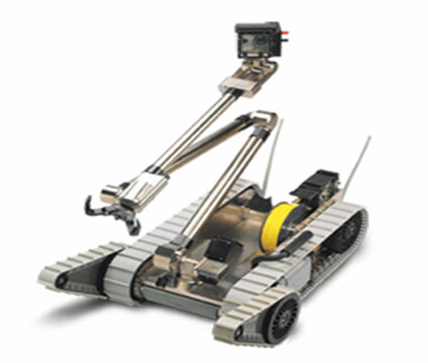
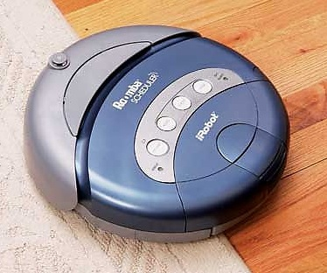
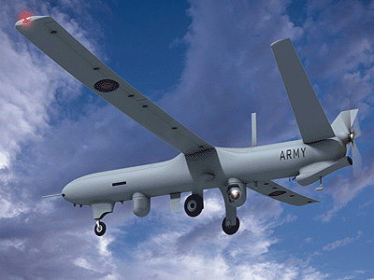
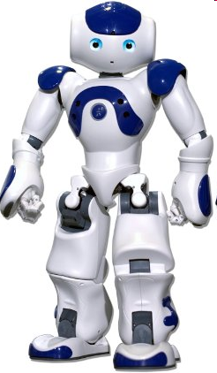
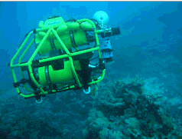
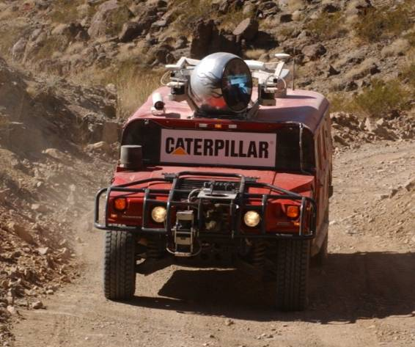
Mobile Robots

Slide 44
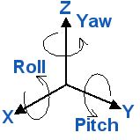
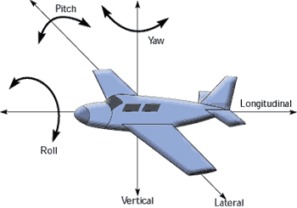
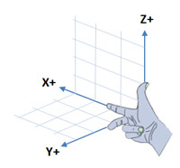
DOFs of a Free Body
Any unattached body in 3D space has 6 DOFs
3 for translation: x, y, z
3 for rotation: roll, pitch, yaw

Slide 45
How to drive a mobile robot
Moving: control its translation velocity
Linear velocity in x,y,z direction [m/s]
Turning: control its rotation velocity
Angular velocity around x,y,z axis [rad/s]
Turning while moving forward (making curves)
All of the above

Slide 46
Drive any Mobile Robot
A robot_node drives the robot platform
Subscribed topic: cmd_vel
Receives Twist messages
geometry_msgs/Twist
Linear velocity in x,y,z direction [m/s]
Vector3 linear
float64 x
float64 y
float64 z
Angular velocity around x,y,z axis [rad/s]
Vector3 angular
float64 x (Roll)
float64 y (Pitch)
float64 z (Yaw)
cmd_vel
Twist
robot_node
ROBOT

Slide 47
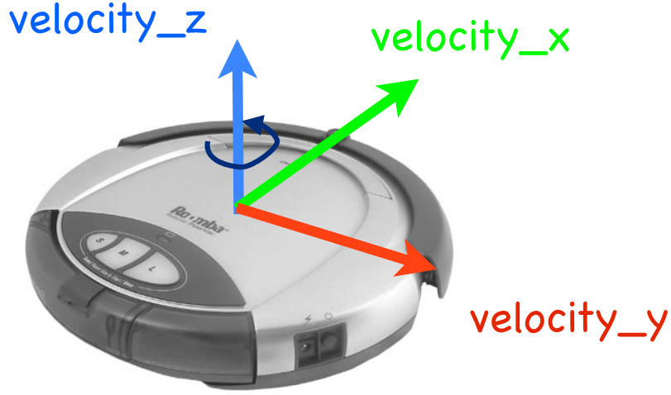
Drive a 2-wheel Mobile Robot
Can only move in X direction and rotate around Z
linear.y = 0
linear.z = 0
angular.x = 0
angular.y = 0
See: http://wiki.ros.org/ROS/Tutorials/UnderstandingTopics

Slide 48
Reference materials

Slide 49
ROS Cheatsheet
http://www.clearpathrobotics.com/ros-cheat-sheet

Slide 50
ROS Books
A Gentle Introduction to ROS
http://www.cse.sc.edu/~jokane/agitr/
C++ examples
ROS By Example
http://www.lulu.com/spotlight/pirobot
Python examples

Slide 51
ROS Tutorials
http://www.ros.org/wiki/ROS/Tutorials
Start here …
C++ and Python examples

