Slide 1

ROS for Engineers – part 2 aka ros without programming

Slide 2
Today’s Goals
Learn how to drive a mobile robot using Twist messages
Learn the concepts of Pose and Odometry
Learn how ROS keeps track of Coordinate Frames using TF
Learn how to do Mapping , Localization, and Navigation

Slide 3
Drive a mobile robot

Slide 4
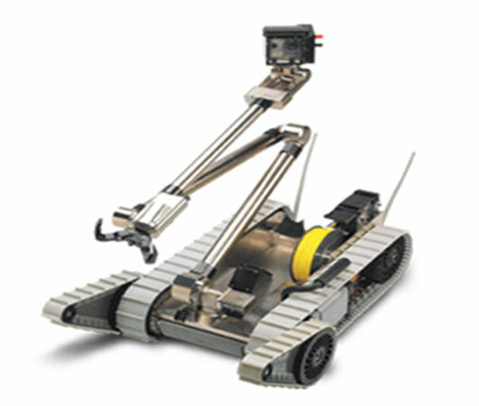
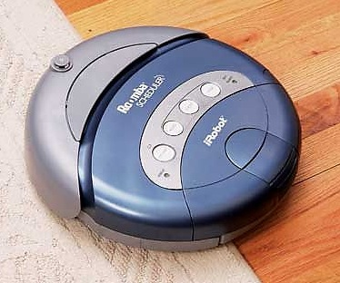
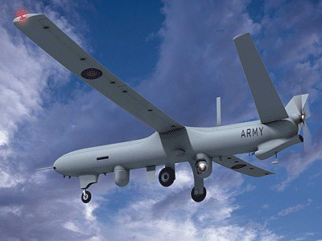
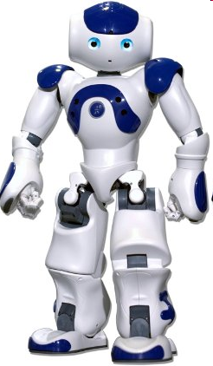
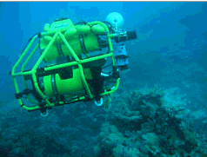
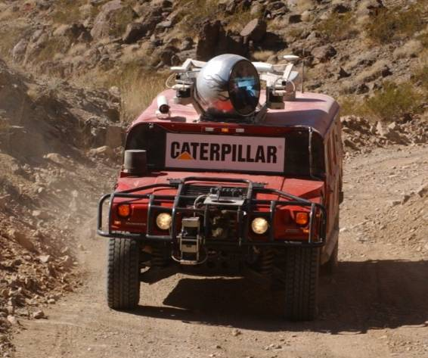
Mobile Robots

Slide 5
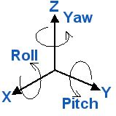
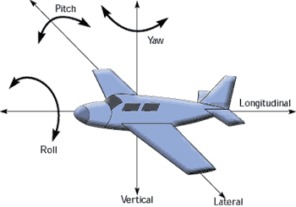
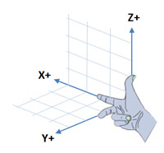
DOFs of a Free Body
Any unattached body in 3D space has 6 DOFs
3 for translation: x, y, z
3 for rotation: roll, pitch, yaw

Slide 6
How to drive a mobile robot
Moving: control its translation velocity
Linear velocity in x,y,z direction [m/s]
Turning: control its rotation velocity
Angular velocity around x,y,z axis [rad/s]
Turning while moving forward (making curves)
All of the above

Slide 7
Drive any Mobile Robot
cmd_vel
geometry_msgs/Twist
Linear velocity in x,y,z direction [m/s]
Vector3 linear
float64 x
float64 y
float64 z
Angular velocity around x,y,z axis [rad/s]
Vector3 angular
float64 x (Roll)
float64 y (Pitch)
float64 z (Yaw)
Twist
robot_node
ROBOT

Slide 8
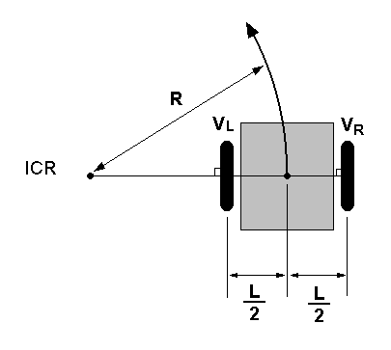
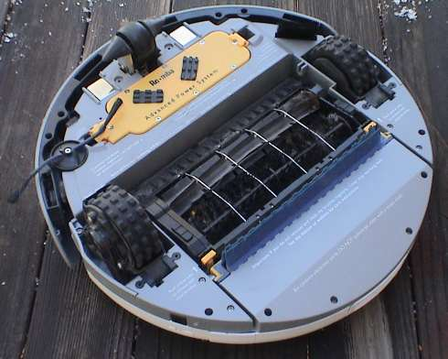
Differential Drive
Each wheel is controlled by a distinct motor.
Steering by means of different motor speeds
ω
v
r

Slide 9
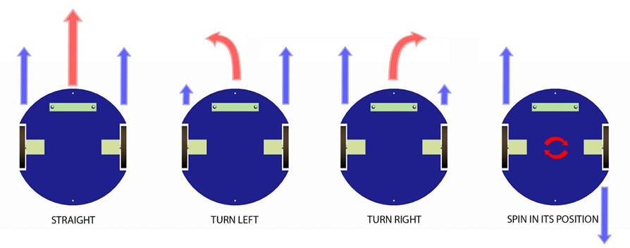
Differential Drive

Slide 10
Differential Drive Kinematics
SUMMARY
Left wheel angular velocity
Right wheel angular velocity
ω
v
R
ω_{L}
ω_{R}
r

Slide 11
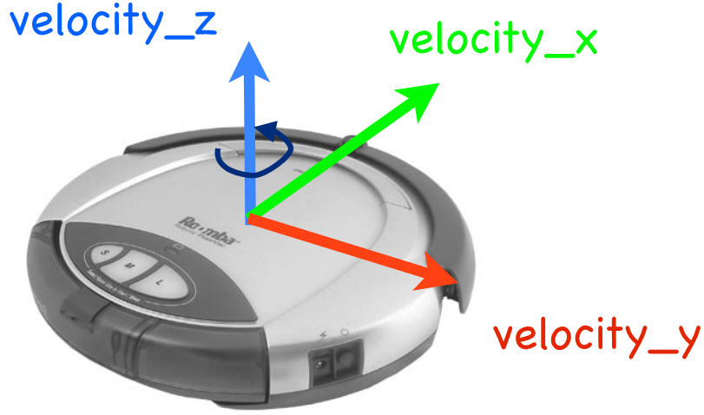
Drive a 2-wheel Mobile Robot
Robot with 2-wheel differential drive can only move in X direction and rotate around Z axis
linear.y = 0
linear.z = 0
angular.x = 0
angular.y = 0
rostopic pub -r 10 /turtle1/cmd_vel geometry_msgs/Twist "{linear: {x: 2.0}, angular: {z: 1.8}}"
rostopic pub -r 10 /turtle1/cmd_vel geometry_msgs/Twist '[2.0, 0.0, 0.0]' '[0.0, 0.0, 1.8]'

Slide 12
odometry

Slide 13
Pose
Robot’s posture in free space
Position
(x,y,z)
Orientation
Quaternion (x,y,z,w)
RPY(r,p,y)
Z
X
y
x
Y
z

Slide 14
Quaternions
https://en.wikipedia.org/wiki/Quaternion
Better then RPY (Euler)
No “gimbal lock”
Better interpolation
Easier calculations
http://www.gamasutra.com/view/feature/131686/rotating_objects_using_quaternions.php
ROS Refs
http://answers.ros.org/question/9981/what-are-quaternions-and-how-can-iuse-them/
http://answers.ros.org/question/9772/quaternions-orientationrepresentation/

Slide 15
Odometry
http://ros.org/doc/api/nav_msgs/html/msg/Odometry.html
Estimate of current Pose and Twist
using proprioceptive sensors (e.g. wheel encoders)
integration of distances while driving
Good for short term, relative position estimate.
Error / uncertainty grows while driving
systematic and non-systematic errors.
(x,y,…)
(0,0,..)

Slide 16
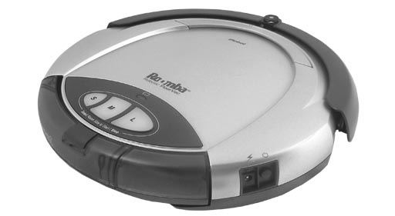
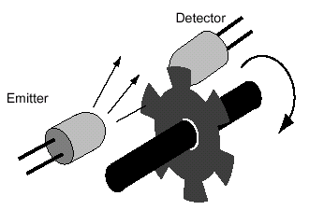
Robot Odometry
http://www.youtube.com/watch?v=S4EkL68uB0c
robot_node
Twist
Odometry
/cmd_vel
/odom
velocities
pose, velocities
wheel encoders

Slide 17
Enhanced Odometry
http://www.ros.org/wiki/robot_pose_ekf
GYRO
3D orientation
/imu_data
GPS
3D pose
/vo
robot
_node
robot _pose_ekf
/cmd_vel
2D pose
/odom
driver
/tf
/odom_combined

Slide 18
TF
Where is everything?

Slide 19
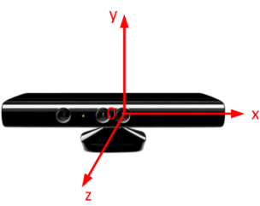

Coordinate Frames
Z
Camera
x
z
y
World (Map)
Y
z
z
x
x
y
X
Object
y
Robot

Slide 20
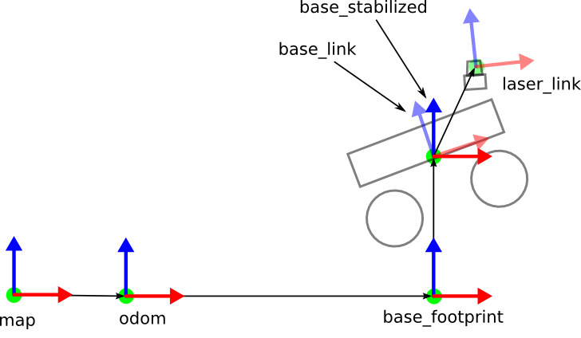
Frames for Mobile Robots
http://www.ros.org/reps/rep-0105.html

Slide 21
Frames for Mobile robots
map
origin: “origin of the map”
long-term global reference
odom
origin: “where the odometry calculation started”
short-term local reference
base_link
origin: “central point on the robot”
rotational center of mobile base
waist of humanoid or manipulator
origin of robot coordinate frame

Slide 22
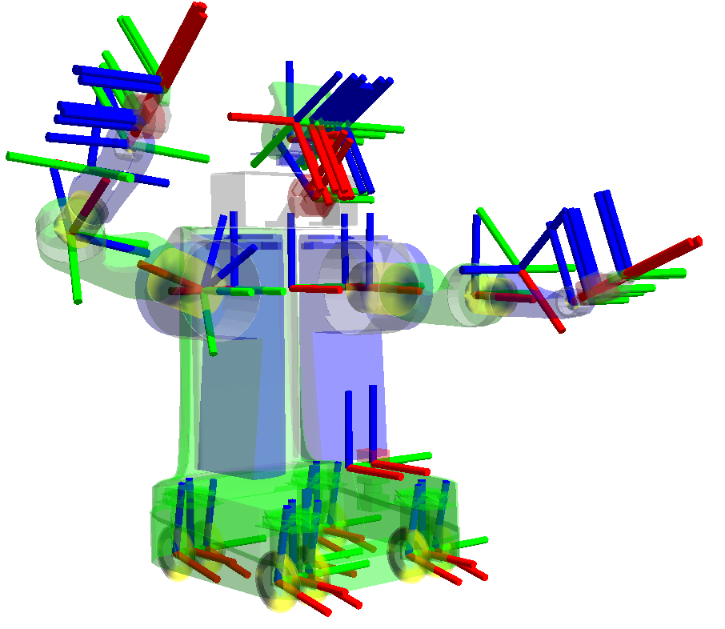
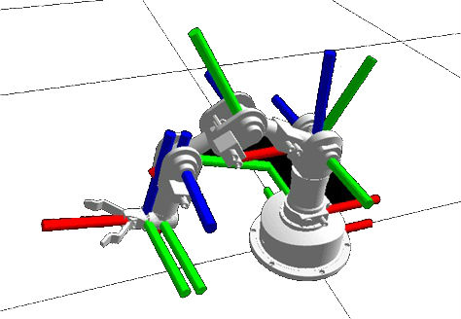
Frames for Humanoids & Manipulators
http://www.ros.org/reps/rep-0120.html

Slide 23
TF
http://www.ros.org/wiki/tf
Provides a uniform way to publish and look up transformations between coordinate frames
TF keeps track of a tree of frames
A frame is identified by ‘frame_id’ string
A frame has one parent, any number of child frames
Every link in the tree represents a transform between two frames: parent and child
Transform = pose of child in the frame of parent

Slide 24
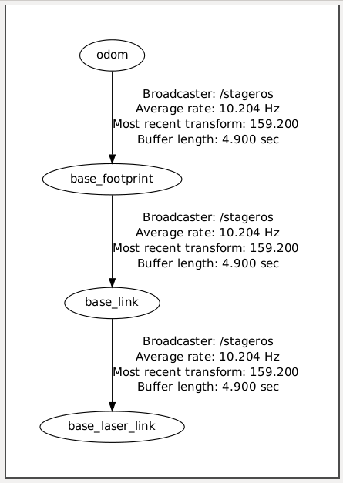
TF Tree

Slide 25
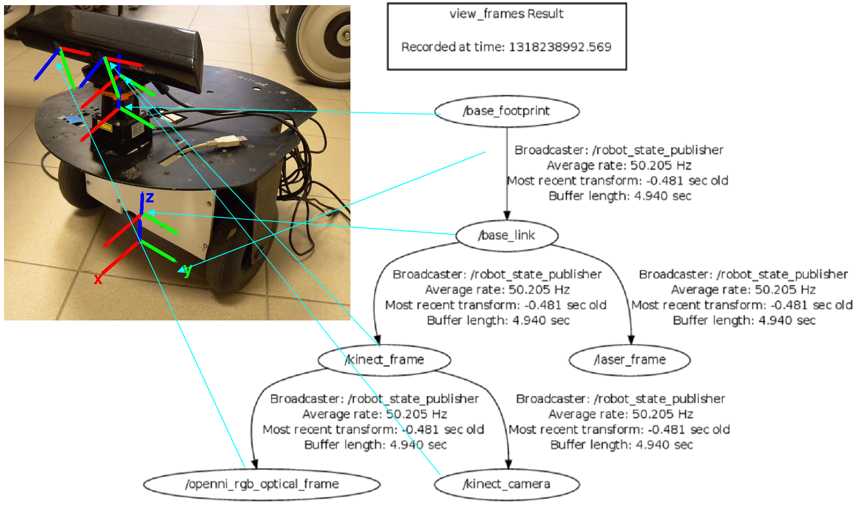
TF Tree

Slide 26
Typical Transforms & Broadcasters
map → odom
localization/mapping nodes (e.g. amcl, gslam)
odom → base_link
odometry nodes (e.g. robot_pose_ekf)
base_link → <other links on the robot>
state publishing nodes (e.g. robot_state_publisher)

Slide 27
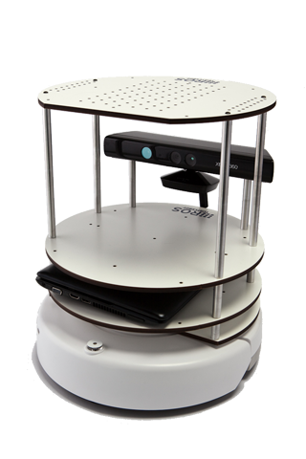
TF Broadcasters
/tf
odom → base_link
map → odom
base_link → …
robot_pose_ekf
robot_state_publisher
amcl gmapping
/imu_data
robot_description
map
/odom
/joint_states
/scan
robot_node
kinect/laser_node

Slide 28
Special TF Broadcasters
static_transform_publisher
http://www.ros.org/wiki/tf#static_transform_publisher
input via commandline arguments (manual or launch file)
publishes one static coordinate transform to TF
robot_state_publisher
http://www.ros.org/wiki/robot_state_publisher
Reads parameter robot_description (URDF robot model)
subscribes to topic /joint_states
publishes all (static + dynamic) state of the robot to TF

Slide 29
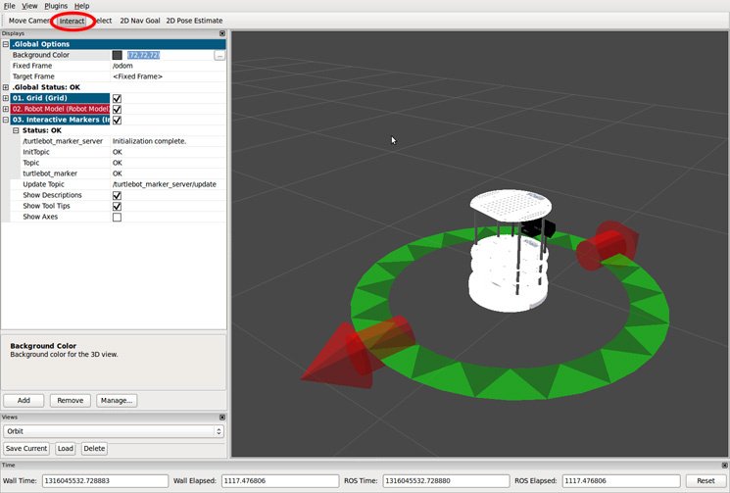
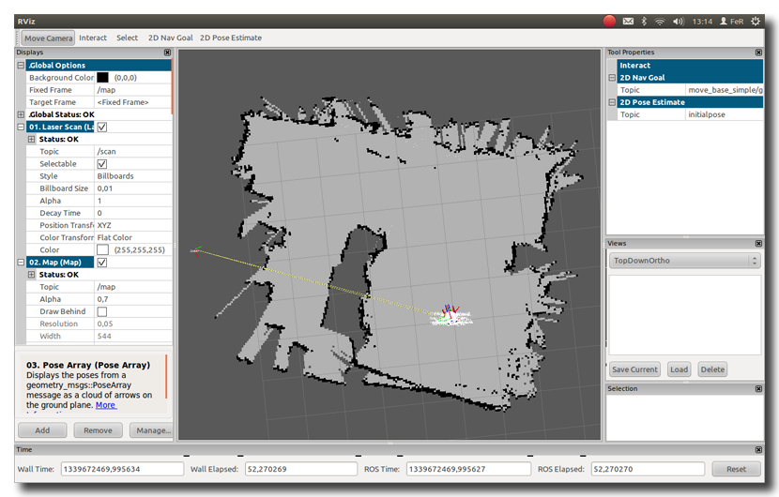
TF Listeners
/tf
rviz

Slide 30
Mapping, Localization, Planning, Navigation
Where are we? How do we get there?

Slide 31
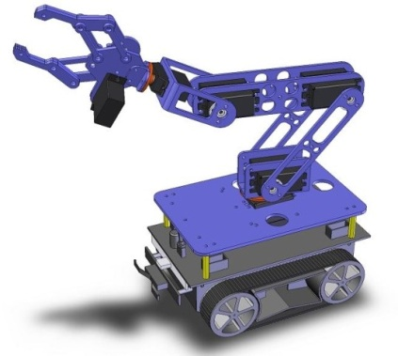
Making the robot more intelligent
/goal
Planning & Navigation
Localization
Mapping
/ tf
/odom
/cmd_vel
Control

Slide 32
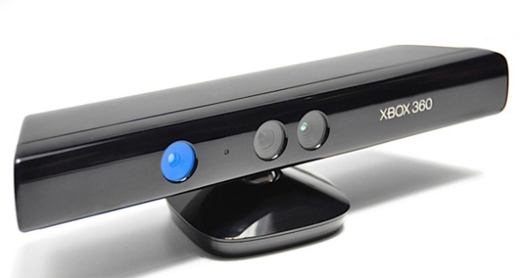
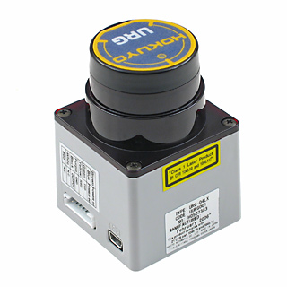
What do we need?
A Map
Sensors to look around
A way to determine location (pose) from sensor data
A way to do path planning & navigation

Slide 33
Probabilistic Robotics
Accept that motion, manipulation and sensing all give noisy and uncertain results
Explicitly represent uncertainty using the calculus of probability theory

Slide 34
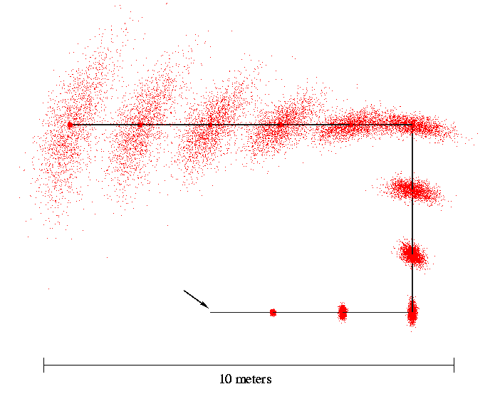
The Real World: Noisy Motion Data
accumulation of odometry errors
Start

Slide 35
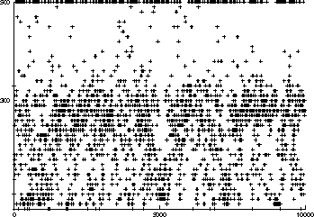
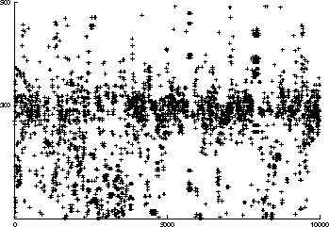
The Real World: Noisy Sensor Data
Noisy measurements
E.g. Measured distances for expected distance of 300 cm.
Sonar
Laser

Slide 36
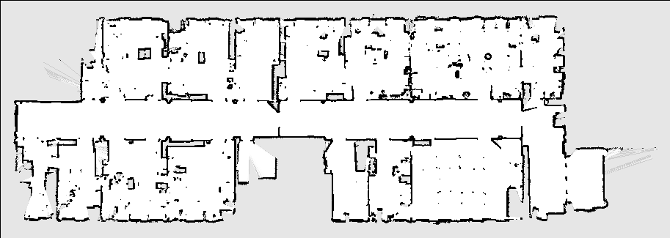
Occupancy Grid Map
http://www.ros.org/doc/api/nav_msgs/html/msg/OccupancyGrid.html
Each cell: probability that it is occupied

Slide 37
Bayes Rule
posterior

Slide 38
Pose Estimation
Calculate Believe of the robot about its pose x from its recorded motions and from the measurements it makes in its environment
BEL(x) = P(x|U,Z)
U: motions (odometry)
Z: measurements (landmarks, distances)

Slide 39
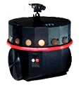
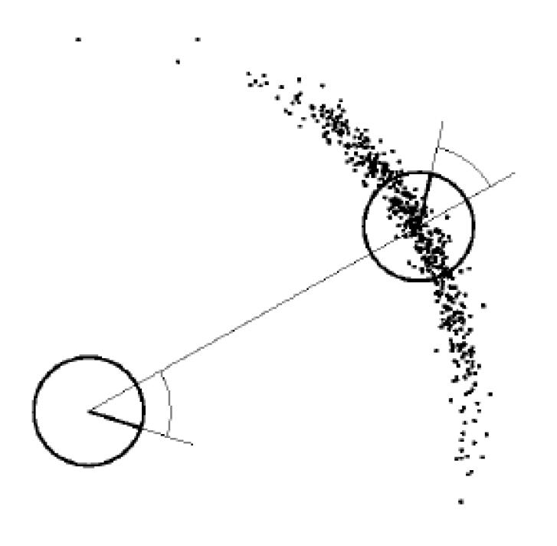
Bayes filter
Motion model: P(x_{t}|u_{t}, x_{t-1})
Probability of x given previous x and motion u
Measurement model: P(z_{t}|x_{t})
Probability of measuring z when in position x
x_{t}
u_{t}
x_{t-1}
z_{t}
x_{t}

Slide 40
Bayes filter
Prediction using motion model
Correction using measurement model
Prediction
motion action: u
Increases uncertainty
Bel’(x)
Correction
measurement: z
Decreases uncertainty
Bel(x)
BEL(x)

Slide 41
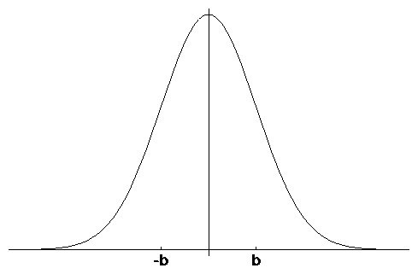
Particle filter
A Bayes filter
Represent PDF’s by discrete particles (samples)
Each particle is a hypothesis

Slide 42
Monte Carlo Localization (MCL)

Slide 43
AMCL
http://wiki.ros.org/amcl
Adaptive Monte Carlo Localization
/tf
map → odom
AMCL
/particlecloud
/scan
/amcl_pose
rviz
map
map_server

Slide 44
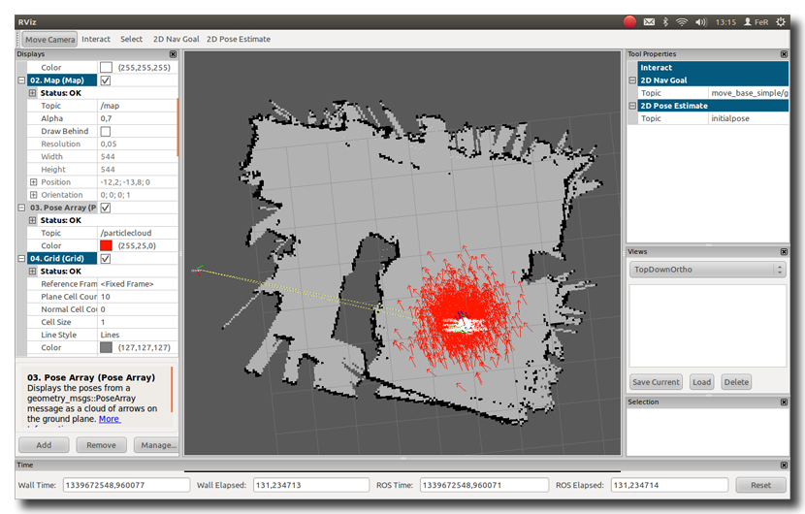
AMCL visualization in RVIZ

Slide 45
What if we do not have a map?
Let the robot make one
Drive it around to learn
Random walk
Teleoperated
Problem
To make a map we need the robots location
But…to localize we need a map

Slide 46
SLAM
Simultaneous Localization and Mapping
Bayes filter
Each particle represents a possible map
Survival of the fittest

Slide 47
GMAPPING
http://www.ros.org/wiki/gmapping
SLAM
/tf
map → odom
slam_ gmapping
/map_metadata
/scan
/map
map_saver

Slide 48
Navigation
Given the map and a goal…we need a plan to get to the goal, while avoiding obstacles!

Slide 49
Path Planning
robot
goal

Slide 50
Problem
Robot is not a “point in space”
Has footprint

Slide 51
Configuration space
“inflation”

Slide 52
Discretization

Slide 53
Problems
New and removed obstacles
Humans
Furniture

Slide 54
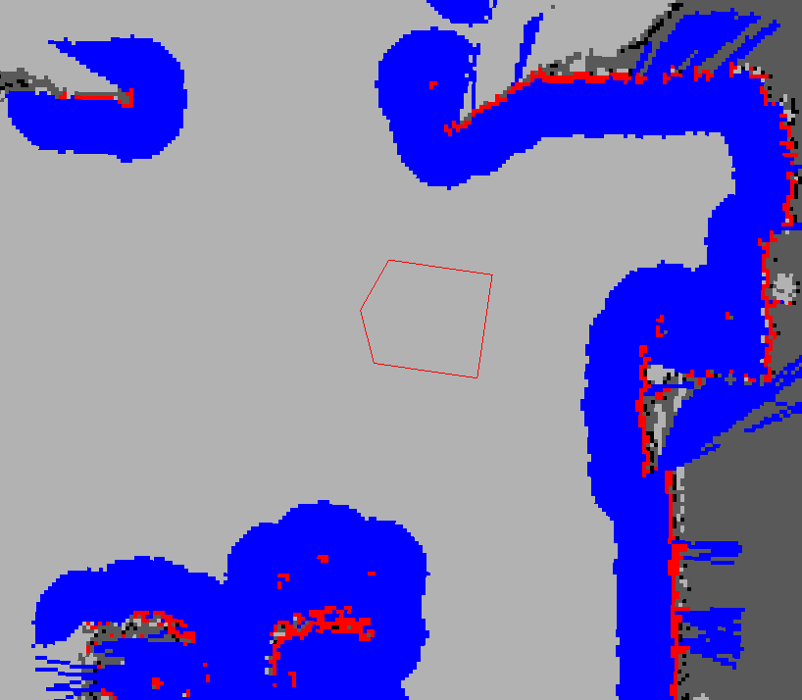
costmap
http://www.ros.org/wiki/costmap_2d
Stores information about obstacles
Inputs
Sensors (dynamic: laserscan, pointcloud)
Map (static)
Inflates obstacles
To avoid contact with robot

Slide 55
ROS Navigation stack
move_base
goal
map
global_planner
global_costmap
Path
local_planner
local_costmap
odom/tf
/cmd_vel
/scan

Slide 56
global_planner
Uses global costmap derived from Map
Computes long-term, global plan
Optimistical, i.e. unaware of new obstacles and of robot’s actual footprint and dynamics (speed/acceleration limitations )
Algorithm
Shortest path
Dijkstra (default)

Slide 57
local_planner
Uses local costmap, updated by obstacle sensors
Controller
Computes a short-term, local plan
Stays close to path, but avoids obstacles dynamically
Adheres to dynamics of the robot (min/max speed , acceleration)
Sends velocity commands to the mobile base of the robot
Algorithms
Trajectory scoring
DWA, Trajectory rollout

Slide 58
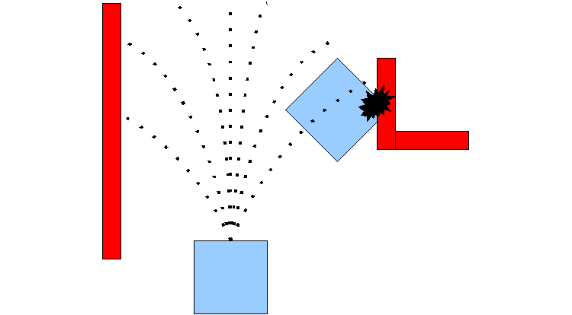
DWA local planner
Dynamic Window Approach
Predict (simulate) outcome of sample velocities
Score each and pick the highest-scoring

