Slide 1

ROS for Engineers – part 3 aka ros without programming

Slide 2
Today’s Goals
Model a robot or robotic manipulator
Publish the model
Visualization
Simulation
Arm Navigation

Slide 3
model a robot

Slide 4
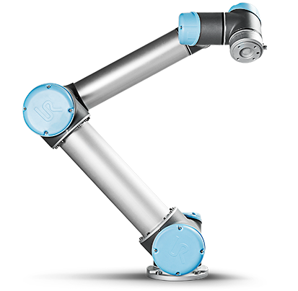
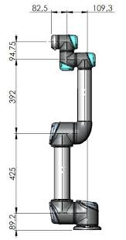
How to model a Robot?
Structure
Connected parts
links, connected by joints
Visualization
How do parts (links) look like
shape, size, color, mesh
Physics
Inertial
mass, moments of inertia

Slide 5
URDF
http://www.ros.org/wiki/urdf
Unified Robot Description Format
XML
Tree of links & joints
Perfect for serial robots or robotic arms
Not perfect for parallel robots (e.g. Delta)
Can only model one single robot
No environment (scene)
No teams

Slide 6
URDF
<robot name=“my_robot">
<link> ... </link>
<link> ... </link>
<link> ... </link>
<joint> .... </joint>
<joint> .... </joint>
<joint> .... </joint>
</robot>

Slide 7
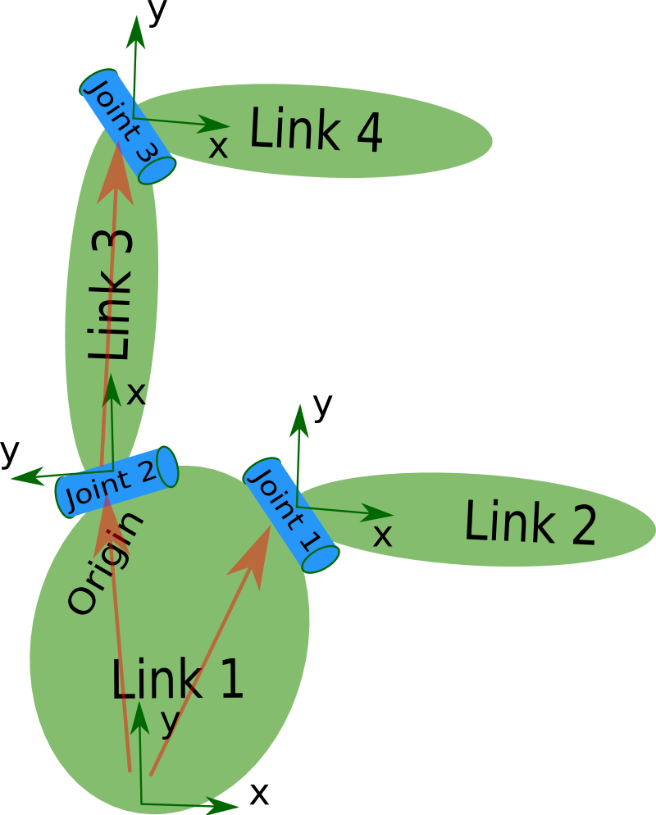
Links and Joints
<robot name=“my_robot">
<link name="link1" />
<link name="link2" />
<link name="link3" />
<link name="link4" />
<joint name="joint1" type=“fixed">
<parent link="link1"/>
<child link="link2"/>
</joint>
<joint name="joint2" type=“revolute">
<parent link="link1"/>
<child link="link3"/>
</joint>
<joint name="joint3" type=“revolute">
<parent link="link3"/>
<child link="link4"/>
</joint>
</robot>

Slide 8
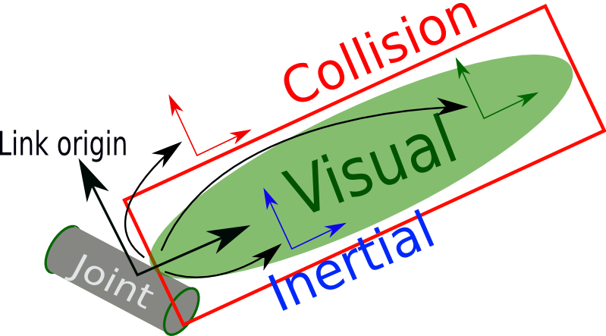
Link
Rigid body
<visual>
Geometry
box, cylinder, sphere
mesh (STL, DAE)
Material
color, image
<collision>
Simplified geometry for trajectory/collision calculations
<inertial>
Physical properties
mass, moments of inertia tensor

Slide 9
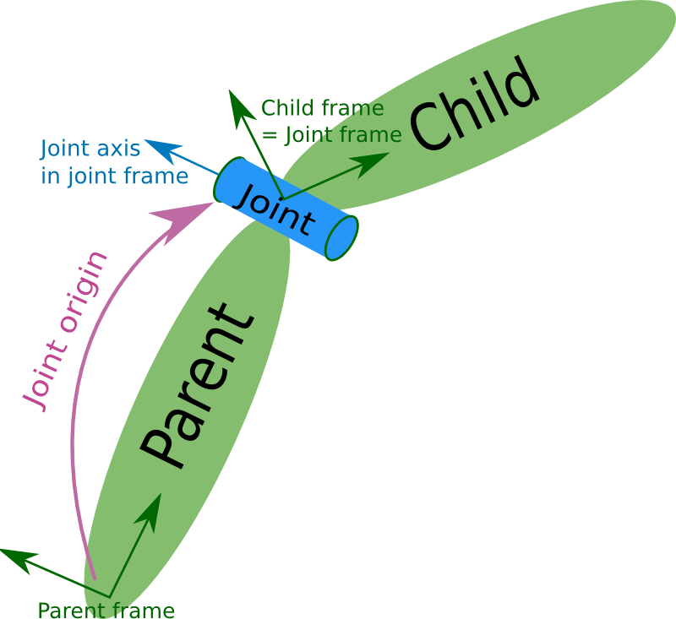
Joint
Joins 2 rigid bodies
type
Fixed
Revolute
Limits (lower, upper)
Continuous
No limits
Prismatic
Floating
Planar
<axis>, <limit>, …

Slide 10
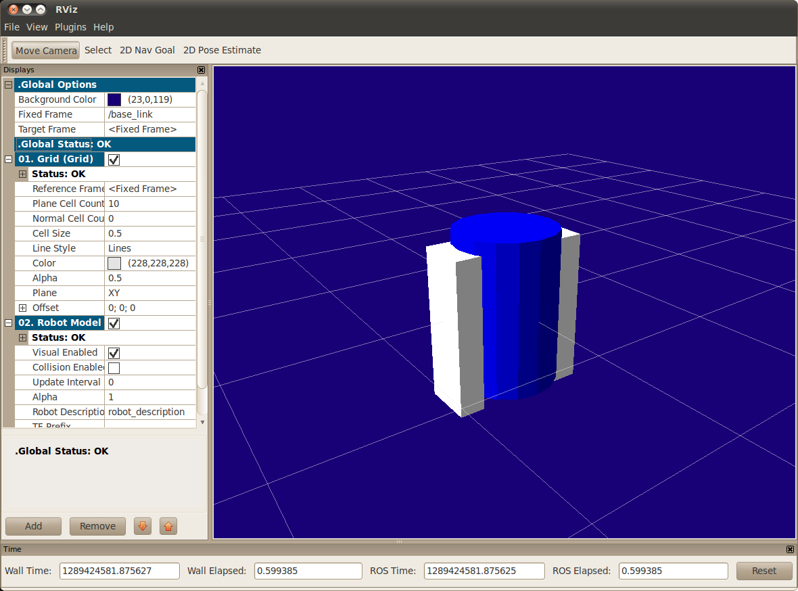
Example Link and Joint
<joint name="base_to_right_leg" type="fixed">
<parent link="base_link"/>
<child link="right_leg"/>
<origin xyz="0.22 0 .25"/>
</joint>
<link name="right_leg">
<visual>
<geometry>
<box size="0.6 .2 .1"/>
</geometry>
<origin xyz="0 0 -0.3“ rpy="0 1.57075 0" />
<material name="white">
<color rgba="1 1 1 1"/>
</material>
</visual>
</link>

Slide 11
XACRO
Problem: Complex URDF files
Solution: Macro’s ➔ XACRO
<xacro:property name="M_PI" value="3.1415926535897931" />
<xacro:property name="width" value=".2" />
<xacro:property name="bodylen" value=".6" />
<cylinder radius="${width/2}" length="${bodylen}"/>
<xacro:macro name="block" params="name">
<link name="${name}“> …. </link>
</xacro:macro>
<xacro:block name=“link1“
<xacro:block name=“link2"

Slide 12
Publish the robot model

Slide 13
robot_description
Launch file
URDF
Parameter_Server
(ROS Master)
robot_description

Slide 14
robot_description
Launching URDF file without XACRO
Launching with XACRO preprocessing
<param name="robot_description“
textfile="$(find …/urdf/myrobot.urdf"/>
<param name="robot_description“
command="$(find xacro)/xacro.py $(find …)/urdf/myrobot.xacro"/>

Slide 15
Visualization

Slide 16
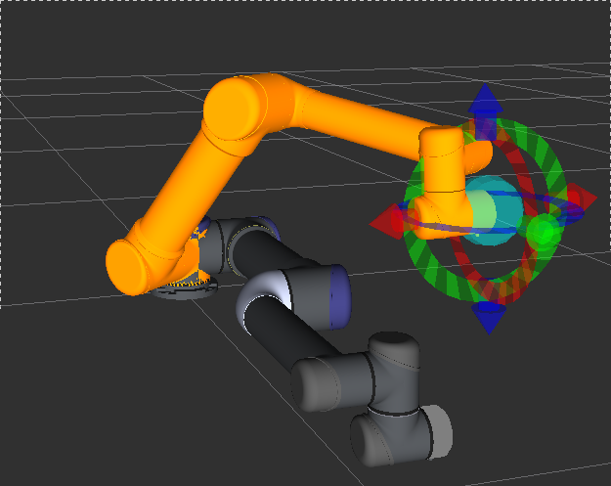
Robot Visualization
rviz
/tf
Parameter Server
robot_state_publisher
robot_description
/joint_states
control_node

Slide 17
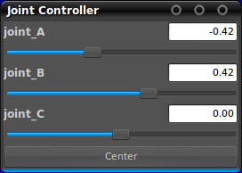
Test tool
joint_state_publisher
http://www.ros.org/wiki/joint_state_publisher
parameter: robot_description (URDF robot model)
publishes the state of non-fixed joints of a robot
topic: /joint_states (sensor_msgs/JointState)
GUI (optional)

Slide 18
URDF Visualization & Testing
rviz
/tf
Parameter Server
robot_state_publisher
robot_description
/joint_states
joint_state_publisher

Slide 19
simulation

Slide 20
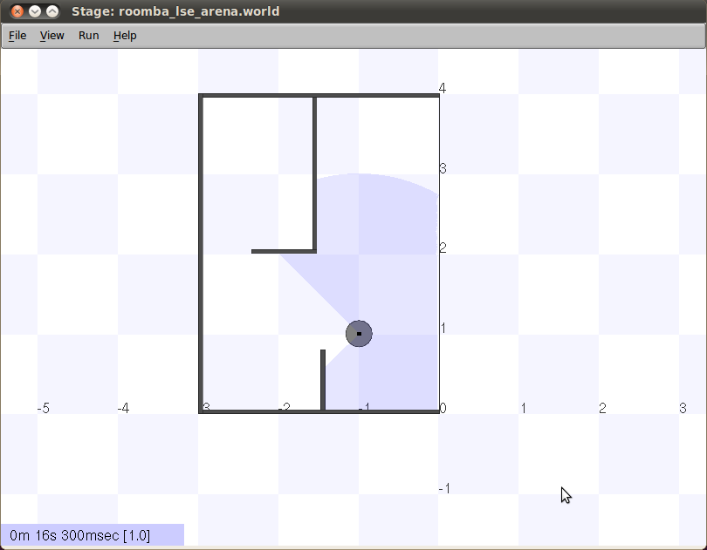
Stage
2D / mobile robots

Slide 21
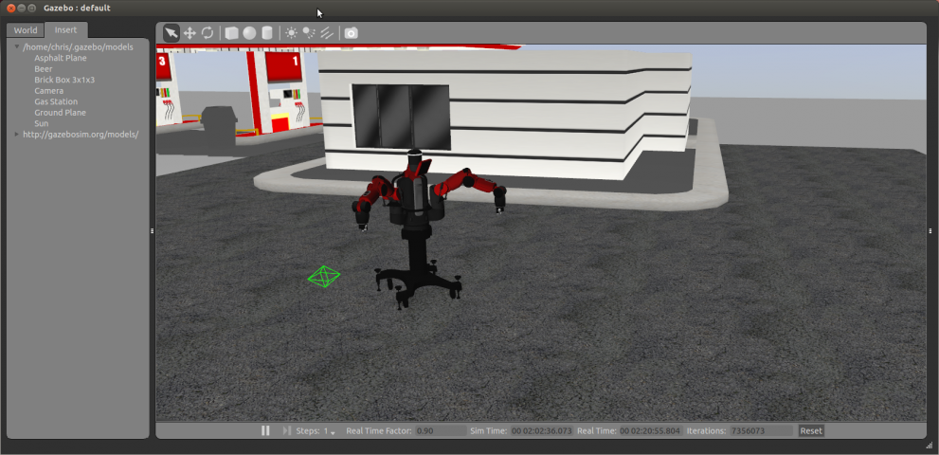
Gazebo

Slide 22
Gazebo
3D / all type of robots
Simulator Description Format (SDF)
solves the shortcomings of URDF
URDF: add <gazebo> elements
Transmission
Friction, stiffness, damping params
Plugins
ros_control
camera, kinect, laser
differential Drive, skid Steering drive, planar Move

Slide 23
Arm navigation

Slide 24
Motion Planning
goal
= tool pose: (x,y,z), (x,y,z,w)
Motion Planning
joint angles (q1, q2, q3…)
Control

Slide 25
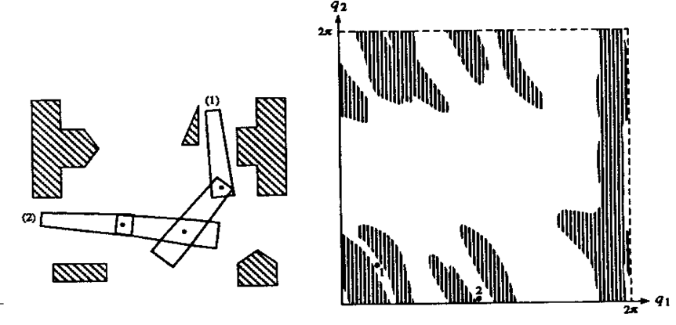
Workspace vs Configuration Space
Carthesian (Work) Space
Robot has shape
Configuration Space
Robot is point
y
x

Slide 26
Motion Planning steps
Translate goal pose from Carthesian to Configuration Space
In Configuration Space search appropiate trajectory (sequence of trajectory points) from current pose to goal pose.
No collision with obstacles and self
Within constraints (Velocity/Acceleration limits

Slide 27
Kinematics
FK
Configuration Space
Carthesian Space
Forward (Direct) Kinematics
q2
Joint Positions
(q1,q2,q3,…)
Tool Pose
(x,y,z), (x,y,z,w)
q1
Inverse Kinematics
IK
Configuration space
Carthesian space

Slide 28
Inverse kinematics in ROS
Iterative IK solver ➔ KDL
http://wiki.ros.org/orocos_kdl
Generic, for any robot
Default in ROS
Analytic IK solver ➔ IKFast
http://openrave.org/docs/latest_stable/openravepy/ikfast/
Generates a C++ file with an analytic solution
Only for a specific robot
Much Faster

Slide 29
OMPL: Open Motion Planning Library
Sampling-based motion planning algorithms
E.g. Rapidly-exploring Random Tree (RRT)
Find a path to the goal in a probabilistic way.

Slide 30

MoveIt!
http://moveit.ros.org/
MoveIt!
Motion planning
Obstacle (and self-collision) avoidance
“Collision-aware IK”
Trajectory Execution
MoveIt! Setup Assistant
Configure MoveIt! for a new robot and interact with a visualized model of the robot in Rviz.
Input: URDF model.

Slide 31
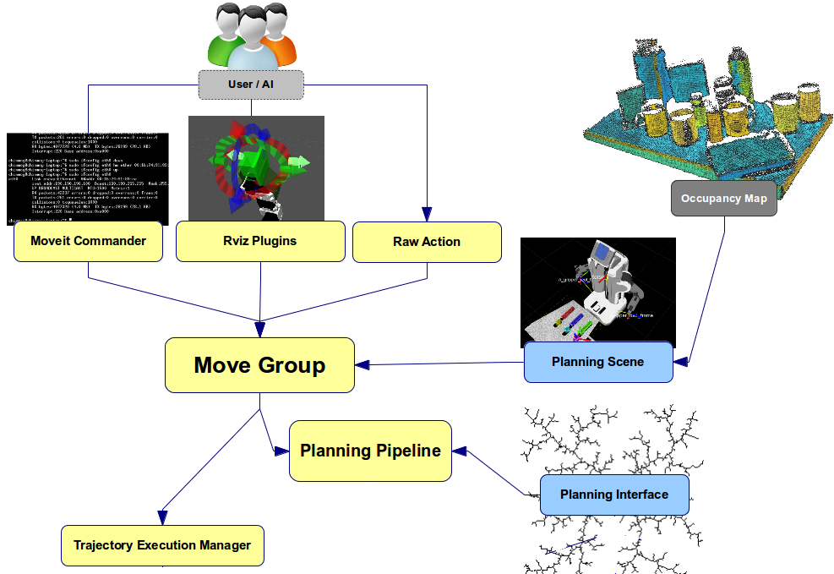
MoveIt!

Slide 32
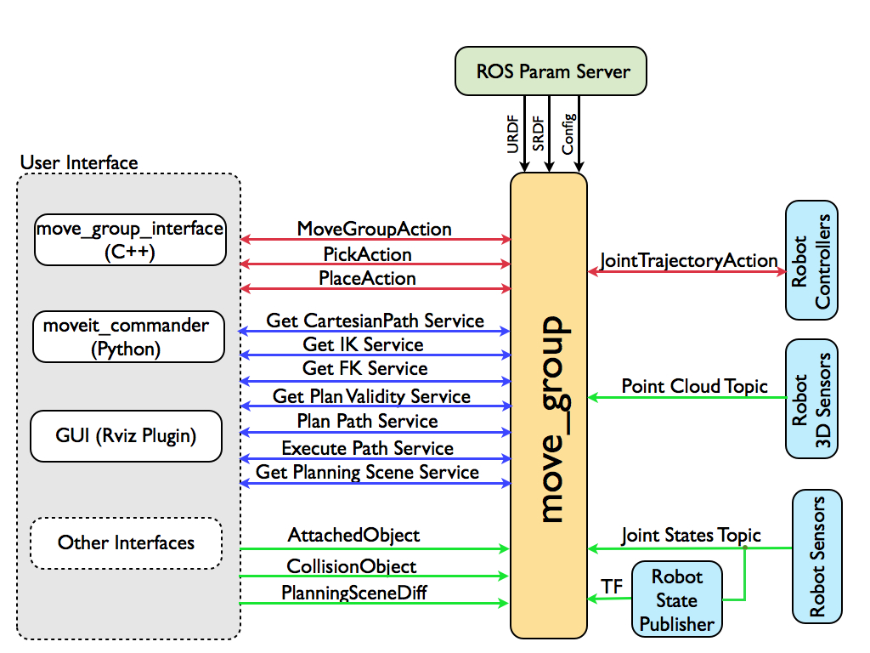
MoveIt!
http://moveit.ros.org/documentation/concepts/

Slide 33

ROS Industrial
http://rosindustrial.org/
http://wiki.ros.org/Industrial

Slide 34
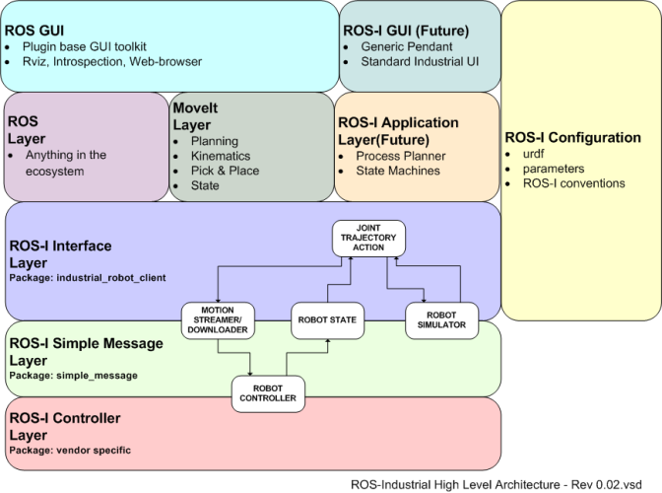
ROS Industrial Stack

Slide 35
Industrial Arm control in ROS
http://wiki.ros.org/Industrial/Industrial_Robot_Driver_Spec
MoveIt
JointTrajectory
JointState
/joint_path_command
/joint_states
industrial_robot_controller
simple_message
Robot Arm Controller

Slide 36
Video
Baxter Research Robot MoveIt! Tutorial
https://www.youtube.com/watch?v=1Zdkwym42P4

