Slide 1
Highland Clearances
A prototype

Slide 2
1819 Computer Games Design Group 9
Kristofer Stevenson
Julian Kelly

Slide 3
Game Idea and Overview
Make a game by considering the aesthetics and narrative first, working backwards towards the dynamics and mechanics.

Slide 4
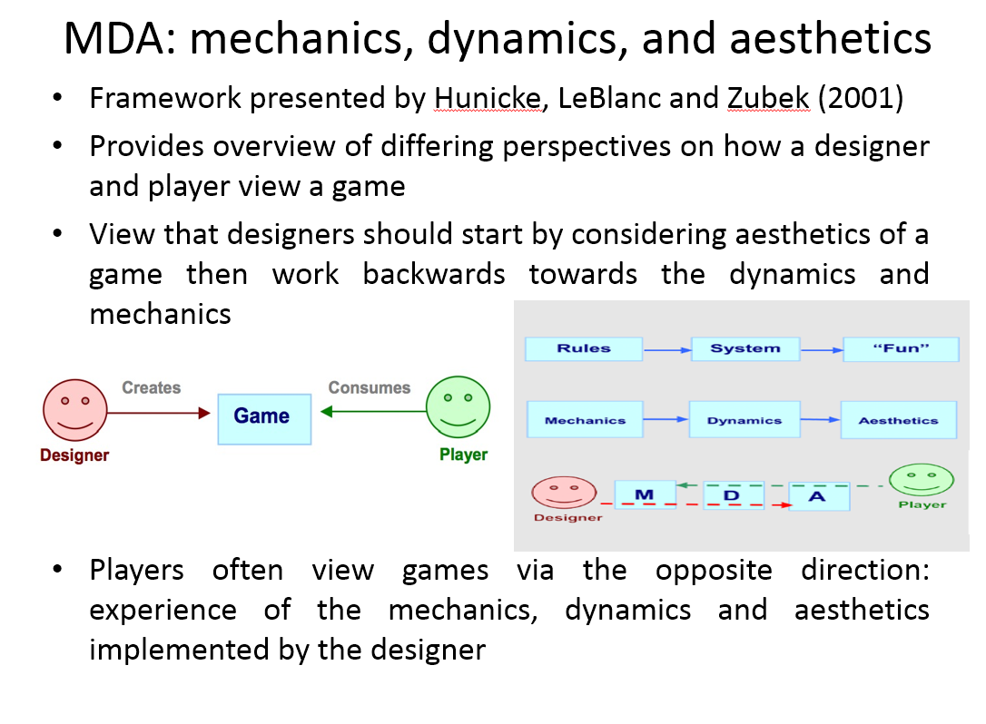
Game Idea and Overview

Slide 5
Game Idea and Overview
Make a game by considering the aesthetics and narrative first, working backwards towards the dynamics and mechanics.
We quickly started exploring the idea of doing something with the Highland Clearances. A period of time running from around 1746 to 1849.

Slide 6
Game Idea and Overview
Make a game by considering the aesthetics first, working backwards towards the dynamics and mechanics.
We quickly started exploring the idea of doing something with the Highland Clearances. A period of time running from around 1746 to 1849.
Often referred to as “Scotland’s Genocide”, highlanders were driven from their lands by British troops in order to make way for intensive sheep farming.

Slide 7
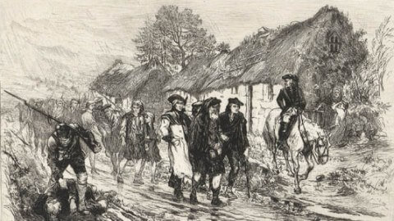
Game Idea and Overview

Slide 8
Game Idea and Overview
During this time the wearing of tartan was made a criminal offence (unless you were in the pay of the British army).

Slide 9
Game Idea and Overview
During this time the wearing of tartan was made a criminal offence (unless you were in the pay of the British army).
The possession of weapons was made illegal for the general citizenry.

Slide 10
Game Idea and Overview
During this time the wearing of tartan was made a criminal offence (unless you were in the pay of the British army).
The possession of weapons was made illegal for the general citizenry.
Tens of thousands of Scots were forcibly removed from their farms.

Slide 11
Game Idea and Overview
During this time the wearing of tartan was made a criminal offence (unless you were in the pay of the British army).
The possession of weapons was made illegal for the general citizenry.
Tens of thousands of Scots were forcibly removed from their farms.
Famine caused the deaths of many.

Slide 12
Game Idea and Overview
During this time the wearing of tartan was made a criminal offence (unless you were in the pay of the British army).
The possession of weapons was made illegal for the general citizenry.
Tens of thousands of Scots were forcibly removed from their farms.
Famine caused the deaths of many.
Highland Scots spread across the world to escape the cruelties in their former lands.

Slide 13
Game Idea and Overview
During this time the wearing of tartan was made a criminal offence (unless you were in the pay of the British army).
The possession of weapons was made illegal for the general citizenry.
Tens of thousands of Scots were forcibly removed from their farms.
Famine caused the deaths of many.
Highland Scots spread across the world to escape the cruelties in their former lands.
Heavy stuff right?

Slide 14
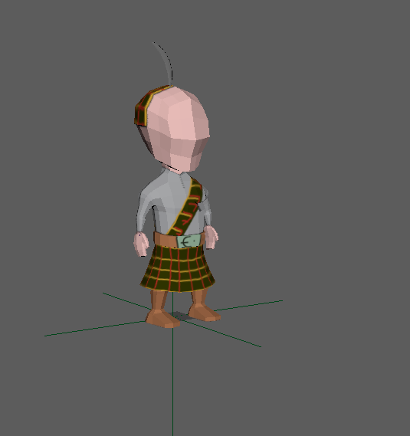
Game Idea and Overview
So we wanted to make it cute to counterbalance the grim story.

Slide 15
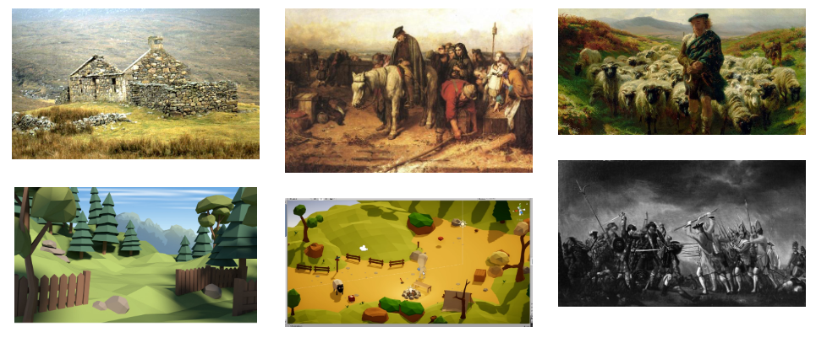
Game Idea and Overview
Our initial thoughts were to implement the scenario as a survival game, maybe a puzzle?
Windows PC focus for development.
A 3rd person, top down(ish) view was the popular choice.

Slide 16
Tool Choices
Unity was chosen as we’ve used it before.
Maya too, as anything’s better than the Blender UI right? New this year!
Gimp as well for textures.
Audacity for audio.

Slide 17
Gameplay and Mechanics
Only two things were fixed in our minds from the outset
Travelling west.
Violent retribution for not travelling west.

Slide 18
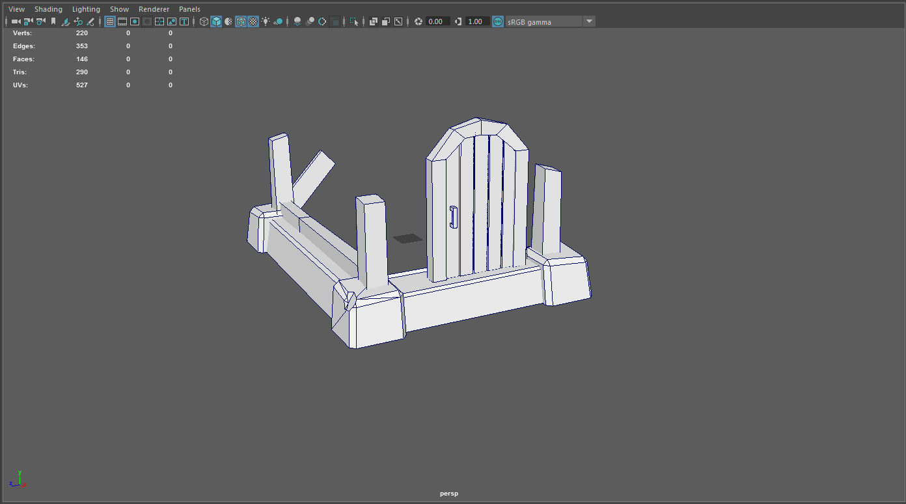
Gameplay and Mechanics
Starting out from your burnt out croft, you flee west.

Slide 19
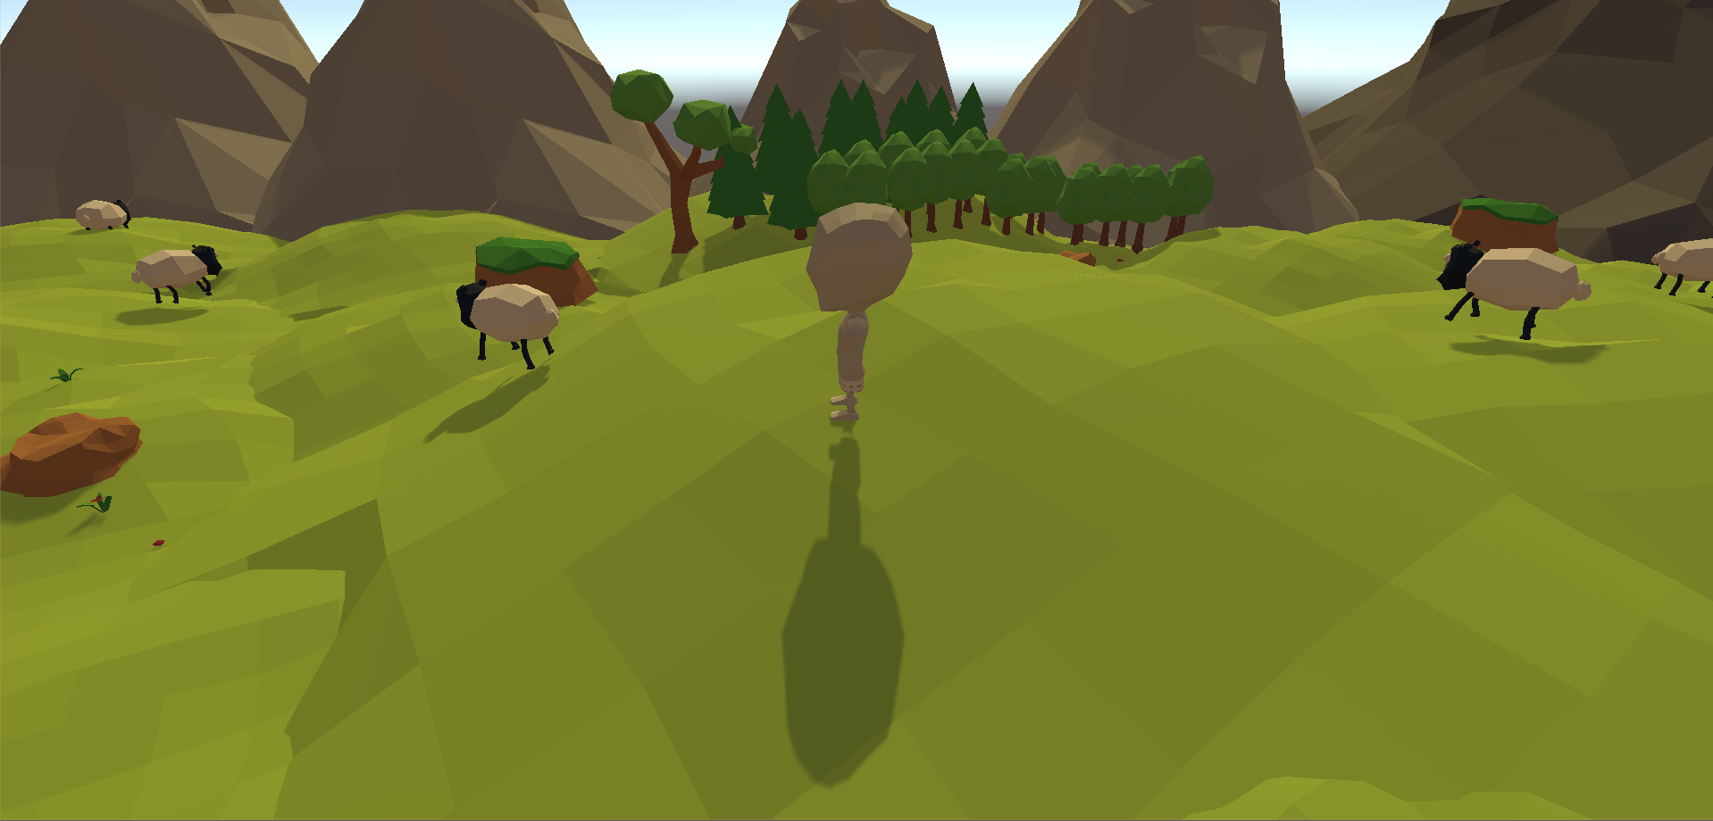
Gameplay and Mechanics
Ever westwards towards the sea.
Hungry huh? Dodge the sheep in order to avoid reprisals.

Slide 20
Gameplay and Mechanics
Swift death.
Unforgiving; no hand holding or explanations.
Almost an “anti-game”.
The only winning strategy is to run in as straight a line as possible to the sea.
Avoid the sheep.

Slide 21
Game Implementation
To start of with we decided to try and source some assets on the unity store, as we have decided to only 3D model the necessities like our main character, burned down croft etc
We then took the assets we found and set up our level which consists of green scenery and hills/mountains

Slide 22
Game Implementation
We then designed a core gameplay loop where the player must run to the left and avoid contact with sheep at all costs or the Red Coats will instantly kill you
Currently in development is the beginning and ending cutscenes and also the win conditions for the game as well.

Slide 23
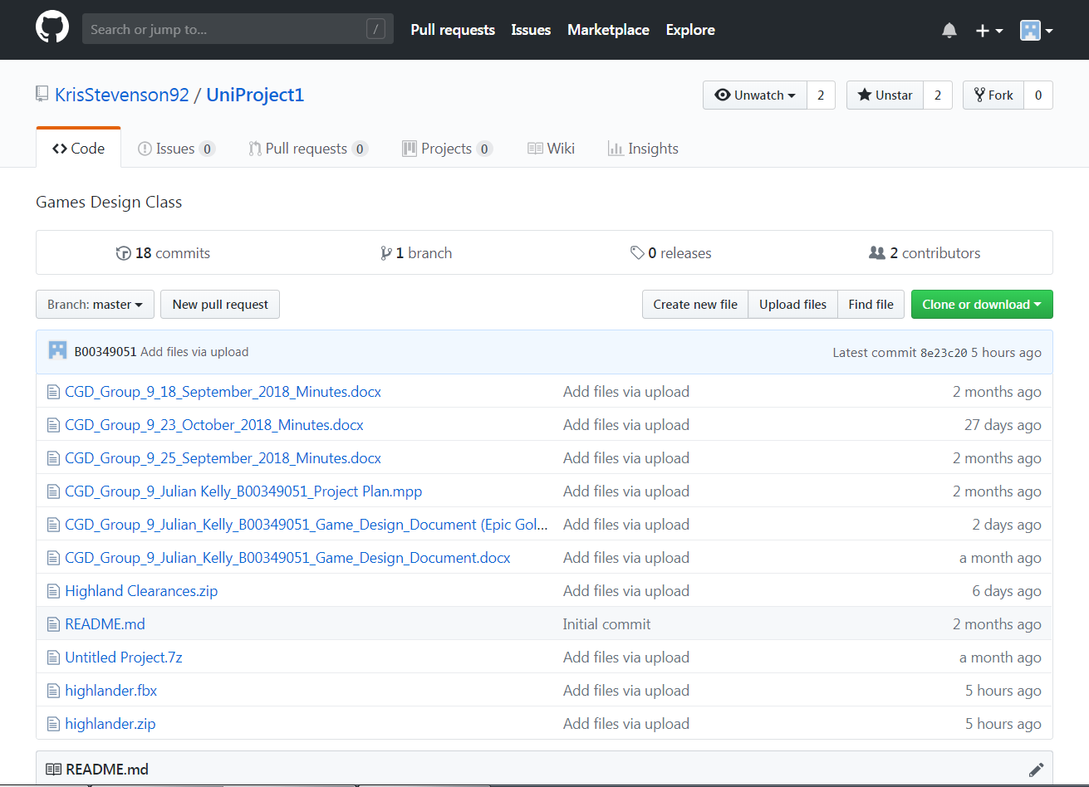
Version Control
We’ve been using Github as requested.
All files are sorted by date with important changes noted.
Source code is kept on a shared Google Drive using iterative filenames for the project folder.

Slide 24
Prototype Demo
This video it shows the goal of the game; run from the starting area, avoid sheep and end up at the ocean where the end of the game is.

Slide 25
Prototype Demo
In this video we can see what happens when the player touches a sheep. (Red Coats will spawn and kill the players character soon!).

Slide 26
Learning Experience as a Team
Julian: I learned that although I am far better with Maya than I ever was with Blender, I still underestimate just how long it takes me to do things.
Kristofer: I learned that 10/12 weeks isn’t enough time to complete a 3D game the way I would want it to be, I’m having to compromise with some of the mechanics…mainly the main menu.

