Slide 1




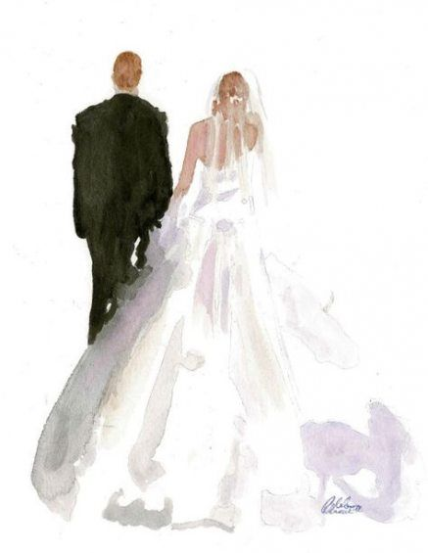
Morning Sept. 3rd
Check In & Activities
Morning Sept. 4th
Activities & Getting Ready
Morning Sept. 5
Brunch & Departure
Evening Sept. 3rd
Welcome Dinner & Drinks
Evening Sept 4th
Ceremony, Dinner & Dancing

