Slide 1




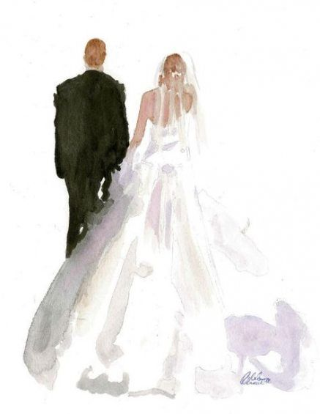
9/3 AM
Check In & Activities
9/4 AM
Activities & Getting Ready
9/5 AM
Brunch & Departure
9/3 PM
Welcome Dinner & Drinks
9/4 PM
Ceremony, Dinner & Dancing

