Slide 1

Verilog
Intro to Hardware Description

Slide 2
What is Verilog?
Language used to design digital Circuits
HDL-Hardware Description Language
We will be using SystemVerilog, taught in ECE 385
Files that end with .sv are systemverilog files
Not Instruction Based like normal programming languages

Slide 3
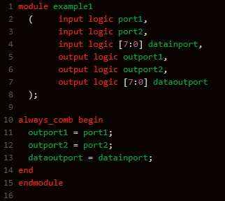
What does this do? Pt.1
Simple Circuit used described in SV
Not Very Clear at First

Slide 4
Module Creation
Modules are the Building Blocks of Circuits in Verilog
Each sv file should describe 1+ modules
Inputs and outputs define modules
End module closes the module’s definition
Observe Lines 1-8

Slide 5
Combination Logic Part 1
Lets only observe Lines 10-14
This is the combination logic of the circuits
Defines everything in between
What could these statements represent in a circuit?

Slide 6
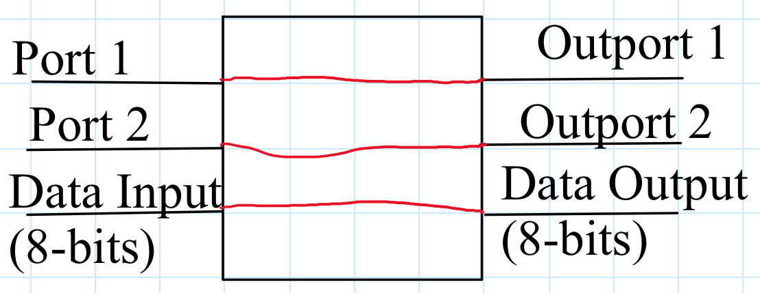
Actual Circuit of Example 1
Here it be!

Slide 7
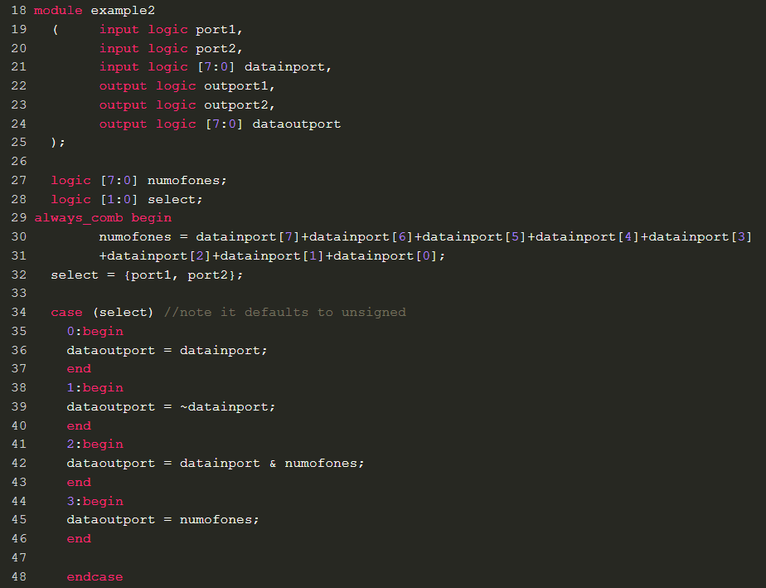
What does this do? Part 2

Slide 8
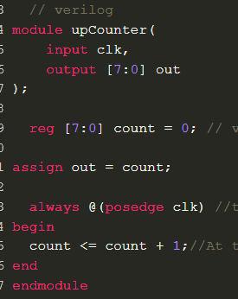
What does this do? Part 3

