Slide 1

Bootcamp
Digital Logic 101

Slide 2
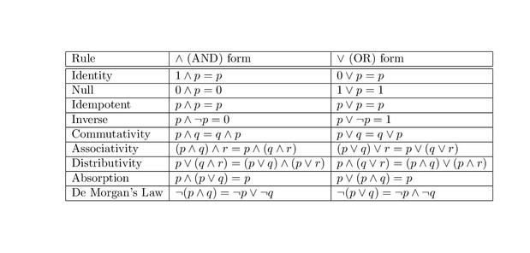
Boolean Algebra
AND = *, ^, &&
OR = +, V, ||
NOT = ~ , ’ , !, ¬

Slide 3
Maps and Tables
In0 | In1 | In2 | In3 | Out0
0 | 0 | 0 | 0 | 1
0 | 0 | 0 | 1 | 1
0 | 0 | 1 | 0 | 0
0 | 0 | 1 | 1 | 1
0 | 1 | 0 | 0 | 0
0 | 1 | 0 | 1 | 1
0 | 1 | 1 | 0 | 0
0 | 1 | 1 | 1 | 0
1 | 0 | 0 | 0 | 0
1 | 0 | 0 | 1 | 1
1 | 0 | 1 | 0 | 0
1 | 0 | 1 | 1 | 1
1 | 1 | 0 | 0 | 0
1 | 1 | 0 | 1 | 0
1 | 1 | 1 | 0 | 1
1 | 1 | 1 | 1 | 1
 | In0 In1
In2 In3 |  | 00 | 01 | 11 | 10
 | 00 | 1 | 0 | 0 | 0
 | 01 | 1 | 1 | 0 | 1
 | 11 | 1 | 0 | 1 | 1
 | 10 | 0 | 1 | 1 | 0
=

Slide 4
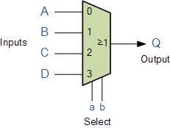
Multiplexers(MUXES)
Select a | Select b | Output Q
0 | 0 | A
0 | 1 | B
1 | 0 | C
1 | 1 | D

Slide 5
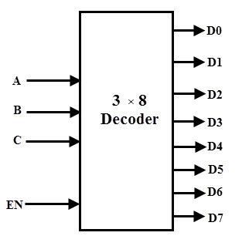
Decoder
A | B | C | E | Active
x | x | x | 0 | None
0 | 0 | 0 | 1 | D0
0 | 0 | 1 | 1 | D1
0 | 1 | 0 | 1 | D2
0 | 1 | 1 | 1 | D3
1 | 0 | 0 | 1 | D4
1 | 0 | 1 | 1 | D5
1 | 1 | 0 | 1 | D6
1 | 1 | 1 | 1 | D7

Slide 6
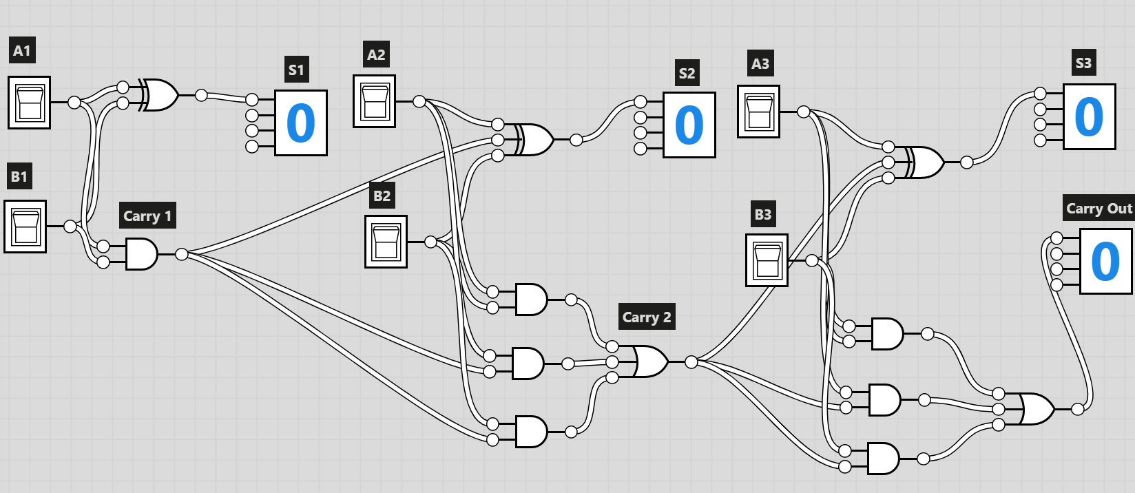
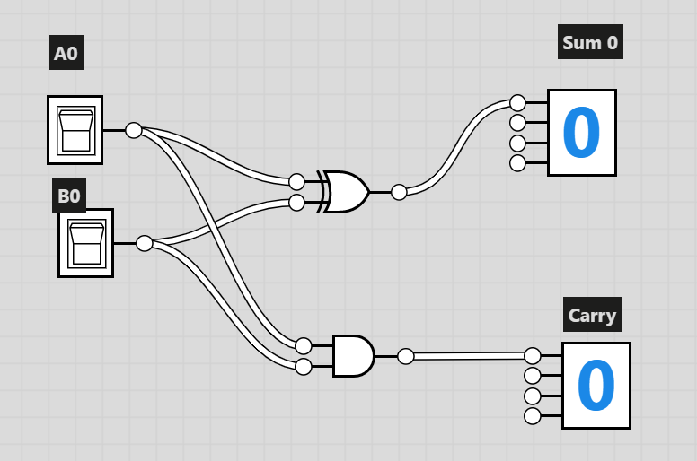
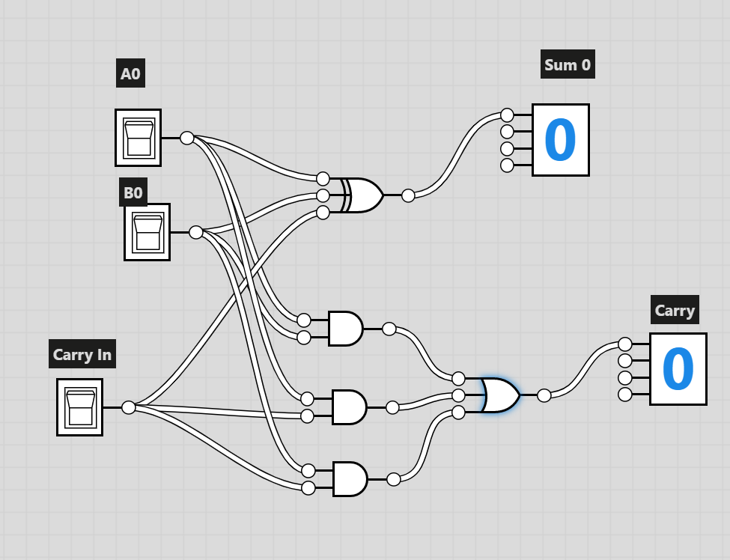
Adder Example
Half Adder
Ripple Carry Adder
Full Adder

Slide 7
Bitslice Design
Useful to design a module for a single bit.
This allows us to make designs of n length. Such as for the carry ripple adder.

Slide 8
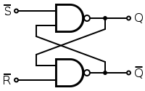
Latches
S’ | R’ |  | Q | Q’
0 | 0 |  | Metastable
0 | 1 |  | 1 | 0
1 | 0 |  | 0 | 1
1 | 1 |  | Latched

Slide 9
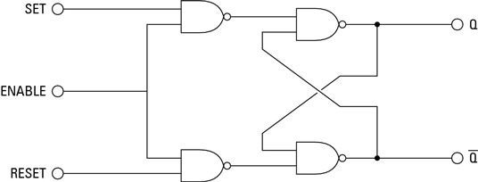
Gated Latch
iffsjafds
S | R | Enable | S’ | R’ | Q | Q’
x | x | 0 | 1 | 1 | Latched
0 | 0 | 1 | 1 | 1 | Latched
0 | 1 | 1 | 1 | 0 | 0 | 1
1 | 0 | 1 | 0 | 1 | 1 | 0
1 | 1 | 1 | 0 | 0 | Metastable
If R and S aren’t the same(S and Enable are only real inputs)
Set | Reset | S’ | R’ | Enable | Q | Q’
S | S’ | 1 | 1 | 0 | Latched
S | S’ | S’ | S | 1 | S | S’

Slide 10
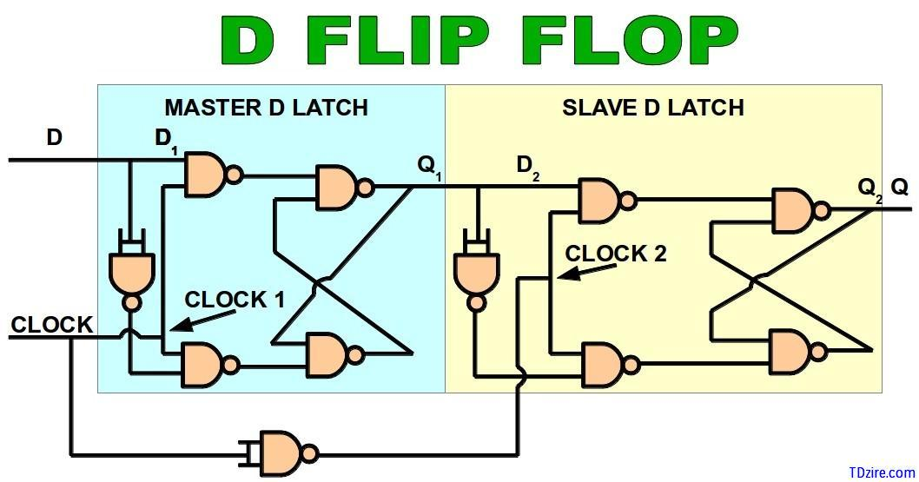
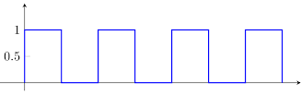
Flip Flops

Slide 11
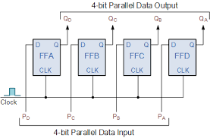
Registers
Just a series of flip flops running on the same clock
Used to save multiple bits

Slide 12
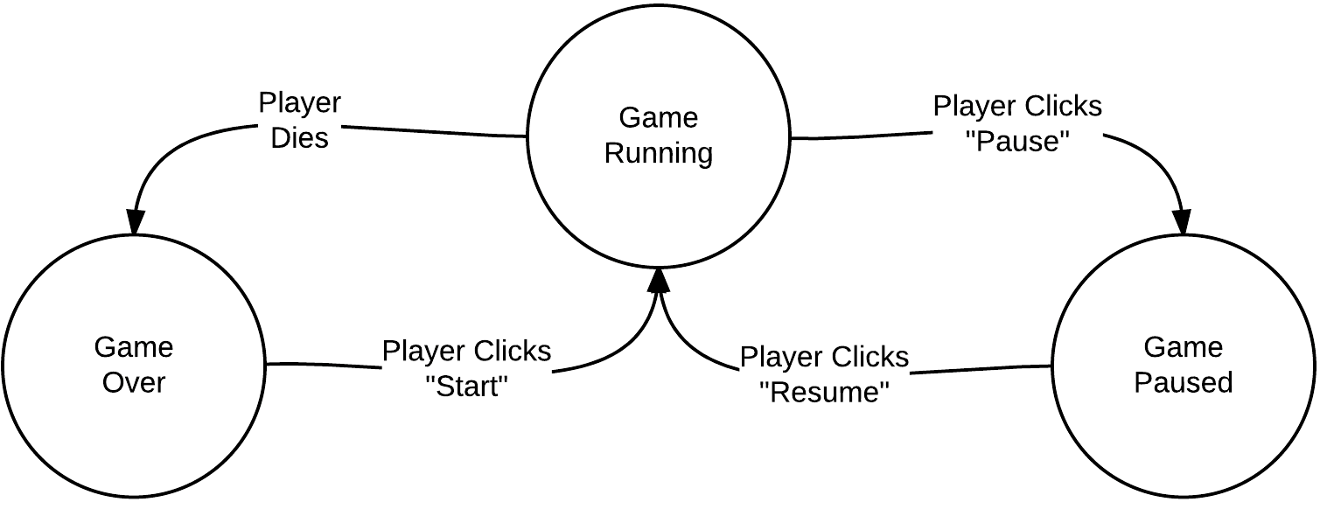
State Machines
Types
Moore
Mealy
120 mostly teaches you Moore machines
Abstract concept

Slide 13
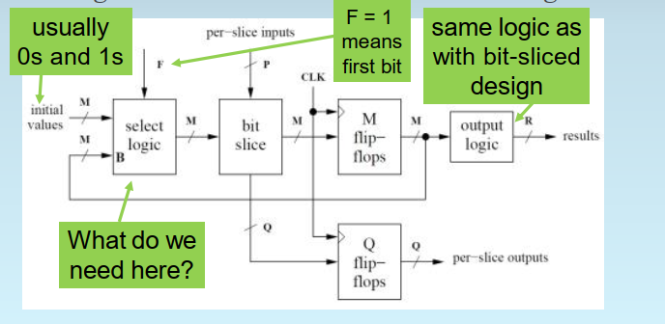
Serializing a design with a State machine

Slide 14
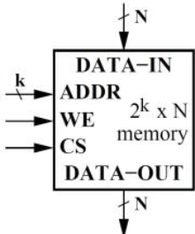
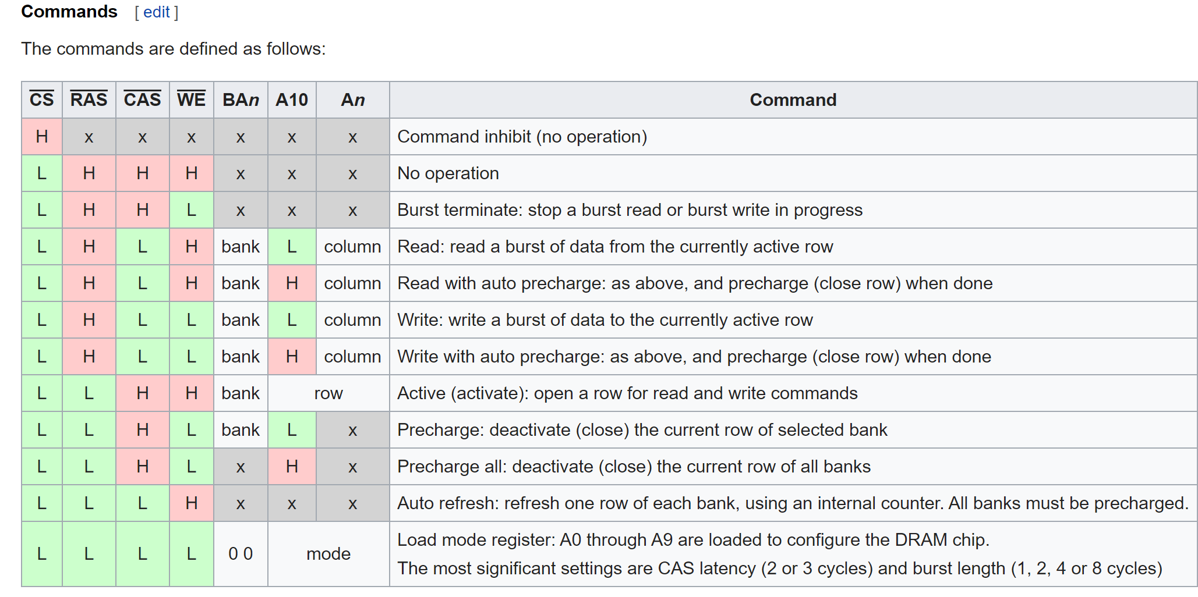
Memory (black box perspective)
SDRAM
Synchronous Dynamic RAM
Out of the scope of us teaching you guys this, but here is some pretty neat stuff

Slide 15
Von Neumann Model
Data and Instructions in the same memory
CPU accesses data and instructions over a bus to memory
Speed Hierarchy of computer components
Registers (fastest)
SRAM (Often times used for caches, that are too complicated to talk about here)
DRAM (Slowest of the types of memory that the processor directly works with
Disk/Flash memory (yeah these are really slow)
RAM disks are stupid btw
Control Signals and Control Flow

Slide 16
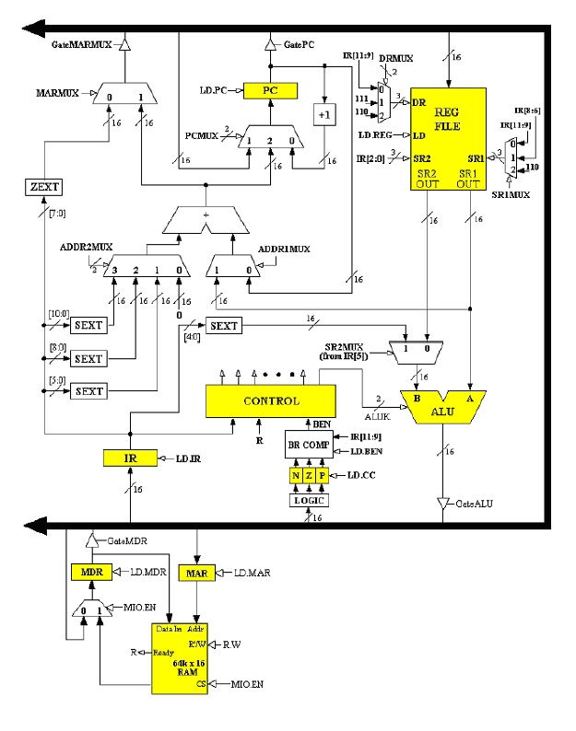

Slide 17

ISAs (Instruction Set Architectures)
Types
x86
LC-3 (industry standard LC-3 created by the lord and savior, Sanjay Patel Ph.D.)
RISC-V
Two approaches to ISA designs
CISC (Complex Instruction Set Computer)
RISC (Reduced Instruction Set Computer)
OPCODES in LC-3 and x86
provides information on # of bytes per instruction for x86
Assembly Language Examples using LC-3 and x86

Slide 18
An aside about booting
Some magical stuff that’s actually kind of interesting

Slide 19
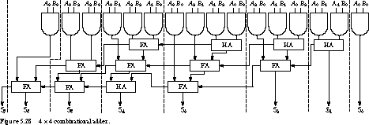
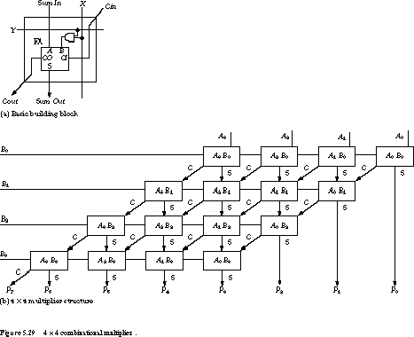
Design Decisions in Computer Architecture
Combinational Delay vs. Registering a value
Is the die space really worth this for this multiplier?
Registering values has its benefits
Serialization from before
ASICs vs. General purpose processors
Parallel processing in GPUs
Multi-core systems
Cost :(

