Slide 1


Slide 2
Introduce
https://facebook.github.io/react/tutorial/tutorial.html
React is a declarative, efficient, and flexible JavaScript library
for building user interfaces.
Declarative
Component-Based
Learn Once, Write Anywhere
1.Learn JavaScript
2.Learn component
Notes:
https://github.com/ruanyf/jstraining/blob/master/docs/react.md

Slide 3
Basic
React
React-router
Redux
Antd
https://github.com/facebookincubator/create-react-app

Slide 4
Other
1) Server Rendering
2)Flow
3)Storybook(Test)
4)React Native
5)Mobx
6)Grapql
7)React VR
8)Dva…

Slide 5
Most used JavaScript Feature
1)Import,Export
2)Const,let变量声明
3)析构赋值
4)箭头函数
5)Spread Operator（…）
6)Map,Filter,Reduce
7)模板字符串
Notes:
https://github.com/dvajs/dva-knowledgemap

Slide 6
Component Class
Create Way Work Type
1)Component 1)Basic Control
2)Stateless Component 2)yewu Component
UI
1)Container Component
2)Presentation Component
Form
1)Controlled/Un Controlled Component
Smart/Stupid HOC
Notes:
http://www.cnblogs.com/wonyun/p/5930333.html

Slide 7
JSX
1)One root element
2){} run js
3)ClassName
Props
State
Render
View=func(State)

Slide 8
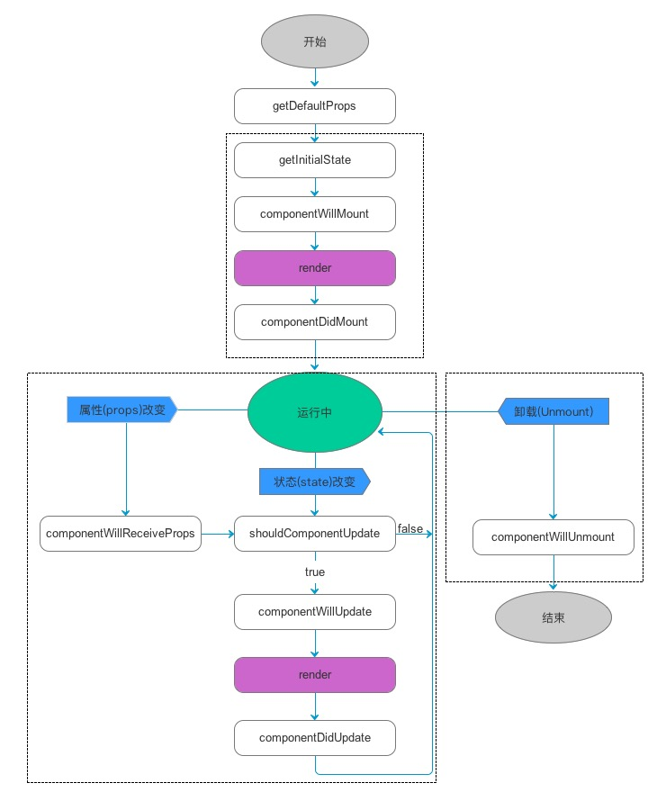
Life cycle
https://facebook.github.io/react/docs/react-component.html
Notes:
https://github.com/hhhyaaon/react-lifecycle-demo/blob/master/src/views/index.js
Constructor
Render

Slide 9
Life cycle
https://facebook.github.io/react/docs/react-component.html

Slide 10
Conditional Rendering/Lists and Keys
https://facebook.github.io/react/docs/conditional-rendering.html
1)if (isLoggedIn) { return <UserGreeting />; }
Else{ return <GuestGreeting />;}
2)isXXX? A :B
3){(){if else}()
const numbers = [1, 2, 3, 4, 5];
const listItems = numbers.map((number) => <li>{number}</li> );

Slide 11
Data flow
1)Parent->Child
Prop
2)Child->Parent
Event
Ref，Context

Slide 12
Axios
this.axios.get(api).then((response) => {
console.log(response.data)
}

Slide 13
Router
https://github.com/ReactTraining/react-router/tree/v3/docs
Config:{ path: '/foo', component: Foo }
Use:1. <Link to="/foo">Go to Foo</Link>
2. browerHistory.push(‘/foo')
Histories Mode
withRouter HoC

Slide 14
Mixin
A mixin object can contain any component options.
When a component uses a mixin, all options in the mixin will be “mixed” into the component’s own options.
// define a mixin object
var myMixin = {
created: function () {
this.hello()
},
methods: {
hello: function () {
console.log('hello from mixin!')
}
}
}
// define a component that uses this mixin
var Component = Vue.extend({
mixins: [myMixin]
})

Slide 15
High Order Component
High Order
High Order
Mix Component
Mix Component
Basic Component1
Basic Component2
Basic Component3
Basic Component4

Slide 16
High Order Component-2 way create
1)Child Class
2)AOP
Notes:
组合优于继承

Slide 17
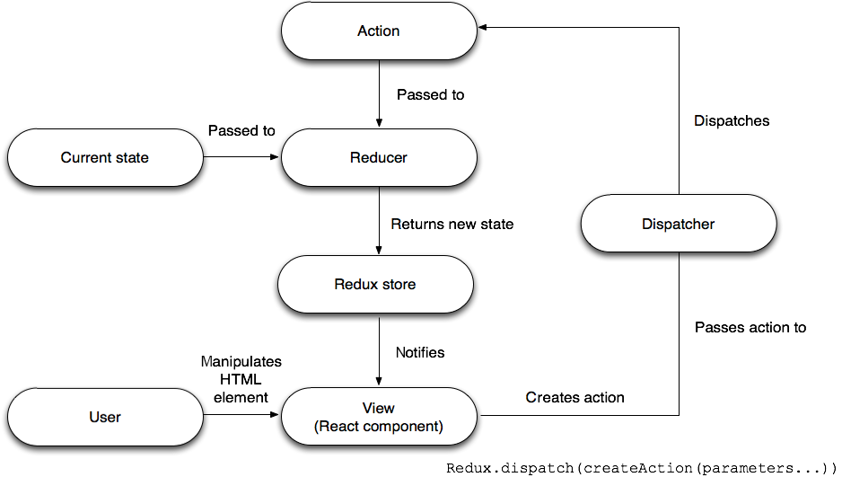
State management(Redux)

Slide 18
State management(Redux)
nextState=func（preState，action）
Action,Reducer,Store
combineReducers,bindActionCreators,
middleware
Connect,mapStateToProps, mapDispatchToProps
Notes:
http://cn.redux.js.org/
https://github.com/mocheng/react-and-redux

Slide 19
Thank you!
(study hard, play hard)

