Slide 1
Intelligent
Emotion and Music Companion
Welcome to a journey into the exciting world of music and emotion. This presentation explores the development of an intelligent music companion that understands and responds to your emotional state.

Slide 2
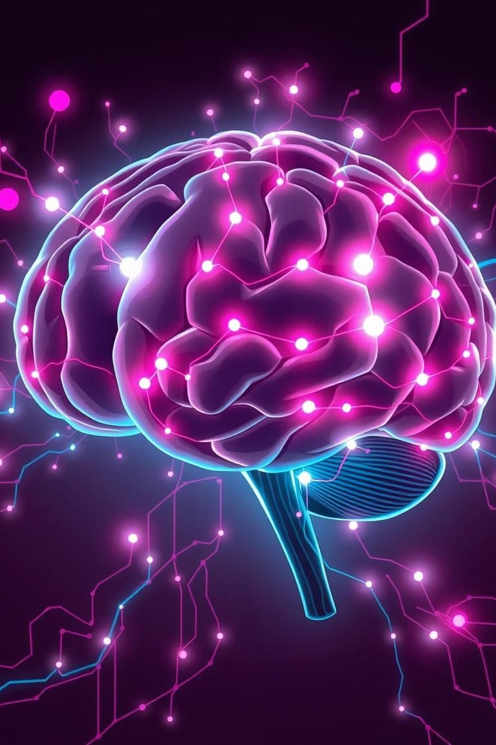
The science behind emotion and music
1
Music's Impact on Mood
Music evokes emotions by stimulating areas of the brain that process feelings and reward.
2
Emotional Response
Specific musical elements, like tempo and melody, influence physiological responses, like heart rate and breathing.
3
Personal Preference
Individual experiences and cultural influences shape personal preferences and emotional connections to music.

Slide 3

Identifying emotional states through music
1
Facial Expression Analysis
AI algorithms can analyze facial expressions, such as smiles and frowns, to infer emotional states.
2
Voice Analysis
Voice tone, pitch, and speech patterns provide valuable insights into a user's emotional state.
3
Music Preference Analysis
Previous listening history and genre preferences can indicate emotional patterns and correlate with specific moods.

Slide 4
Personalizing the music experience
Mood-Based Recommendations
The companion recommends music tailored to the detected emotional state, offering uplifting tunes for low moods or calming melodies for anxious moments.
Adaptive Playlists
The companion dynamically adjusts playlists based on real- time emotional feedback, ensuring a continuously personalized musical experience.

Slide 5

Integrating AI to enhance the experience
1 2
3
Natural Language Processing
AI enables the companion to understand and respond to user requests through voice commands or text inputs.
Machine Learning
The companion continuously learns from user interactions, refining recommendations and improving its understanding of individual preferences.
Deep Learning
Advanced AI techniques analyze complex patterns in music and emotional responses, allowing for more nuanced and personalized recommendations.

Slide 6
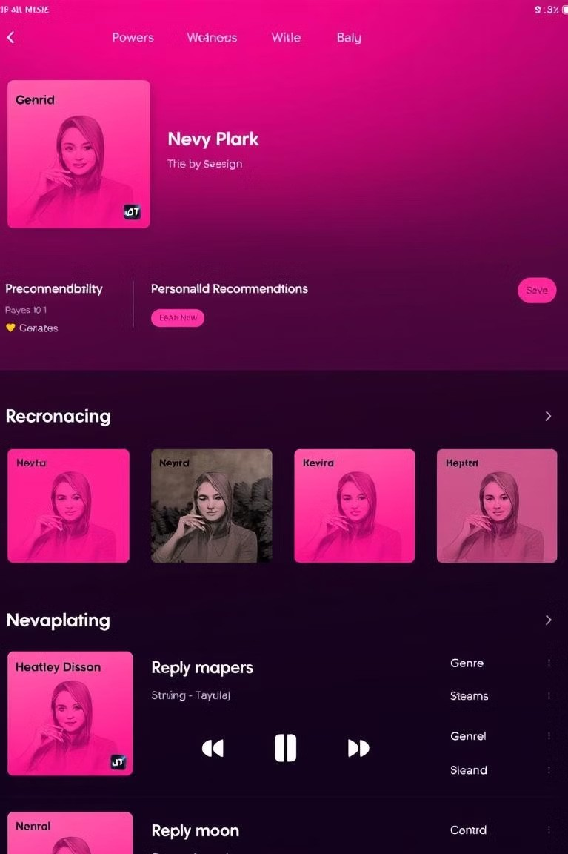
Predicting user preferences and mood
Algorithm | Prediction
Collaborative Filtering | Predicts preferences based on similar users' listening history.
Content-Based Filtering | Recommends music based on the user's previous choices and preferred genres.
Hybrid Approaches | Combine different techniques for more accurate and comprehensive predictions.

Slide 7
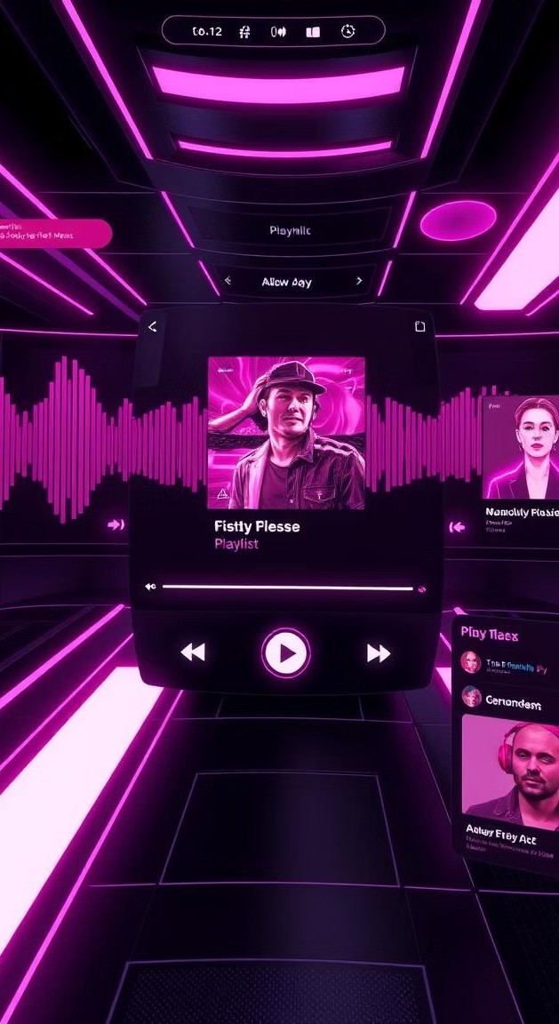
Enabling seamless playlist generation
Genre Selection
The companion allows users to select preferred genres, ensuring the playlist aligns with their musical tastes.
Mood Selection
Users can specify their desired mood, whether it's energetic, relaxing, or anything in between.
Randomization Options
The companion offers various randomization options, allowing for personalized and unpredictable playlists.

Slide 8

Therapeutic applications of the technology
Stress Relief
The companion provides soothing music to alleviate stress and promote relaxation.
Mood Regulation
The companion helps individuals manage their emotions by offering music tailored to their current state.
Cognitive Enhancement
The companion can provide music for focus and concentration, improving cognitive performance.

Slide 9



The future of intelligent music companions
AI-Powered Personalization
The companion will further evolve to understand individual preferences and emotions with greater accuracy.
Immersive Music Experiences
The companion will integrate with virtual reality and augmented reality technologies to create immersive musical experiences.
Seamless Integration
The companion will seamlessly integrate with smart home devices, creating a personalized and connected music experience.

Slide 10

Conclusion and key takeaways
Intelligent music companions have the potential to revolutionize the way we experience and interact with music. By understanding and responding to our emotional states, they can create personalized and enriching musical experiences.

