Slide 1

Intelligent Emotion & Music Companion
Welcome to the future of music discovery, where emotional intelligence meets personalized sound.

Slide 2

Meet the Team
Yashwant Sonkar
Lead Developer, bringing technical expertise and innovation.
Krish Jain
Design Lead, crafting intuitive and engaging user experiences.
Arjun Tiwari
Music & AI Expert, curating emotions and shaping the sonic journey.

Slide 3
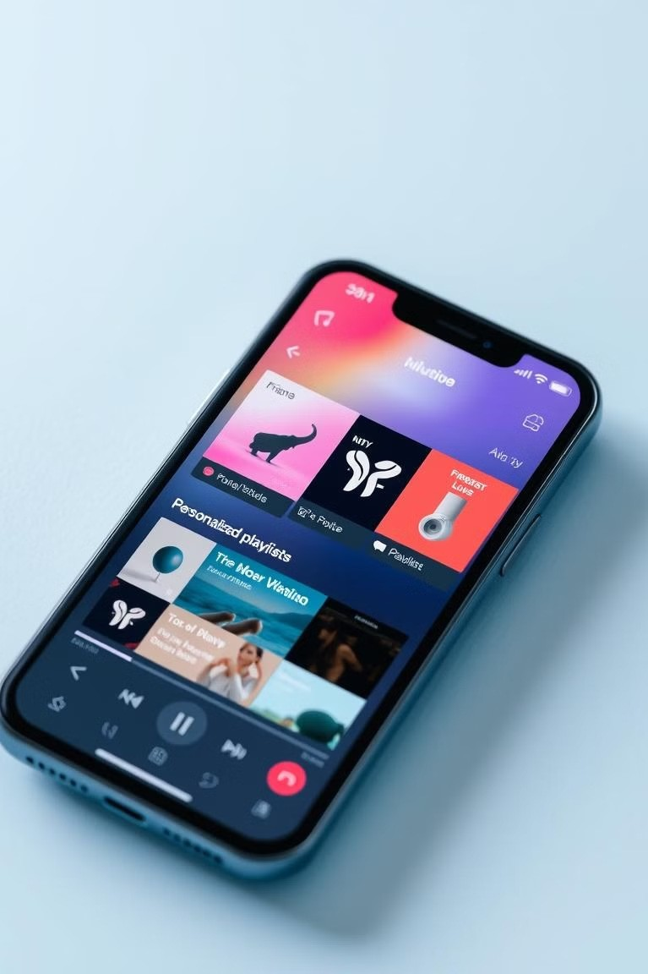
Introducing our AI- powered music experience
1
Personalized Music
Discover music that perfectly matches your mood, enhancing your listening experience.
2
Intelligent Insights
Cain deeper understanding of your emotional responses to music, fostering self- awareness.
3
Seamless Integration
Effortlessly integrate with your favorite music streaming platforms for a smooth transition.

Slide 4
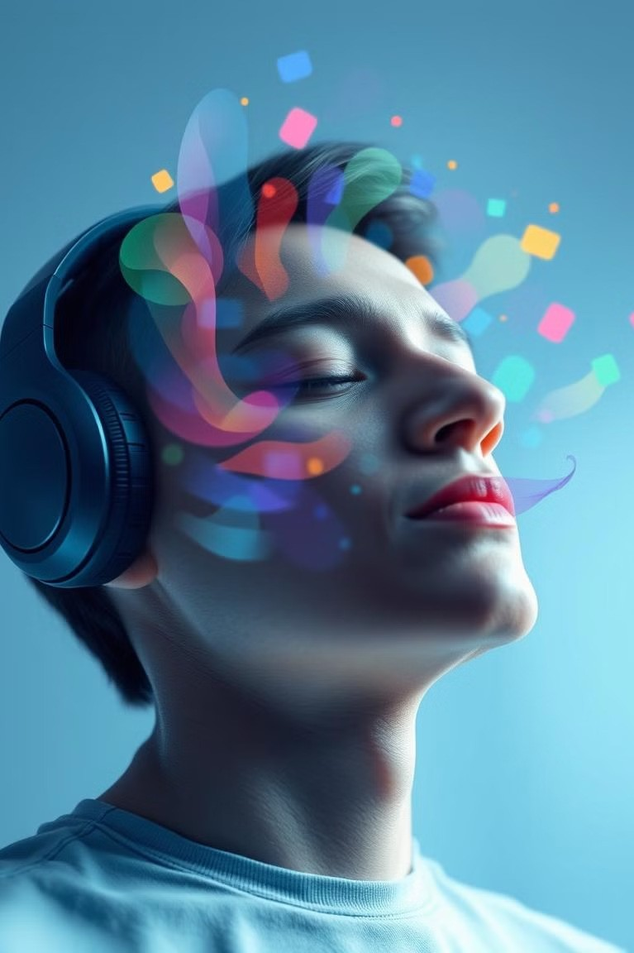
Understand your mood and emotions
Real-time Emotion Detection
1
Advanced algorithms analyze your physiological responses to understand your current emotional state.
Personalized Music Selection
Our AI curates a playlist based on your identified emotions, creating a personalized sonic journey.
2
Enhanced Listening Experience
Experience music that resonates with your emotions, deepening your connection and understanding of yourself.
3

Slide 5

Enhance productivity and focus
Concentration-Boosting Music
Listen to calming and stimulating music to enhance focus and improve work efficiency.
Time Management
Use music to regulate your workflow and create a productive environment for optimal performance.
Cognitive Enhancement
Experience music designed to improve mental clarity and cognitive function, amplifying your mental abilities.

Slide 6

Reduce stress and anxiety
1
Stress Detection
Our AI identifies signs of stress and anxiety, allowing for targeted music interventions.
2
Calming Music Selection
Curated playlists featuring relaxing melodies and ambient sounds create a sense of peace and tranquility.
3
Stress Reduction
Experience a reduction in stress levels, promoting relaxation and emotional well-being.

Slide 7

Strengthen mental well- being
Mood Boosting | Positive affirmations and uplifting melodies promote a sense of joy and optimism.
Emotional Regulation | Music helps manage and express emotions, improving overall emotional health and resilience.
Self-Discovery | Cain deeper understanding of yourself and your emotional landscape through personalized music experiences.

Slide 8

The future of emotional intelligence in music
We envision a world where music empowers emotional intelligence and well-being, shaping a future where technology and artistry harmonize to create a more emotionally connected world.

