Slide 1
DATA ANALYTICS PROJECT
HR Analytics Dashboard
Employee Attrition & Workforce Insights
By Krishna Bhise
Notes:
1

Slide 2
OVERVIEW
Project Overview
What This Project Does
Why It Matters
Analyzes employee data to understand attrition trends and workforce patterns using Power BI — empowering HR teams with actionable, data-driven insights.
Employee attrition is one of the most costly challenges organizations face. Understanding the why behind turnover is the first step to solving it.
Notes:
2

Slide 3

BUSINESS PROBLEM
The Challenge
Identify Problems
Define Goals
Implement Solutions
Analyze Data
High employee attrition strains resources and disrupts team performance. This project targets the root causes to enable smarter retention strategies.
Notes:
3

Slide 4




OBJECTIVES
Project Objectives
Attrition Trends
High-Risk Groups
Analyze patterns over time and across departments
Identify employee segments most likely to leave
Workforce Distribution
Data-Driven HR
Understand how the workforce is structured
Support smarter, evidence-based HR decisions
Notes:
4

Slide 5
DATASET
IBM HR Analytics Dataset
Source
Key Features
IBM HR Analytics Employee Attrition Dataset — a widely used benchmark dataset for workforce analytics projects.
Age, Gender, Department
Job Role & Salary Slab
Job Satisfaction & Performance
Years at Company & Attrition Flag
Notes:
5

Slide 6
KPIS
Key Performance Indicators
1,470
237
16.1%
Total Employees
Attrition Count
Attrition Rate
1,233
$6.5K
Active Employees
Avg. Monthly Salary
Notes:
6

Slide 7
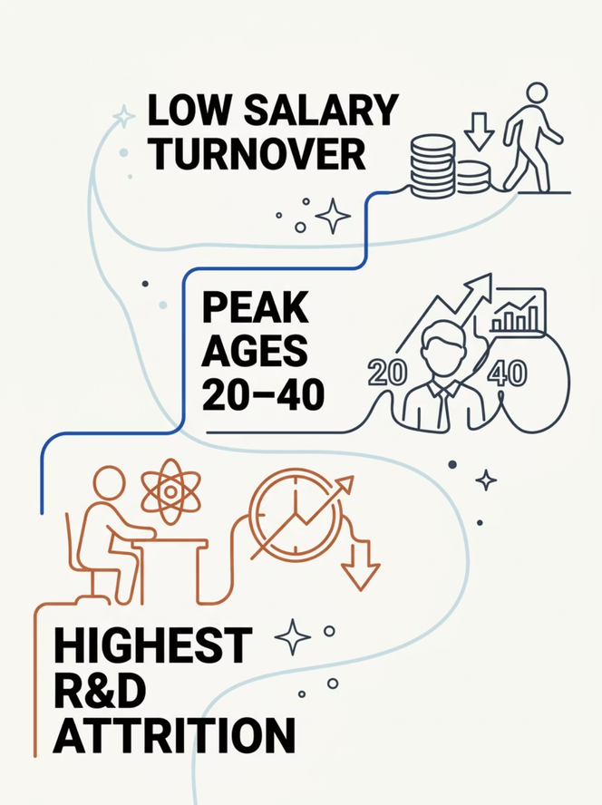

INSIGHTS
Key Insights
R&D Leads Attrition
Age 20–40 at Risk
Salary Drives Turnover
The R&D department accounts for the highest share of employee exits.
Younger and mid-career employees show the greatest tendency to leave.
Employees in lower salary slabs have significantly higher attrition rates.
Notes:
7

Slide 8
IMPACT & TOOLS
Business Impact & Tools Used
Business Impact
Tools & Technologies
Helps HR teams reduce attrition proactively
Power BI
Interactive dashboards
Improves workforce planning and resource allocation
DAX
Custom KPI calculations
Enables data-driven decision-making at every level
Excel / CSV
Data preparation
Notes:
8

Slide 9
Conclusion
The HR Analytics Dashboard delivers actionable insights that empower organizations to improve employee retention, optimize workforce planning, and make smarter, data-driven HR decisions.
Thank You
Open for questions — Krishna Bhise
Notes:
9

