Slide 1
Vendor Performance Analysis Dashboard
A data-driven deep dive into vendor revenue, cost, profit, and efficiency — powered by SQL, Python, and Power BI.
By Krishna Bhise · Data Analytics
Notes:
1

Slide 2
EXECUTIVE SUMMARY
What This Project Does
This project leverages data analytics and Power BI to provide organizations with a comprehensive view of vendor performance. By integrating SQL-driven data extraction with Python-based processing, the dashboard surfaces actionable insights across four critical dimensions:
Project Goal
Empower business stakeholders with a single source of truth for vendor evaluation — eliminating guesswork and enabling data-backed decisions at every level of the supply chain.
Revenue
Cost
Track total income generated per vendor
Monitor procurement and operational spend
Profit
Efficiency
Measure net value delivered by each vendor
Evaluate profit margins and performance ratios
Notes:
2

Slide 3
PROBLEM STATEMENT
The Visibility Gap in Vendor Management
Without structured analytics, organizations operate blind — unable to distinguish high-value vendors from cost drains.
🔍 No Clear Ranking
💸 Uncontrolled Costs
Difficult to identify which vendors drive the most revenue or profit
Lack of cost visibility leads to overspending and missed savings
📉 Profitability Blind Spots
⚠️ Decision Risk
No systematic way to analyze margins across vendor portfolios
Strategic vendor decisions made on incomplete or outdated data
Notes:
3

Slide 4
OBJECTIVES
What We Set Out to Achieve
1
2
Revenue, Cost & Profit Analysis
Identify Top Vendors
Break down financial performance across all vendors in the dataset
Surface the top 10 vendors by revenue and profitability contribution
3
4
Evaluate Profit Margins
Visualize Profit Breakdown
Benchmark margin performance and flag underperforming relationships
Deliver interactive Power BI visuals for intuitive stakeholder reporting
Notes:
4

Slide 5
TOOLS & DATASET
Technology Stack & Data Sources
Tools Used
Dataset Fields
Field
Description
SQL
Vendor ID
Unique vendor identifier
Data extraction, table joins, and structured querying across vendor records
Sales
Units sold per vendor
Revenue
Total income generated
Cost
Procurement & operational cost
Python
Inventory
Stock levels and movement data
Data cleaning, merging datasets, and validating KPI calculations with pandas
Power BI
Interactive dashboard creation with KPI cards, charts, and drill-through reports
Notes:
5

Slide 6
KPIS
Key Performance Indicators
Four headline metrics define the financial health of the vendor portfolio — all derived from clean, validated data.
$452M
$308M
Total Revenue
Total Cost
Gross income across all vendors
Combined procurement spend
$136M
30%
Total Profit
Profit Margin
Net value after costs
Consistent across the portfolio
Notes:
6

Slide 7

SQL & PYTHON ANALYSIS
From Raw Data to Reliable Insights
SQL — Data Extraction Layer
Queried multi-table vendor databases using structured joins
Filtered and aggregated records by vendor ID, sales, and revenue
Ensured data completeness before downstream processing
SQL Extract
SQL Join & Filter
Python Clean
Python — Processing & Validation
Cleaned raw exports using pandas — handled nulls and duplicates
Merged SQL outputs into a single analytical dataset
Validated KPIs: Revenue, Cost, Profit, and Margin calculations
Python Merge & Validate
Notes:
7

Slide 8

DASHBOARD OVERVIEW
Power BI Dashboard Layout
The dashboard is structured into four focused analytical panels, each designed to answer a specific business question at a glance.
KPI Cards
Top 10 Vendors
Headline metrics — Revenue, Cost, Profit, and Margin — displayed prominently at the top for instant executive visibility
Ranked bar chart showing the highest-performing vendors by revenue contribution
Profit vs Cost
Margin Analysis
Side-by-side comparison chart exposing vendors where costs erode margins
Visual breakdown of profit margin distribution across the vendor portfolio
Dashboard Screenshot: Insert Power BI dashboard export here for live portfolio demonstrations.
Notes:
8

Slide 9
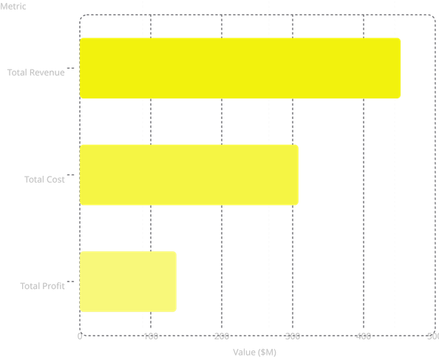
KEY INSIGHTS
What the Data Reveals
Revenue Is Concentrated
High Costs Compress Profit
A small subset of vendors drives the majority of total revenue — classic Pareto distribution applies
Certain high-revenue vendors carry disproportionate costs, significantly reducing their net contribution
452
Margins Remain Stable
Vendor Performance Varies Widely
308
Portfolio-wide profit margin holds steady at ~30%, indicating consistent pricing discipline
Significant disparity exists between top and bottom-tier vendors — signaling renegotiation opportunities
136
Notes:
9

Slide 10
CONCLUSION
Business Value & Impact
How the Dashboard Drives Value
Final Takeaway
Smarter Decision-Making
Data analytics transforms vendor management from a reactive process into a strategic advantage — enabling faster decisions, lower costs, and stronger partnerships.
Stakeholders gain real-time clarity on which vendors to prioritize, grow, or exit
Tools Mastered: SQL · Python · Power BI
Cost Optimization
Outcome: A production-ready portfolio dashboard that demonstrates end-to-end analytical thinking.
Identifies hidden cost drivers and enables targeted renegotiation with underperforming vendors
Scalable Vendor Evaluation
A repeatable analytics framework that can be extended to new vendors and time periods
Notes:
10

