Slide 1

DEPARTMENT OF
CHEMISTRY
Inductively Coupled Plasma-Mass Spectrometry
NAME : Dhanyashree H.R
MSc 1st Year
Analytical Chemistry
01JST23PAC007

Slide 2
CONTENTS
Introduction
Principle
Instrumentation
Sample preparation
Sample analysis
Application
Conclusion
Reference

Slide 3
INTRODUCTION
INDUCTIVELY COUPLED PLASMA MASS SPECTROPHOTOMETRY is a type of mass spectrophotometry which is capable of detecting metals and several non metals at concentration as low as parts per billion.
ICP-MS is a type of mass spectrometry that uses an inductively coupled plasma to ionise the sample which are then detected.
It can detect different isotopes of same element which makes it a versatile tool in isotopic labelling.
ICP-MS has greater speed , precision and sensitivity.

Slide 4
PRINCIPLE
This technology couples use of an ICP with MS for elemental analysis by generation of ions. The ICP is involved in generation of a high temperature plasma source at 10000 degree celcius , sample is passed. The elements in sample at such high temperature are ionised (Icp converts atoms of elements in sample into ion) and directed further into ms .
The ions enter into an electric field and are separated according to their mass/charge ratio by mass spectrometry . The mass spectrometry then sorts the ions according to their mass/charge ratio followed by directing them to an electron multiplier tube detector . The detector then identifies and quantifies each ion.

Slide 5
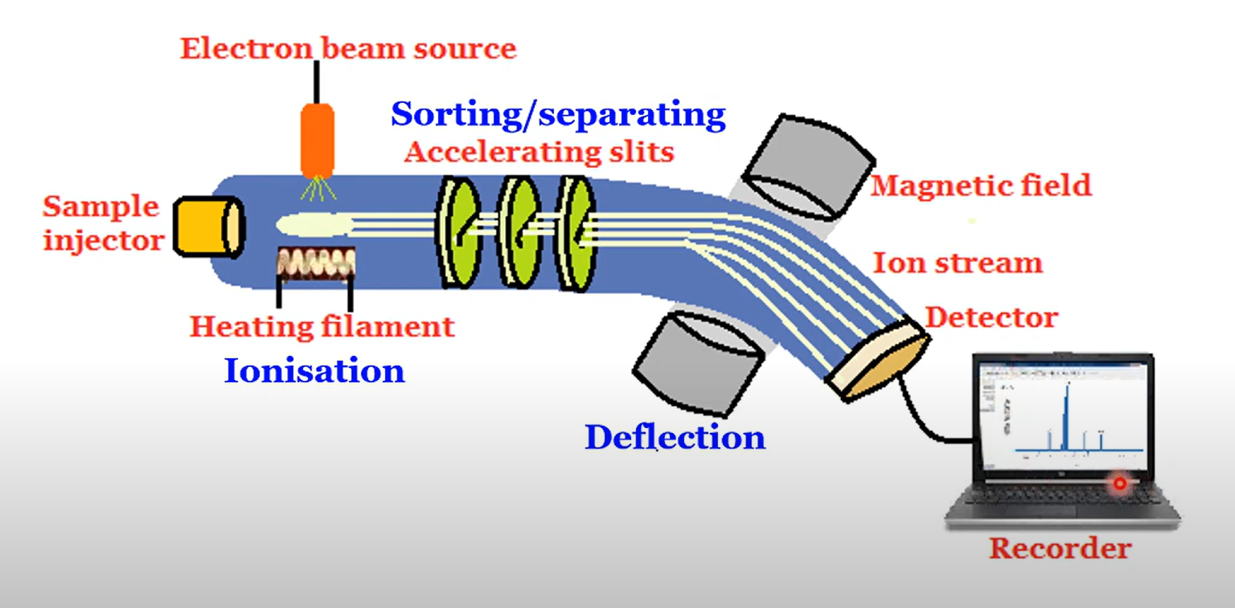
INSTRUMENTATION

Slide 6
INLET SYSTEM :-The sample is introduced and vapourised by heating .
IONISATION SOURCE :- sample molecules or atoms are ionised by knocking out one or more electrons (forms mixture of gaseous ions i.e., molecular ions and fragmented ions).
Electron bombardment – electrons generated in glowing filament bombard with sample molecules and produces a beam of light .
Thermal ionisation – atoms gets ionised when in contact with heated metal surface (filament such as Pt,W etc).
Different current arc – plasma discharge (ionised gas with positive ions and electrons is produced when two electrodes are perpendicular to axis of electric field with high potential difference)

Slide 7
ACCELERATOR :- The ions are accelerated and focused as a single beam by passing through accelerating slits of higher potential [~10000v] to lower potential [0v] .
MASS ANALYSER/SEPARATOR:- The ions are sorted and separated based on mass to charge ratio.
Quadropole – separation based on combination of radio waves and DC electric fields .
Magnetic sector – it uses magnetic field to deflect the ions based on the mass.
the lighter the ions [low M/Z ratio] are deflected more than the heavier ions [high M/Z ratio].
The high charged ions are deflected more than the low charged ions .

Slide 8
ION DETECTOR :- Electron multiplier, scintillation counter, faraday cup detector . Detects the number of ions entering the detector and produces electric current proportional to it .
RECORDER :- it records the relative abundance of each ion having specific mass/charge ratio to give a mass spectrum.
number of ions with that m/z ratio
Total number of ions detected
Relative abundance =
× 100

Slide 9
SAMPLE PREPARATION :-
ICP MS is mainly for liquid samples.
Total dissolved solids must be kept below 0.2%.
Common dissolution agents are nitric acid, perchloric acid ,hydrogen peroxide or various mixtures of these typically used for metals ,soils ,or sediments , minerals and biological samples .
The acid concentration in the final solution being presented to the instrument should ideally be 2-3% maximum . Appropriate corrosion resistant sample introduction components should be used for it .
Ultrapure reagents and milipores water and argon should be used for preparation and dilution . Reagents should not contaminate or interfere with the analysis .

Slide 10
SAMPLE ANALYSIS :-
Liquid samples are first nebulised in the sample introduction system , creating a fine aerosol that subsequently transferred to the argon plasma .
The high temperature plasma atomised and ionises the sample generating ions. Ions which are then extracted through the interface region and into a set of electrostatic lenses called the ion optics .
The ion optics focused and guides the ion beam into the quadropole mass analyser . The mass analyser separates ion according to their M/Z ratio and these ions are measured at the detector

Slide 11
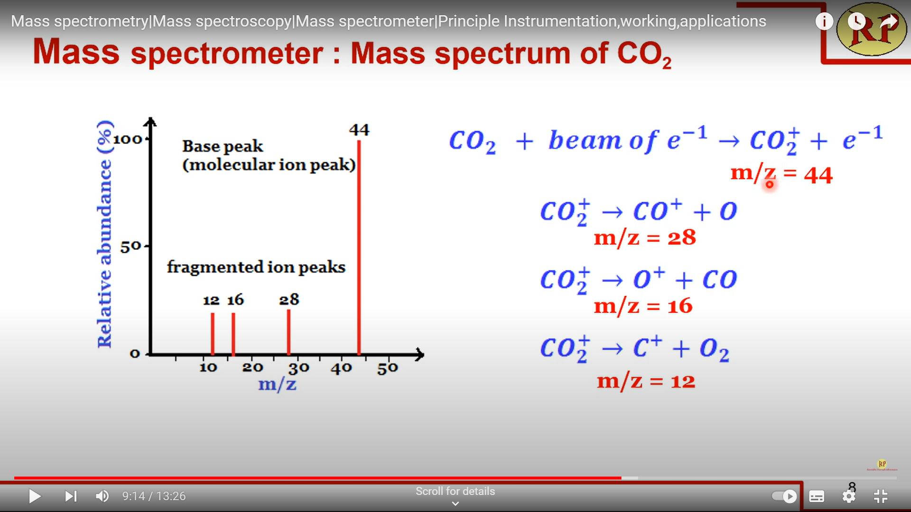
MASS SPECTRUM OF CO2 :

Slide 12
applications of icp-ms
It is mainly used in the medical and forensic fields, particularly in toxicology.
It is also used to analyze blood, urine, plasma, and RBC samples.
This instrument is mainly used in the environmental field, including soil and water analysis.
In the forensic field, it is used for glass analysis.

Slide 13
It is widely used in geochemistry for radioactive dating to analyze the relative abundance of different isotopes, mainly uranium and lead.
In pharmaceutical industries, it is used for detecting inorganic impurities in pharmaceuticals and their ingredients.

Slide 14
Conclusion
ICP-MS is a powerful analytical technique that provides exceptional sensitivity, accuracy, and versatility for the detection and quantification of a wide range of elements and isotopes. Its applications span various fields, making it an indispensable tool for researchers and analysts.

Slide 15
Reference
Instrumental Methods of Chemical Analysis by Gurudeep R. Chatwal.

Slide 16


