Slide 1

Classifying Corporate Announcements
This presentation provides a detailed overview of the classification and clustering of corporate announcements, as well as the model details, dataset, accuracy, and future work associated with this process.

Slide 2

Efficient Few-Shot Learning
1
SetFit Model
This is a SetFit model utilized for Text Classification. It leverages the sentence-transformers/all-mpnet-base-v2 as its Sentence Transformer embedding model and a LogisticRegression instance for classification.
2
Fine-Tuning
The model has been fine-tuned with contrastive learning techniques, enhancing its ability to accurately cluster announcements based on their labels.
3
Classification Head
A classification head has been trained using features from the fine-tuned Sentence Transformer, further enhancing the model's capability.

Slide 3
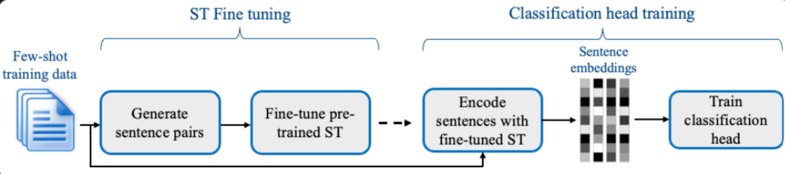
Model details
SetFit is designed with efficiency and simplicity in mind. SetFit first fine-tunes a Sentence Transformer model on a small number of labeled examples (typically 8 or 16 per class). This is followed by training a classifier head on the embeddings generated from the fine-tuned Sentence Transformer.
SetFit takes advantage of Sentence Transformers’ ability to generate dense embeddings based on paired sentences.

Slide 4
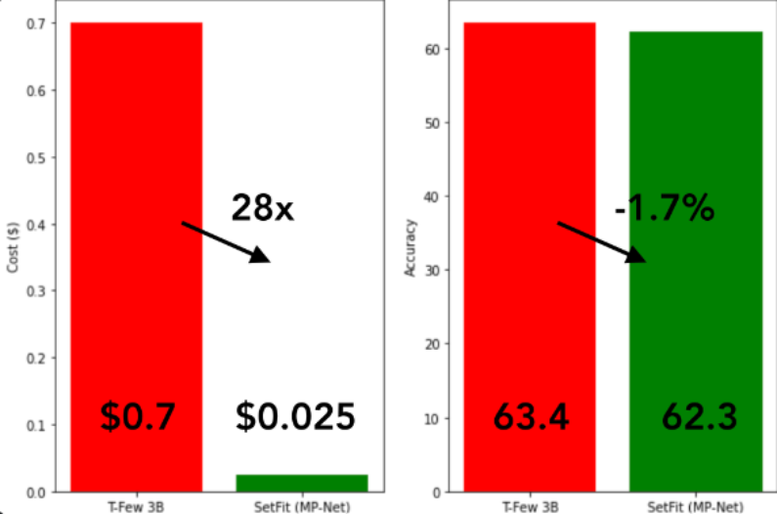
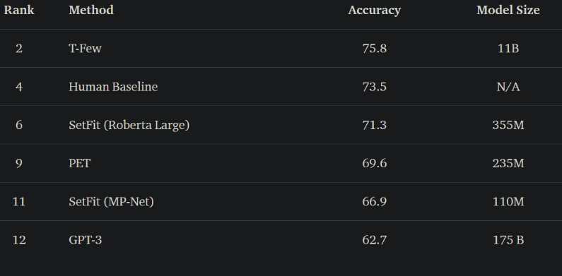
Why SetFit Model?
SetFit performs on par or better than state of the art few-shot regimes on a variety of benchmarks. On RAFT, a few-shot classification benchmark, SetFit Roberta with 355 million parameters outperforms PET and GPT-3. It places just under average human performance and the 11 billion parameter T-few - a model 30 times the size of SetFit Roberta. SetFit also outperforms the human baseline on 7 of the 11 RAFT tasks
SetFit achieves high accuracy with relatively small models, it's blazing fast to train and at much lower cost. For instance, training SetFit on an NVIDIA V100 with 8 labeled examples takes just 30 seconds, at a cost of $0.025. By comparison, training T-Few 3B requires an NVIDIA A100 and takes 11 minutes, at a cost of around $0.7 for the same experiment - a factor of 28x more.

Slide 5
Dataset Overview
The dataset for corporate announcement classification is meticulously curated, combining manual labeling of corporate announcements by scraping from BSE website and data generated by ChatGPT.
The dataset covers a wide spectrum of corporate communications, including press releases, business updates, investor meetings, earnings calls, ESOP/ESPS announcements, legal matters, research findings, and resignations.
We employed a set of nine labels for more refined classification, ensuring comprehensive coverage of all types of corporate announcements. These labels encompass a wide spectrum, including press releases, business updates, investor meetings, earnings call transcripts, ESOP/ESPS announcements, legal matters, research findings, and resignations. This approach allows for a thorough and nuanced understanding of various corporate communication scenarios, providing a robust foundation for effective classification and analysis.

Slide 6
Corporate Announcement Labels
Press Release / Media Release (Label 0)
Business Updates (Label 1):
"Announcement under Regulation 30 (LODR)-Press Release / Media Release"
"Updates - Corporate Insolvency Resolution Process"
Investor Meetings/Board Meeting (Label 2)
Earnings Call Transcript (Label 3)
"Board Meeting - Un-Audited Financial Results For The Quarter Ended June 30, 2023"
"Earnings Call - Intimation"

Slide 7
Corporate Announcement Labels
ESOP/ESPS (Label 4)
Violation/Litigation/Penalty (Label 5)
"Grant Of Stock Options Under The Employee Stock Option Scheme Of The Bank (ESOP Scheme)."
"Intimation Regarding Change in Compliance Officer Under Regulation 30 Of SEBI (Listing Obligations and Disclosure Requirements) Regulations"
Research (Label 7)
Resignation (Label 8)
"Energizing Change: Infosys-HFS Research Unveils Companies' Top 3 Priorities in the Energy Transition Era,"
"Resignation Of Smt. Nita M. Ambani From The Board Of The Company - Disclosure Dated August 28"

Slide 8

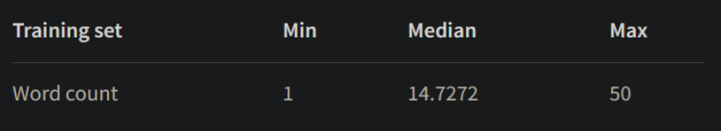
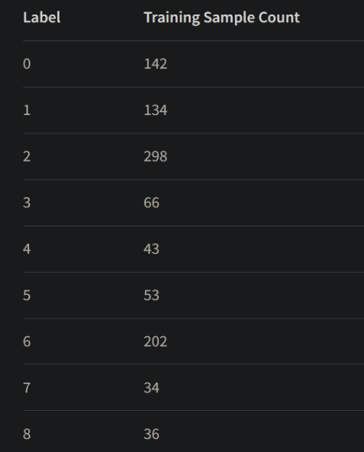
Dataset Details
The dataset contains corporate announcements with a minimum length of 1 and a maximum length of 50.
In this chart, we can see the distribution of data across different labels. It provides valuable insights into the composition of the dataset and helps us understand the patterns and trends within each label category.

Slide 9

Model Accuracy
95.58
Training Accuracy
Upon training for 2 epochs, the model achieved an impressive accuracy of 95.58% on nearly 40000 pairs generated from sentence generator.
This remarkable performance demonstrates the effectiveness and capability of the model in understanding and generating coherent sentences.
By leveraging advanced techniques and extensive training, the model has been able to achieve high levels of accuracy and generate meaningful text.

Slide 10
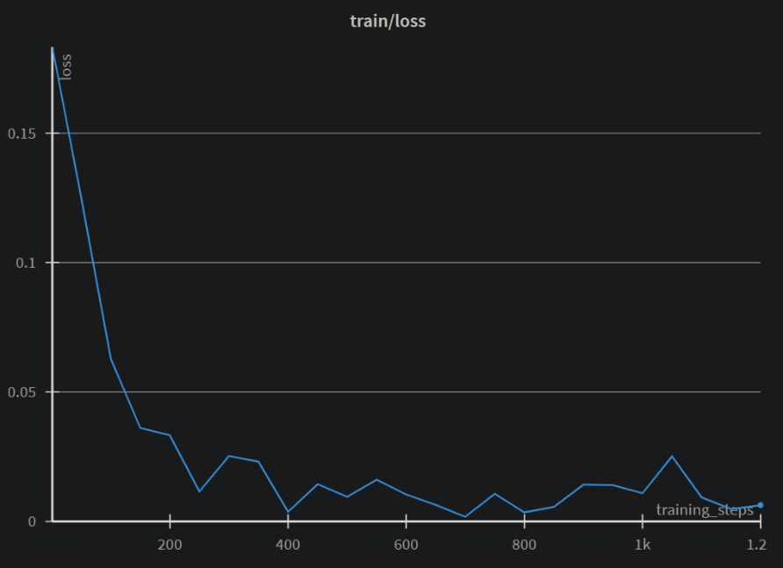
Training_steps vs Loss Graph
This is the training_steps vs loss graph in which we can see significant decrease in loss as the training_steps goes on.

Slide 11

Future Work
Enhanced Training
Expanded Datasets
Continuous training and refinement to improve the model's performance and accuracy for real-time applications.
Incorporating larger and more diverse datasets to ensure robustness and adaptability across various corporate announcement scenarios.

Slide 12
THANK YOU

