Slide 1
AICAD
Natural Language 3D CAD Generation
Bridging generative AI and parametric boundary-representation modeling workflows. Speak in prose, engineer in solid code models, compile watertight STEP assets.

Slide 2
AICAD PIPELINE
The Problem & Opportunity
The Limitations Today
• High Learning Curve: Traditional CAD programs require deep GUI modeling and coordinates training.
• Static AI Output: Existing AI 3D model generators export triangulated polygonal meshes (STL/OBJ).
• Non-Parametric: Meshes cannot be cleanly edited, resized, hollowed, or fitted with holes in professional engineering workflows.
• Industrial Mismatch: CNC, injection molding, and aerospace tooling require mathematically precise CAD formats (STEP/IGES).
The AICAD Solution
• Prose-to-CAD: Express structural intent in natural language description phrases.
• Deterministic Code: Translation of description into build123d Python script models rather than directly guessing vertices.
• Watertight Solid Compilation: Real-time compiling of standard geometries using OpenCascade CAD kernel.
• Direct B-Rep Exports: Produces standard STEP files as primary source of truth, retaining editable curves, faces, and design history.

Slide 3
AICAD PIPELINE
System Architecture & Pipeline Flow
1. Input
• User describes part via terminal or the interactive Web UI.
• Prompts can specify dimensions, holes, fillets, and constraints.
2. Translate
• Gemini CLI Agent wakes up and parses the prompt.
• Generates verified Python script using the build123d library syntax.
3. Compile
• Subprocess runner calls OCP (OpenCascade) to build the solids.
• Validates volume and face watertight status, writing STEP.
4. Export
• Converts parent STEP to STL (3D Printing mesh), 3MF (metadata slicer), or DXF (2D Laser CNC).
• Loads details to Web UI.

Slide 4
AICAD PIPELINE
Under the Hood: build123d & OpenCascade
OpenCascade Technology (OCP)
• Industrial standard B-Rep (Boundary Representation) geometric kernel.
• Calculates exact curves, arcs, splines, and boolean cuts programmatically.
• Provides solid geometry structures with high tolerances and precision.
• Guarantees that files export cleanly to SolidWorks, Fusion 360, and CNC tooling.
Why build123d?
• High-level Python wrapper with clear, readable CAD modeling semantics.
• Supports algebraic operators (extrude, revolve, loft, sweep, sweep_path).
• Coordinate system helper frames allow easy hole alignments and relative offsets.
• Ideal for AI code generation due to consistent structures, object-oriented APIs, and descriptive docstrings.

Slide 5
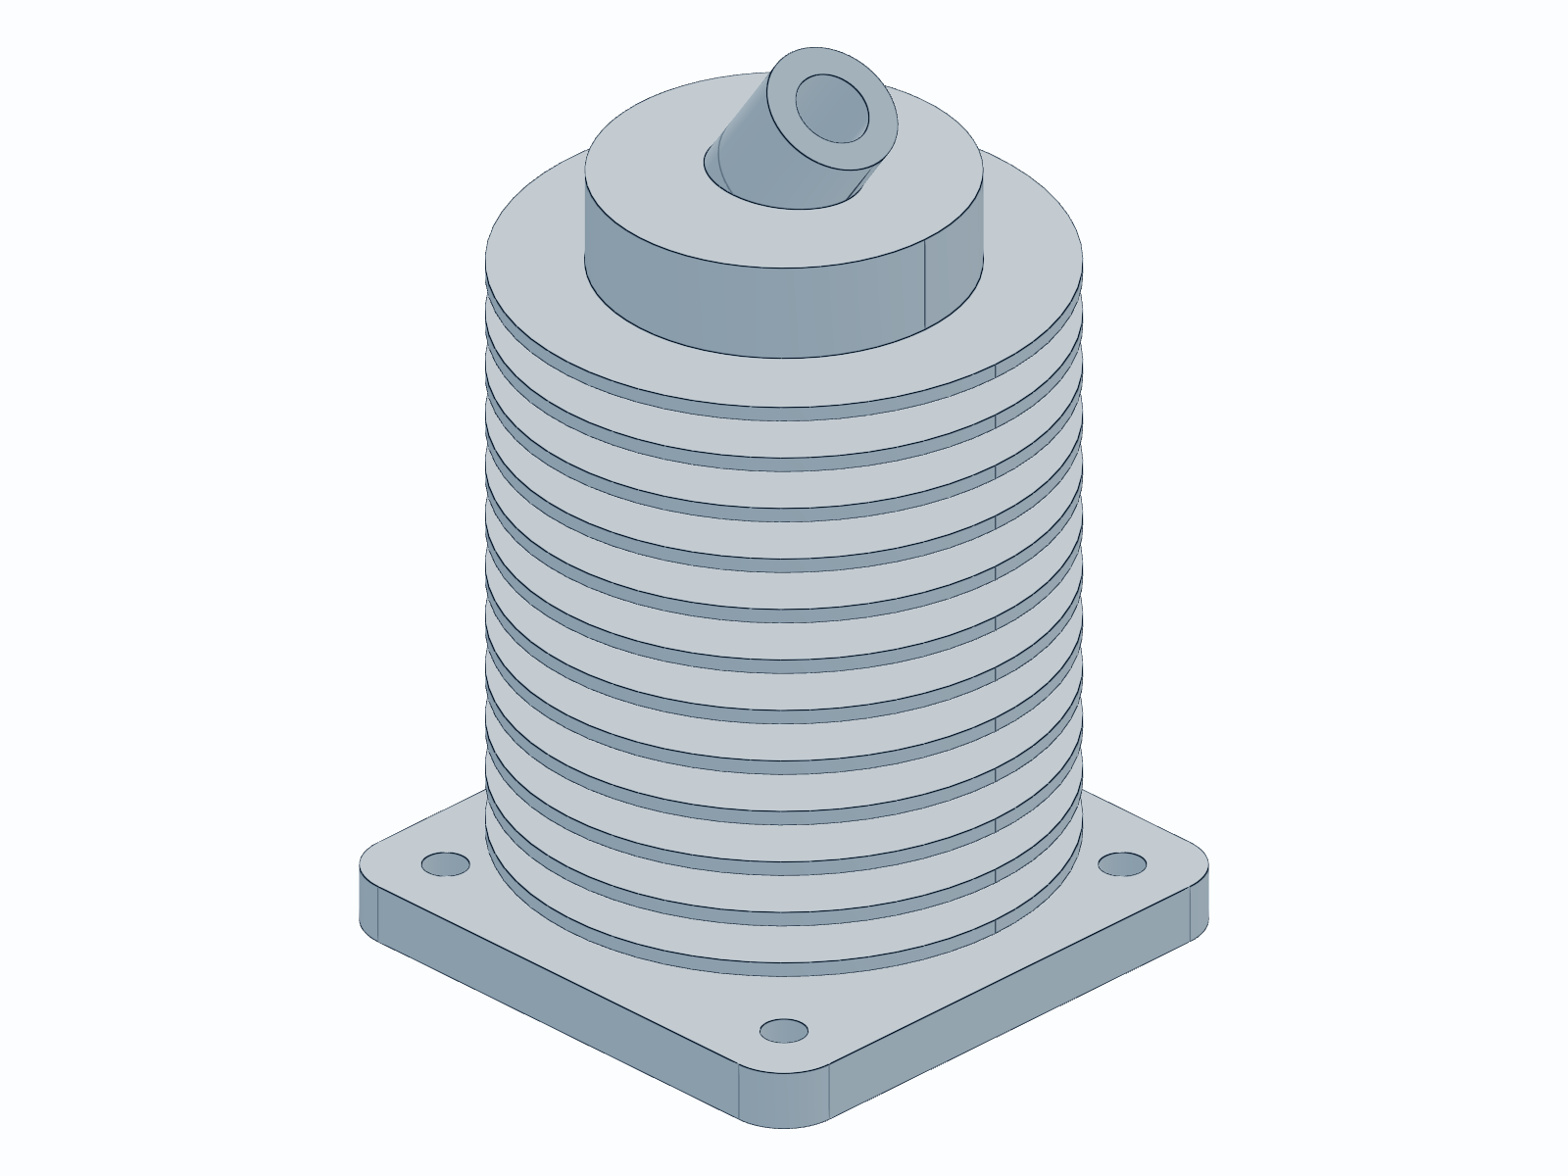
AICAD PIPELINE
Interactive Web User Interface
A Modern Browser Experience
• Live Progress Tracker: Real-time visibility into agent states (Queued -> Coding -> Compiling -> Rendering -> Completed).
• Interactive WebGL Viewer: Three.js integration displays converted STL models directly in the viewport. Drag to rotate, scroll to zoom, right-click to pan.
• Code & Render Side-by-Side: View the compiled python source code and the rendered rasterized snapshot side-by-side.
• Direct Artifact Downloads: Single-click download links for industrial-grade STEP files, STL meshes, and raw python builders.
• Status Log Streaming: Raw compilation stderr/stdout output streams for instant developers debugging.

Slide 6
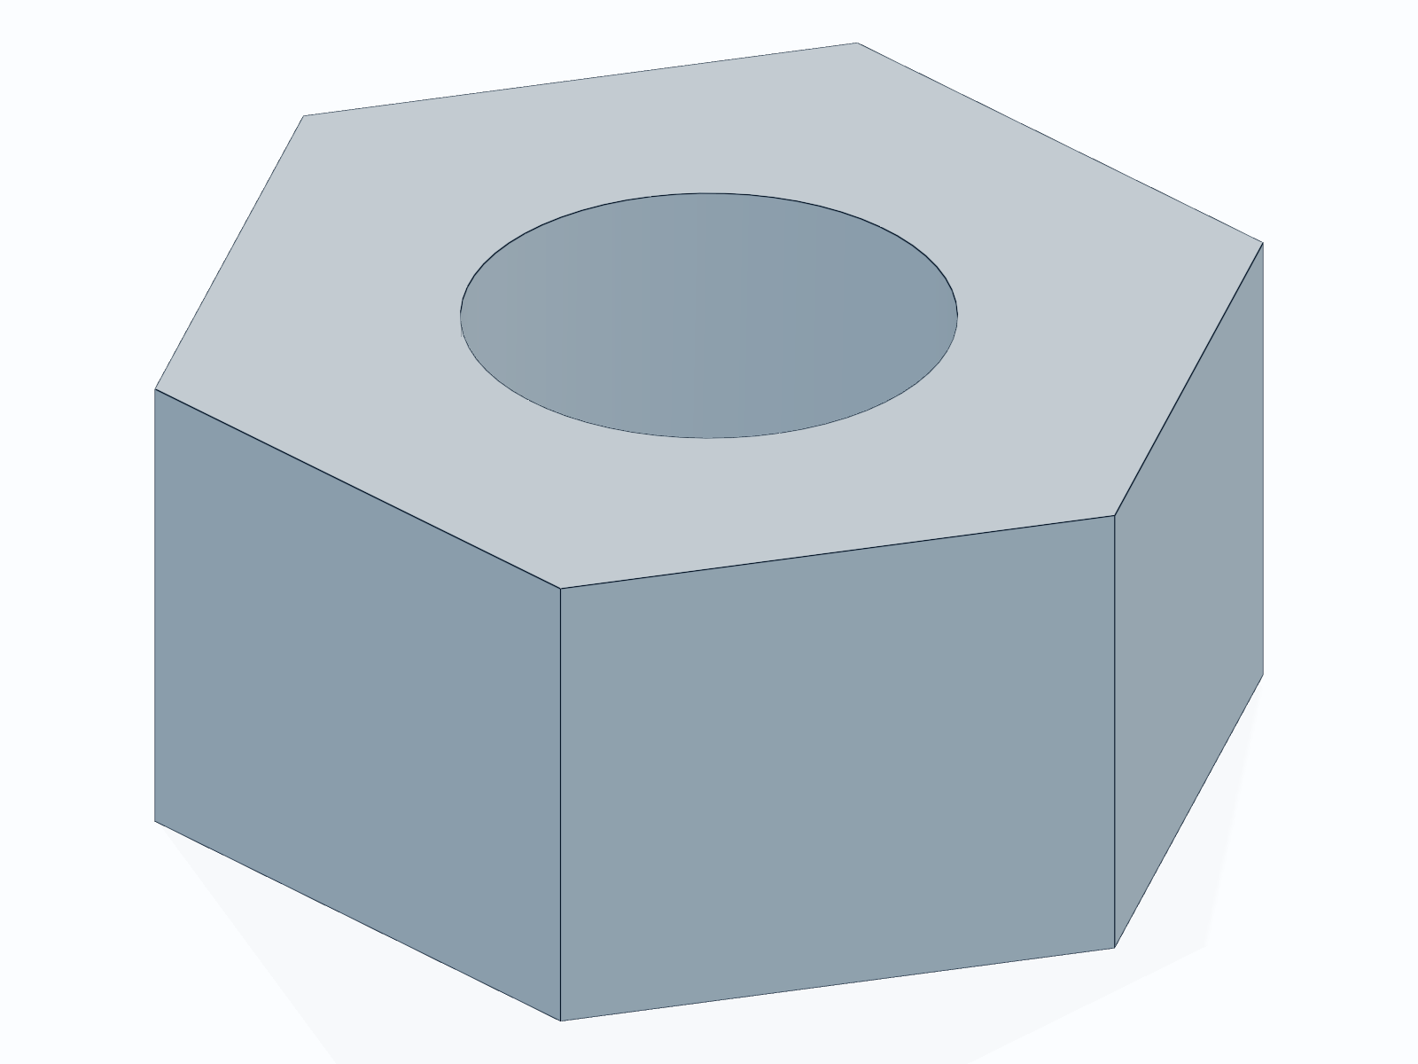
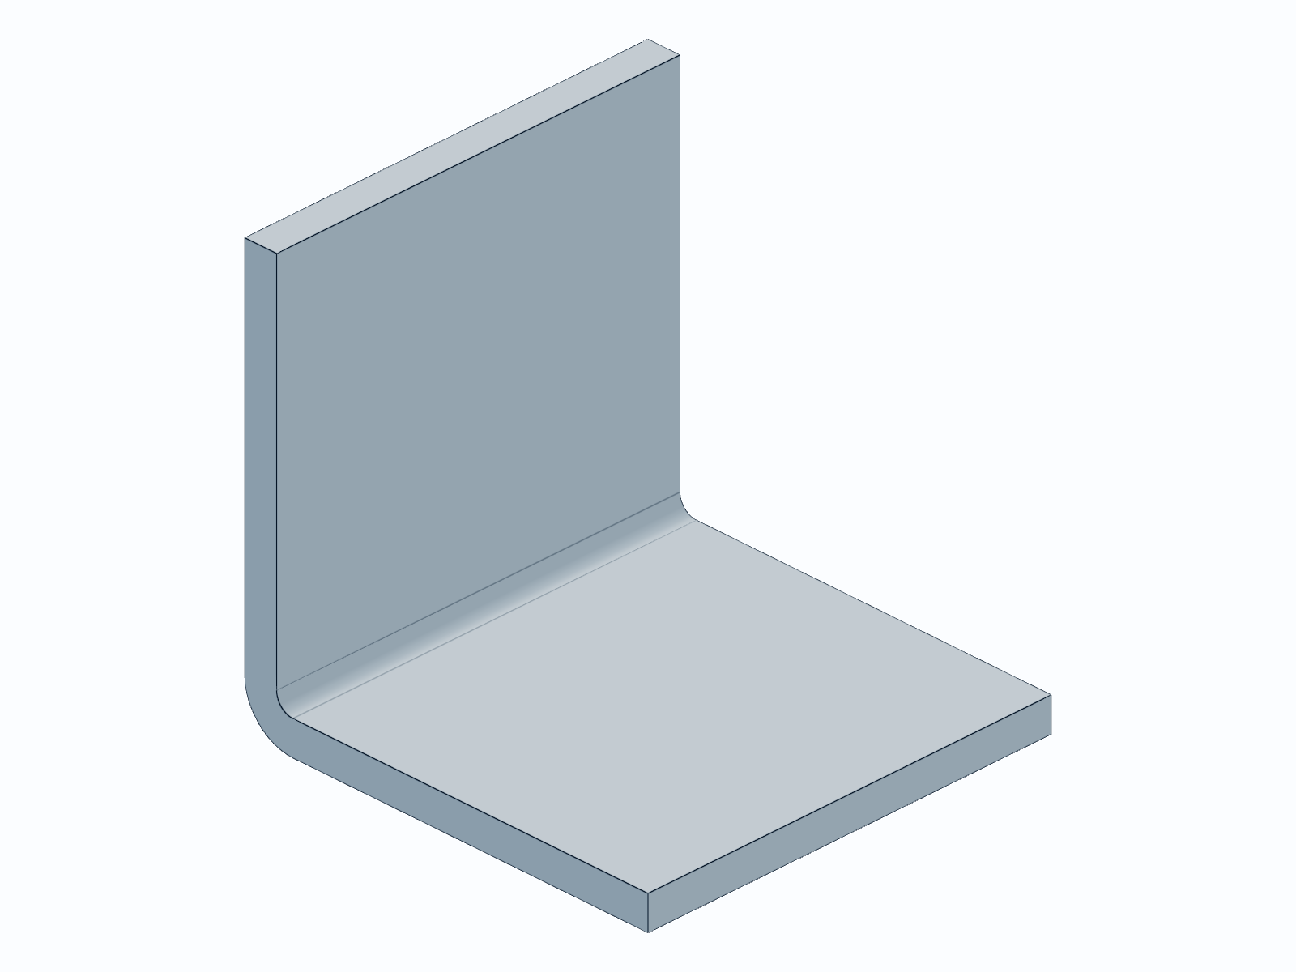
AICAD PIPELINE
Case Studies & Compiled Examples
Parametric Models Produced
• Engine Cylinder (Complex Parametric solid):
- A central piston cylinder chamber with radial cooling fins.
- Bolt circle attachment mounting flanges.
• L-Bracket (Structural attachment):
- 50mm leg lengths, 4mm thick solid face.
- Auto-positioned M4 countersunk holes.
• M5 Hex Nut (Mechanical standard):
- Exact 10mm flat-to-flat distance hex profile.
- Inner clearance cylinder with thread tolerancing.
Generated M5 Hex Nut
Generated L-Bracket

Slide 7
AICAD PIPELINE
Conclusion & Future Roadmap
Project Achievements
• Prototyped a complete Text-to-CAD translation pipeline combining LLMs with build123d.
• Established automated execution, inspection, and format conversion workflows.
• Designed and implemented a responsive, real-time web interface.
• Created a zero-install local environment powered by uv package manager.
The Road Ahead
• Constraint-Based Assemblies: Move from individual solid parts to complex mechanical assemblies with mated joints.
• Fine-Tuned Modeling Agents: Train specialized models on standard libraries and engineering handbook databases.
• Automated Technical Blueprints: Generate standard 2D technical drawings with automatic dimension callouts in DXF.
• CAD Integrations: Directly plug output scripts into professional CAD platforms (FreeCAD, Fusion 360, Onshape).

