Slide 1

Parallel DSCNN–Vision Transformer Fusion with Regularized ELM for Brain Tumor MRI Classification
NAME | ROLLNO
VYSHNASRI | 24BD1A05AT
KRISHNA ADITHYA | 24BD1A05AX
ALAHARI DEDEEPYA | 24BD1A05A3
LALITHYA | 24BD1A05AE
SHARATH | 24BD1A05AR

Slide 2
Abstract
Brain tumor diagnosis from MRI images is a critical and time-sensitive task that requires accurate and reliable interpretation. Existing CNN-based models effectively extract local spatial features but have limited capability to capture global contextual information, while Vision Transformers model global dependencies but may overlook fine local details. We propose a Parallel PDSCNN Vision Transformer Fusion framework integrated with Regularized Ridge Extreme Learning Machine (RRELM) for efficient and explainable brain tumor classification. The MRI image is simultaneously processed by the PDSCNN branch for local feature extraction and the Vision Transformer branch for global contextual learning. The extracted features are fused and classified using RRELM, improving classification accuracy with reduced computational complexity. The framework integrates Grad-CAM and Vision Transformer Attention Maps to provide visual explanations by highlighting tumor regions and attention patterns influencing the prediction. The proposed model classifies MRI images into Glioma, Meningioma, Pituitary Tumor, and No Tumor, providing an accurate, efficient, and transparent computer-aided diagnostic solution for clinical decision support.

Slide 3
Base Paper
A Hybrid Explainable Model Based on Advanced Machine Learning and Deep Learning Models for Classifying Brain Tumors Using MRI Images (Scientific Reports, Nature, 2025)
Core Idea:
Uses Parallel Depth Wise Separable CNN (PDSCNN) as the feature extraction network. Employs Regularized Extreme Learning Machine (RRELM) as the classifier. Focuses on efficient extraction of local spatial features. Achieves high classification accuracy with low computational complexity.
Suitable for lightweight medical image classification.
Why it’s a good fit as your base paper:
Lightweight CNN architecture
Efficient RRELM classifier
Explainable AI framework
High classification accuracy
Suitable foundation for further enhancement

Slide 4
Literature Survey
Author | Method | Contribution | Limitation
Deepak & Ameer (2019) | Transfer Learning (GoogLeNet) | High MRI classification accuracy | Captures limited global context
Dosovitskiy et al. (2021) | Vision Transformer | Global contextual learning | Requires large datasets
Nahiduzzaman et al. (2025) | PDSCNN + RRELM + SHAP | Lightweight explainable framework | Uses only CNN features and SHAP explanation
Research Gap
CNNs capture only local spatial features.
Vision Transformers alone are computationally expensive.
Existing hybrid models mainly focus on improving accuracy.
Most methods use dense neural classifiers.
Explainability is generally limited to a single visualization technique.
Few frameworks combine PDSCNN, Vision Transformer, RRELM, Grad-CAM, and Attention Maps in one architecture.

Slide 5
Existing System
Current brain tumor diagnostic systems primarily utilize Convolutional Neural Networks (CNNs), particularly Parallel Depthwise Separable CNN (PDSCNN) architectures, for automatic MRI image classification.
These models focus on extracting local spatial features to identify brain tumor categories from MRI scans. Publicly available benchmark MRI datasets containing Glioma, Meningioma, Pituitary Tumor, and No Tumor images are commonly used for training and evaluation.
Existing frameworks employ Regularized Ridge Extreme Learning Machine (RRELM) as the classifier and SHAP for providing basic model interpretability by identifying feature contributions during prediction.

Slide 6
Advantages of Existing System
Achieves high classification accuracy of 99% with a lightweight PDSCNN architecture.
Reduces computational complexity through Depthwise Separable Convolutions.
RRELM provides faster training and inference compared to conventional neural classifiers.
SHAP improves model transparency by explaining feature contributions.
Suitable for efficient computer-aided brain tumor diagnosis.

Slide 7
Disadvantages of Existing System
Extracts only local spatial features and lacks global contextual understanding.
Does not incorporate Vision Transformer for long-range dependency learning.
Explainability is limited to SHAP and does not provide spatial heatmap visualization.
Hybrid feature learning is absent, reducing representation capability.
Performance may decrease for complex MRI images with subtle tumor variations.

Slide 8
Proposed System
The proposed framework is an end-to-end hybrid deep learning model for accurate and explainable brain tumor classification from MRI images.
MRI Preprocessing: MRI images are resized, normalized, and augmented to improve image quality and model robustness.
Parallel Feature Extraction: The input MRI image is simultaneously processed by a Parallel CNN to extract local spatial features and a Vision Transformer (ViT) to capture global contextual information.
Feature Fusion: The complementary features from both branches are fused to create a rich hybrid feature representation.
Brain Tumor Classification: The fused features are classified using Regularized Ridge Extreme Learning Machine (RRELM) into Glioma, Meningioma, Pituitary Tumor, or No Tumor.
Explainable AI: Grad-CAM and Vision Transformer Attention Maps visualize the regions and attention patterns responsible for the prediction, providing transparent clinical decision support.

Slide 9
Advantages of Proposed System
Combines local CNN features and global ViT features for improved classification.
Hybrid feature fusion enhances the representation of complex brain tumor characteristics.
RRELM enables fast and computationally efficient multi-class classification.
Grad-CAM and Attention Maps provide comprehensive visual explanations for predictions.
Improves diagnostic reliability and supports clinicians with transparent AI-assisted decision-making.
Lightweight architecture suitable for real-world medical imaging applications.

Slide 10
Disadvantages of Proposed System
Hybrid CNN–ViT architecture increases implementation complexity.
Vision Transformer branch requires additional computational resources.
Feature fusion and dual explainability introduce extra inference overhead.
Performance depends on the availability of high-quality annotated MRI datasets.
Requires careful tuning of fusion and classifier parameters for optimal performance.

Slide 11
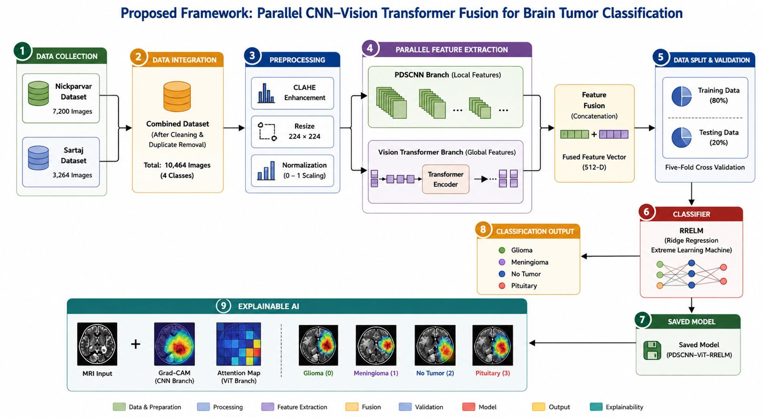
Architecture diagram

Slide 12
Architecture Diagram Explanation
Step | Module | Description
1 | Data Collection | Nick parvar Dataset • Sartaj Dataset
2 | Data Integration | Merge Datasets • Remove Duplicates • Combined Dataset
3 | Preprocessing | CLAHE • Resize (224×224) • Normalization
4 | Parallel Feature Extraction | PDSCNN: Local Features • ViT: Global Features
5 | Feature Fusion | Concatenate Local + Global Features (512-D)
6 | Data Split & Validation | 80% Training • 20% Testing • 5-Fold Cross Validation
7 | Classifier (RRELM) | Classifies Fused Features
8 | Saved Model | PDSCNN + ViT + RRELM Model
9 | Classification Output | Glioma • Meningioma • Pituitary • No Tumor
10 | Explainable AI | Grad-CAM • ViT Attention Map

Slide 13
THANK YOU!

