Slide 1
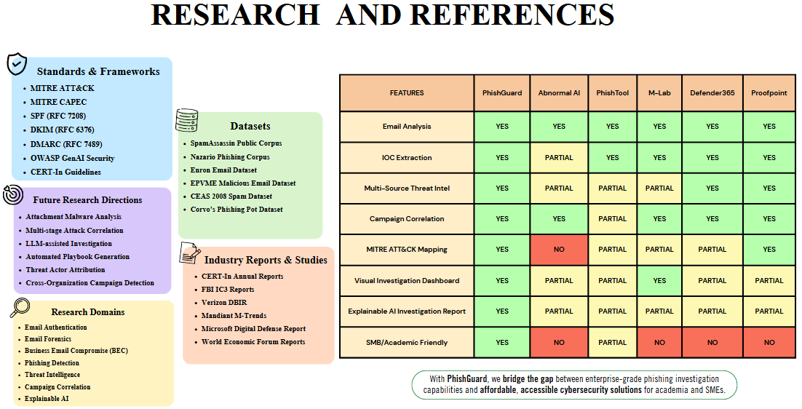
RESEARCH AND REFERENCES
Standards & Telemetry
• MITRE ATT&CK and CAPEC
FEATURES | E-TAP | Abnormal AI | PhishTool | M-Lab† | Defender 365 | Proofpoint
Email analysis | YES | YES | YES | NV | YES | YES
IOC / intel enrichment | VT / APIs | Native intel | NV | NV | Native intel | Native intel
Dynamic attachment analysis | Win11 VM | NV | NV | NV | Sandbox | Sandbox
QR phishing links | YES | YES | NV | NV | YES | YES
Campaign correlation | YES | NV | NV | NV | Plan 2 | YES
Investigation reports | Evidence + AI | AI analyst | NV | NV | Plan 2 | Workbench
RAG over stored cases | YES | NV | NV | NV | NV | NV
Visual investigation | Graph | Dashboard | NV | NV | Explorer | Workbench
Review / PDF / JSON | YES | NV | NV | NV | NV | NV
• SPF — RFC 7208
• DKIM — RFC 6376
• DMARC — RFC 7489
Datasets & Validation
• OWASP GenAI Security
• SpamAssassin debugging fixtures
• Microsoft Sysmon event telemetry
• Synthetic EML/MSG and QR fixtures
• Macro, PII and provider-response tests
Current Architecture
• Broader phishing benchmarks: planned
• EML/MSG + Gmail original retrieval
Fixture tests are not a production benchmark.
• Static + Win11 VM attachment checks
• Sysmon: ~64 eligible behavior rules
• QR decoding + Tesseract OCR
• XGBoost triage + Gemini assessment
Technical & Industry Sources
• IOC campaigns + graph diffusion
• Microsoft Sysmon documentation
• RAG case chat; evidence reports
• VirusTotal / AbuseIPDB API docs
• MITRE ATT&CK knowledge base
Investigation Scope
• OWASP GenAI Security guidance
• Header authentication and routing
• CERT-In reports; Verizon DBIR
• Static + dynamic attachment behavior
• Mandiant M-Trends research
• QR phishing and image evidence
• IOC reputation and case correlation
YES = documented capability; NV = not verified, not absence. Editions and add-ons vary.
• Evidence-based AI; MITRE mapping
† M-Lab identity is unspecified. Capability comparison, not a detection-performance benchmark.
• Review, exports and retention
E-TAP combines forensic evidence, VM behavior and contextual AI
in one workspace for research and analyst investigation.
Notes:
Updated 18 October 2026. User supplied the original image reference. Preserve one-slide layout and exact reference aspect ratio. E-TAP features are based on study.txt and current code; Windows 11 VM, Sysmon operational logs and approximately 64 eligible behavior rules are user-confirmed. No geolocation shown. No accuracy, price or production-readiness comparison is claimed.
Comparison method: YES or descriptive cells reflect a documented product role; NV means the exact capability was not verified from the sources reviewed, never absence. Editions/add-ons may change capability. No comparative product testing was performed. PhishTool's basic email-analysis role is supplied in the user's original slide; its current public site/docs returned access errors during this task, so new feature claims remain NV. M-Lab identity is unspecified, so its entire column remains NV. RAG means retrieval over stored case context, not generic chat; other products' generic AI features are not assumed to prove the same implementation. Review/PDF/JSON is a combined workflow row; NV does not mean any individual function is absent.
Primary sources reviewed:
[1] MITRE ATT&CK: https://attack.mitre.org/
[2] SPF RFC 7208: https://www.rfc-editor.org/info/rfc7208/
[3] DKIM RFC 6376: https://www.rfc-editor.org/info/rfc6376/
[4] DMARC RFC 7489: https://www.rfc-editor.org/info/rfc7489/
[5] OWASP GenAI: https://genai.owasp.org/
[6] Microsoft Sysmon: https://learn.microsoft.com/en-us/sysinternals/downloads/sysmon
[7] Abnormal platform: https://abnormal.ai/platform/overview
[8] Abnormal AI Data Analyst: https://abnormal.ai/platform/ai-data-analyst
[9] Abnormal QR: https://abnormal.ai/fr/newsroom/press-releases/qr-code-detector
[10] Microsoft Safe Attachments: https://learn.microsoft.com/en-us/defender-office-365/safe-attachments-about
[11] Microsoft campaigns: https://learn.microsoft.com/en-us/defender-office-365/step-by-step-guides/track-and-respond-to-emerging-threats-with-campaigns
[12] Microsoft QR phishing protection: https://learn.microsoft.com/en-us/shows/microsoft-sentinel-defender-xdr-virtual-ninja-training/qr-code-phishing-protection
[13] Proofpoint Core Email Protection: https://www.proofpoint.com/us/products/email-protection
[14] Proofpoint sandbox / threat-intel scope: https://www.proofpoint.com/uk/products/advanced-threat-protection/targeted-attack-protection
[15] Proofpoint QR: https://www.proofpoint.com/us/blog/email-and-cloud-threats/malicious-qr-code-detection-takes-giant-leap-forward
Industry reports are background research references retained from the supplied slide, not sources of performance statistics on this slide. Dataset box names only local debugging/test fixtures; it does not assert that the model was trained on all named research datasets. Native PowerPoint text, comparison table and template boxes are editable. Small icons reuse cropped original reference artwork.

