Slide 1

Intro To Cyber Labs: AI
Dr David Glance

Slide 2
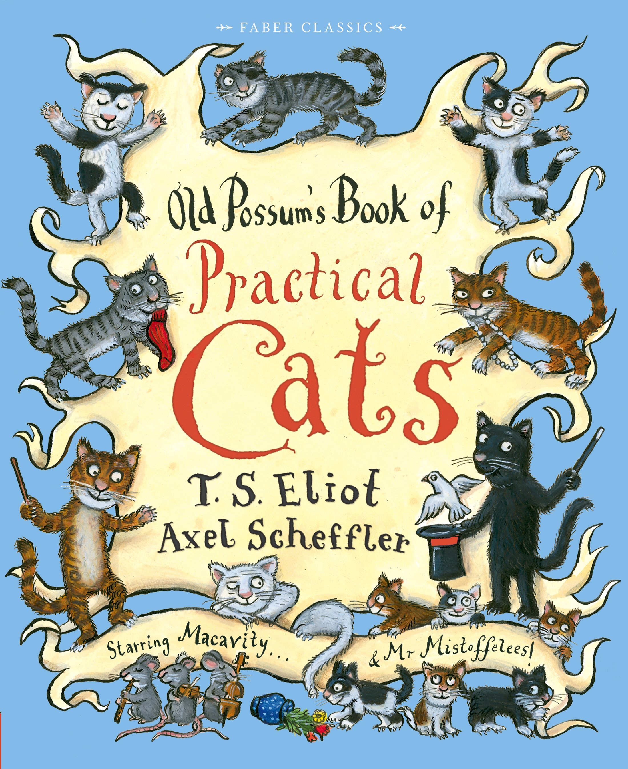
A practical guide to cats cybersecurity

