Slide 1

Raspberry PI and AI Stream
ZAS
Academy
Dr. Roohi Banu
Mr. Fakruddin Mohammed

Slide 2
Day 2.
Raspberry PI - AI, ML, DL & RL Introduction
ZAS
Academy
Dr. Roohi Banu
Mr. Fakruddin Mohammed

Slide 3

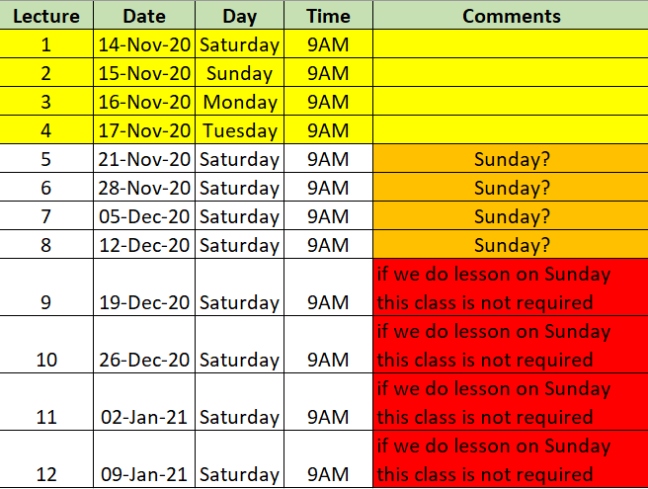

Z A S A C A D E M Y
Raspberry PI - Machine and Deep Learning
(12 Weeks ADVANCED Course for Secondary & College Students)
@78 99 11 222 5
Week1
Week2
Week3
Week4
Week5
Week6
AI Introduction & ML/DL Life Cycle
Data Handling (Pandas & Numpy)
Data Handling & Visualization (matplotlib)
Probability & Statistics (Variable Selection)
Regression
Classification
Course content may be altered depending on participant needs & speed of grasping power
Week7
Week8
Week9
Week10
Week11
Week12
Artificial Neural Networks & Backpropagation
2 Layers Neural Networks & CNN Intuition
Deep Learning CNN & Raspberry PI
Deep Learning CNN & Raspberry PI
Deep Learning CNN & Raspberry PI
Deep Learning CNN & Raspberry PI
Live ZOOM Lectures from 14-Nov:
Natural Language Processing – NLP - ???
At the end of course participants will have
Thorough & deeper understanding of AI/ML/DL (Neural Networks)
Seen full end-to-end life cycle of Data Science Projects
Built at least 1 Deep Learning OBJECT DETECTION model from SCRATCH end-to-end and deploy on to PI

Slide 4
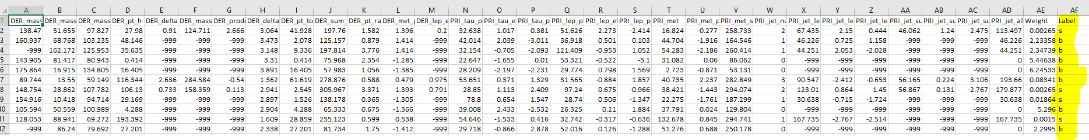
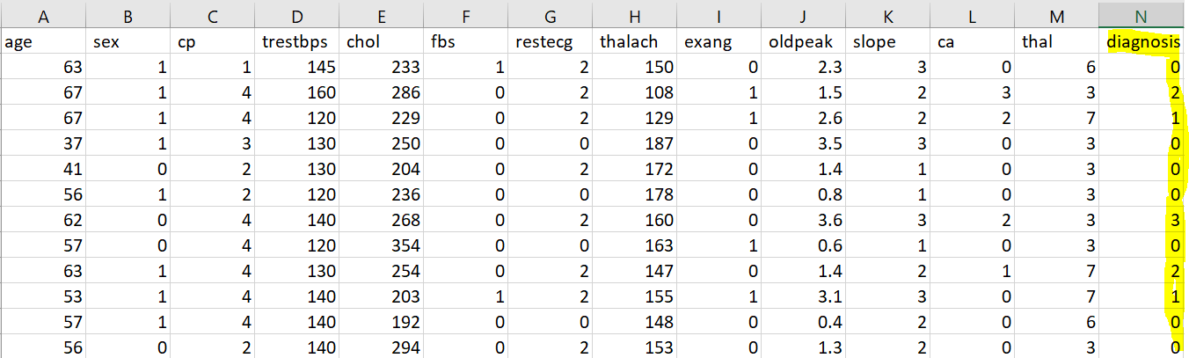
Scene Setting
Existence of God’s Particle (Data from CERN Laboratory)
Heart Disease Data
https://blogs.nvidia.com/blog/2016/07/29/whats-difference-artificial-intelligence-machine-learning-deep-learning-ai/

Slide 5
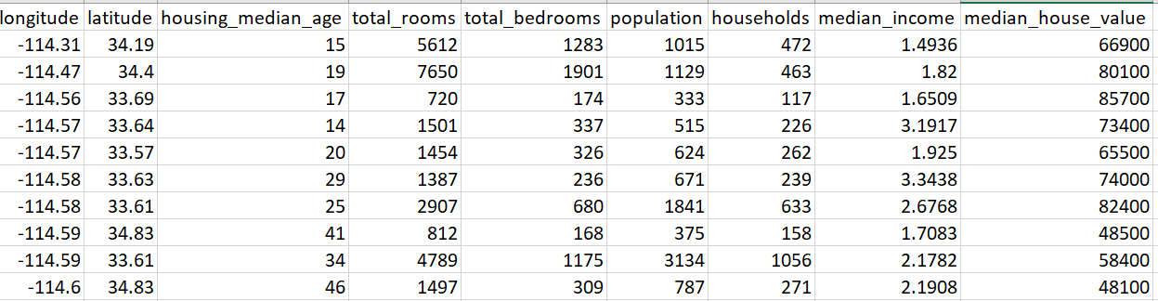
Scene Setting
House Pricing Data
https://blogs.nvidia.com/blog/2016/07/29/whats-difference-artificial-intelligence-machine-learning-deep-learning-ai/

Slide 6
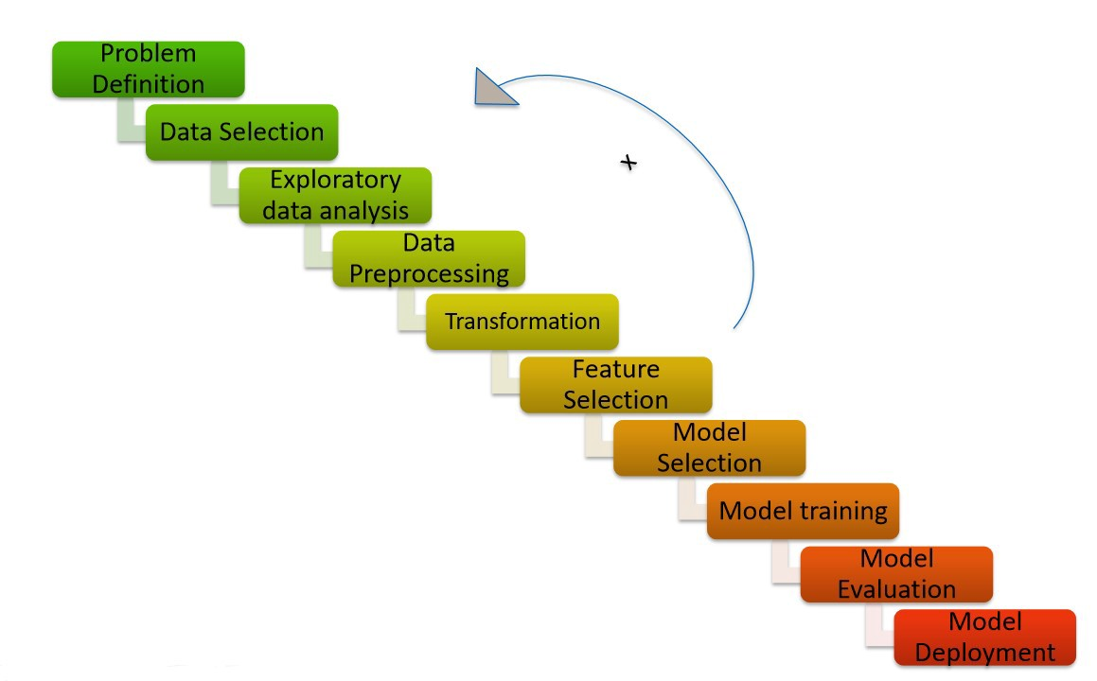
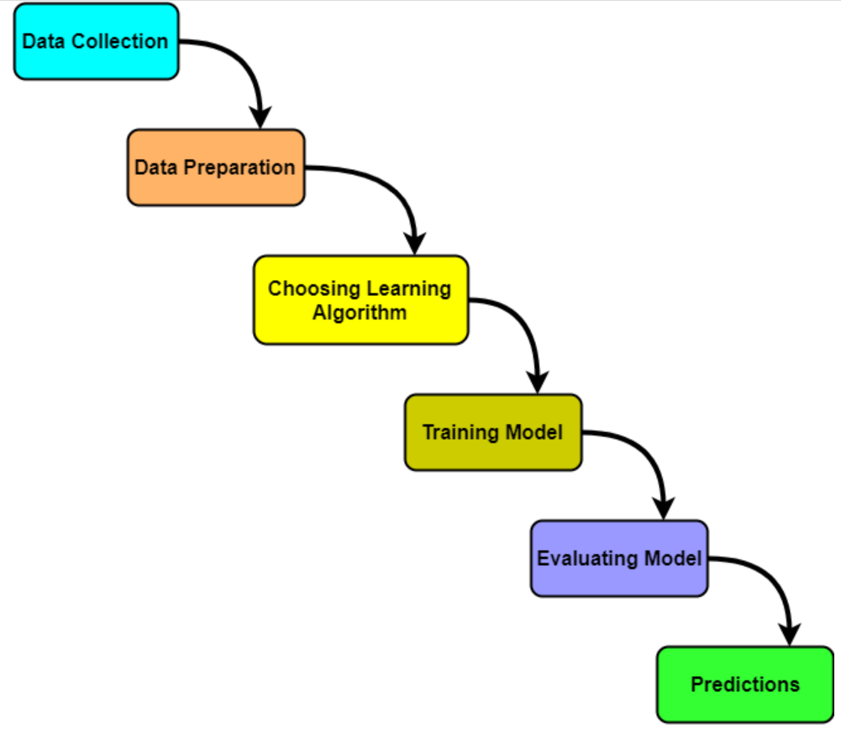
Recap – DS/Machine Learning Life Cycle
https://blogs.nvidia.com/blog/2016/07/29/whats-difference-artificial-intelligence-machine-learning-deep-learning-ai/

Slide 7
Agenda
Data Handling/Processing
Python
Pandas
Open CV
https://blogs.nvidia.com/blog/2016/07/29/whats-difference-artificial-intelligence-machine-learning-deep-learning-ai/

Slide 8
Types of Data
Text Data
Numeric Data
Images
Audio
https://blogs.nvidia.com/blog/2016/07/29/whats-difference-artificial-intelligence-machine-learning-deep-learning-ai/

Slide 9
Types of Data
Qualitative/Categorical Data - when you describes or judge or classify the data then you are dealing with qualitative data
Binary Data: Yes/No, Good/Bad, Tall/Short etc.
Nominal Data: Colours of M&M or Jelly Beans in a sweet pocket (Red, Purple, Green and Blue)
Ordinal Data: Small/Medium/Large (there is some order in the data), Movie Ratings (1, 2, 3, 4 and 5)
Quantitative Data – when you measure some thing and assign a numeric value then you are dealing with quantitative data
Discrete Data: No of family members, No of games lost in a season
Continuous Data: temperature, weight, pressure, force, price
https://blogs.nvidia.com/blog/2016/07/29/whats-difference-artificial-intelligence-machine-learning-deep-learning-ai/

Slide 10
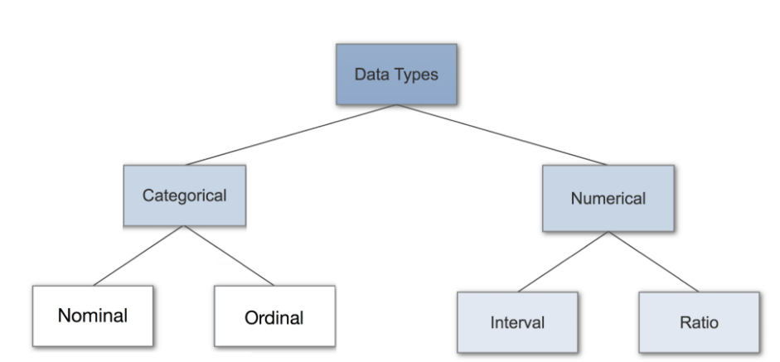
Types of Data
https://blogs.nvidia.com/blog/2016/07/29/whats-difference-artificial-intelligence-machine-learning-deep-learning-ai/

Slide 11
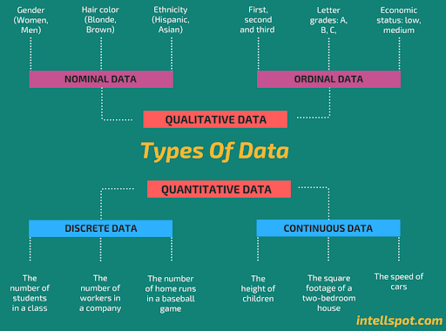
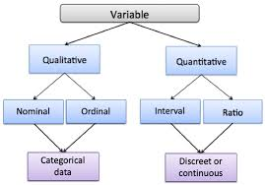
Types of Data
https://blogs.nvidia.com/blog/2016/07/29/whats-difference-artificial-intelligence-machine-learning-deep-learning-ai/

Slide 12
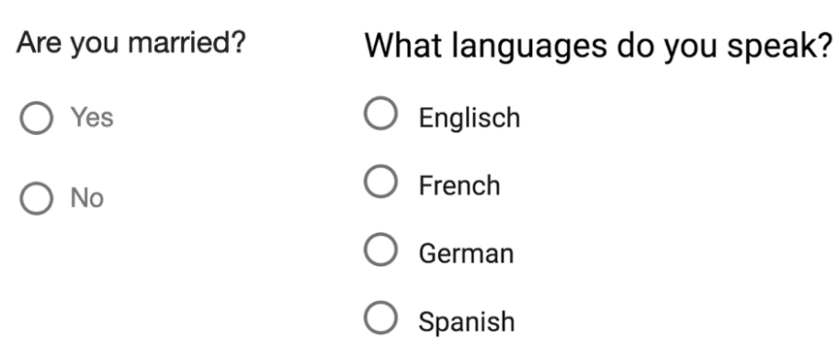
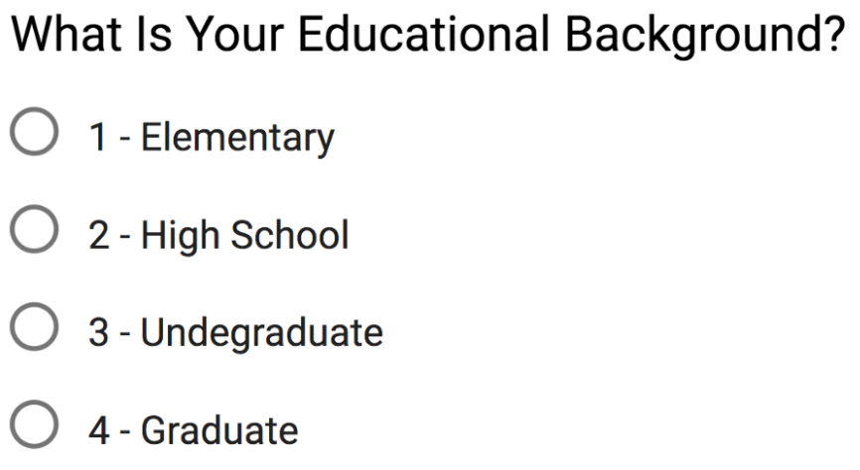
Types of Data
Nominal Data
Ordinal Data
https://blogs.nvidia.com/blog/2016/07/29/whats-difference-artificial-intelligence-machine-learning-deep-learning-ai/

Slide 13
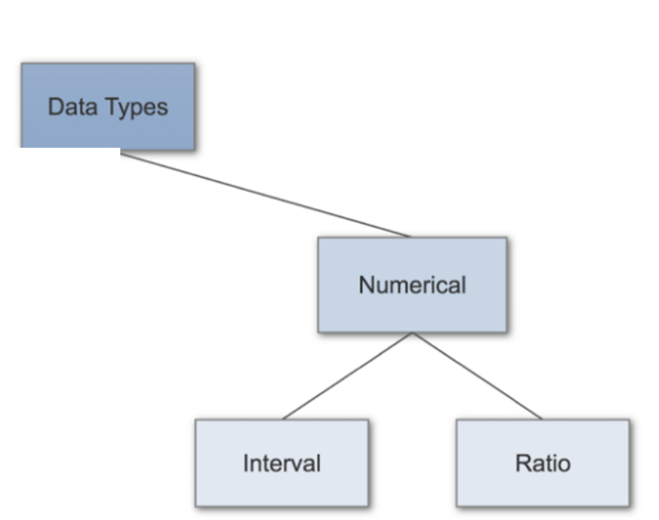
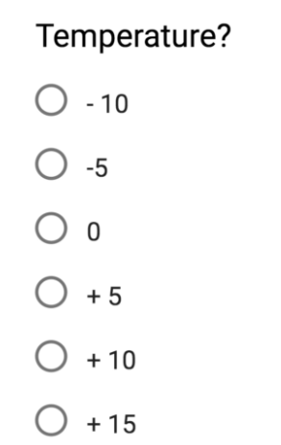
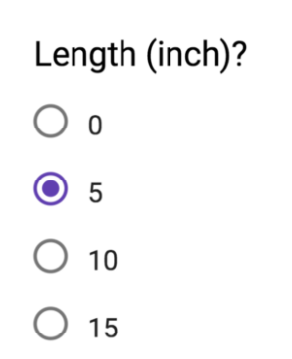
Types of Data
Continuous
Discrete
https://blogs.nvidia.com/blog/2016/07/29/whats-difference-artificial-intelligence-machine-learning-deep-learning-ai/

Slide 14
Python Libraries for Data Processing
Pandas
Numpy
https://blogs.nvidia.com/blog/2016/07/29/whats-difference-artificial-intelligence-machine-learning-deep-learning-ai/

Slide 15
Pandas – Loading Data from Files
Load Data
Look at the Data
Get Summary of Data
Rename Columns (if required)
Select important columns
Select few rows based on criterion
Merge two data frames for easier comparison
https://blogs.nvidia.com/blog/2016/07/29/whats-difference-artificial-intelligence-machine-learning-deep-learning-ai/

Slide 16
Numpy – Loading Data from Image Files
Load Image
Get Image Data Summary
Plot the Data/Image
https://blogs.nvidia.com/blog/2016/07/29/whats-difference-artificial-intelligence-machine-learning-deep-learning-ai/

Slide 17


SKLEARN – Scaling and Transformation of Input Data
Scaling
Scaler
Transformations
Standard Scaler
MinMax Scaler
MaxAbs Scaler
Few More Advanced Scalers
Power Transformer
Normalize
Quantile Transformer
Lognormal Transformer
https://blogs.nvidia.com/blog/2016/07/29/whats-difference-artificial-intelligence-machine-learning-deep-learning-ai/

Slide 18
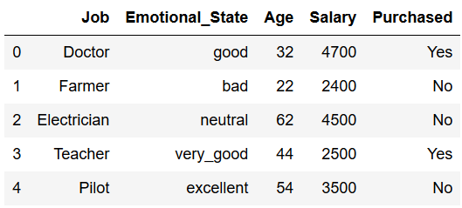
SKLEARN – Encoding Categorical Features
Ordinal Encoder
Input Data
Purchased
No → 0
Yes → 1
Emotional State
Good → 0
Bad → 1
Neutral → 2
Very Good → 3
Excellent → 4
Emotional State
Bad → 0
Neutral → 1
Good → 2
Very Good → 3
Excellent → 4
OR
One Hot Encoder
No Yes
[0 1]
[1 0],
[1 0],
[0 1],
[1 0]
Bad Neutral Good V.Good Ex
[0 0 1 0 0]
[1 0 0 0 0]
[0 1 0 0 0]
[0 0 0 1 0]
[0 0 0 0 1]

