Slide 1

Raspberry PI and AI Stream
ZAS
Academy
Dr. Roohi Banu
Mr. Fakruddin Mohammed

Slide 2
Day 2.
Raspberry PI - AI, ML, DL & RL Introduction
ZAS
Academy
Dr. Roohi Banu
Mr. Fakruddin Mohammed

Slide 3

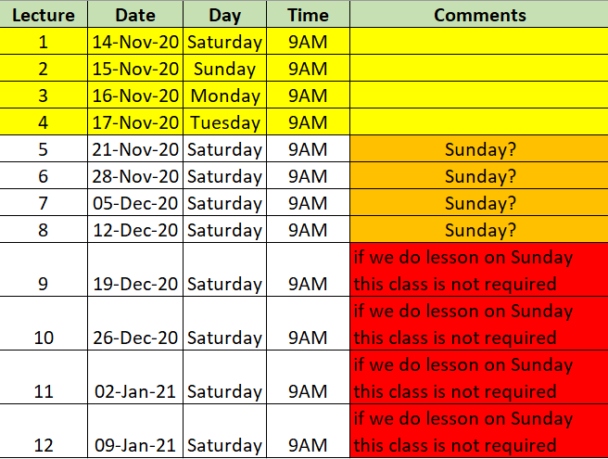

Z A S A C A D E M Y
Raspberry PI - Machine and Deep Learning
(12 Weeks ADVANCED Course for Secondary & College Students)
@78 99 11 222 5
Week1
Week2
Week3
Week4
Week5
Week6
AI Introduction & ML/DL Life Cycle
Data Handling (Pandas & Numpy)
Data Handling & Visualization (matplotlib)
Probability & Statistics (Variable Selection)
Regression
Classification
Course content may be altered depending on participant needs & speed of grasping power
Week7
Week8
Week9
Week10
Week11
Week12
Artificial Neural Networks & Backpropagation
2 Layers Neural Networks & CNN Intuition
Deep Learning CNN & Raspberry PI
Deep Learning CNN & Raspberry PI
Deep Learning CNN & Raspberry PI
Deep Learning CNN & Raspberry PI
Live ZOOM Lectures from 14-Nov:
Natural Language Processing – NLP - ???
At the end of course participants will have
Thorough & deeper understanding of AI/ML/DL (Neural Networks)
Seen full end-to-end life cycle of Data Science Projects
Built at least 1 Deep Learning OBJECT DETECTION model from SCRATCH end-to-end and deploy on to PI

Slide 4


SKLEARN – Scaling and Transformation of Input Data
Scaling
Scaler
Transformations
Standard Scaler
MinMax Scaler
MaxAbs Scaler
Few More Advanced Scalers
Power Transformer
Normalize
Quantile Transformer
Lognormal Transformer
https://blogs.nvidia.com/blog/2016/07/29/whats-difference-artificial-intelligence-machine-learning-deep-learning-ai/

Slide 5
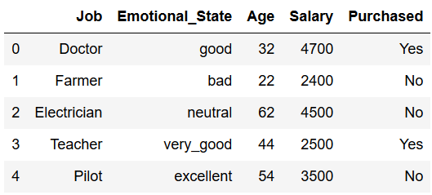
SKLEARN – Encoding Categorical Features
Ordinal Encoder
Input Data
Purchased
No → 0
Yes → 1
Emotional State
Good → 0
Bad → 1
Neutral → 2
Very Good → 3
Excellent → 4
Emotional State
Bad → 0
Neutral → 1
Good → 2
Very Good → 3
Excellent → 4
OR
One Hot Encoder
No Yes
[0 1]
[1 0],
[1 0],
[0 1],
[1 0]
Bad Neutral Good V.Good Ex
[0 0 1 0 0]
[1 0 0 0 0]
[0 1 0 0 0]
[0 0 0 1 0]
[0 0 0 0 1]

Slide 6
SKLEARN – Exploratory Data Analysis
Quickly describe a dataset; number of rows/columns, missing data, data types, preview.
Clean corrupted data; handle missing data, invalid data types, incorrect values.
Visualize data distributions; bar charts, histograms, box plots.
Calculate and visualize correlations (relationships) between variables; heat map.
https://blogs.nvidia.com/blog/2016/07/29/whats-difference-artificial-intelligence-machine-learning-deep-learning-ai/

Slide 7
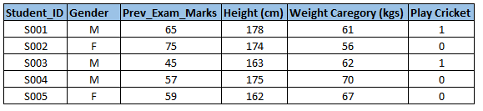
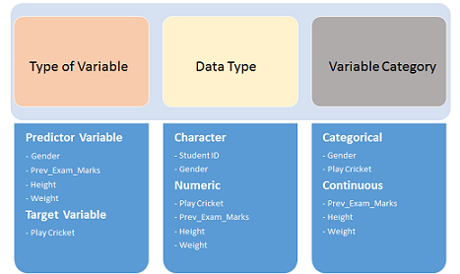
SKLEARN – Exploratory Data Analysis
Variable Identification
https://blogs.nvidia.com/blog/2016/07/29/whats-difference-artificial-intelligence-machine-learning-deep-learning-ai/

Slide 8
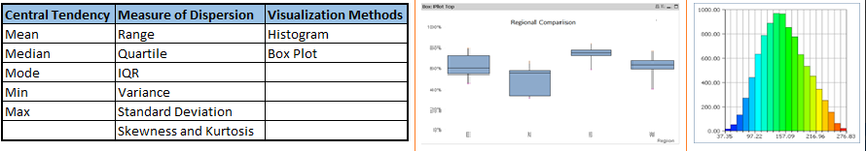
SKLEARN – Exploratory Data Analysis
Univariate Analysis
https://blogs.nvidia.com/blog/2016/07/29/whats-difference-artificial-intelligence-machine-learning-deep-learning-ai/

Slide 9
SKLEARN – Exploratory Data Analysis
Univariate Analysis
Continuous
Categorical
Bar Charts
Count
Count %
https://blogs.nvidia.com/blog/2016/07/29/whats-difference-artificial-intelligence-machine-learning-deep-learning-ai/

Slide 10
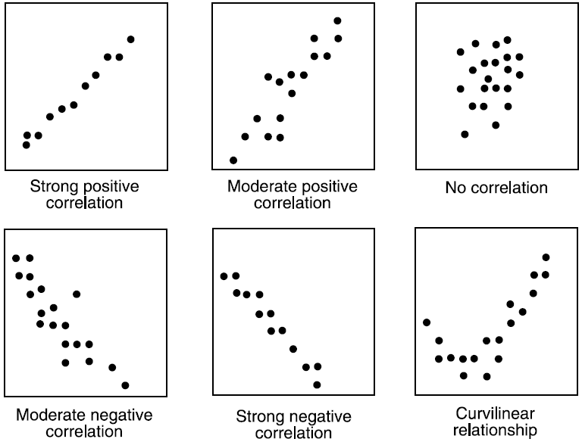
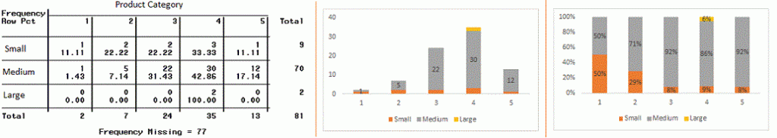
SKLEARN – Exploratory Data Analysis
Bivariate Analysis
Continuous Vs Continuous
Continuous Vs Categorical: Bar Charts
Categorical Vs Categorical: Bar Charts, 2-way Tables
https://blogs.nvidia.com/blog/2016/07/29/whats-difference-artificial-intelligence-machine-learning-deep-learning-ai/

Slide 11
SKLEARN – Exploratory Data Analysis
Bivariate Analysis
Chi Square Test
Z-Test/T-Test
ANOVA
https://blogs.nvidia.com/blog/2016/07/29/whats-difference-artificial-intelligence-machine-learning-deep-learning-ai/

Slide 12
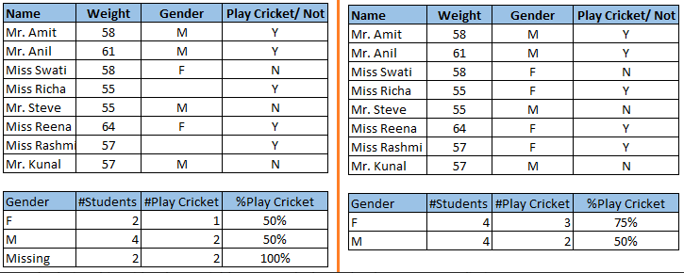
SKLEARN – Exploratory Data Analysis
Missing Values
https://blogs.nvidia.com/blog/2016/07/29/whats-difference-artificial-intelligence-machine-learning-deep-learning-ai/

Slide 13
SKLEARN – Exploratory Data Analysis
Missing Values Treatment
Drop the rows/data
Fill/Replace with mean, median or mode
Use model to predict them (Regression, ANOVA etc.)
https://blogs.nvidia.com/blog/2016/07/29/whats-difference-artificial-intelligence-machine-learning-deep-learning-ai/

Slide 14
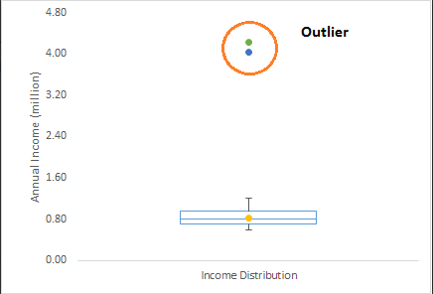
SKLEARN – Exploratory Data Analysis
Outliers
https://blogs.nvidia.com/blog/2016/07/29/whats-difference-artificial-intelligence-machine-learning-deep-learning-ai/

Slide 15
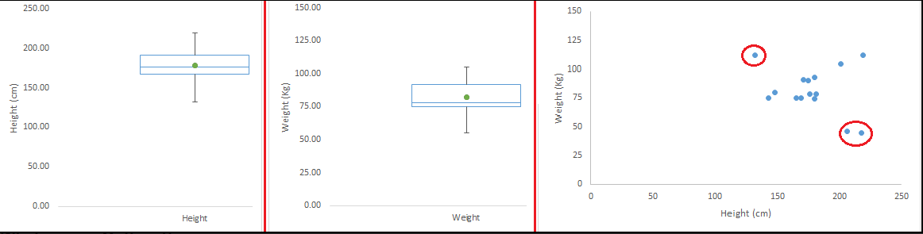
SKLEARN – Exploratory Data Analysis
Outliers
https://blogs.nvidia.com/blog/2016/07/29/whats-difference-artificial-intelligence-machine-learning-deep-learning-ai/

Slide 16
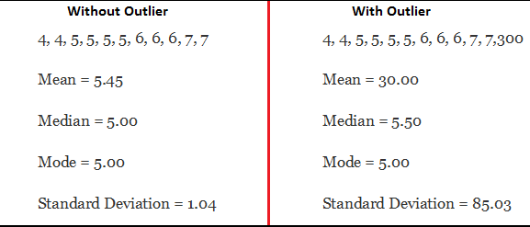
SKLEARN – Exploratory Data Analysis
Outliers Impact
https://blogs.nvidia.com/blog/2016/07/29/whats-difference-artificial-intelligence-machine-learning-deep-learning-ai/

Slide 17
SKLEARN – Exploratory Data Analysis
How to detect outliers?
Box Plot
Scatter Plot
Histogram
https://blogs.nvidia.com/blog/2016/07/29/whats-difference-artificial-intelligence-machine-learning-deep-learning-ai/

Slide 18
SKLEARN – Exploratory Data Analysis
Outliers Treatment
Delete those observations
Transform (between 0 and 1)
Binning/Intervals
Replace with predicted values from modelling
https://blogs.nvidia.com/blog/2016/07/29/whats-difference-artificial-intelligence-machine-learning-deep-learning-ai/

