Slide 1

Raspberry PI and AI Stream
ZAS
Academy
Dr. Roohi Banu
Mr. Fakruddin Mohammed

Slide 2
Day 2.
Raspberry PI - AI, ML, DL & RL Introduction
ZAS
Academy
Dr. Roohi Banu
Mr. Fakruddin Mohammed

Slide 3

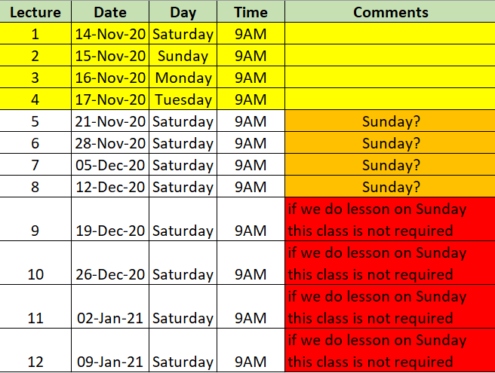

Z A S A C A D E M Y
Raspberry PI - Machine and Deep Learning
(12 Weeks ADVANCED Course for Secondary & College Students)
@78 99 11 222 5
Week1
Week2
Week3
Week4
Week5
Week6
AI Introduction & ML/DL Life Cycle
Data Handling (Pandas & Numpy)
Data Handling & Visualization (matplotlib)
Probability & Statistics (Variable Selection)
Regression
Classification
Course content may be altered depending on participant needs & speed of grasping power
Week7
Week8
Week9
Week10
Week11
Week12
Artificial Neural Networks & Backpropagation
2 Layers Neural Networks & CNN Intuition
Deep Learning CNN & Raspberry PI
Deep Learning CNN & Raspberry PI
Deep Learning CNN & Raspberry PI
Deep Learning CNN & Raspberry PI
Live ZOOM Lectures from 14-Nov:
Natural Language Processing – NLP - ???
At the end of course participants will have
Thorough & deeper understanding of AI/ML/DL (Neural Networks)
Seen full end-to-end life cycle of Data Science Projects
Built at least 1 Deep Learning OBJECT DETECTION model from SCRATCH end-to-end and deploy on to PI

Slide 4
Linear Regression
Linear Regression with 2 Observations
Y = m X + c
Y
(x2,y2)
y1 = m x1 + c
y2 = m x2 + c
(x1,y1)
m = (y2-y1)/(x2-x1)
X
https://blogs.nvidia.com/blog/2016/07/29/whats-difference-artificial-intelligence-machine-learning-deep-learning-ai/

Slide 5
Linear Regression
Linear Regression with 2 Observations
Y = m X + c
Y
(x2,y2)
y1 = m x1 + c
y2 = m x2 + c
(x1,y1)
(x3,y3)
?
m = (y2-y1)/(x2-x1)
X
https://blogs.nvidia.com/blog/2016/07/29/whats-difference-artificial-intelligence-machine-learning-deep-learning-ai/

Slide 6
Linear Regression
Linear Regression with 4 Observations
Y = m X + c
Y
(x2,y2)
(x3,y3)
y1 = m x1 + c
y2 = m x2 + c
y3 = m x3 + c
y4 = m x4 + c
(x1,y1)
(x4,y4)
X
m = (y2-y1)/(x2-x1)
m = (y3-y1)/(x3-x1)
m = (y4-y2)/(x4-x2)
…
https://blogs.nvidia.com/blog/2016/07/29/whats-difference-artificial-intelligence-machine-learning-deep-learning-ai/

Slide 7
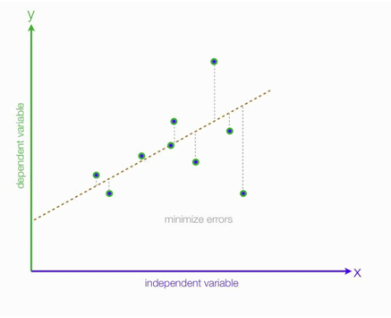


Linear Regression
Estimating Linear Regression Coefficients
9 observations index from 1 to 9
y^₉
Model:
error
} error₉ = y₉-y^₉
Model
y^₉
y is the actual output (y_{1,} y_{2,} y_{3….} y₉)
x is the independent variable (x_{1,} x_{2,} x_{3….} x₉)
y^ is the model/estimated/calculate output
(y^_{1,} y ^ _{2,} y ^ _{3….} y ^ ₉)
Actual
y₉
(x₉,y₉)
x₉
Total Error =
e = e1+e2+e3+…+e9
e = (y₁₋ y^₁) + (y₂₋ y^₂) + (y₃₋ y^₃) +… + (y₉₋ y^₉)

Slide 8
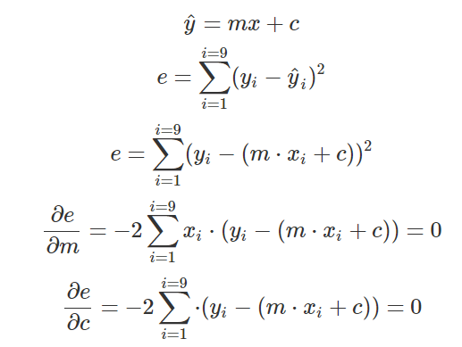
Linear Regression
Estimate Coefficients
9 observations index from 1 to 9
Model
y^₉
error
} error₉ = y₉-y^₉
Model
y^₉
Total Model Error (Mean Square Error – MSE)
Actual
y₉
(x₉,y₉)
y and x is fixed or known (as data is already given to you)
m and c are unknowns and hence solve for it by minimising the MSE
x₉
https://blogs.nvidia.com/blog/2016/07/29/whats-difference-artificial-intelligence-machine-learning-deep-learning-ai/

Slide 9
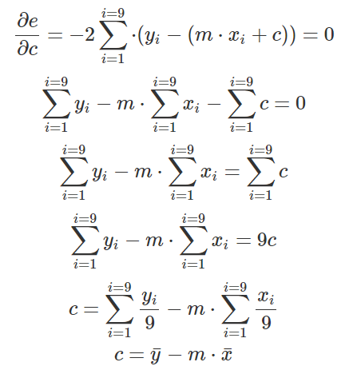
Linear Regression
Estimate Coefficients
9 observations index from 1 to 9
y^₉
error
} error₉ = y₉-y^₉
Model
y^₉
Actual
y₉
(x₉,y₉)
x₉
https://blogs.nvidia.com/blog/2016/07/29/whats-difference-artificial-intelligence-machine-learning-deep-learning-ai/

Slide 10
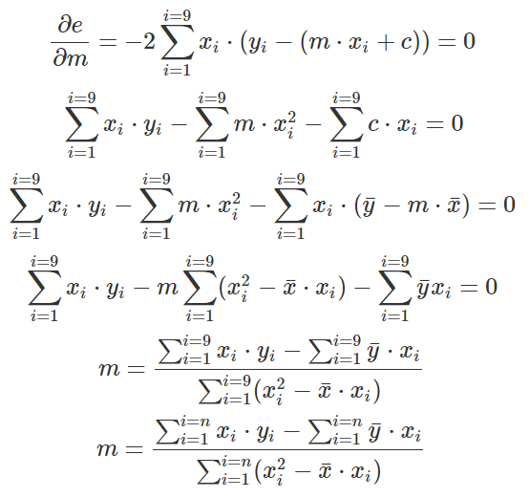
Linear Regression
Estimate Coefficients
Substituting the value of c in the equation below
y^₉
error
} error₉ = y₉-y^₉
Model
y^₉
Actual
y₉
(x₉,y₉)
x₉
https://blogs.nvidia.com/blog/2016/07/29/whats-difference-artificial-intelligence-machine-learning-deep-learning-ai/

Slide 11




Linear Regression
R² Statistic
y^₉
error
} error₉ = y₉-y^₉
Model
y^₉
Actual
y₉
(x₉,y₉)
x₉
R² Value is always between 0 and 1; higher the number the better is the model
https://blogs.nvidia.com/blog/2016/07/29/whats-difference-artificial-intelligence-machine-learning-deep-learning-ai/

Slide 12
Linear Regression
R² Statistic
y^₉
Prediction is always mean of y
error
} error₉ = y₉-y^₉
Y mean
Model
y^₉
x
Prediction is from model
(model is explaining)
Actual
y₉
(x₉,y₉)
LR
x
Y estiamte
x₉
TSS – RSS ➔ Unexplained Error
(neither model nor a simple prediction of mean of y explains this)
https://blogs.nvidia.com/blog/2016/07/29/whats-difference-artificial-intelligence-machine-learning-deep-learning-ai/

Slide 13





SKLEARN – Feature Selection
Linear Regression – Hypothesis Testing
Model
Null Hypothesis
Alternate Hypothesis
https://blogs.nvidia.com/blog/2016/07/29/whats-difference-artificial-intelligence-machine-learning-deep-learning-ai/

Slide 14
SKLEARN – Feature Selection
Statistical Modelling
In statistical modelling
we observe behaviour of some process – camera and image
we gather data from our observations - images
we try to find relationship between dependent (output/response) and independent variables (predictors or inputs).
Some techniques to find relationship is: plotting (x-y scatter plot), calculating correlation - plotting
We define null hypothesis (H₀: given input/variable has no relationship with output).
In that process we apply statistics techniques (chi^2 or fisher tests) to find significant inputs/predictors/variables that explains the output/response
We look at z-value and p-values whether to reject or do not reject the null hypothesis. If the model gives high z-value and low p-value (less than 0.05) then reject the null hypothesis otherwise DO-NOT reject the null hypothesis.
Statistical models also give something called R^2 value; higher R^2 value can be a useful criterion for evaluating the best model. The other measures for model optimization is: MSE, RMSE etc.
https://blogs.nvidia.com/blog/2016/07/29/whats-difference-artificial-intelligence-machine-learning-deep-learning-ai/

Slide 15
SKLEARN – Feature Selection
Feature Selection
Chi Square Test
Z-Test/T-Test
ANOVA
Forward Selection
Backward Selection
ANOVA
https://blogs.nvidia.com/blog/2016/07/29/whats-difference-artificial-intelligence-machine-learning-deep-learning-ai/

