Slide 1

Raspberry PI and AI Stream
ZAS
Academy
Dr. Roohi Banu
Mr. Fakruddin Mohammed

Slide 2
Day 2.
Raspberry PI - AI, ML, DL & RL Introduction
ZAS
Academy
Dr. Roohi Banu
Mr. Fakruddin Mohammed

Slide 3

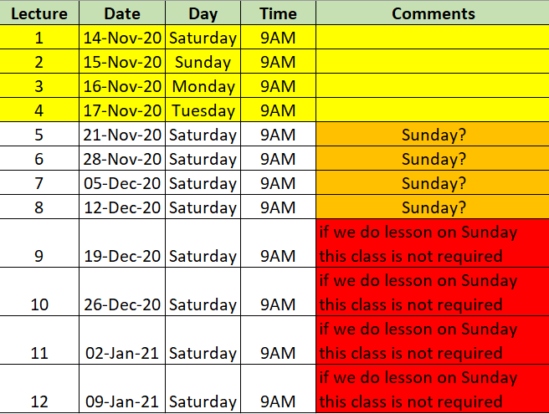

Z A S A C A D E M Y
Raspberry PI - Machine and Deep Learning
(12 Weeks ADVANCED Course for Secondary & College Students)
@78 99 11 222 5
Week1
Week2
Week3
Week4
Week5
Week6
AI Introduction & ML/DL Life Cycle
Data Handling (Pandas & Numpy)
Data Handling & Visualization (matplotlib)
Probability & Statistics (Variable Selection)
Regression
Classification
Course content may be altered depending on participant needs & speed of grasping power
Week7
Week8
Week9
Week10
Week11
Week12
Artificial Neural Networks & Backpropagation
2 Layers Neural Networks & CNN Intuition
Deep Learning CNN & Raspberry PI
Deep Learning CNN & Raspberry PI
Deep Learning CNN & Raspberry PI
Deep Learning CNN & Raspberry PI
Live ZOOM Lectures from 14-Nov:
Natural Language Processing – NLP - ???
At the end of course participants will have
Thorough & deeper understanding of AI/ML/DL (Neural Networks)
Seen full end-to-end life cycle of Data Science Projects
Built at least 1 Deep Learning OBJECT DETECTION model from SCRATCH end-to-end and deploy on to PI

Slide 4
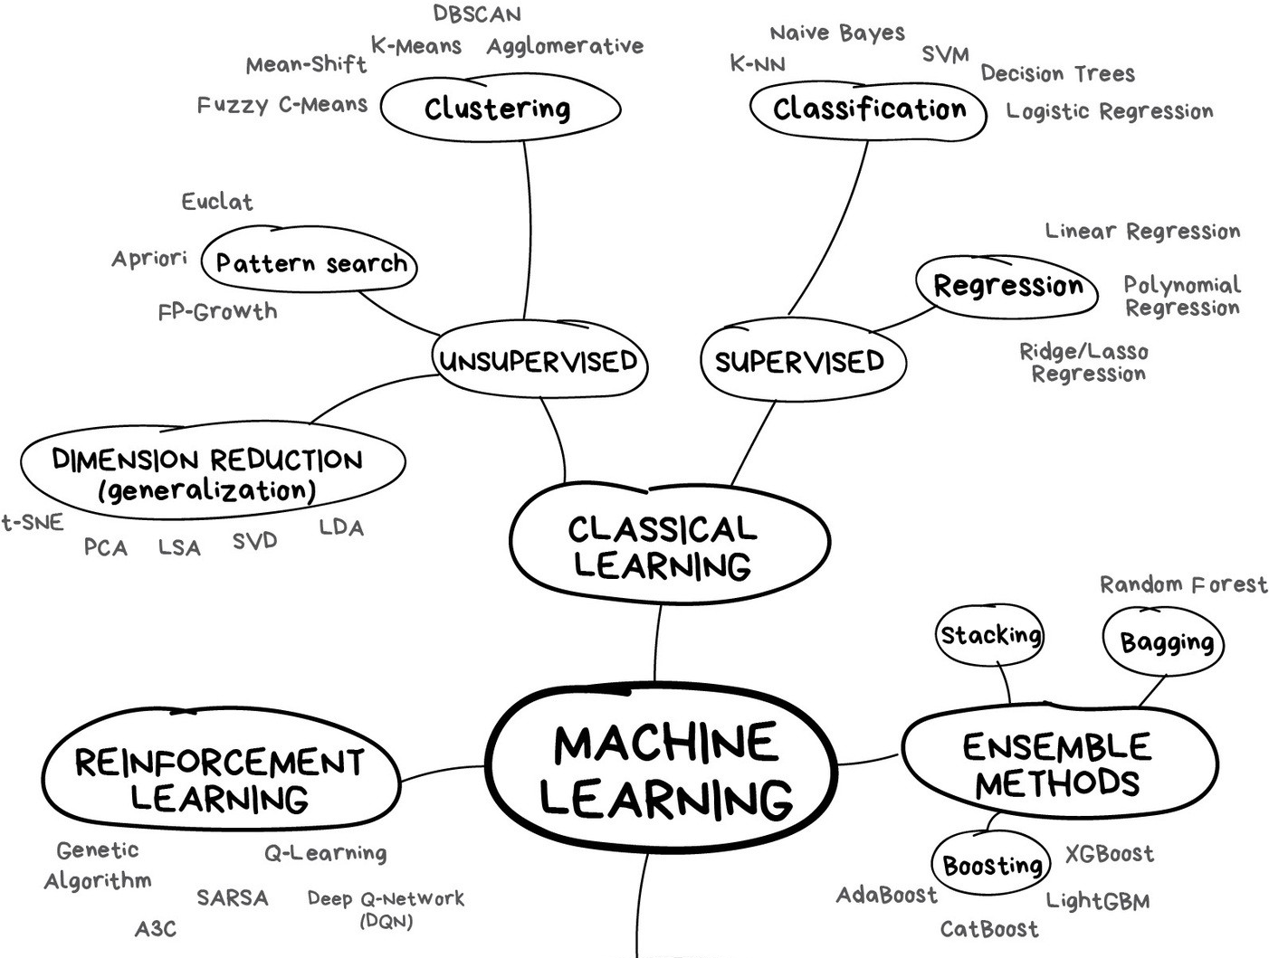
AI Introduction: Machine Learning
https://blogs.nvidia.com/blog/2016/07/29/whats-difference-artificial-intelligence-machine-learning-deep-learning-ai/

Slide 5
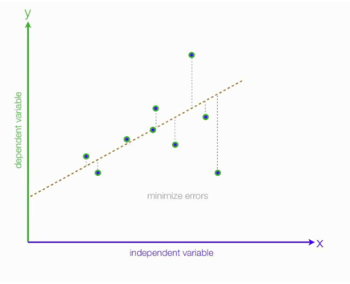


Linear Regression
Estimating Linear Regression Coefficients
9 observations index from 1 to 9
y^₉
Model:
error
} error₉ = y₉-y^₉
Model
y^₉
y is the actual output (y_{1,} y_{2,} y_{3….} y₉)
x is the independent variable (x_{1,} x_{2,} x_{3….} x₉)
y^ is the model/estimated/calculate output
(y^_{1,} y ^ _{2,} y ^ _{3….} y ^ ₉)
Actual
y₉
(x₉,y₉)
x₉
Total Error =
e = e1+e2+e3+…+e9
e = (y₁₋ y^₁) + (y₂₋ y^₂) + (y₃₋ y^₃) +… + (y₉₋ y^₉)

Slide 6
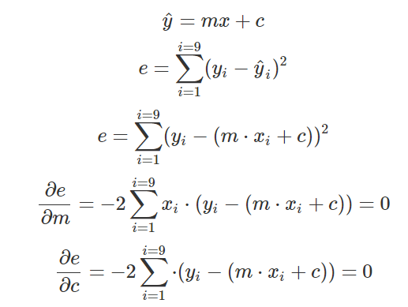
Linear Regression
Estimate Coefficients
9 observations index from 1 to 9
AE = Absolute Error
MSE = Mean Square Error
RMSE = Root MSE
MAE = Mean Absolute Error
Model
y^₉
error
} error₉ = y₉-y^₉
Model
y^₉
Total Model Error (Mean Square Error – MSE)
Actual
y₉
(x₉,y₉)
y and x is fixed or known (as data is already given to you)
m and c are unknowns and hence solve for it by minimising the MSE
x₉
Cost Function
Loss Function
https://blogs.nvidia.com/blog/2016/07/29/whats-difference-artificial-intelligence-machine-learning-deep-learning-ai/

Slide 7
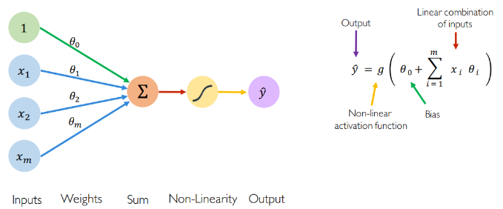
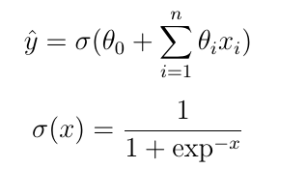
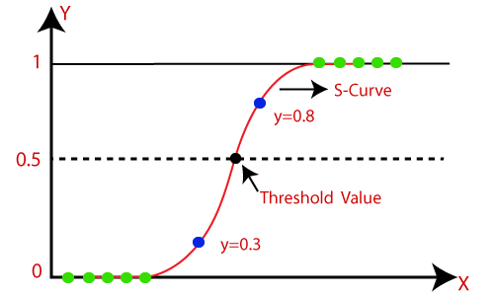
Logistic Regression
Estimating Logistic Regression Coefficients
Model:
y is the actual output (y_{1,} y_{2,} y_{3….} y_{n})
x is the independent variable (x_{1,} x_{2,} x_{3….} x_{n})
y^ is the model/estimated/calculate output
(y^_{1,} y ^ _{2,} y ^ _{3….} y ^ ₉)

Slide 8
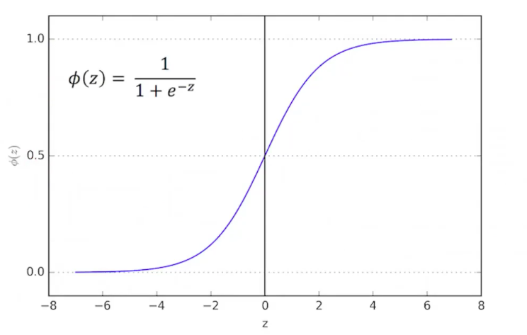
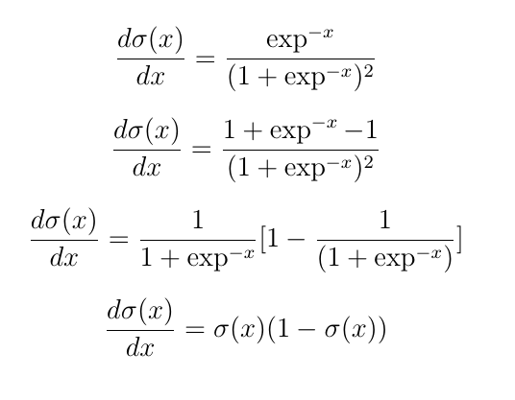
Logistic Regression
Estimating Logistic Regression Coefficients
Model

Slide 9
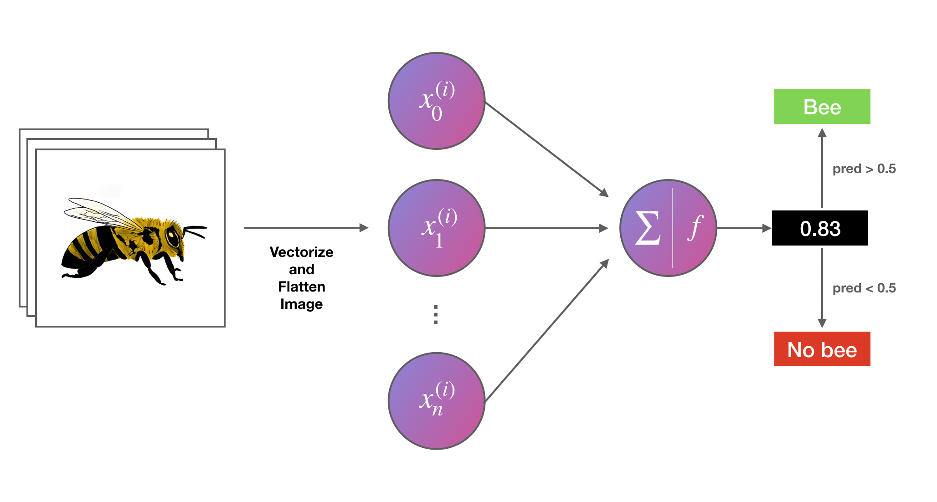
Logistic Regression
Estimating Logistic Regression Coefficients
Model:

Slide 10
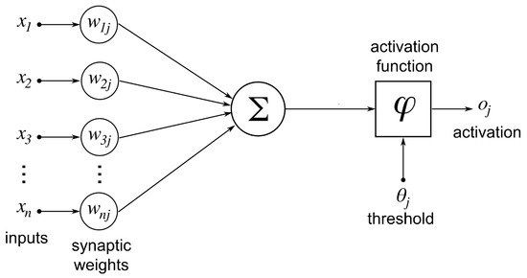
Logistic Regression
Estimating Logistic Regression Coefficients
Model

Slide 11
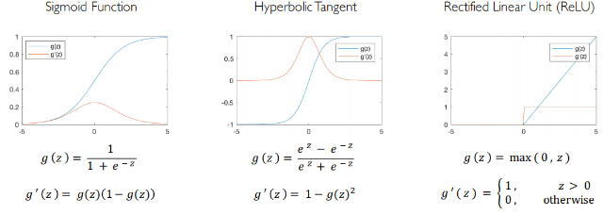
Logistic Regression
Estimating Logistic Regression Coefficients
Activation Functions

Slide 12
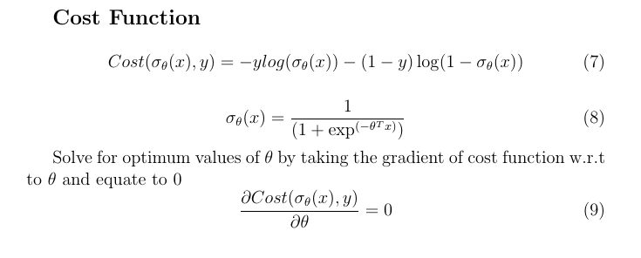
Logistic Regression
Estimating Logistic Regression Coefficients

