Slide 1

Raspberry PI and AI Stream
ZAS
Academy
Dr. Roohi Banu
Mr. Fakruddin Mohammed

Slide 2
Day 2.
Raspberry PI - AI, ML, DL & RL Introduction
ZAS
Academy
Dr. Roohi Banu
Mr. Fakruddin Mohammed

Slide 3



Z A S A C A D E M Y
Raspberry PI - Machine and Deep Learning
(12 Weeks ADVANCED Course for Secondary & College Students)
@78 99 11 222 5
Week1
Week2
Week3
Week4
Week5
Week6
AI Introduction & ML/DL Life Cycle
Data Handling (Pandas & Numpy)
Data Handling & Visualization (matplotlib)
Probability & Statistics (Variable Selection)
Regression
Classification
Course content may be altered depending on participant needs & speed of grasping power
Week7
Week8
Week9
Week10
Week11
Week12
Artificial Neural Networks & Backpropagation
2 Layers Neural Networks & CNN Intuition
Deep Learning CNN & Raspberry PI
Deep Learning CNN & Raspberry PI
Deep Learning CNN & Raspberry PI
Deep Learning CNN & Raspberry PI
Live ZOOM Lectures from 14-Nov:
Natural Language Processing – NLP - ???
At the end of course participants will have
Thorough & deeper understanding of AI/ML/DL (Neural Networks)
Seen full end-to-end life cycle of Data Science Projects
Built at least 1 Deep Learning OBJECT DETECTION model from SCRATCH end-to-end and deploy on to PI

Slide 4
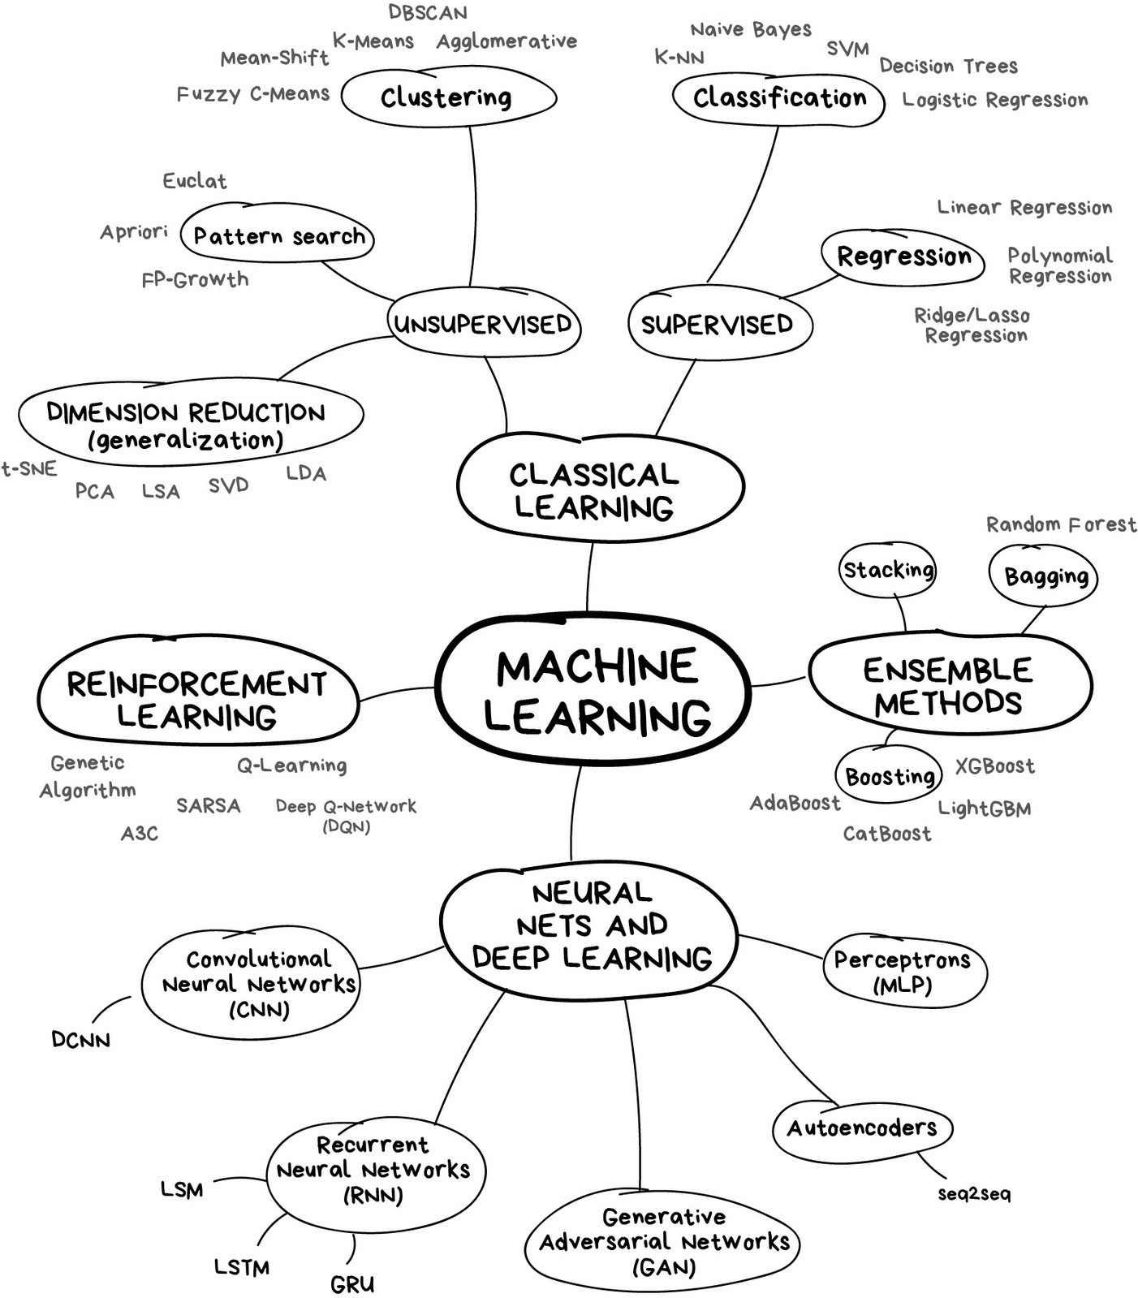
AI Introduction: Machine Learning
https://blogs.nvidia.com/blog/2016/07/29/whats-difference-artificial-intelligence-machine-learning-deep-learning-ai/

Slide 5
AI Introduction: Deep Learning
https://blogs.nvidia.com/blog/2016/07/29/whats-difference-artificial-intelligence-machine-learning-deep-learning-ai/

Slide 6
Differentiation Chain Rule
Differentiation Chain Rule

Slide 7
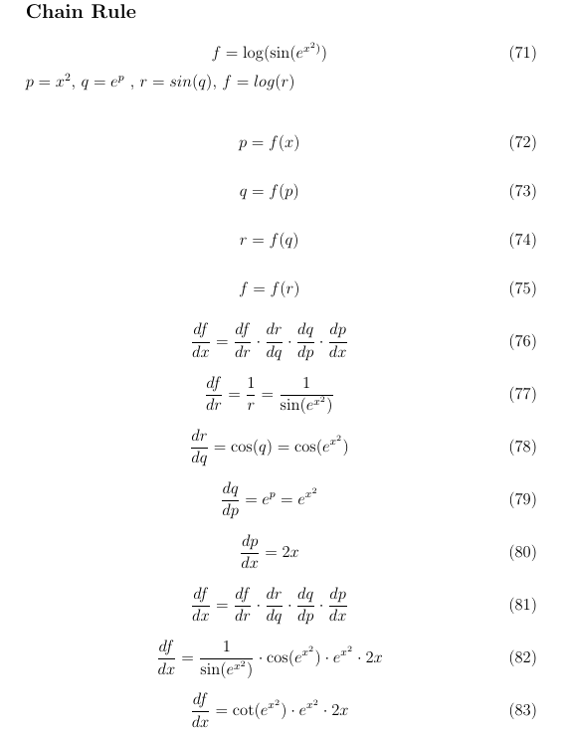
Differentiation Chain Rule

Slide 8
Back Propagation Derivations
Back Propagation Approach for Gradient Descent

Slide 9



Back Propagation Derivations
W_L-2
A_L-2
W_L-1
A_L-1
W_L
A_L
X
E = Y – Y^
B_L-2
B_L-1
B_L

Slide 10
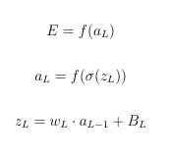

Back Propagation Derivations
Last Layer
a_L-1
w_L
a_L
z_L
E = (Y – Y^)^2
E = (Y – a_L)^2
b_L

Slide 11
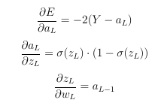

Back Propagation Derivations
Last Layer
a_L-1
w_L
a_L
z_L
E = (Y – Y^)^2
E = (Y – a_L)^2
b_L

Slide 12

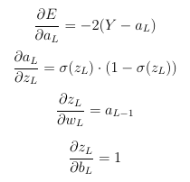

Back Propagation Derivations
Last Layer
a_L-1
w_L
a_L
z_L
E = (Y – Y^)^2
E = (Y – a_L)^2
b_L

Slide 13
Back Propagation Derivations
Last and Last-1 Layer
A_L-2
W_L-1
A_L-1
W_L
A_L
E = Y – Y^
B_L-2
B_L-1
B_L

Slide 14

Back Propagation Derivations
Last and Last-1 Layer
A_L-2
W_L-1
A_L-1
W_L
A_L
E = Y – Y^
B_L-1
B_L

Slide 15
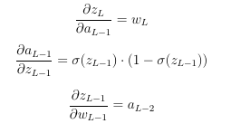

Back Propagation Derivations
A_L-2
W_L-1
A_L-1
W_L
A_L
E = Y – Y^
B_L-1
B_L
Last and Last-1 Layer

Slide 16

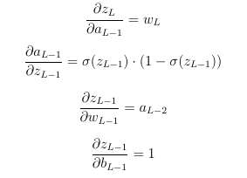

Back Propagation Derivations
A_L-2
W_L-1
A_L-1
W_L
A_L
E = Y – Y^
B_L-1
B_L
Last and Last-1 Layer

Slide 17
Back Propagation Derivations
Last, Last-1 and Last-2 Layer
W_L-2
A_L-2
W_L-1
A_L-1
W_L
A_L
X
E = Y – Y^
B_L-2
B_L-1
B_L

Slide 18

Back Propagation Derivations
W_L-2
A_L-2
W_L-1
A_L-1
W_L
A_L
X
E = Y – Y^
B_L-2
B_L-1
B_L
Last, Last-1 and Last-2 Layer

Slide 19
Back Propagation Derivations
W_L-2
A_L-2
W_L-1
A_L-1
W_L
A_L
X
E = Y – Y^
B_L-2
B_L-1
B_L
Last, Last-1 and Last-2 Layer

Slide 20

Back Propagation Derivations
W_L-2
A_L-2
W_L-1
A_L-1
W_L
A_L
X
E = Y – Y^
B_L-2
B_L-1
B_L

Slide 21
Neural Network XOR Gate Derivations
Back Propagation Equations for
No Hidden Layers (AND/OR Gate)
And
One Hidden Layer (XOR)

Slide 22
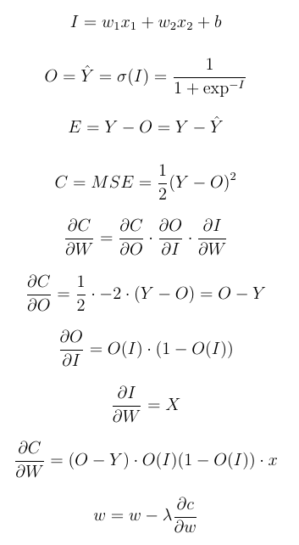
Neural Network OR/AND/NOT Gate Derivations – No Hidden Layer
No Hidden Layer or 1 Perceptron
b
x1
w1
I
O
∑
σ
x2
w2

Slide 23
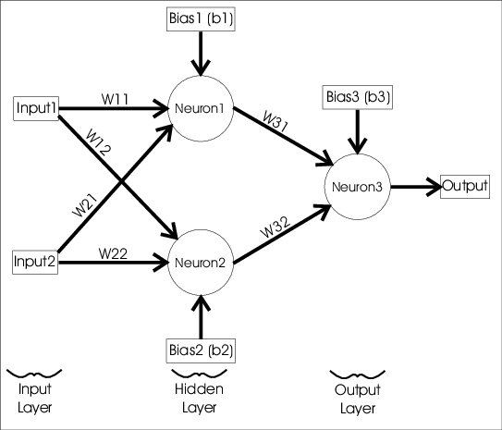
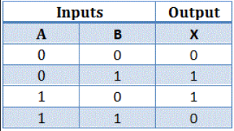
Neural Network Simulating XOR Logic Gate – One Hidden Layer
One Hidden Layer
Hidden Layer
https://towardsdatascience.com/mcculloch-pitts-model-5fdf65ac5dd1

Slide 24
Neural Network XOR Gate Derivations – One Hidden Layer
One Hidden Layer
da_h/dw_h
dx_o/da_h
da_o/dx_o
a_h
X1
da_o/dw_o
dy^/da_o
dE/dy^
b1_h
a_o
X2
b1_o
b2_h

Slide 25
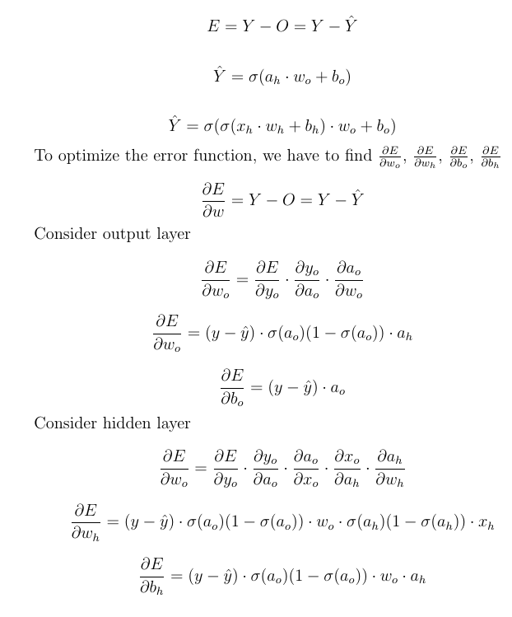
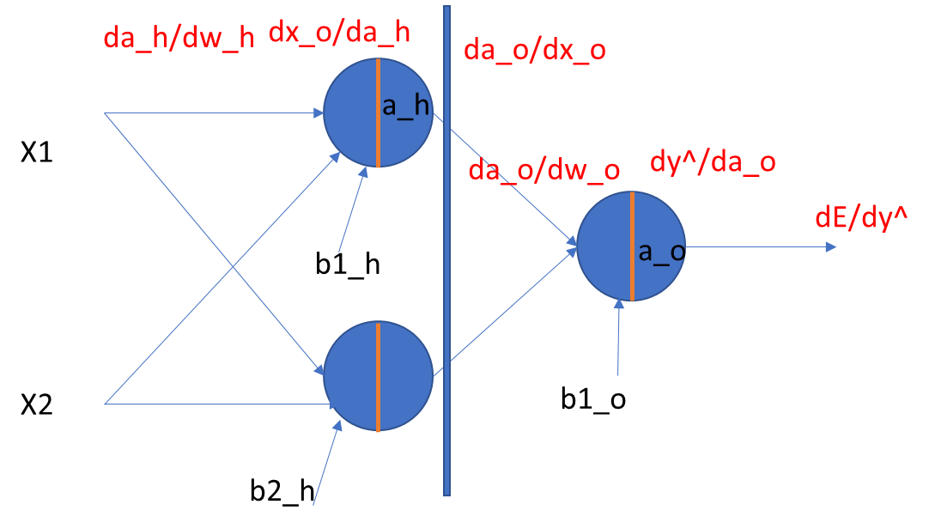
Neural Network XOR Gate Derivations – One Hidden Layer
One Hidden Layer
Z2 = W1^{T}A1+b2
A2 = sigmoid(Z2)

Slide 26
Neural Network XOR Gate Derivations
Additional Material

Slide 27
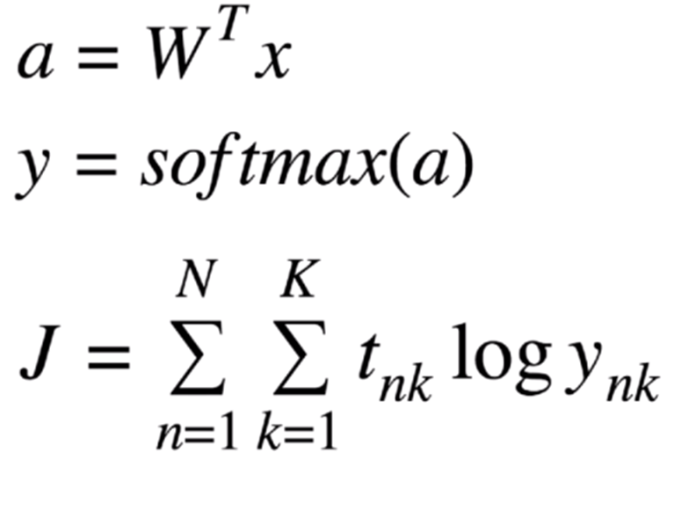
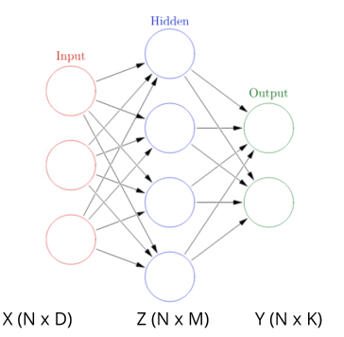
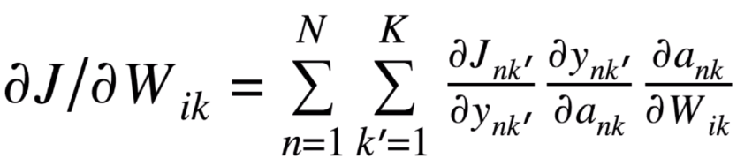
Neural Network with 1 Hidden Layer and Multi output Classes (K)
https://towardsdatascience.com/mcculloch-pitts-model-5fdf65ac5dd1

Slide 28
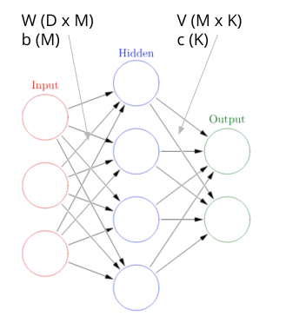
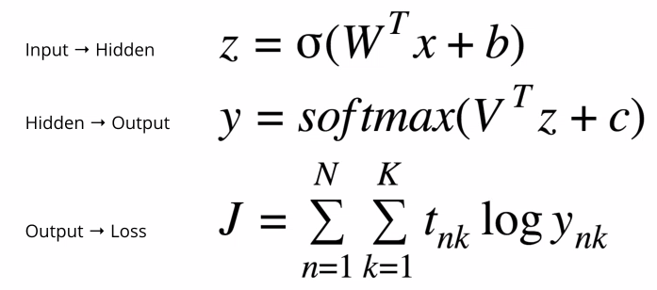
Neural Network with 1 Hidden Layer and Multi output Classes (K)
https://towardsdatascience.com/mcculloch-pitts-model-5fdf65ac5dd1

Slide 29
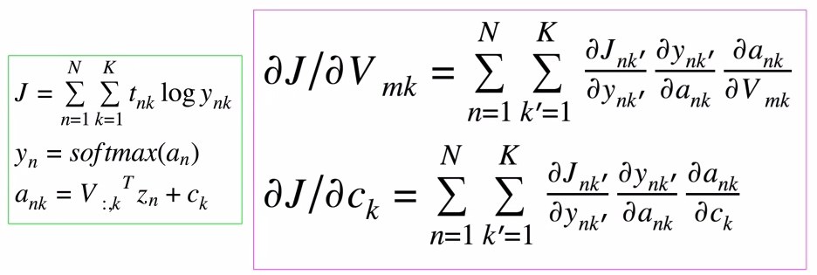
Neural Network with 1 Hidden Layer and Multi output Classes (K)
https://towardsdatascience.com/mcculloch-pitts-model-5fdf65ac5dd1

Slide 30
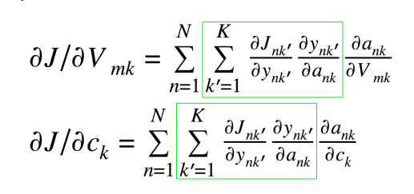
Neural Network with 1 Hidden Layer and Multi output Classes (K)
https://towardsdatascience.com/mcculloch-pitts-model-5fdf65ac5dd1

Slide 31
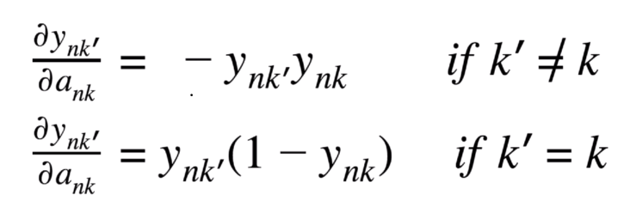
Neural Network with 1 Hidden Layer and Multi output Classes (K)
https://towardsdatascience.com/mcculloch-pitts-model-5fdf65ac5dd1

Slide 32
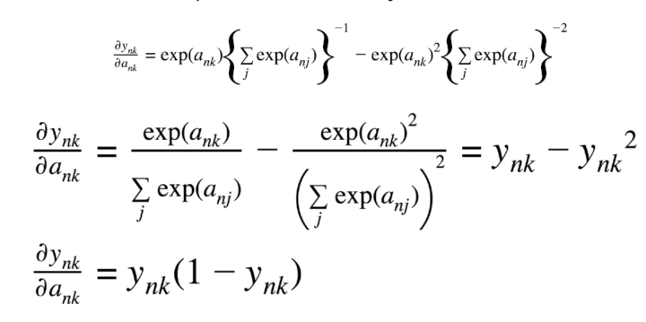
Neural Network with 1 Hidden Layer and Multi output Classes (K)
https://towardsdatascience.com/mcculloch-pitts-model-5fdf65ac5dd1

Slide 33
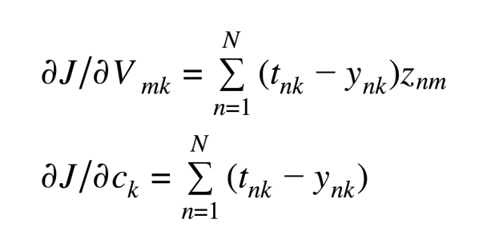
Neural Network with 1 Hidden Layer and Multi output Classes (K)
https://towardsdatascience.com/mcculloch-pitts-model-5fdf65ac5dd1

Slide 34
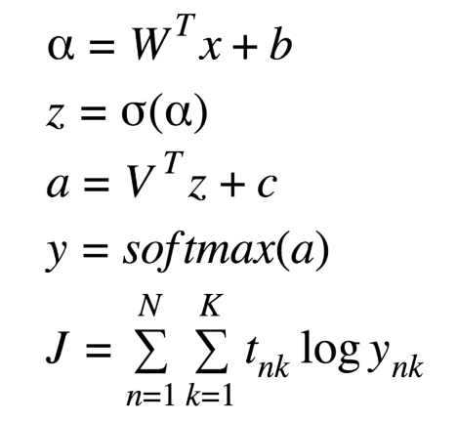
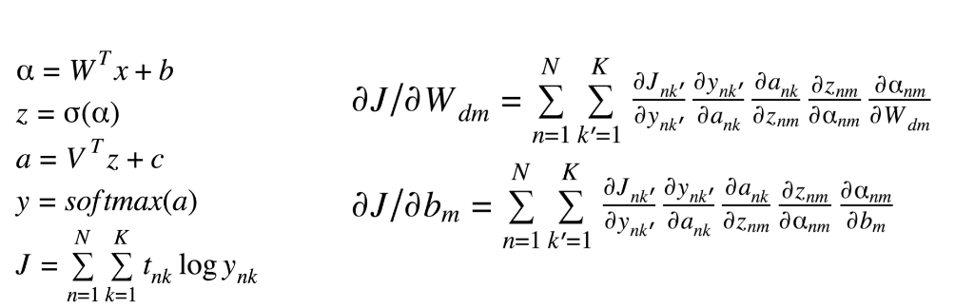
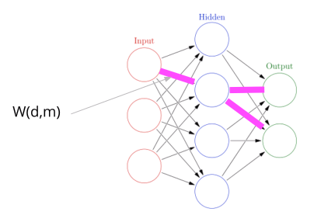
Neural Network with 1 Hidden Layer and Multi output Classes (K)
https://towardsdatascience.com/mcculloch-pitts-model-5fdf65ac5dd1

Slide 35
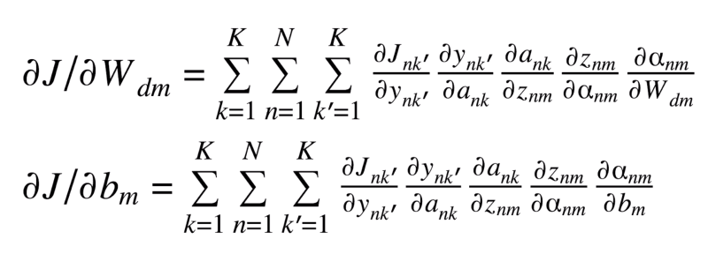
Neural Network with 1 Hidden Layer and Multi output Classes (K)
https://towardsdatascience.com/mcculloch-pitts-model-5fdf65ac5dd1

Slide 36
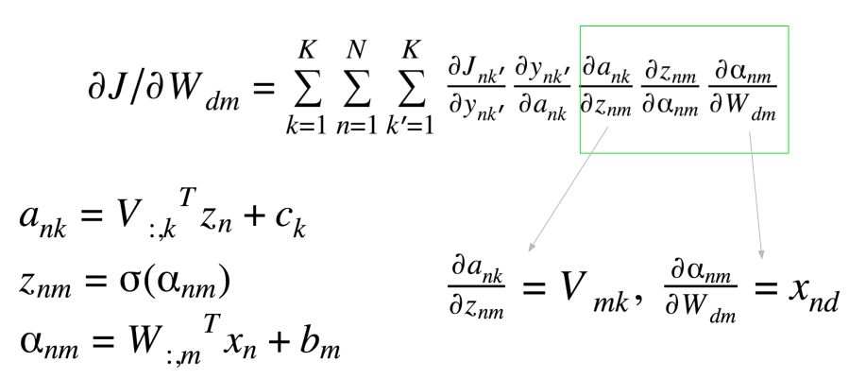
Neural Network with 1 Hidden Layer and Multi output Classes (K)
https://towardsdatascience.com/mcculloch-pitts-model-5fdf65ac5dd1

Slide 37
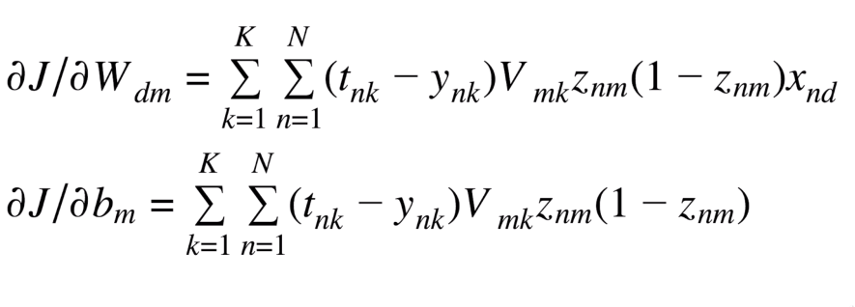
Neural Network with 1 Hidden Layer and Multi output Classes (K)
https://towardsdatascience.com/mcculloch-pitts-model-5fdf65ac5dd1

Slide 38
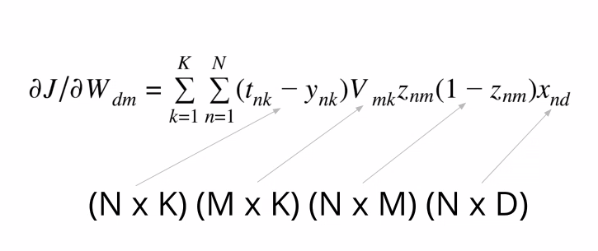
Neural Network with 1 Hidden Layer and Multi output Classes (K)
https://towardsdatascience.com/mcculloch-pitts-model-5fdf65ac5dd1

Slide 39
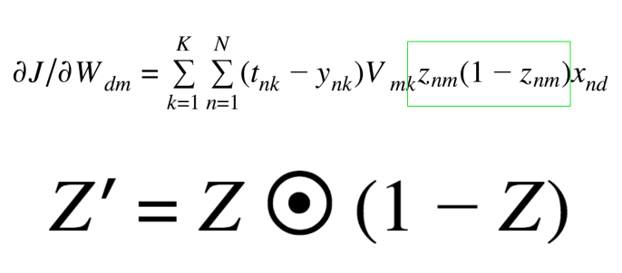
Neural Network with 1 Hidden Layer and Multi output Classes (K)
https://towardsdatascience.com/mcculloch-pitts-model-5fdf65ac5dd1

Slide 40
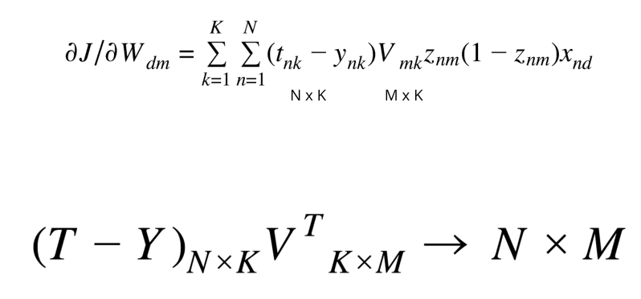
Neural Network with 1 Hidden Layer and Multi output Classes (K)
https://towardsdatascience.com/mcculloch-pitts-model-5fdf65ac5dd1

Slide 41
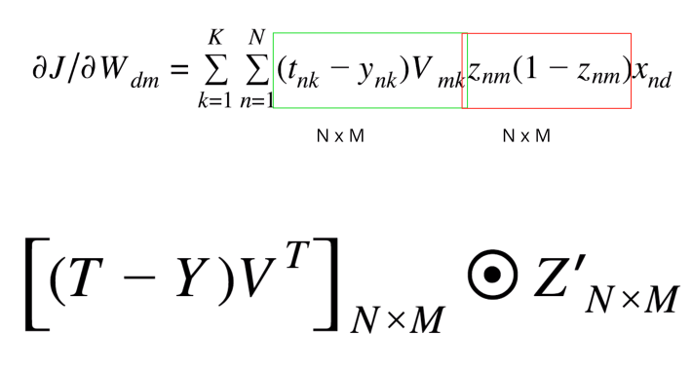
Neural Network with 1 Hidden Layer and Multi output Classes (K)
https://towardsdatascience.com/mcculloch-pitts-model-5fdf65ac5dd1

Slide 42
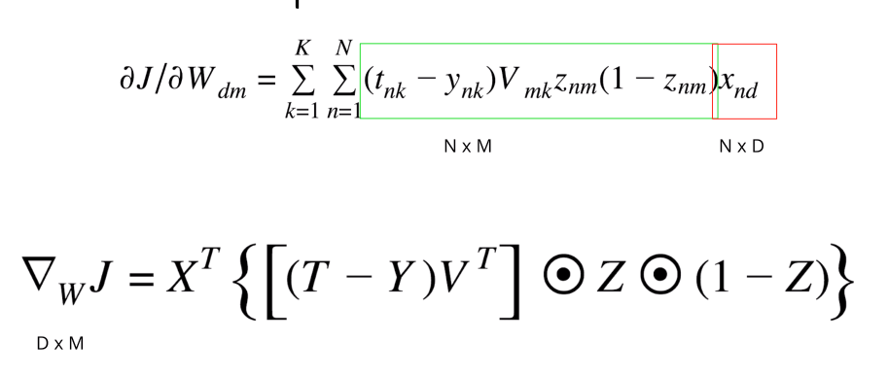
Neural Network with 1 Hidden Layer and Multi output Classes (K)
https://towardsdatascience.com/mcculloch-pitts-model-5fdf65ac5dd1

Slide 43
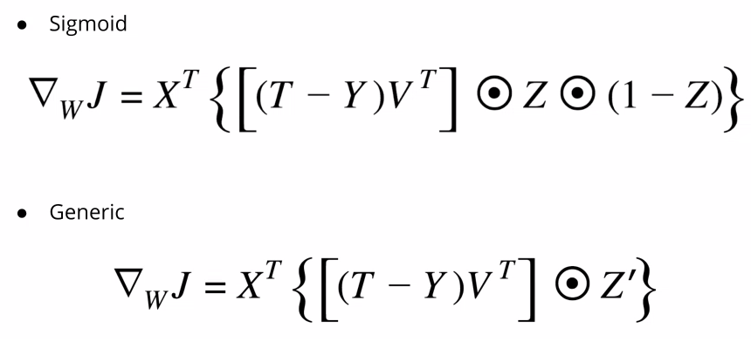
Neural Network with 1 Hidden Layer and Multi output Classes (K)
https://towardsdatascience.com/mcculloch-pitts-model-5fdf65ac5dd1

Slide 44
Neural Network XOR Gate Derivations
Additional Material - Appendix

Slide 45
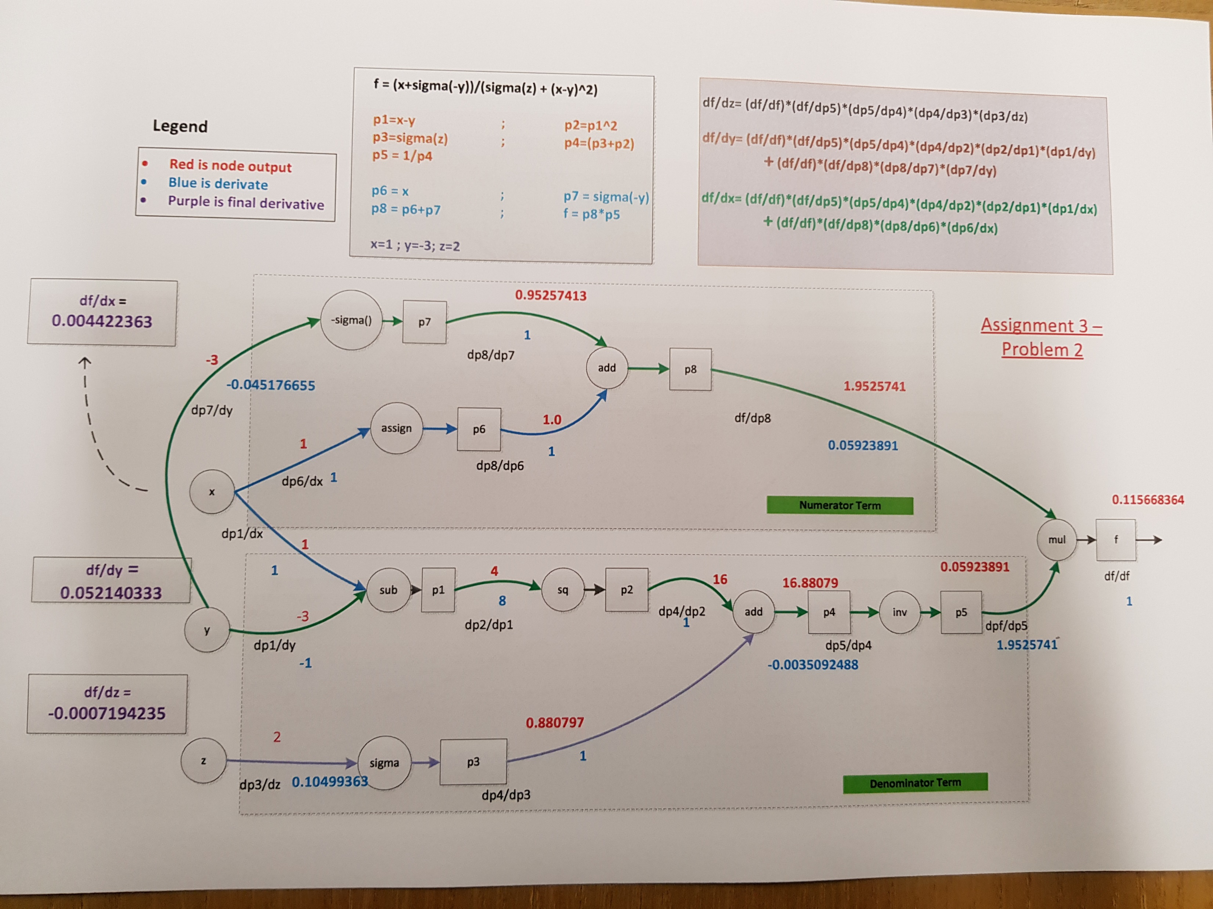


Neural Network Simulating XOR Logic Gate
Given a function f
Calculate the following derivatives using back propagation approach
https://towardsdatascience.com/mcculloch-pitts-model-5fdf65ac5dd1

