Slide 1
ZAS Academy
Python Curriculum for IOT & AI

Slide 2
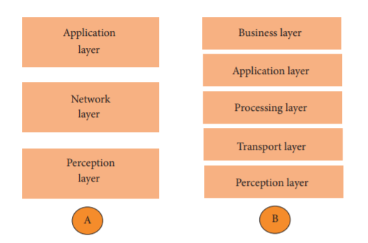
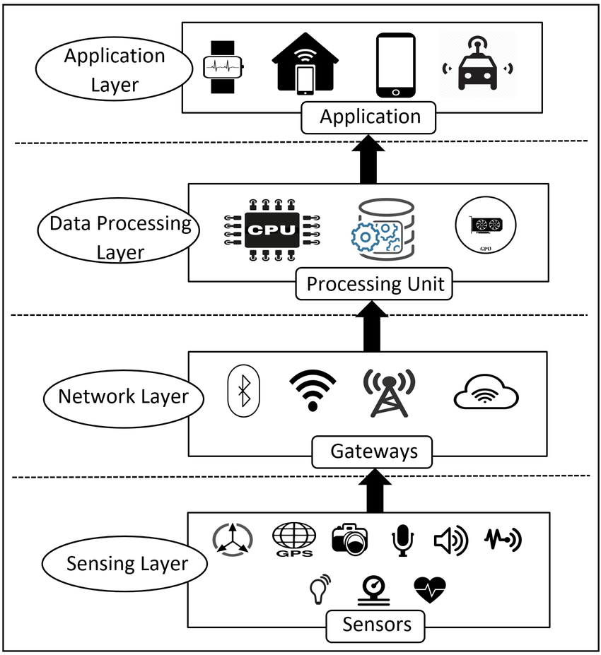
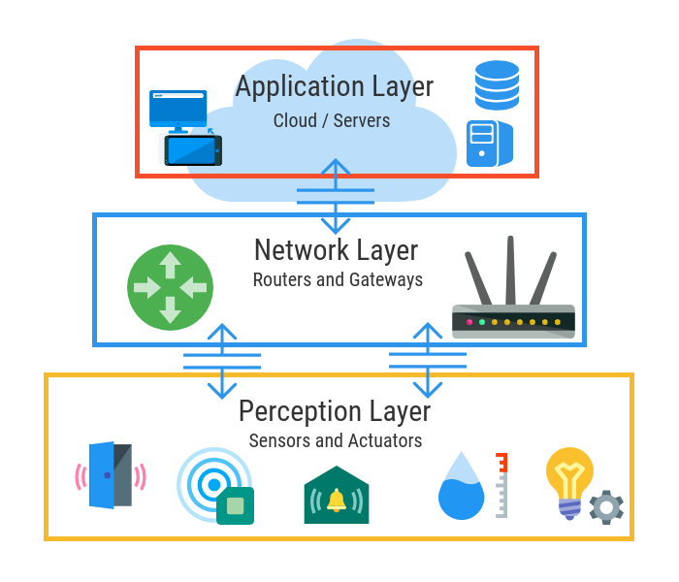
IOT Architecture – Based on Network Protocol
3 Layers
4 Layers
5 Layers

Slide 3
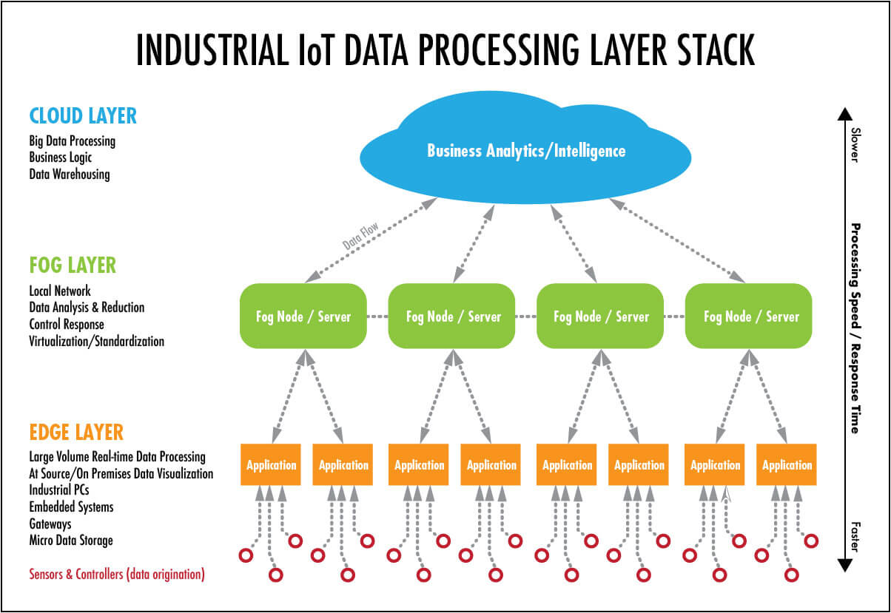
IOT Architecture – Based on Systems Architecture

Slide 4
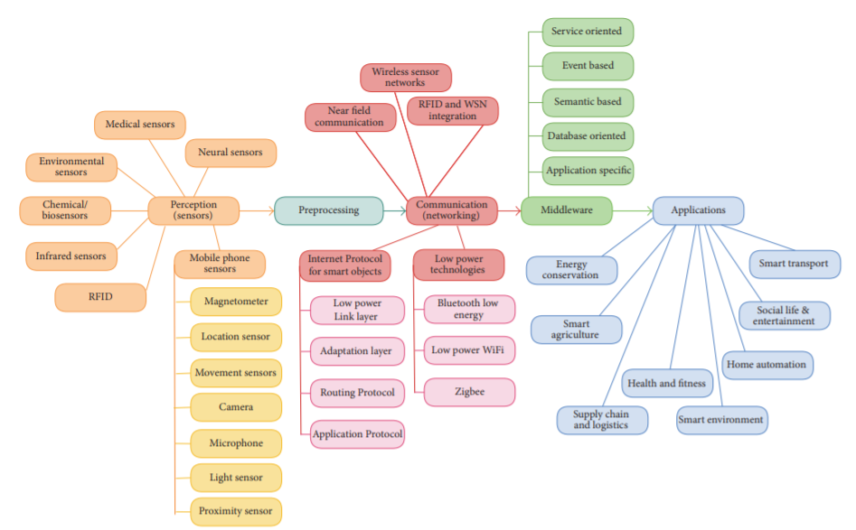
IOT Architecture

Slide 5
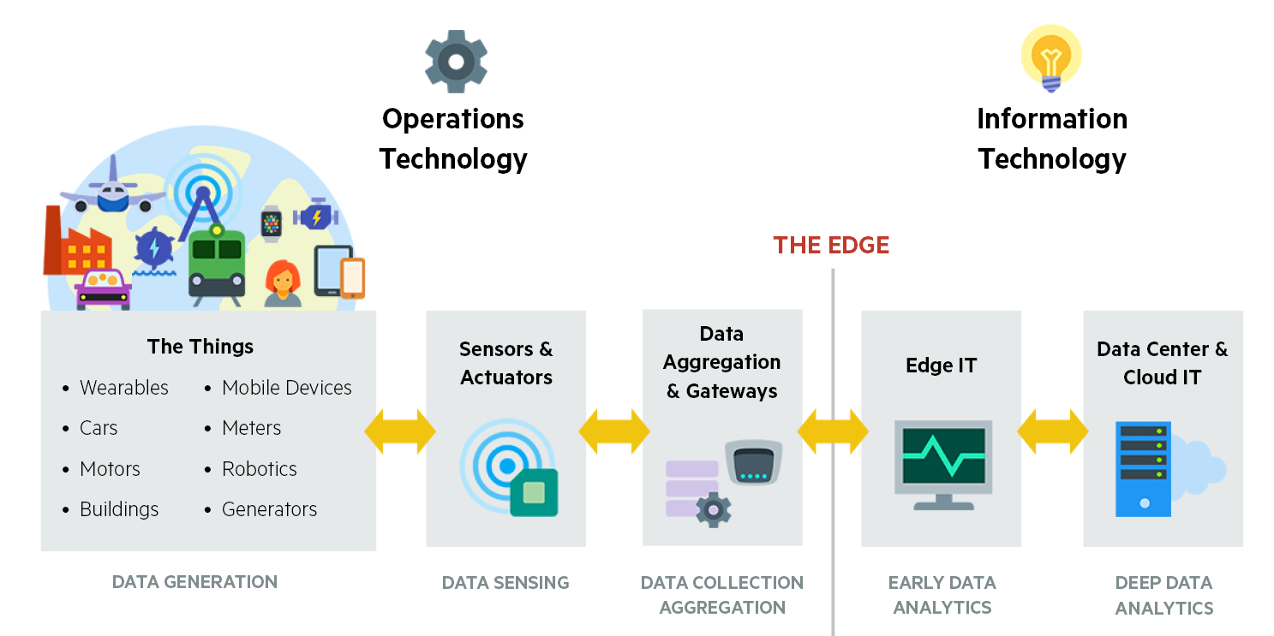
IOT Architecture – Example 1

Slide 6
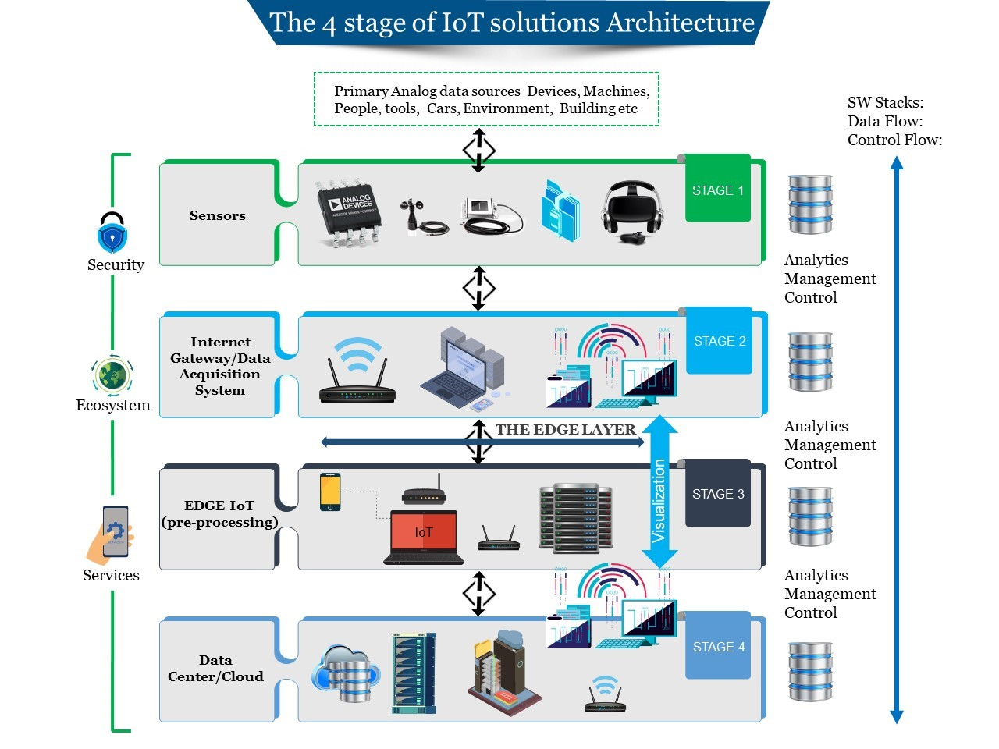
IOT Architecture – 4 Stages – Example 2

Slide 7
Port Forwarding for Inbound Traffic using raspberry PI
Router/Firewall
PI/Device/Sensors
Email
SMS
Cloud
MQTT
WebSite
Firebase DB
Laptop
File (Temp Sensor)
Database

Slide 8
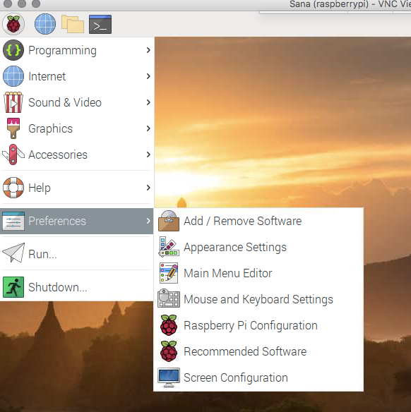
Node Red

Slide 9
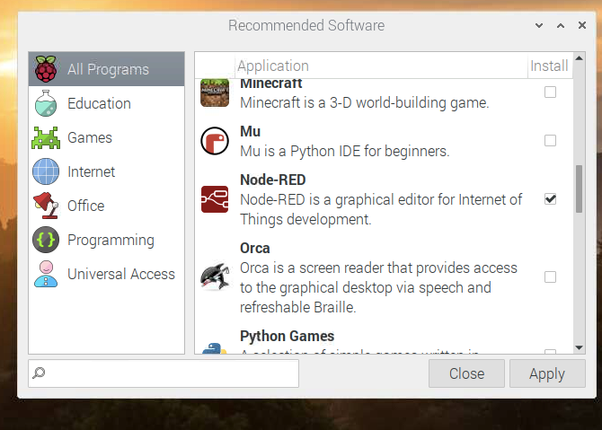
Node Red

Slide 10
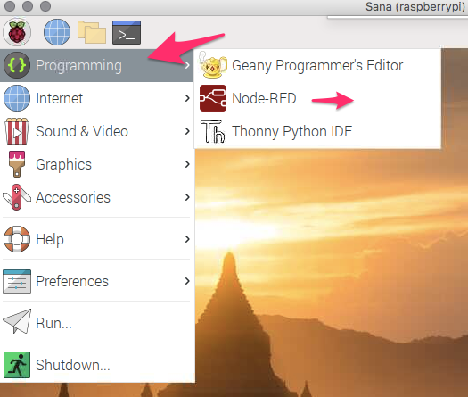
Node Red – Starting Manually
Node Red – Starting on Reboot

Slide 11
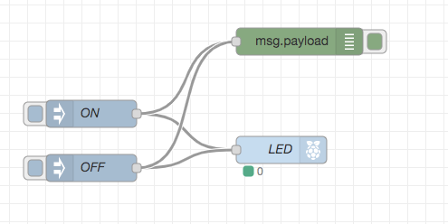
Node Red – Simple LED

Slide 12
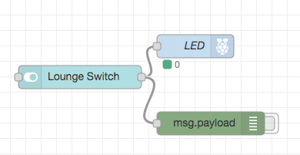
Node Red – Simple LED with Dashboard

Slide 13
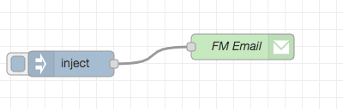
Node Red – Email Sender

Slide 14
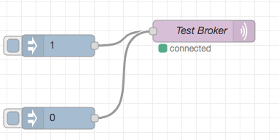
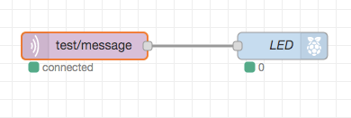
Node Red – MQTT Message Publisher – LED (Node Red)

Slide 15
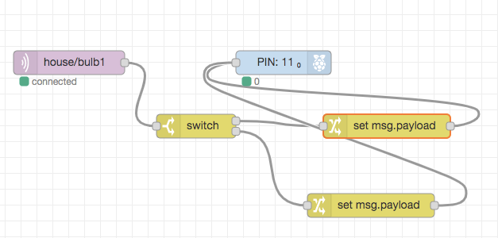
Node Red – MQTT Message Publisher – LED (Python)

Slide 16
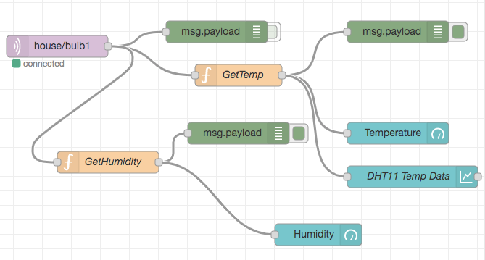
Node Red – MQTT Message Publisher – DHT11 Data

Slide 17
Mosquitto Broker Installation
sudo apt update
sudo apt install -y mosquitto mosquitto-clients
sudo systemctl enable mosquitto.service
pip3 install paho-mqtt

Slide 18
Mosquitto Broker Installation - Testing
mosquitto –v
mosquitto_sub -d -t testTopic
mosquitto_pub -d -t testTopic -m "Hello world!"
https://randomnerdtutorials.com/testing-mosquitto-broker-and-client-on-raspbbery-pi/

