Slide 1
ZAS Academy
Python Curriculum for IOT & AI

Slide 2
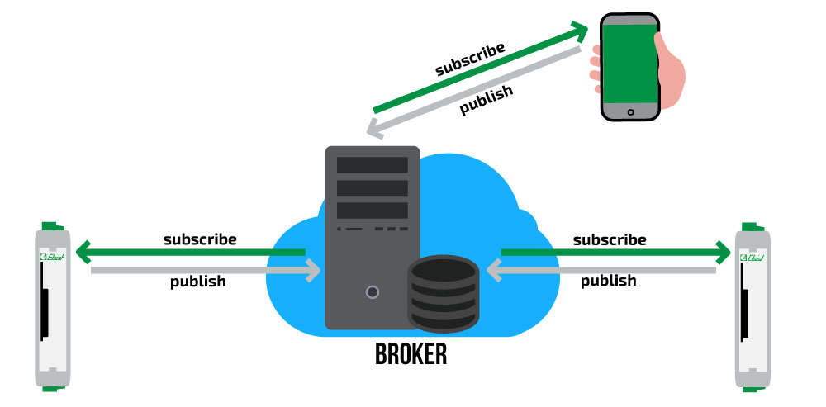
Mosquitto Broker Installation

Slide 3
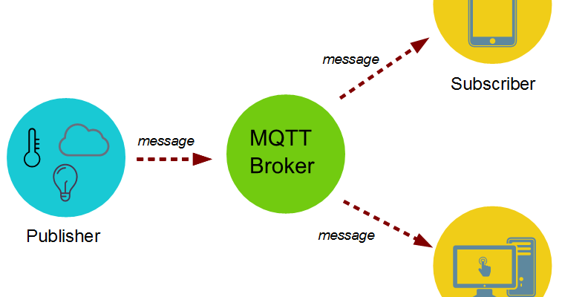
Mosquitto Broker Installation

Slide 4
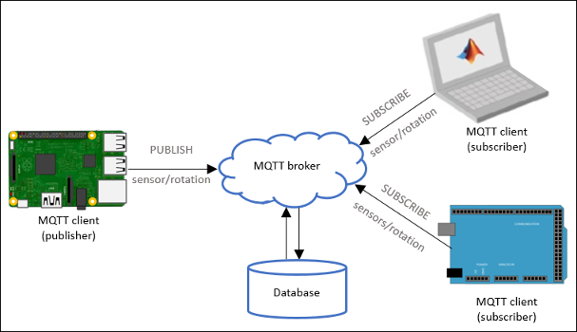
Mosquitto Broker Installation

Slide 5
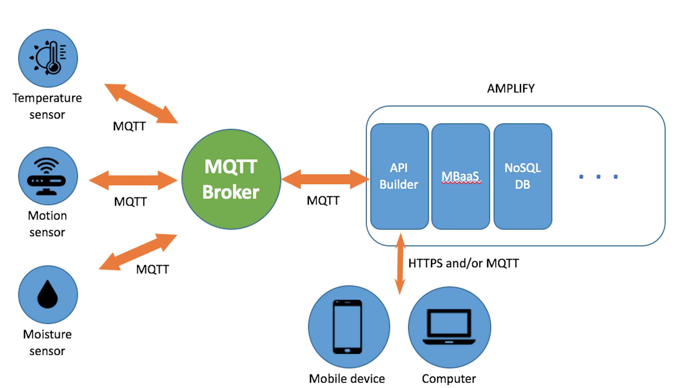
Mosquitto Broker Installation

Slide 6
Mosquitto Broker Installation
sudo apt update
sudo apt install -y mosquitto mosquitto-clients
sudo systemctl enable mosquitto.service
pip3 install paho-mqtt

Slide 7
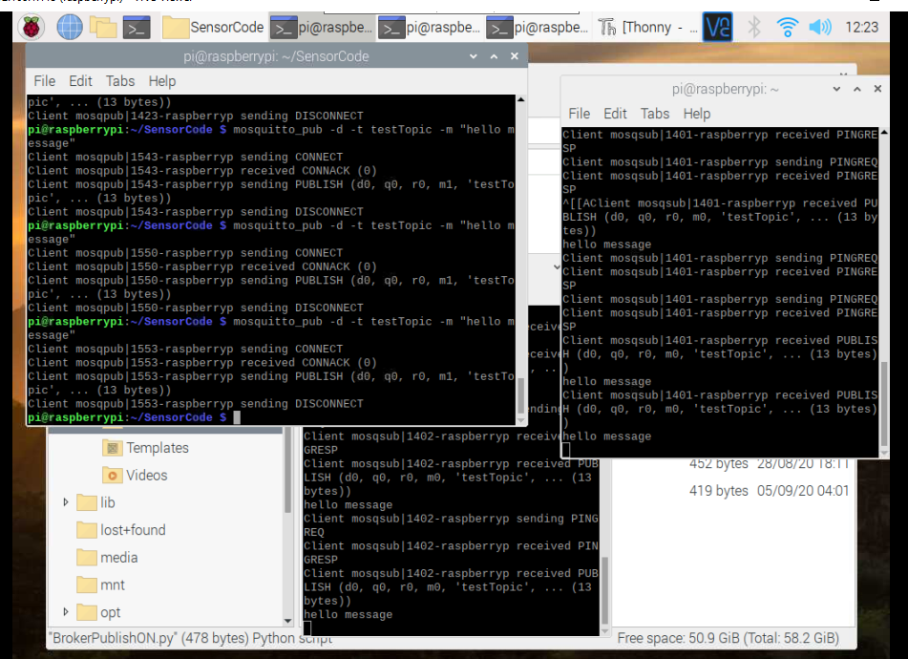
Mosquitto Broker Installation - Testing
Publisher
Subscriber
Subscriber

Slide 8
Mosquitto Broker Installation - Testing
mosquitto –v
mosquitto_sub -d -t testTopic
mosquitto_pub -d -t testTopic -m "Hello world!"
https://randomnerdtutorials.com/testing-mosquitto-broker-and-client-on-raspbbery-pi/

Slide 9
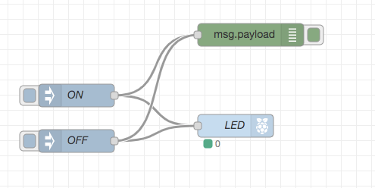
Node Red – Simple LED

Slide 10
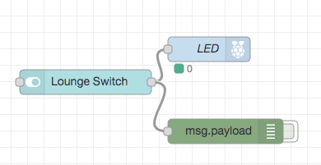
Node Red – Simple LED with Dashboard

Slide 11
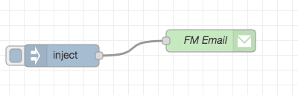
Node Red – Email Sender

Slide 12
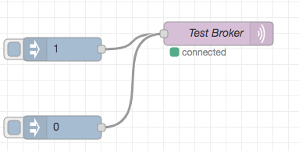
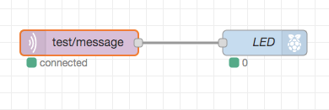
Node Red – MQTT Message Publisher – LED (Node Red)

Slide 13
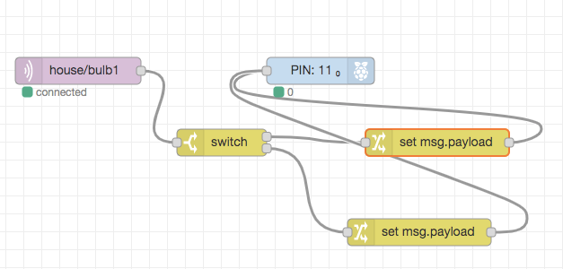
Node Red – MQTT Message Publisher – LED (Python)

Slide 14
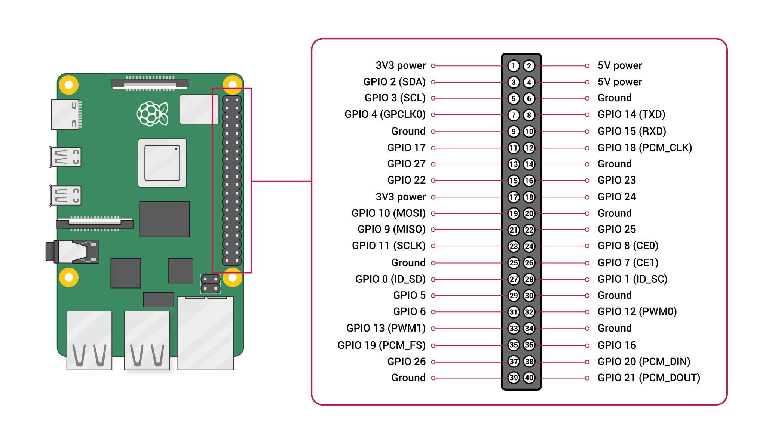
Python/Node Red – MQTT Message Publisher – DHT11 Data
Connect DHT11 to BACM PIN 27

Slide 15
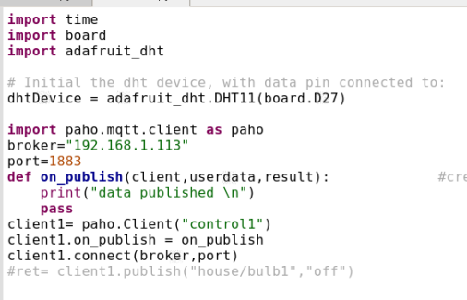
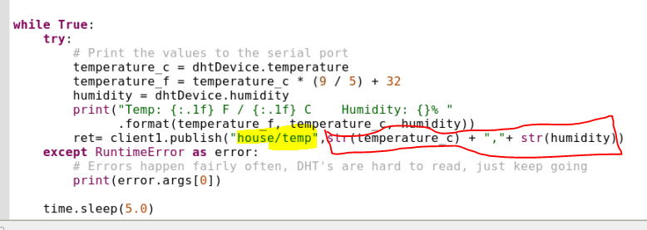
Python– MQTT Message Publisher – DHT11 Data

Slide 16
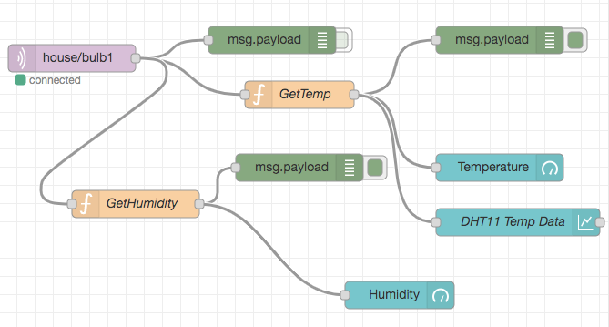
Node Red – MQTT Message Subscriber – DHT11 Data

