Slide 1
ZAS Academy
Python Curriculum for IOT & AI

Slide 2
Day4 - Agenda
Day 4
Blynking LED
Touch sensor
DHT11 sensor

Slide 3
So far…
Step-1: Format the SD Card
Step-2: Burn the OS Image on to the SD Card
Step-3: Create an empty file called “ssh”
Step-4: Insert the SD Card into PI and Bootup
Step-5: Connect to Raspberry PI (via Terminal/Putty)
Step-6: Update/Upgrade OS
Step-7: Change Raspi-Configuration: enable VNC, Resolution and Restart
Step-8: Enable WIFI, Configure Screen Resolution
Step-9: Connect to PI using VNC Viewer
Step-10: Update/Install Software on Raspberry PI

Slide 4
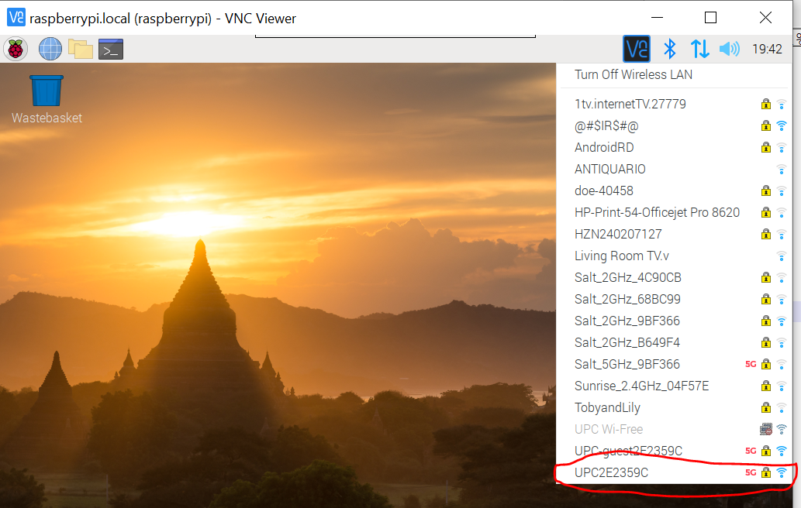
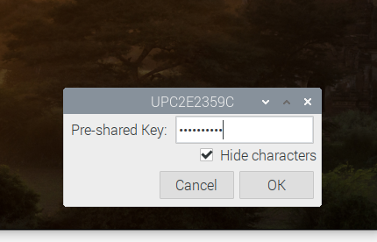
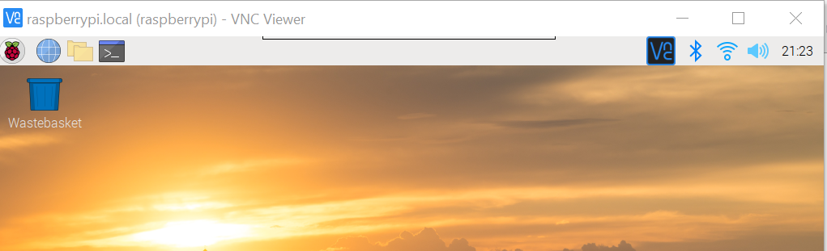
Pi Connected to Wifi
1
3
2
4

Slide 5
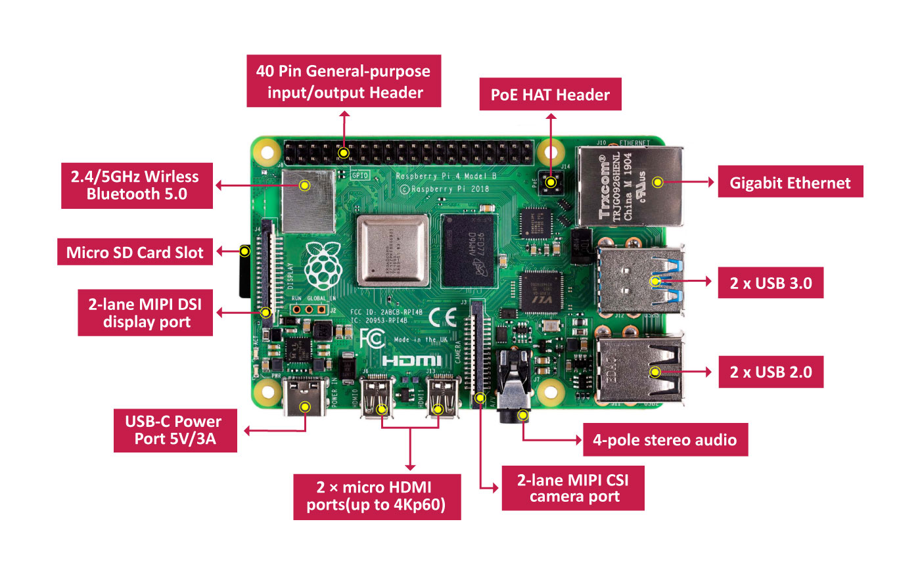
Pi Architecture

Slide 6
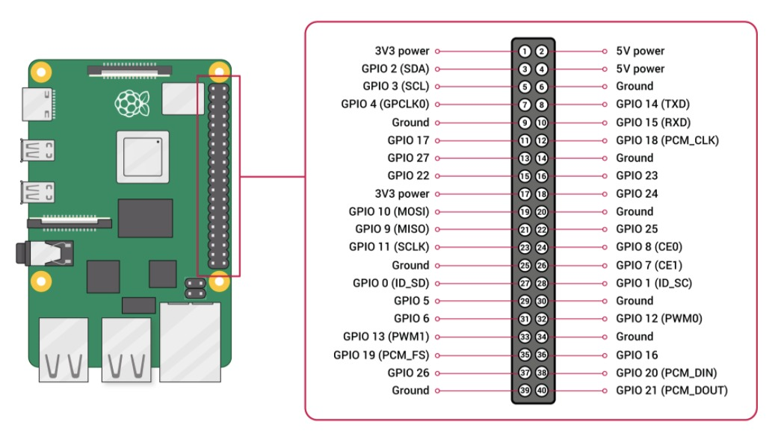
Pi Pin Diagram

Slide 7
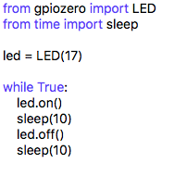

PILED

Slide 8
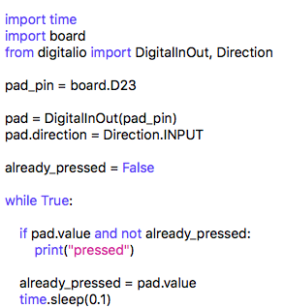
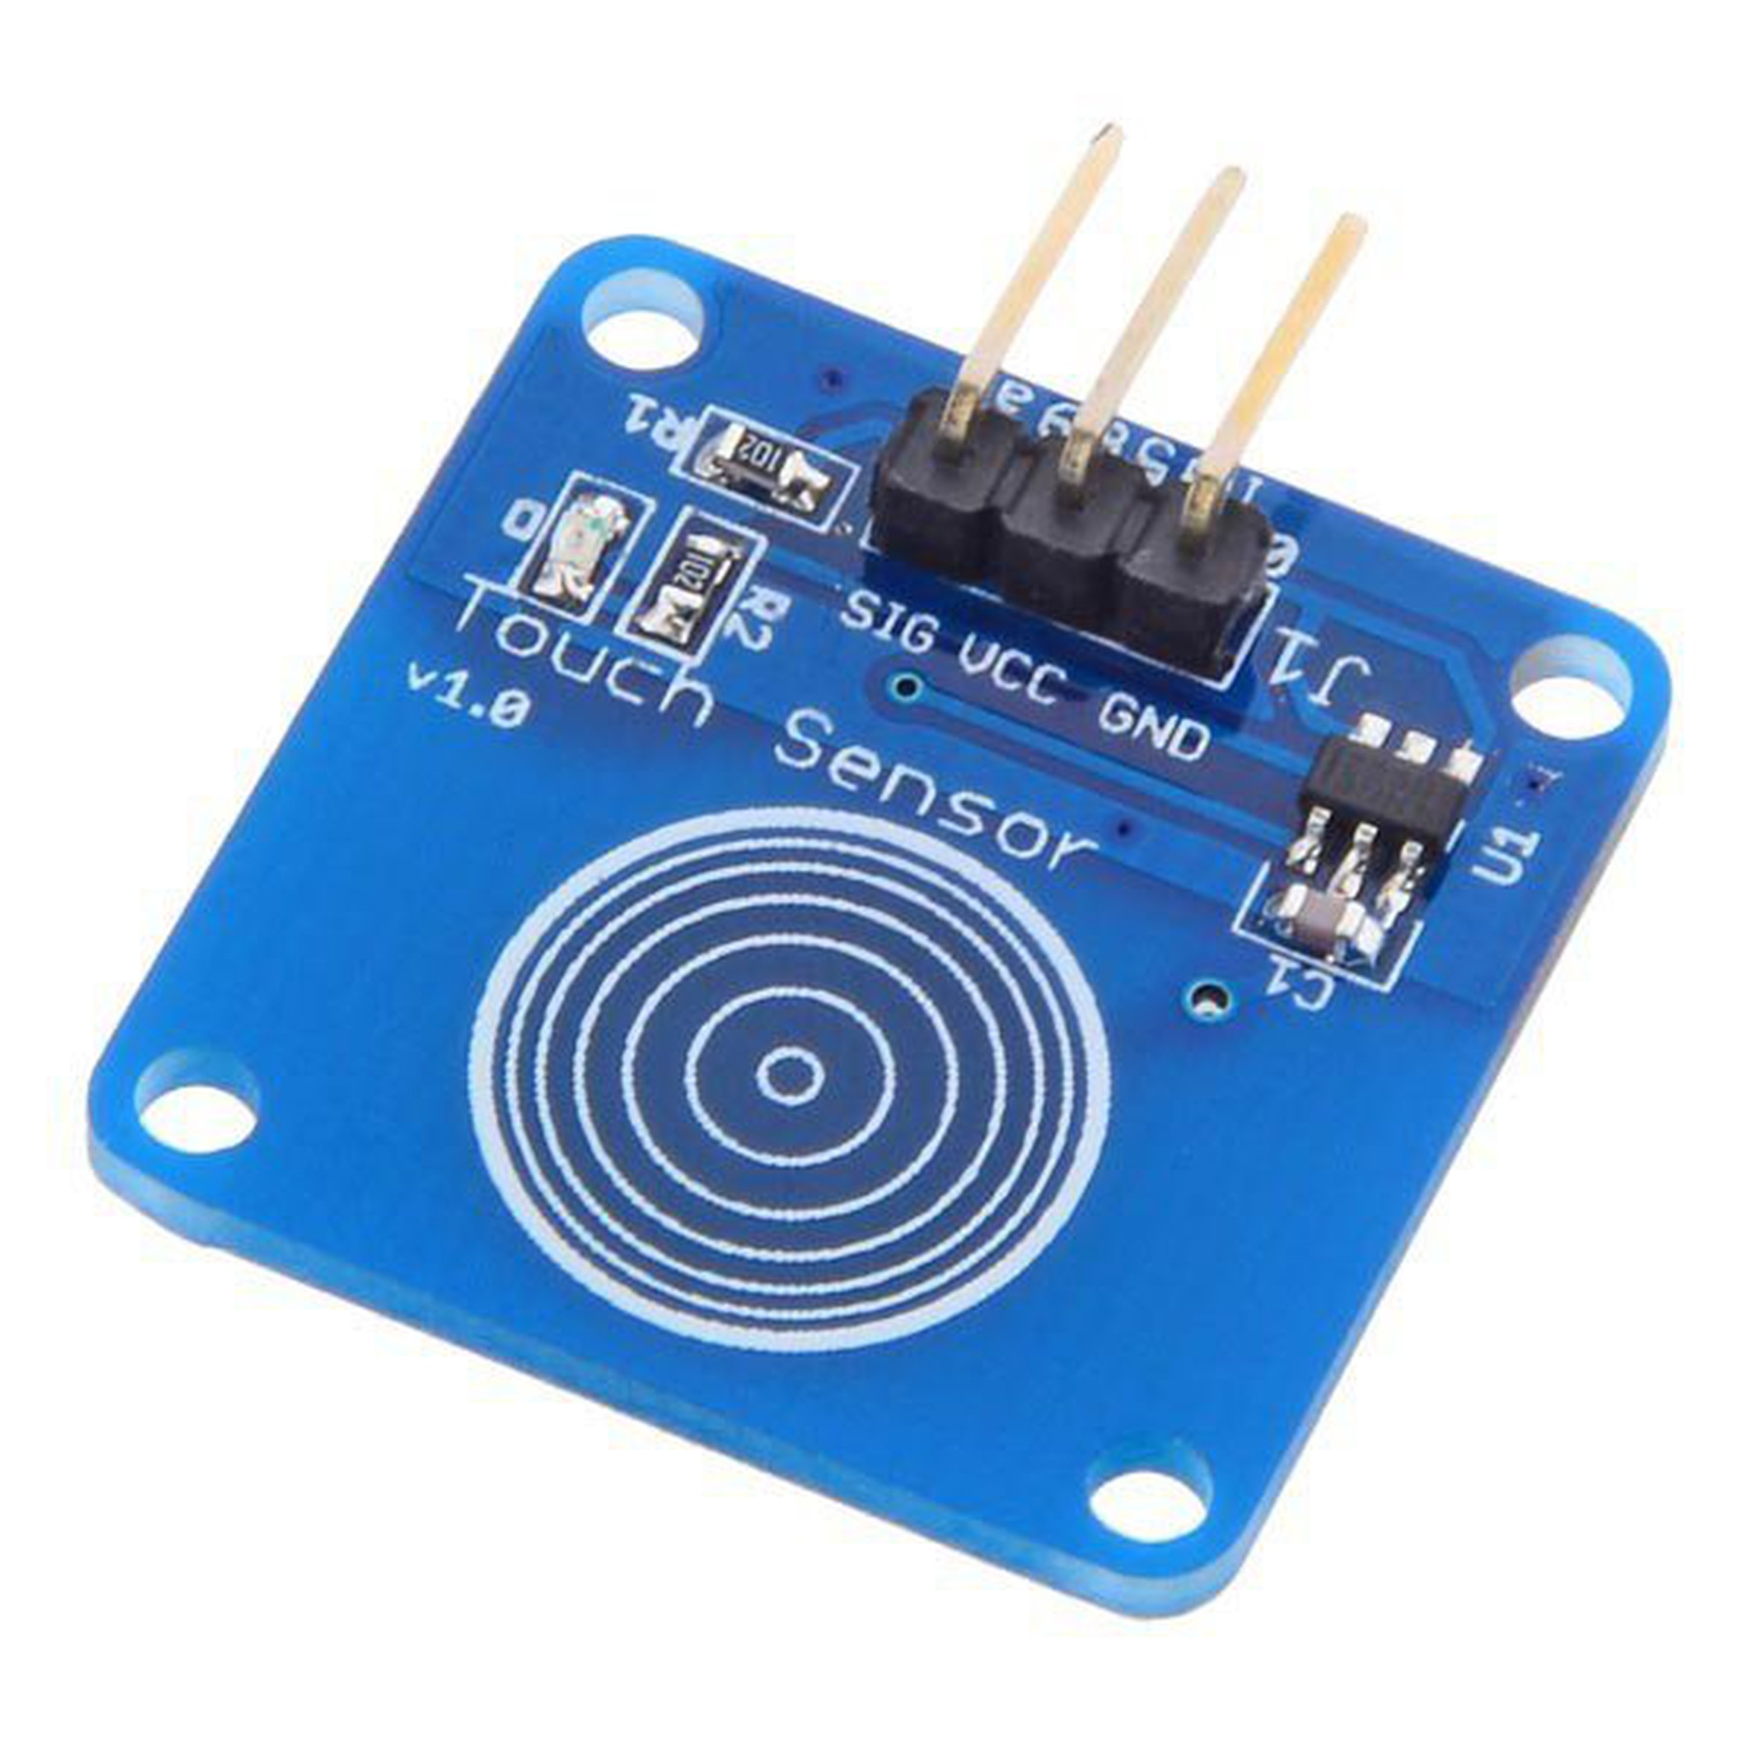
Touch Sensor

Slide 9
Day1 – Step-9: Install Python Libraries for DHT11 Sensor on PI
Connect to PI
Run the following commands to install Python Libraries for DHT11 Sensor.
Reference Link: https://github.com/adafruit/Adafruit_Python_DHT
sudo pip3 install Adafruit_DHT

Slide 10
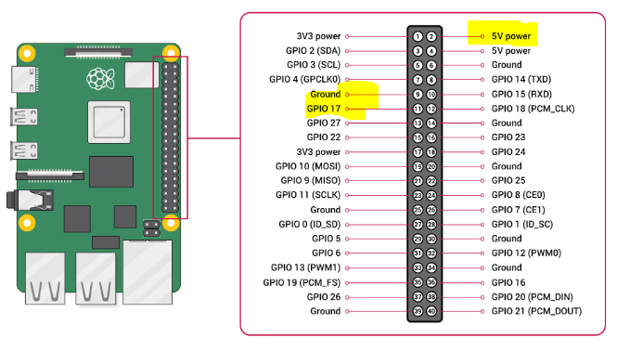
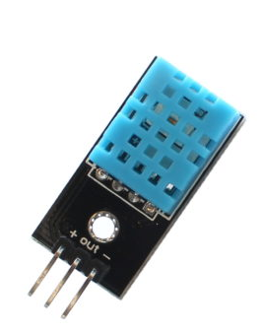
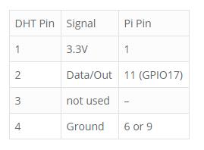
Day1 – DHT11 - Wiring
Please pay attention to PIN Numbers and the corresponding GPIO xx numbers
https://www.raspberrypi-spy.co.uk/2017/09/dht11-temperature-and-humidity-sensor-raspberry-pi/
You Can Use PIN2 which is 5V (as shown in the PIN Diagram)

Slide 11
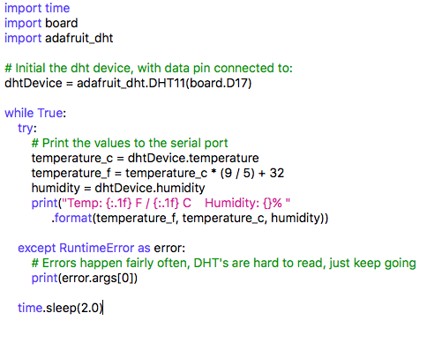
DHT11 Code

Slide 12
Logistics
Lecture | Date | Day | Time | Comments
1 | 15-Aug-2010 | SAT | 09:00AM
2 | 22-AUG-2020 | SAT | 09:00AM
3 | 29-AUG-2020 | SAT | 09:00AM
4 | 05-Sep-2020 | SAT | 09:00AM
5 | 12-Sep-2020 | SAT | 09:00AM
 | 19-Sep-2020 | SAT | 09:00AM | Midterm Exams
6 | 26-Sep-2020 | SAT | 09:00AM
7 | 03-OCT-2020 | SAT | 09:00AM
8 | 10-OCT-2020 | SAT | 09:00AM
9 | 17-OCT-2020 | SAT | 09:00AM
 | 24-OCT-2020 | SAT | 09:00AM | Dasara Break
 | 31-OCT-2020 | SAT | 09:00AM | Dasara Break
10 | 07-NOV-2020 | SAT | 09:00AM
 | 14-NOV-2020 | SAT | 09:00AM | Diwali Break
11 | 21-NOV-2020 | SAT | 09:00AM
12 | 28-NOV-2020 | SAT | 09:00AM

Slide 13
Logistics
Lecture | Date | Day | Time | Comments
1 | 15-Aug-2010 | SAT | 09:00AM
2 | 22-AUG-2020 | SAT | 09:00AM
3 | 29-AUG-2020 | SAT | 09:00AM
4 | 05-Sep-2020 | SAT | 09:00AM
5 | 12-Sep-2020 | SAT | 09:00AM
 | 19-Sep-2020 | SAT | 09:00AM | Midterm Exams
6 | 26-Sep-2020 | SAT | 09:00AM
7 | 03-OCT-2020 | SAT | 09:00AM
8 | 10-OCT-2020 | SAT | 09:00AM
9 | 17-OCT-2020 | SAT | 09:00AM
 | 24-OCT-2020 | SAT | 09:00AM | Dasara Break
 | 31-OCT-2020 | SAT | 09:00AM | Dasara Break
10 | 07-NOV-2020 | SAT | 09:00AM
 | 14-NOV-2020 | SAT | 09:00AM | Diwali Break
11 | 21-NOV-2020 | SAT | 09:00AM
12 | 28-NOV-2020 | SAT | 09:00AM

