Slide 1
ZAS Academy
Python Curriculum for IOT & AI

Slide 2
Day4 - Agenda
Day 5
Blynking LED
Touch sensor
DHT11 sensor

Slide 3
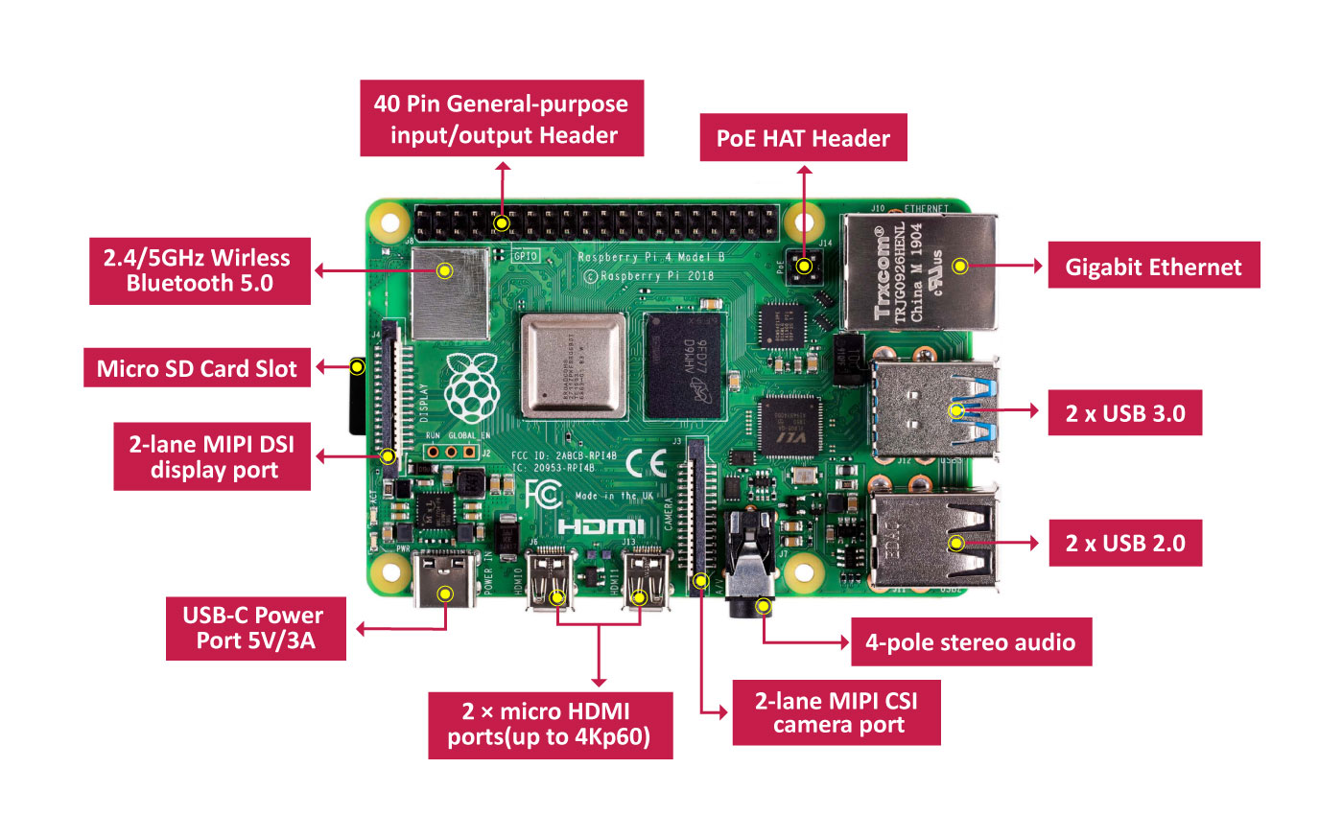
Pi Architecture

Slide 4
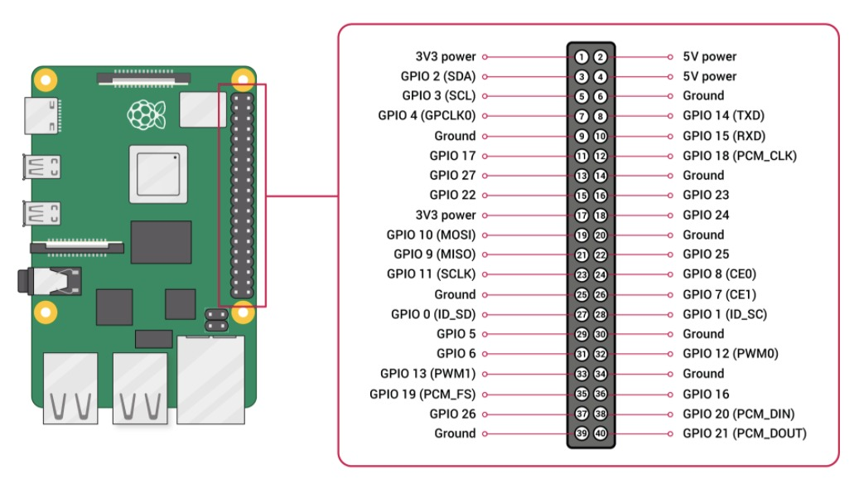
Pi Pin Diagram

Slide 5
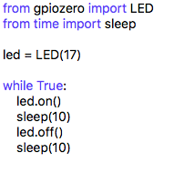
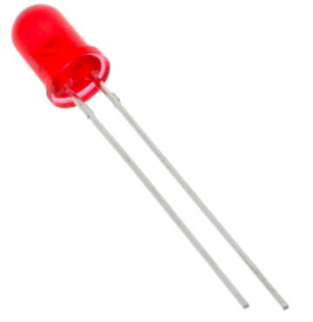
PILED

Slide 6
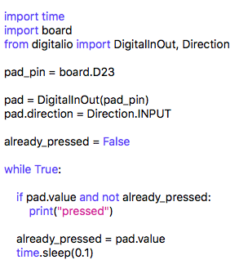
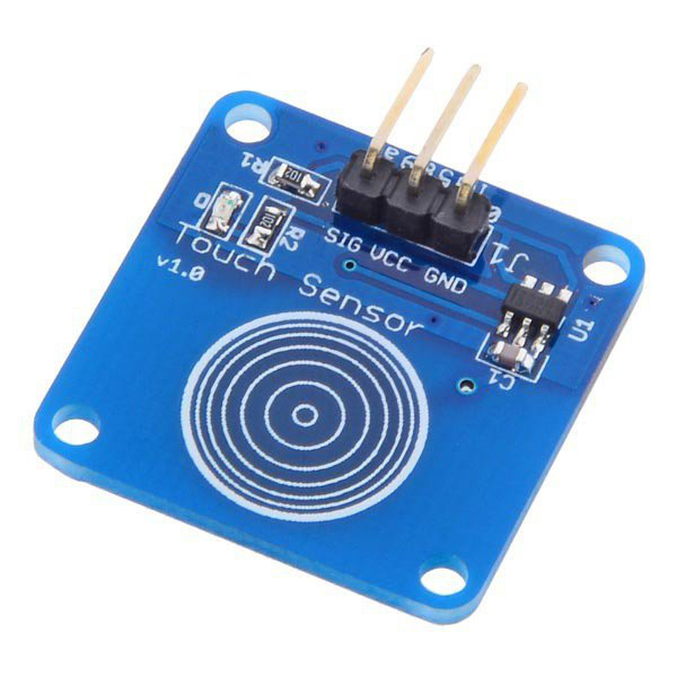
Touch Sensor

Slide 7
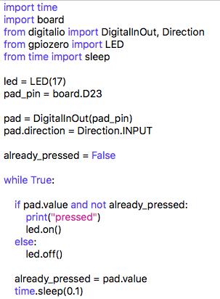
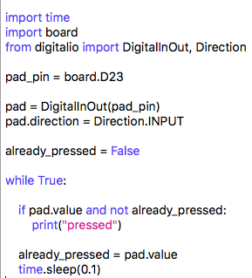
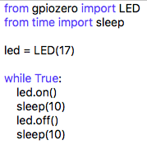
Touch Sensor

Slide 8
Day1 – Step-9: Install Python Libraries for DHT11 Sensor on PI
Connect to PI
Run the following commands to install Python Libraries for DHT11 Sensor.
Reference Link: https://github.com/adafruit/Adafruit_Python_DHT
sudo pip3 install Adafruit_DHT

Slide 9
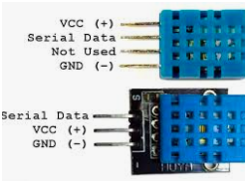
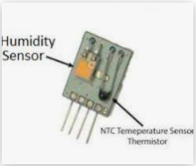
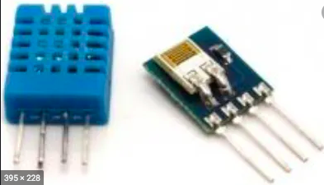
DHT11/DHT22

Slide 10
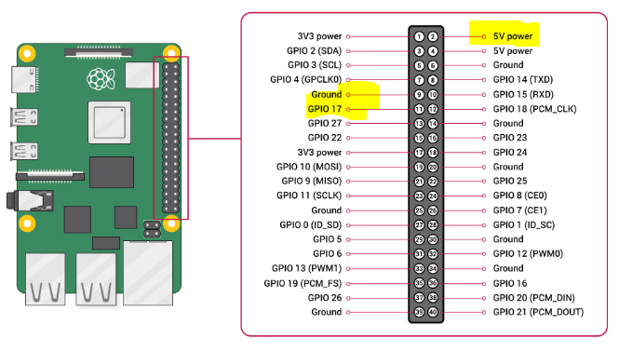
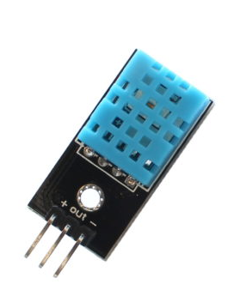
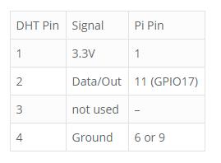
Day1 – DHT11 - Wiring
Please pay attention to PIN Numbers and the corresponding GPIO xx numbers
https://www.raspberrypi-spy.co.uk/2017/09/dht11-temperature-and-humidity-sensor-raspberry-pi/
You Can Use PIN2 which is 5V (as shown in the PIN Diagram)

Slide 11
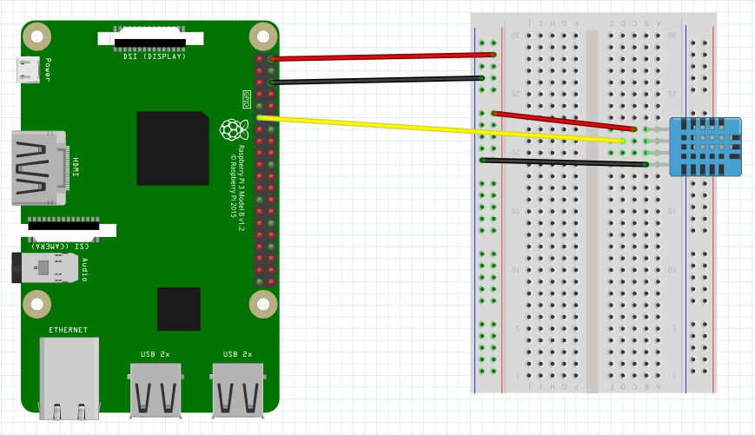
Prototyping

Slide 12
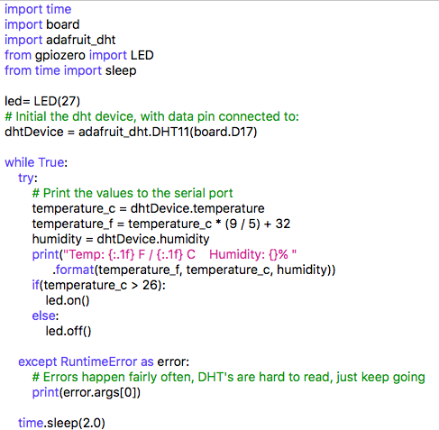
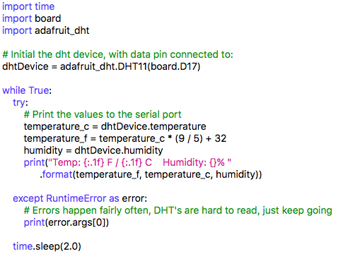
DHT11 Code

Slide 13
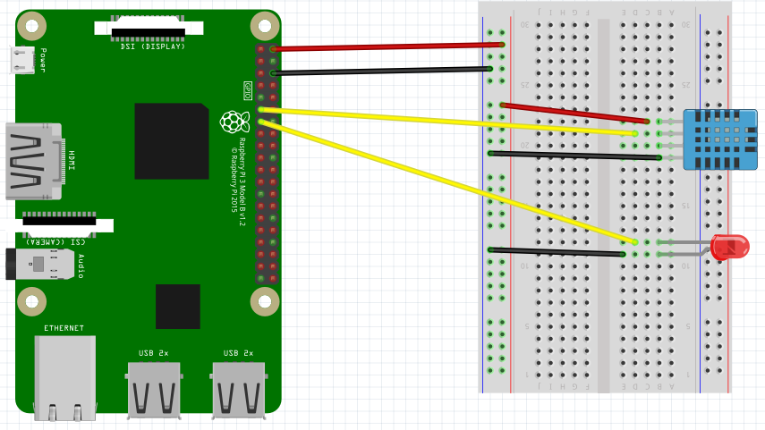
Prototype

Slide 14
Logistics
Lecture | Date | Day | Time | Comments
1 | 15-Aug-2010 | SAT | 09:00AM
2 | 22-AUG-2020 | SAT | 09:00AM
3 | 29-AUG-2020 | SAT | 09:00AM
4 | 05-Sep-2020 | SAT | 09:00AM
5 | 12-Sep-2020 | SAT | 09:00AM
 | 19-Sep-2020 | SAT | 09:00AM | Midterm Exams
6 | 26-Sep-2020 | SAT | 09:00AM
7 | 03-OCT-2020 | SAT | 09:00AM
8 | 10-OCT-2020 | SAT | 09:00AM
9 | 17-OCT-2020 | SAT | 09:00AM
 | 24-OCT-2020 | SAT | 09:00AM | Dasara Break
 | 31-OCT-2020 | SAT | 09:00AM | Dasara Break
10 | 07-NOV-2020 | SAT | 09:00AM
 | 14-NOV-2020 | SAT | 09:00AM | Diwali Break
11 | 21-NOV-2020 | SAT | 09:00AM
12 | 28-NOV-2020 | SAT | 09:00AM

Slide 15
Logistics
Lecture | Date | Day | Time | Comments
1 | 15-Aug-2010 | SAT | 09:00AM
2 | 22-AUG-2020 | SAT | 09:00AM
3 | 29-AUG-2020 | SAT | 09:00AM
4 | 05-Sep-2020 | SAT | 09:00AM
5 | 12-Sep-2020 | SAT | 09:00AM
 | 19-Sep-2020 | SAT | 09:00AM | Midterm Exams
6 | 26-Sep-2020 | SAT | 09:00AM
7 | 03-OCT-2020 | SAT | 09:00AM
8 | 10-OCT-2020 | SAT | 09:00AM
9 | 17-OCT-2020 | SAT | 09:00AM
 | 24-OCT-2020 | SAT | 09:00AM | Dasara Break
 | 31-OCT-2020 | SAT | 09:00AM | Dasara Break
10 | 07-NOV-2020 | SAT | 09:00AM
 | 14-NOV-2020 | SAT | 09:00AM | Diwali Break
11 | 21-NOV-2020 | SAT | 09:00AM
12 | 28-NOV-2020 | SAT | 09:00AM

Slide 16
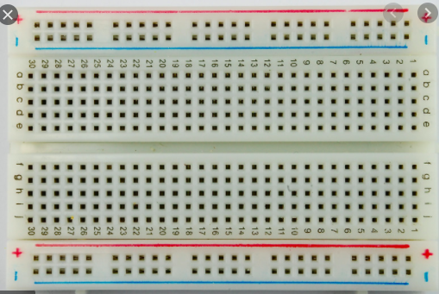
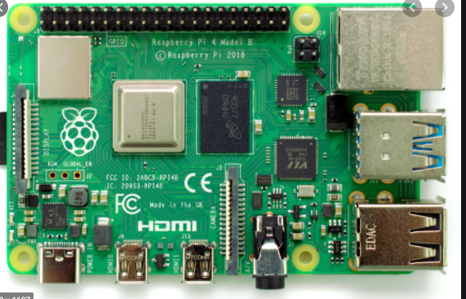

Slide 18
Pi Pin Diagram

