Slide 1
ZAS Academy
Python Curriculum for IOT & AI

Slide 2
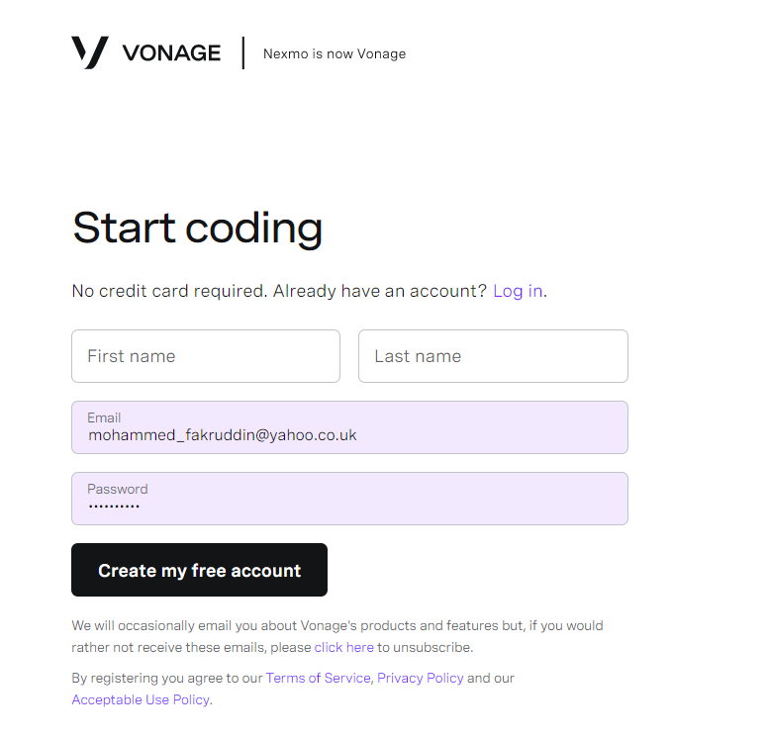
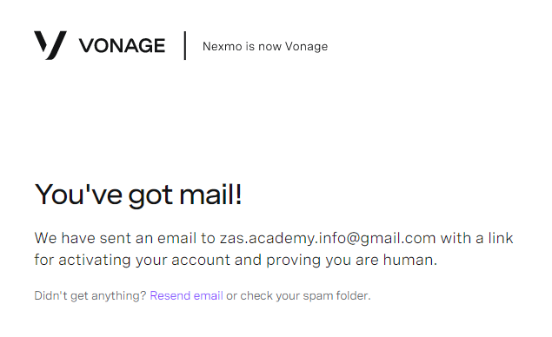
Nexmo Register
Step 1 : User Registration
https://dashboard.nexmo.com/sign-up

Slide 3
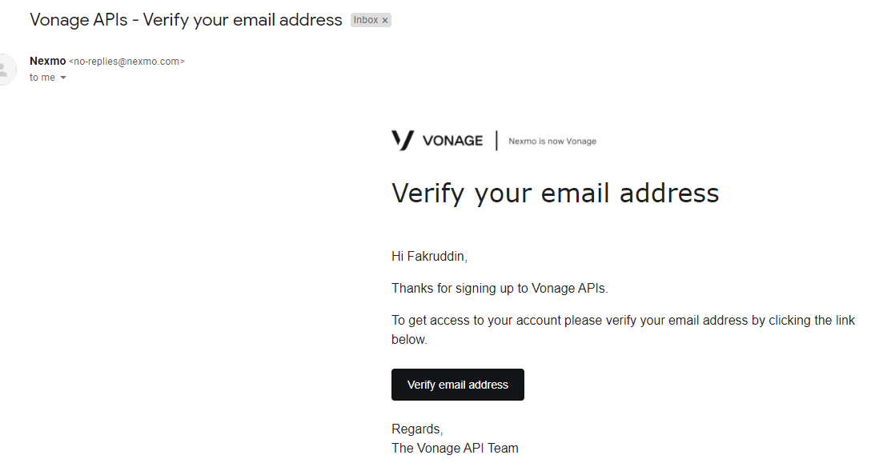
Nexmo Register
Step 2 – Email Verification
After registration, you should have received email like the below
Click on Very Email Address Button

Slide 4
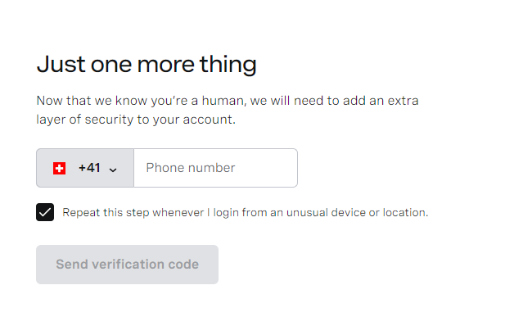
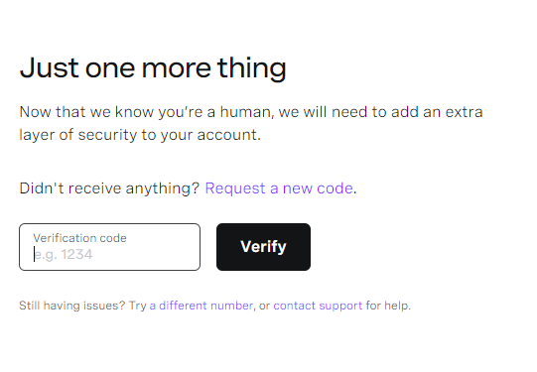
Nexmo Register
Step 3 – Register your telephone number to which you want to receive the login token
Note: This telephone number is important and this number will be the one receiving the SMS messages (using free account)

Slide 5
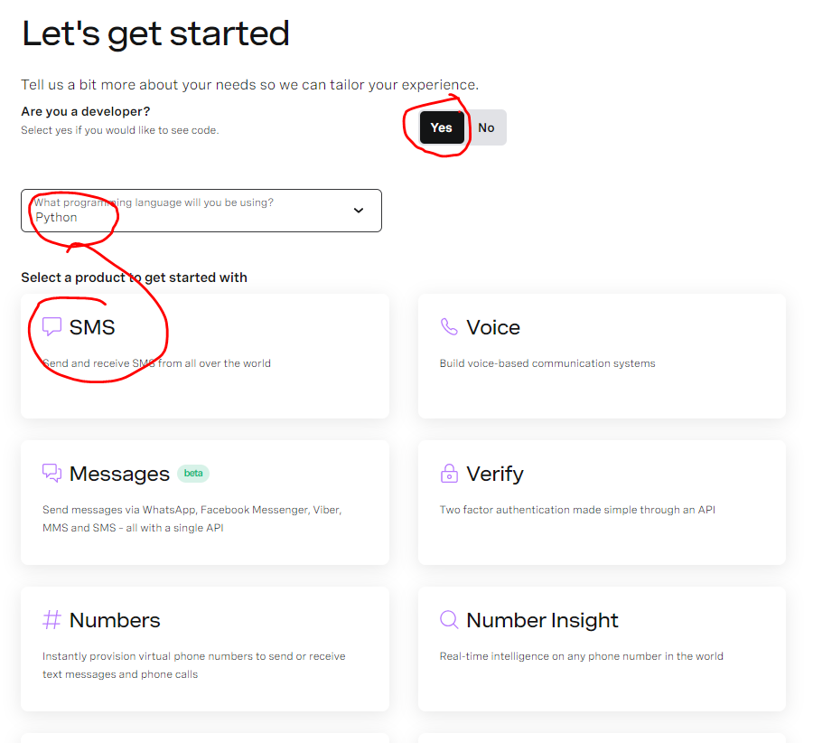
Nexmo Register
Step 4 – Select the Coding Language

Slide 6
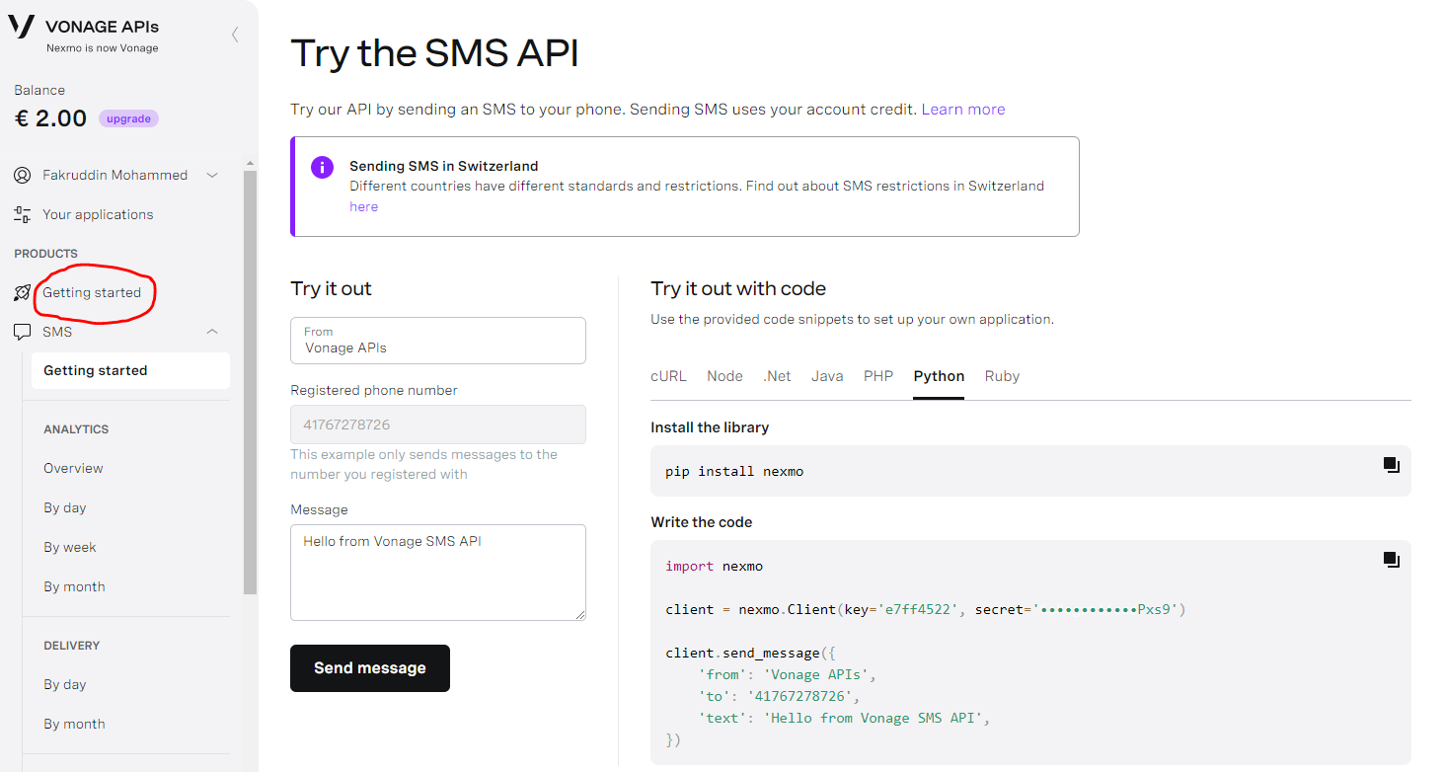
Nexmo Register
Step 5 –Click on Getting Started for API Keys

Slide 7
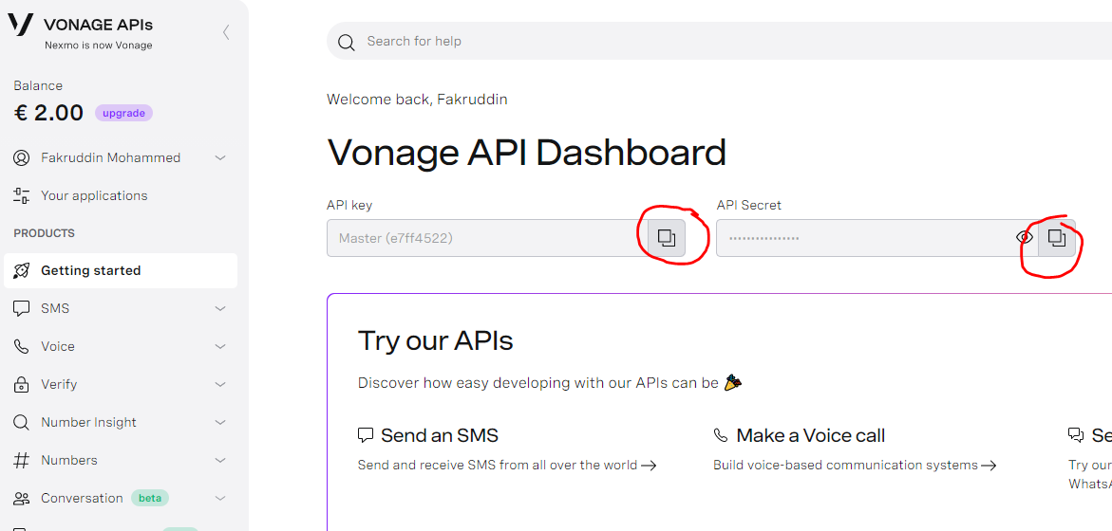
Nexmo Register
Step 6 – API Keys
You will need both API Key and API Secret
Click on copy icon and paste into the Python Code (shown in the next slide)

Slide 8
Install Nexmo Library on Raspberry PI
Step 7 – Install nexmo library on Raspberry PI
pip3 install nexmo

Slide 9
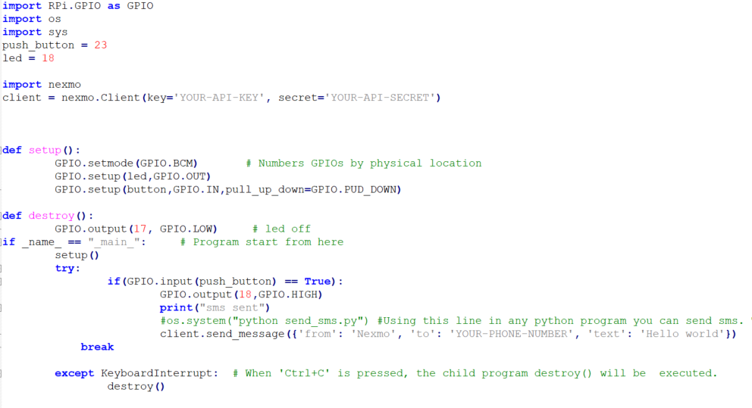
Python Code to Send SMS on Push Button
Step 7 – Edit the Python Code on Raspberry PI for “API Key” and “API Secret”
(key & secret copied from nexmo dashboard)

Slide 10
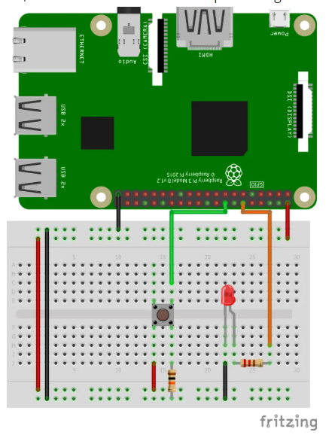
Send SMS Text Message on Push Button
Step 8 – Push Button Wiring for sending SMS Message

Slide 11
Send SMS Text Message on Push Button
Step 9 – Run the Python Code on Raspberry Code
python PI_SEND_SMS.py

Slide 12
Install Nexmo Library on Raspberry PI
Install nexmo library on PI
pip3 install nexmo
Not required
Code snippet to send SMS Text
import nexmo client = nexmo.Client(key='YOUR-API-KEY', secret='YOUR-API-SECRET') client.send_message({'from': 'Nexmo', 'to': 'YOUR-PHONE-NUMBER', 'text': 'Hello world'})
https://iot-guider.com/raspberrypi/send-sms-from-raspberry-pi-python/

Slide 13
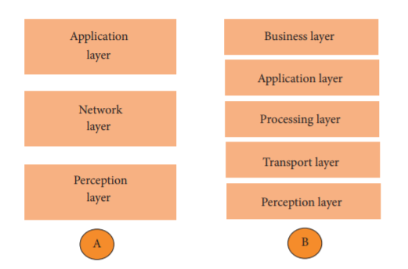
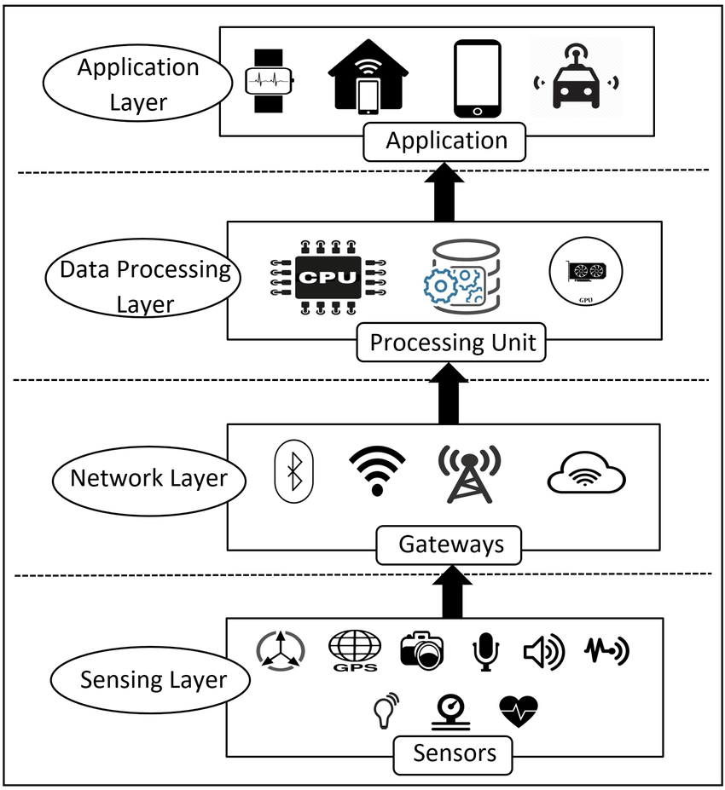
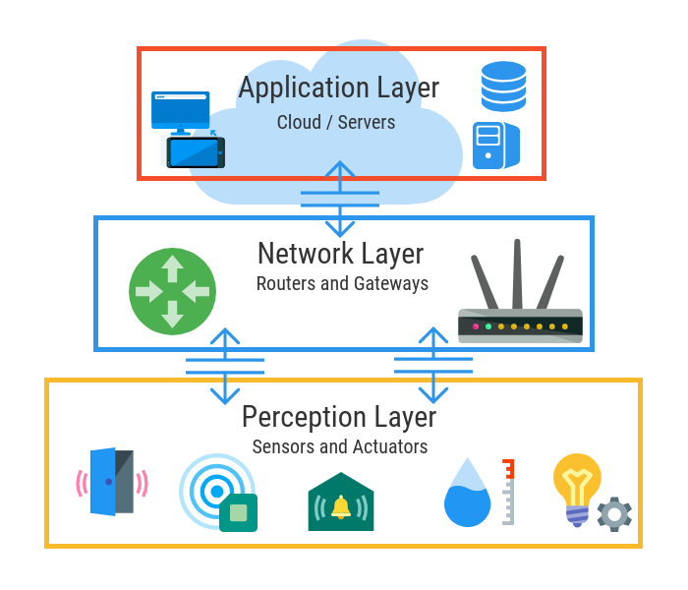
IOT Architecture – Based on Network Protocol
3 Layers
4 Layers
5 Layers

Slide 14
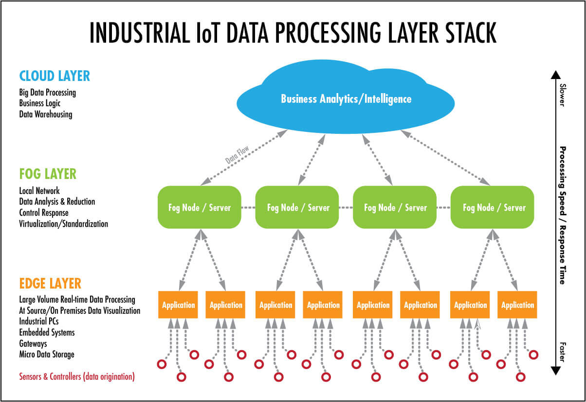
IOT Architecture – Based on Systems Architecture

Slide 15
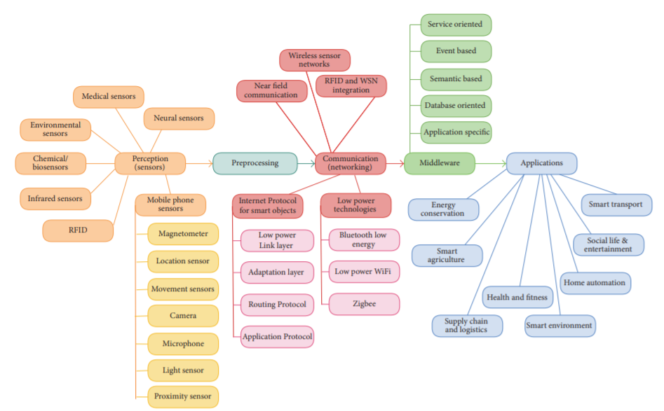
IOT Architecture

Slide 16
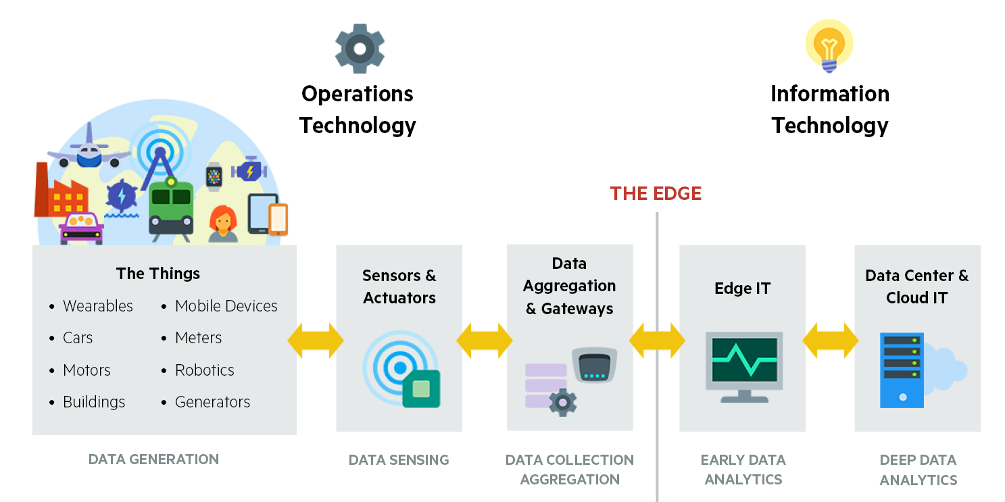
IOT Architecture – Example 1

Slide 17
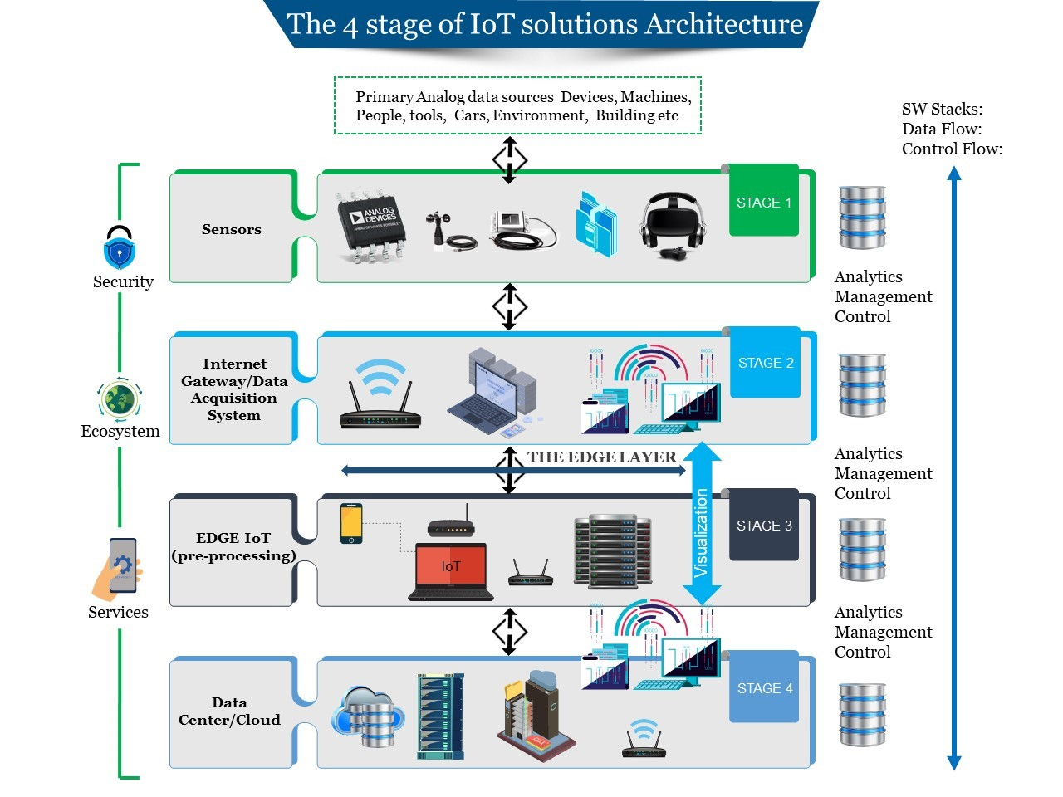
IOT Architecture – 4 Stages – Example 2

