Slide 1



SQL+PowerBI_Sales
View in Power BI
Last data refresh:
03/05/2024 12:07:29 UTC
Downloaded at:
03/05/2024 12:15:12 UTC

Slide 2
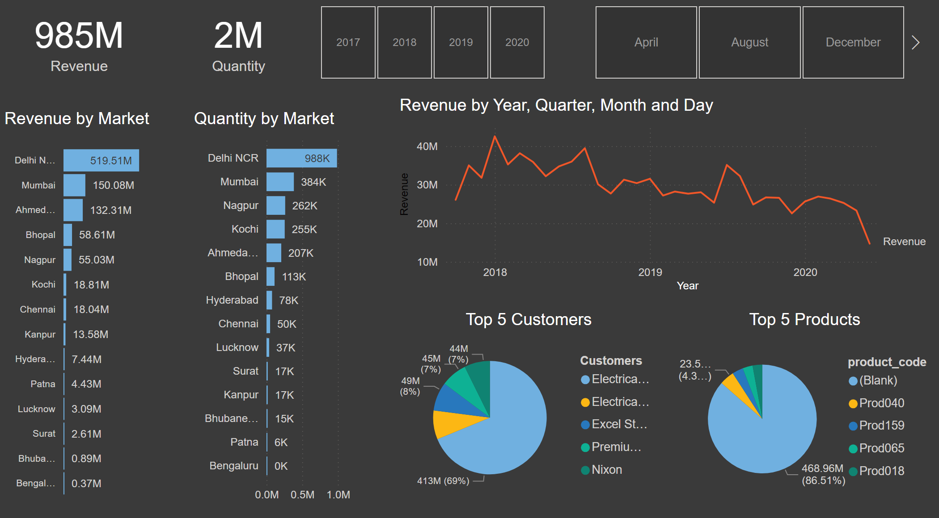
Page 1
Notes:
card
No alt text provided
card
No alt text provided
slicer
No alt text provided
slicer
No alt text provided
Revenue by Market
No alt text provided
Quantity by Market
No alt text provided
Top 5 Customers
No alt text provided
Top 5 Products
No alt text provided
lineChart
No alt text provided

