Slide 1
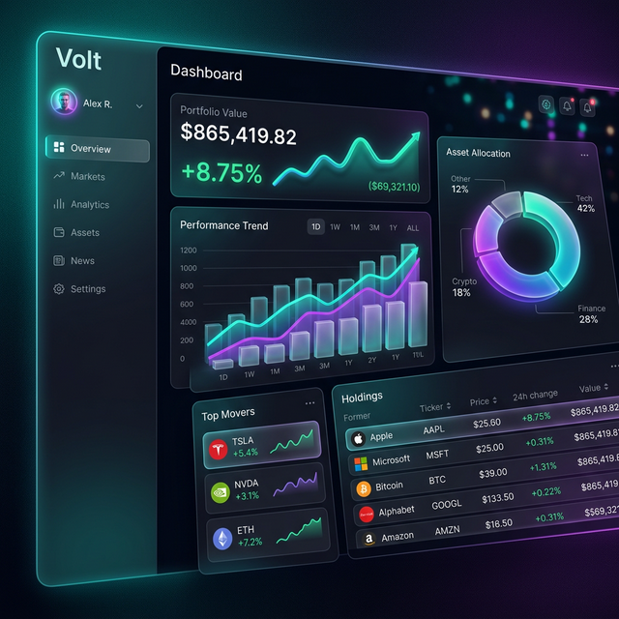
VOLT
Professional Portfolio Risk Analysis

Slide 2
The Problem
Complexity & Access Gap
  • Risk analysis tools are prohibitively expensive.
  • Most retail investors lack institutional-grade metrics.
  • Data visualization is often poor or non-existent.

Slide 3

The Solution: Volt
Institutional Intelligence for Everyone
  • Simple, visual risk dashboard.
  • Real-time pricing & volatility tracking.
  • Advanced metrics: Sharpe Ratio, Beta, VaR.

Slide 4
Key Features
• Monte Carlo Simulations (Prediction)
• Historical Stress Tests (Crises analysis)
• Real-time API Integration (Yahoo Finance/Alpha Vantage)
• Sector Diversification Heatmaps

Slide 5
Tech Stack
Frontend: React.js + Tailwind CSS
Backend: Python (Flask/FastAPI) & Node.js
Data: Alpha Vantage, Financial APIs
Database: PostgreSQL for user portfolios

Slide 6
Democratizing Finance
Thank You!
Contact: [Your Name/Email]

