Slide 1
Recap: Mining association rules from large datasets

Slide 2
Recap
Task 1: Methods for finding all frequent itemsets efficiently
Task 2: Methods for finding association rules efficiently

Slide 3
Recap
Frequent itemsets (measure: support)
Apriori principle
Apriori algorithm for finding frequent itemsets
  Prunes really well in practice
  Makes multiple passes over the dataset

Slide 4
Making a single pass over the data: the AprioriTid algorithm
The database is not used for counting support after the 1st pass!
Instead information in data structure C_{k}’ is used for counting support in every step
  C_{k}’ is generated from C_{k-1}’
  For small values of k, storage requirements for data structures could be larger than the database!
  For large values of k, storage requirements can be very small

Slide 5
Lecture outline
Task 1: Methods for finding all frequent itemsets efficiently
Task 2: Methods for finding association rules efficiently

Slide 6
Definition: Association Rule
Let D be database of transactions
  e.g.:
Let I be the set of items that appear in the database, e.g., I={A,B,C,D,E,F}
A rule is defined by X → Y, where X⊂I, Y⊂I, and X∩Y=∅
  e.g.: {B,C} → {A} is a rule
Transaction ID | Items
2000 | A, B, C
1000 | A, C
4000 | A, D
5000 | B, E, F

Slide 7




Definition: Association Rule
Association Rule
  An implication expression of the form X → Y, where X and Y are non-overlapping itemsets
  Example:
  {Milk, Diaper} → {Beer}
Rule Evaluation Metrics
  Support (s)‏
    Fraction of transactions that contain both X and Y
  Confidence (c)‏
    Measures how often items in Y
    appear in transactions that
    contain X
Example:

Slide 8
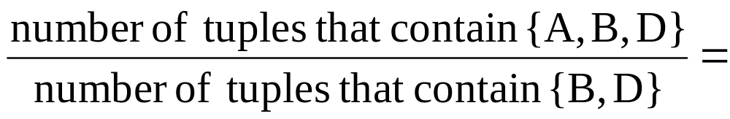
Example
TID date items_bought
100 10/10/99 {F,A,D,B}
200 15/10/99 {D,A,C,E,B}
300 19/10/99 {C,A,B,E}
400 20/10/99 {B,A,D}
What is the support and confidence of the rule: {B,D} → {A}
Support:
  percentage of tuples that contain {A,B,D} =
75%
Confidence:
100%

Slide 9
Association-rule mining task
Given a set of transactions D, the goal of association rule mining is to find all rules having
  support ≥ minsup threshold
  confidence ≥ minconf threshold

Slide 10
Brute-force algorithm for association-rule mining
List all possible association rules
Compute the support and confidence for each rule
Prune rules that fail the minsup and minconf thresholds
⇒ Computationally prohibitive!

Slide 11
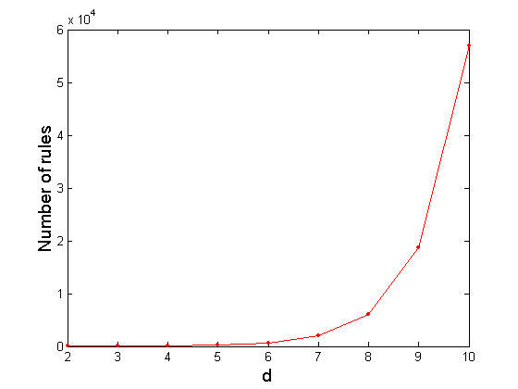
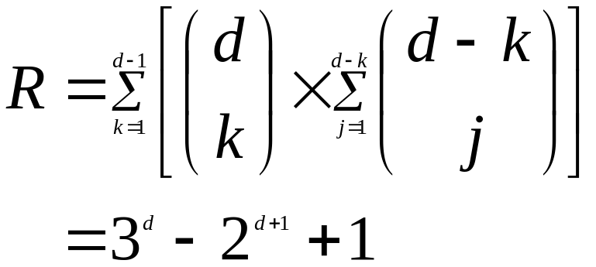
How many association rules are there?
Given d unique items in I:
  Total number of itemsets = 2^{d}
  Total number of possible association rules:
If d=6, R = 602 rules

Slide 12
Mining Association Rules
Two-step approach:
  Frequent Itemset Generation
    Generate all itemsets whose support ≥ minsup
  Rule Generation
    Generate high confidence rules from each frequent itemset, where each rule is a binary partition of a frequent itemset

Slide 13
Rule Generation – Naive algorithm
Given a frequent itemset X, find all non-empty subsets y⊂ X such that y→ X – y satisfies the minimum confidence requirement
  If {A,B,C,D} is a frequent itemset, candidate rules:
    ABC →D, ABD →C, ACD →B, BCD →A,
    A →BCD, B →ACD, C →ABD, D →ABC
    AB →CD, AC → BD, AD → BC, BC →AD,
    BD →AC, CD →AB,
If |X| = k, then there are 2^{k} – 2 candidate association rules (ignoring X → ∅ and ∅ → X)‏

Slide 14
Efficient rule generation
How to efficiently generate rules from frequent itemsets?
  In general, confidence does not have an anti-monotone property
    c(ABC →D) can be larger or smaller than c(AB →D)‏
  But confidence of rules generated from the same itemset has an anti-monotone property
  Example: X = {A,B,C,D}:
  c(ABC → D) ≥ c(AB → CD) ≥ c(A → BCD)‏
  Why?
Confidence is anti-monotone w.r.t. number of items on the RHS of the rule

Slide 15

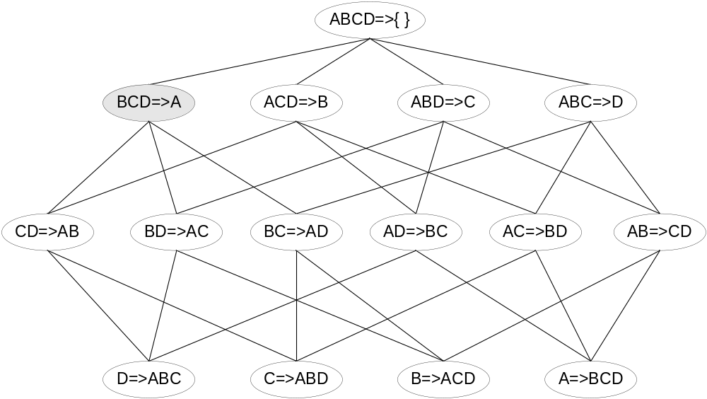
Rule Generation for Apriori Algorithm
Lattice of rules
Low Confidence Rule
Pruned Rules

Slide 16
Apriori algorithm for rule generation
Candidate rule is generated by merging two rules that share the same prefix
in the rule consequent
join(CD→AB,BD—>AC)
would produce the candidate
rule D →ABC
Prune rule D→ABC if there exists a
subset (e.g., AD→BC) that does not have
high confidence
CD→AB
BD→AC
D→ABC

Slide 17
Reducing the collection of itemsets: alternative representations and combinatorial problems

Slide 18
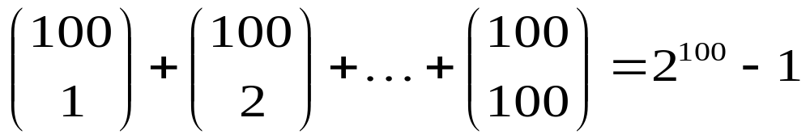
Too many frequent itemsets
If {a₁, …, a₁₀₀} is a frequent itemset, then there are
1.27*10³⁰ frequent sub-patterns!
There should be some more condensed way to describe the data

Slide 19
Frequent itemsets maybe too many to be helpful
If there are many and large frequent itemsets enumerating all of them is costly.
We may be interested in finding the boundary frequent patterns.
Question: Is there a good definition of such boundary?

Slide 20
empty set
Frequent itemsets
border
Non-frequent itemsets
all items

Slide 21
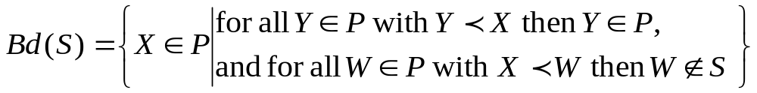
Borders of frequent itemsets
Itemset X is more specific than itemset Y if X superset of Y (notation: Y<X). Also, Y is more general than X (notation: X>Y)
The Border: Let S be a collection of frequent itemsets and P the lattice of itemsets. The border Bd(S) of S consists of all itemsets X such that all more general itemsets than X are in S and no pattern more specific than X is in S.

Slide 22
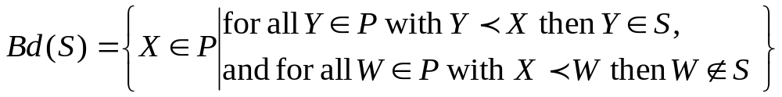
Positive and negative border
Border
Positive border: Itemsets in the border that are also frequent (belong in S)
Negative border: Itemsets in the border that are not frequent (do not belong in S)

Slide 23
Examples with borders
Consider a set of items from the alphabet: {A,B,C,D,E} and the collection of frequent sets
S = {{A},{B},{C},{E},{A,B},{A,C},{A,E},{C,E},{A,C,E}}
The negative border of collection S is
Bd⁻(S) = {{D},{B,C},{B,E}}
The positive border of collection S is
Bd⁺(S) = {{A,B},{A,C,E}}

Slide 24
Descriptive power of the borders
Claim: A collection of frequent sets S can be fully described using only the positive border (Bd⁺(S)) or only the negative border (Bd⁻(S)).

Slide 25
Maximal patterns
Frequent patterns without proper frequent super pattern

Slide 26
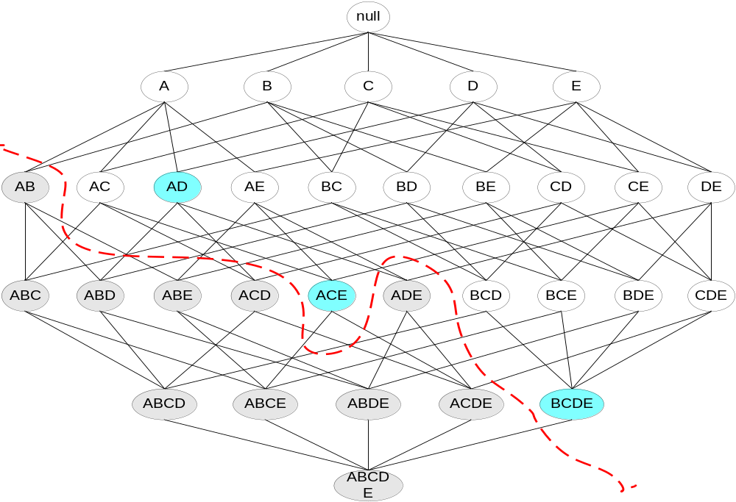
Maximal Frequent Itemset
An itemset is maximal frequent if none of its immediate supersets is frequent
Maximal Itemsets
Infrequent Itemsets
Border

Slide 27
Maximal patterns
The set of maximal patterns is the same as the positive border
Descriptive power of maximal patterns:
  Knowing the set of all maximal patterns allows us to reconstruct the set of all frequent itemsets!!
  We can only reconstruct the set not the actual frequencies

Slide 28
MaxMiner: Mining Max-patterns
Idea: generate the complete set-enumeration tree one level at a time, while prune if applicable.
Φ (ABCD)
A (BCD)
B (CD)
C (D)
D ()
AB (CD)
AC (D)
AD ()
BC (D)
BD ()
CD ()
ABC (C)
ABD ()
ACD ()
BCD ()
ABCD ()

Slide 29
Local Pruning Techniques (e.g. at node A)
Check the frequency of ABCD and AB, AC, AD.
If ABCD is frequent, prune the whole sub-tree.
If AC is NOT frequent, remove C from the parenthesis before expanding.
Φ (ABCD)
A (BCD)
B (CD)
C (D)
D ()
AB (CD)
AC (D)
AD ()
BC (D)
BD ()
CD ()
ABC (C)
ABD ()
ACD ()
BCD ()
ABCD ()

Slide 30
Algorithm MaxMiner
Initially, generate one node N= , where h(N)=Φ and t(N)={A,B,C,D}.
Consider expanding N,
  If h(N)∪t(N) is frequent, do not expand N.
  If for some i∈t(N), h(N)∪{i} is NOT frequent, remove i from t(N) before expanding N.
Apply global pruning techniques…
Φ (ABCD)

Slide 31
Global Pruning Technique (across sub-trees)
When a max pattern is identified (e.g. ABCD), prune all nodes (e.g. B, C and D) where h(N)∪t(N) is a sub-set of it (e.g. ABCD).
Φ (ABCD)
A (BCD)
B (CD)
C (D)
D ()
AB (CD)
AC (D)
AD ()
BC (D)
BD ()
CD ()
ABC (C)
ABD ()
ACD ()
BCD ()
ABCD ()

Slide 32
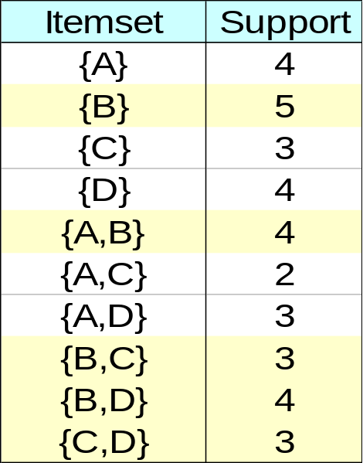
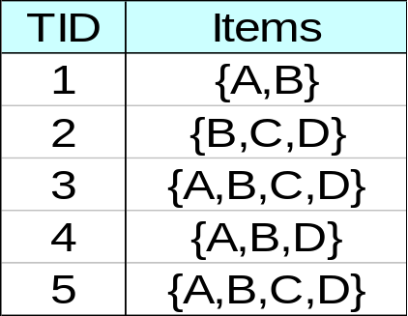
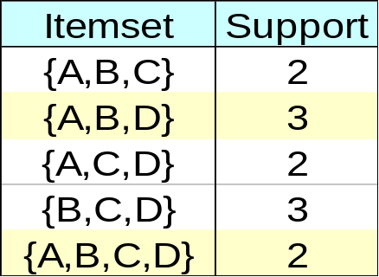
Closed patterns
An itemset is closed if none of its immediate supersets has the same support as the itemset

Slide 33
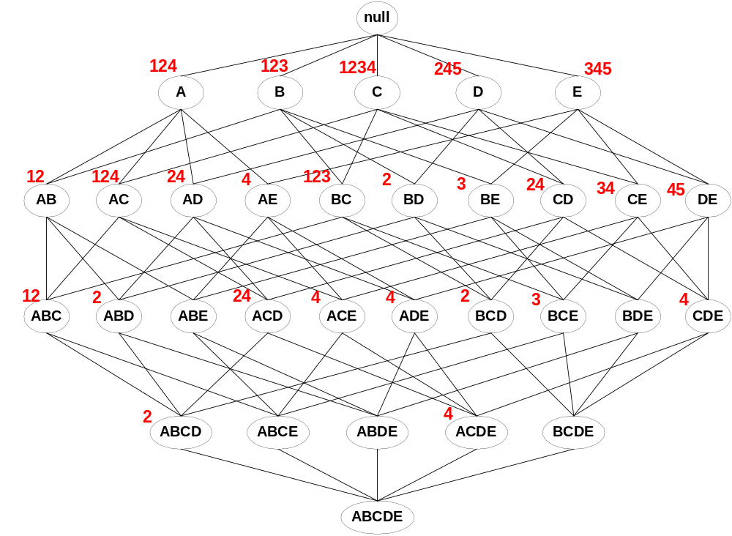
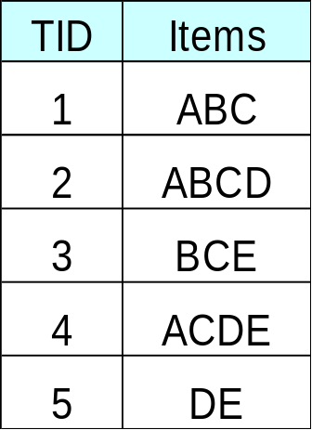
Maximal vs Closed Itemsets
Transaction Ids
Not supported by any transactions

Slide 34
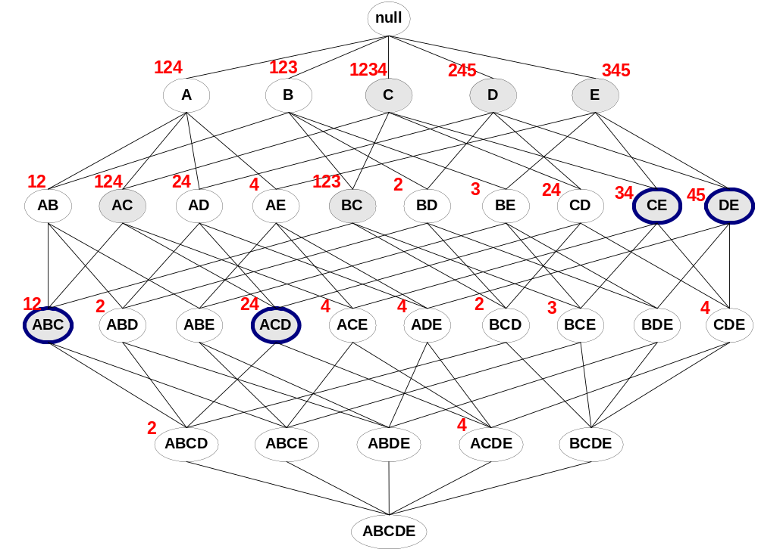
Maximal vs Closed Frequent Itemsets
Minimum support = 2
Closed but not maximal
Closed and maximal
# Closed = 9
# Maximal = 4

Slide 35
Why are closed patterns interesting?
s({A,B}) = s(A), i.e., conf({A}→{B}) = 1
We can infer that for every itemset X ,
s(A U {X}) = s({A,B} U X)
No need to count the frequencies of sets X U {A,B} from the database!
If there are lots of rules with confidence 1, then a significant amount of work can be saved
  Very useful if there are strong correlations between the items and when the transactions in the database are similar

Slide 36
Why closed patterns are interesting?
Closed patterns and their frequencies alone are sufficient representation for all the frequencies of all frequent patterns
Proof: Assume a frequent itemset X:
  X is closed → s(X) is known
  X is not closed →
  s(X) = max {s(Y) | Y is closed and X subset of Y}

Slide 37
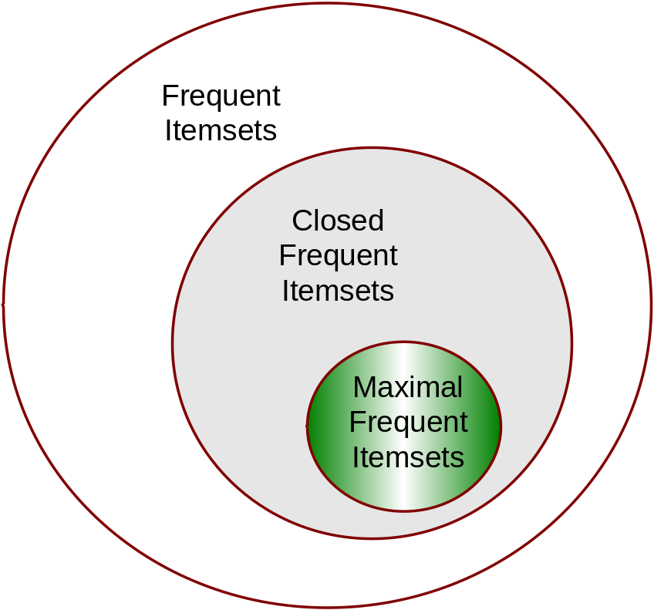
Maximal vs Closed sets
Knowing all maximal patterns (and their frequencies) allows us to reconstruct the set of frequent patterns
Knowing all closed patterns and their frequencies allows us to reconstruct the set of all frequent patterns and their frequencies

Slide 38
A more algorithmic approach to reducing the collection of frequent itemsets

Slide 39
Prototype problems: Covering problems
Setting:
  Universe of N elements U = {U₁,…,U_{N}}
  A set of n sets S = {s₁,…,s_{n}}
  Find a collection C of sets in S (C subset of S) such that U_{cєC}c contains many elements from U
Example:
  U: set of documents in a collection
  s_{i}: set of documents that contain term t_{i}
  Find a collection of terms that cover most of the documents

Slide 40
Prototype covering problems
Set cover problem: Find a small collection C of sets from S such that all elements in the universe U are covered by some set in C
Best collection problem: find a collection C of k sets from S such that the collection covers as many elements from the universe U as possible
Both problems are NP-hard
Simple approximation algorithms with provable properties are available and very useful in practice

Slide 41
Set-cover problem
Universe of N elements U = {U₁,…,U_{N}}
A set of n sets S = {s₁,…,s_{n}} such that U_{i}s_{i} =U
Question: Find the smallest number of sets from S to form collection C (C subset of S) such that U_{cєC}c=U
The set-cover problem is NP-hard (what does this mean?)

Slide 42
Trivial algorithm
Try all subcollections of S
Select the smallest one that covers all the elements in U
The running time of the trivial algorithm is O(2^{|S}||U|)
This is way too slow

Slide 43
Greedy algorithm for set cover
Select first the largest-cardinality set s from S
Remove the elements from s from U
Recompute the sizes of the remaining sets in S
Go back to the first step

Slide 44
As an algorithm
X = U
C = {}
while X is not empty do
  For all sєS let a_{s}=|s intersection X|
  Let s be such that a_{s} is maximal
  C = C U {s}
  X = X\ s

Slide 45
How can this go wrong?
No global consideration of how good or bad a selected set is going to be

Slide 46
How good is the greedy algorithm?
Consider a minimization problem
  In our case we want to minimize the cardinality of set C
Consider an instance I, and cost a*(I) of the optimal solution
  a*(I): is the minimum number of sets in C that cover all elements in U
Let a(I) be the cost of the approximate solution
  a(I): is the number of sets in C that are picked by the greedy algorithm
An algorithm for a minimization problem has approximation factor F if for all instances I we have that
a(I)≤F x a*(I)
Can we prove any approximation bounds for the greedy algorithm for set cover ?

Slide 47
How good is the greedy algorithm for set cover?
(Trivial?) Observation: The greedy algorithm for set cover has approximation factor F = s_{max}, where s_{max} is the set in S with the largest cardinality
Proof:
  a*(I)≥N/|s_{max}| or N ≤ |s_{max}|a*(I)
  a(I) ≤ N ≤ |s_{max}|a*(I)

Slide 48
How good is the greedy algorithm for set cover? A tighter bound
The greedy algorithm for set cover has approximation factor F = O(log |s_{max}|)
Proof: (From CLR “Introduction to Algorithms”)

Slide 49
Best-collection problem
Universe of N elements U = {U₁,…,U_{N}}
A set of n sets S = {s₁,…,s_{n}} such that U_{i}s_{i} =U
Question: Find the a collection C consisting of k sets from S such that f (C) = |U_{cєC}c| is maximized
The best-colection problem is NP-hard
Simple approximation algorithm has approximation factor F = (e-1)/e

Slide 50
Greedy approximation algorithm for the best-collection problem
C = {}
for every set s in S and not in C compute the gain of s:
g(s) = f(C U {s}) – f(C)
Select the set s with the maximum gain
C = C U {s}
Repeat until C has k elements

Slide 51
Basic theorem
The greedy algorithm for the best-collection problem has approximation factor F = (e-1)/e
C* : optimal collection of cardinality k
C : collection output by the greedy algorithm
f(C ) ≥ (e-1)/e x f(C*)

Slide 52
Submodular functions and the greedy algorithm
A function f (defined on sets of some universe) is submodular if
  for all sets S, T such that S is subset of T and x any element in the universe
  f(S U {x}) – f(S ) ≥ f(T U {x} ) – f(T)
Theorem: For all maximization problems where the optimization function is submodular, the greedy algorithm has approximation factor
F = (e-1)/e

Slide 53
Again: Can you think of a more algorithmic approach to reducing the collection of frequent itemsets

Slide 54
Approximating a collection of frequent patterns
Assume a collection of frequent patterns S
Each pattern X є S is described by the patterns that covers
Cov(X) = { Y | Y є S and Y subset of X}
Problem: Find k patterns from S to form set C such that
|U_{XєC} Cov(X)|
is maximized

Slide 55
empty set
Frequent itemsets
border
Non-frequent itemsets
all items

