Slide 1
SEEM4630 2015-2016
Tutorial 3 – Frequent Itemset Mining

Slide 2
Frequent Itemsets
Frequent itemset: a set of items that occurs frequently in a data set
  itemset: A set of one or more items
  k-itemset: X = {x₁, …, x_{k}}
  Mining algorithms
    Apriori
    FP-growth
Tid | Items bought
10 | Beer, Nuts, Diaper
20 | Beer, Coffee, Diaper
30 | Beer, Diaper, Eggs
40 | Nuts, Eggs, Milk
50 | Nuts, Coffee, Diaper, Eggs, Beer

Slide 3
Support & Confidence
Support
  (absolute) support, or, support count of X: Frequency or occurrence of an itemset X
  (relative) support, s, is the fraction of transactions that contains X (i.e., the probability that a transaction contains X)
  An itemset X is frequent if X’s support is no less than a minsup threshold
Confidence (association rule: X→Y )
  sup(X∪Y)/sup(x) (conditional prob.: Pr(Y|X) = Pr(X^Y)/Pr(X) )
  confidence, c, conditional probability that a transaction having X also contains Y
  Find all the rules X→Y with minimum support and confidence
    sup(X∪Y) ≥ minsup
    sup(X∪Y)/sup(X) ≥ minconf

Slide 4
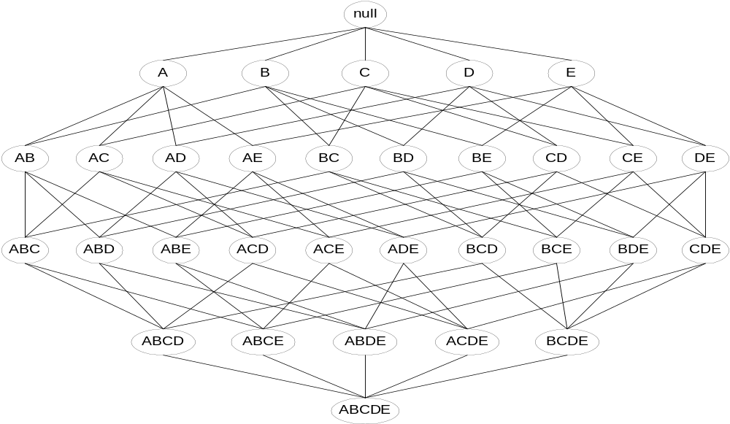
Apriori Principle
If an itemset is frequent, then all of its subsets must also be frequent
If an itemset is infrequent, then all of its supersets must be infrequent too
(X → Y)
(¬Y → ¬X)
frequent
frequent
infrequent
infrequent

Slide 5
Apriori: A Candidate Generation & Test Approach
Initially, scan DB once to get frequent 1-itemset
Loop
  Generate length (k+1) candidate itemsets from length k frequent itemsets
  Test the candidates against DB
  Terminate when no frequent or candidate set can be generated

Slide 6
Generate candidate itemsets
Example
Frequent 3-itemsets:
{1, 2, 3}, {1, 2, 4}, {1, 2, 5}, {1, 3, 4}, {1, 3, 5}, {2, 3, 4}, {2, 3, 5} and {3, 4, 5}
  Candidate 4-itemset:
  {1, 2, 3, 4}, {1, 2, 3, 5}, {1, 2, 4, 5}, {1, 3, 4, 5}, {2, 3, 4, 5}
  Which need not to be counted?
  {1, 2, 4, 5}, {1, 3, 4, 5}, {2, 3, 4, 5}

Slide 7
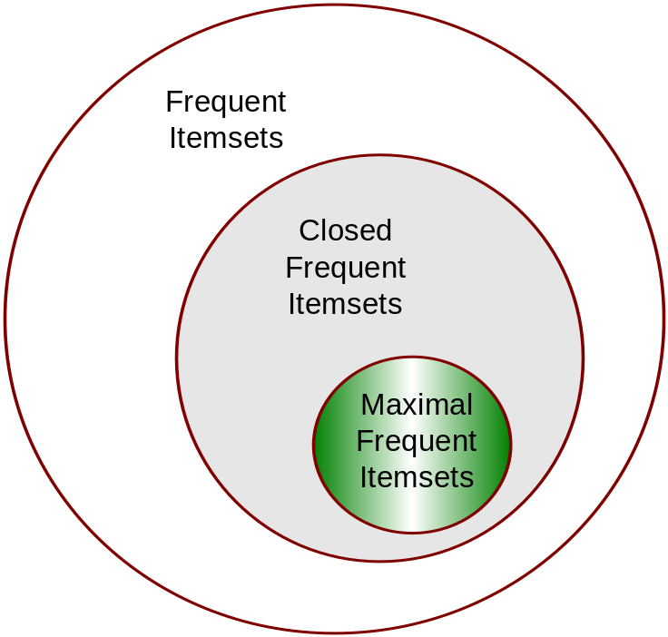
Maximal vs Closed Frequent Itemsets
An itemset X is a max-pattern if X is frequent and there exists no frequent super-pattern Y כ X
An itemset X is closed if X is frequent and there exists no super-pattern Y כ X, with the same support as X
Closed Frequent Itemsets are Lossless: the support for any frequent itemset can be deduced from the closed frequent itemsets

Slide 8
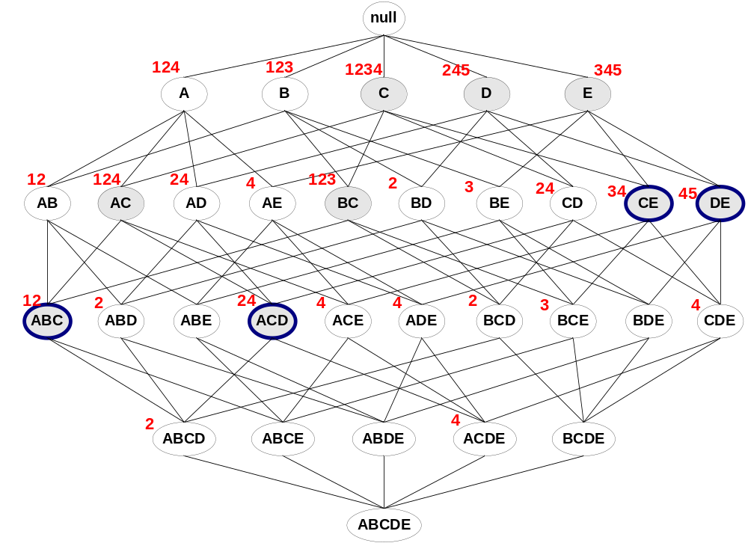
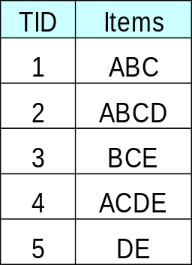
Maximal vs Closed Frequent Itemsets
Closed but not maximal
minsup=2
Closed and maximal frequent
# Closed = 9
# Maximal = 4

Slide 9
Pattern-Growth Approach: Mining Frequent Patterns Without Candidate Generation
The FP-Growth Approach
  Depth-first search (Apriori: Breadth-first search)
  Avoid explicit candidate generation
FP-Growth approach:
For each frequent item, construct its conditional pattern-base, and then its conditional FP-tree
Repeat the process on each newly created conditional FP-tree
Until the resulting FP-tree is empty, or it contains only one path—single path will generate all the combinations of its sub-paths, each of which is a frequent pattern
Fp-tree construction:
Scan DB once, find frequent 1-itemset (single item pattern)
Sort frequent items in frequency descending order, f-list
Scan DB again, construct FP-tree

Slide 10
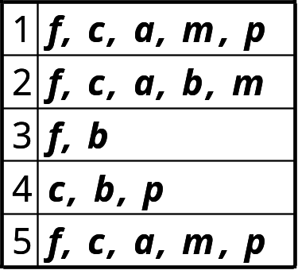
Find Patterns Having p From P-conditional Database
Start at the frequent item header table in the FP-tree
Traverse the FP-tree by following the link of each frequent item p
Accumulate all of transformed prefix paths of item p to form p’s conditional pattern base
{}
Conditional pattern bases
item cond. pattern base
c f:3
a fc:3
b fca:1, f:1, c:1
m fca:2, fcab:1
p fcam:2, cb:1
Header Table
Item frequency head
f 4
c 4
a 3
b 3
m 3
p 3
f:4
c:1
c:3
b:1
b:1
a:3
p:1
m:2
b:1
p:2
m:1

Slide 11
{}
{}
f:2
c:1
f:3
c:2
b:1
c:3
{}
a:2
p:1
a:3
f:4
c:1
+ p
b:1
+ m
m:2
c:3
b:1
b:1
(1)
(2)
a:3
p:1
{}
{}
{}
m:2
b:1
f:2
c:1
f:3
f:4
f:3
p:2
m:1
c:1
c:3
+ c
+ a
+ b
a:1
(3)
(4)
(5)
(6)

Slide 12
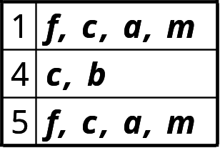
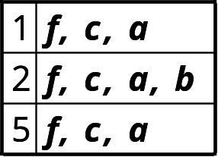
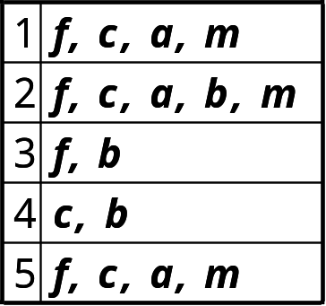
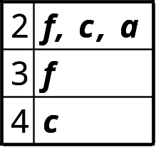
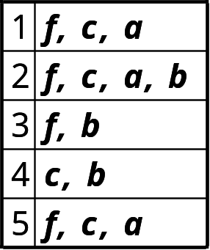
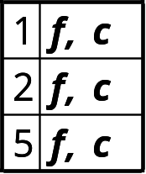
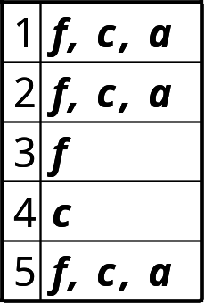
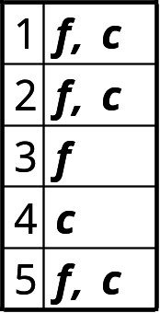
FP-Growth
+ p
+ m
+ b
+ a

Slide 13
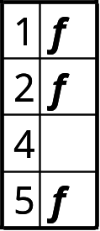
FP-Growth
+ p
+ m
(1)
(2)
+ b
+ a
(3)
(4)
+ c
f: 1,2,3,5
(6)
(5)

Slide 14
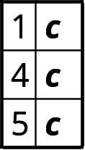
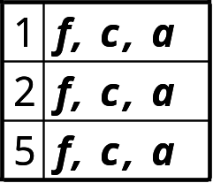
+ p
p: 3
cp: 3
+ p
+ m
m: 3
fm: 3
cm: 3
am: 3
fcm: 3
fam: 3
cam: 3
fcam: 3
min_sup = 3
+ m
+ b
b: 3
a: 3
fa: 3
ca: 3
fca: 3
+ a
c: 4
fc: 3
+ c
f: 1,2,3,5
f: 4

