Slide 1


University Admission System
IGATE is now a part of Capgemini

Slide 2

TEAM
SS Krishnakanth Sattiraju
Durga Venkatesan
Utti Jayasree
Meghana Upputuri
Devisetty Raga
S Harshitha
Tamonash Mukherjee
Notes:
KK

Slide 3



Actors Of University Management System
Admin
MAC
Committee
Applicant
Notes:
KK

Slide 4
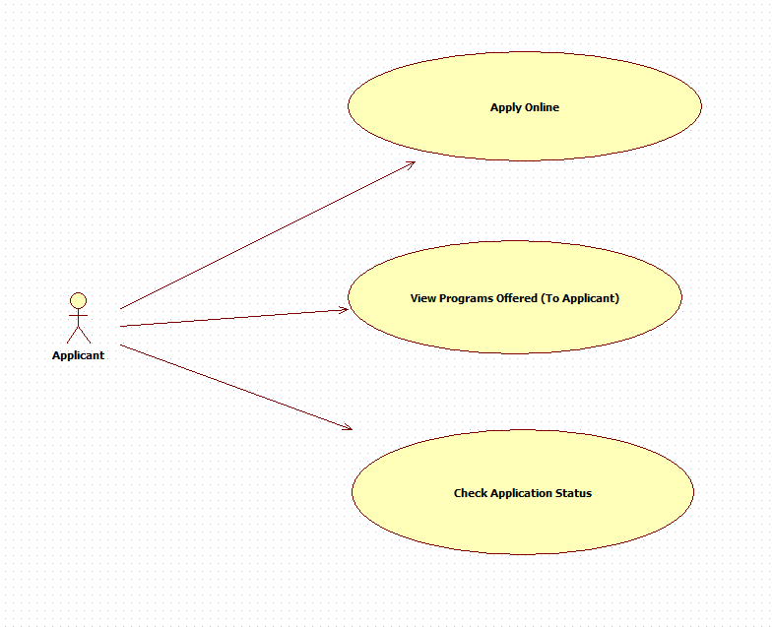
Functions of Applicant
UseCases.docx
Notes:
KK

Slide 5
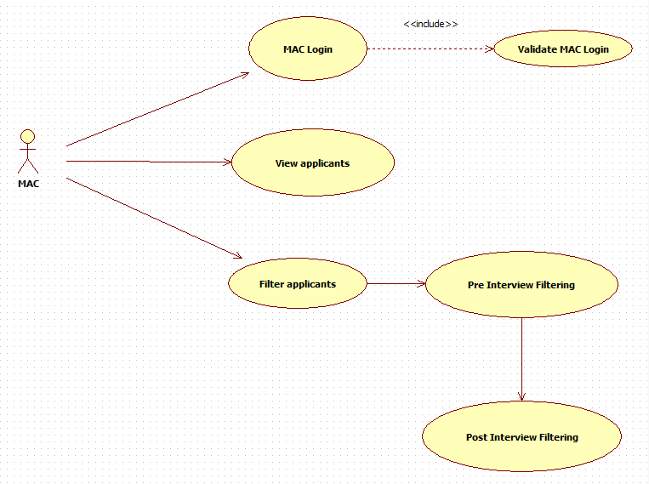
Functions of MAC Committee
UseCases.docx
Notes:
Dur

Slide 6
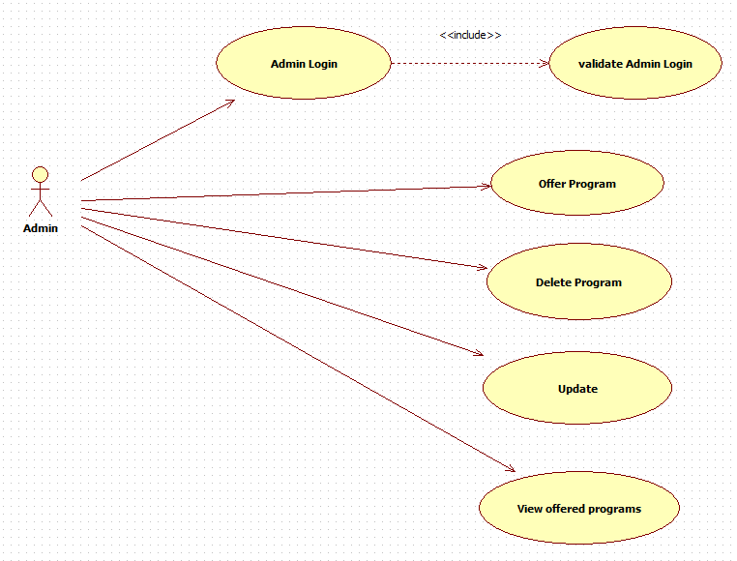
Functions of Admin
UseCases.docx
Notes:
Dur

Slide 7
Requirements Validation And Functional Decomposition
RVFD.xls
Termination
End process
File Handling
Storage of information
Invocation
Start process
Implicit
Efficiency
RVFD
System
Minimum specifications
Explicit
Query
improvements
Error Handling
consistency
Security
For confidentiality

Slide 8
RVFD: Requirement Validation and Functional Decomposition
RVFD.xls
Use Cases
Explicit
Implicit
Security
System
Authentications
Error Handling
File Handling
Invocation
Termination

Slide 9
RVFD: Requirement Validation and Functional Decomposition
RVFD.xls
Explicit
Implicit
Security
System
Error Handling
File Handling
Invocation
Termination

Slide 10
RVFD: Requirement Validation and Functional Decomposition
RVFD.xls
Implicit
Client | SME
Does Auto-generated Applicant ID be mailed? | Format of Applicant ID
How long will it take to get the unique Applicant ID ?
What will be the lower Age Limit and Upper Age Limit to Apply for Program

Slide 11
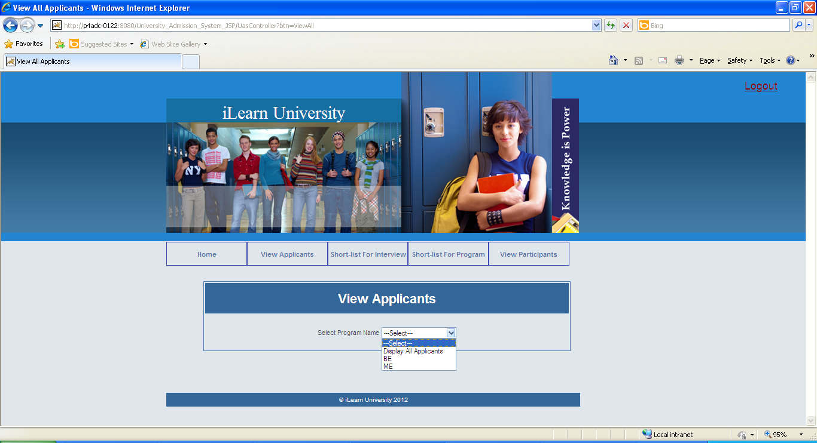
Test Cases for MAC
MAC cases.xls

Slide 12
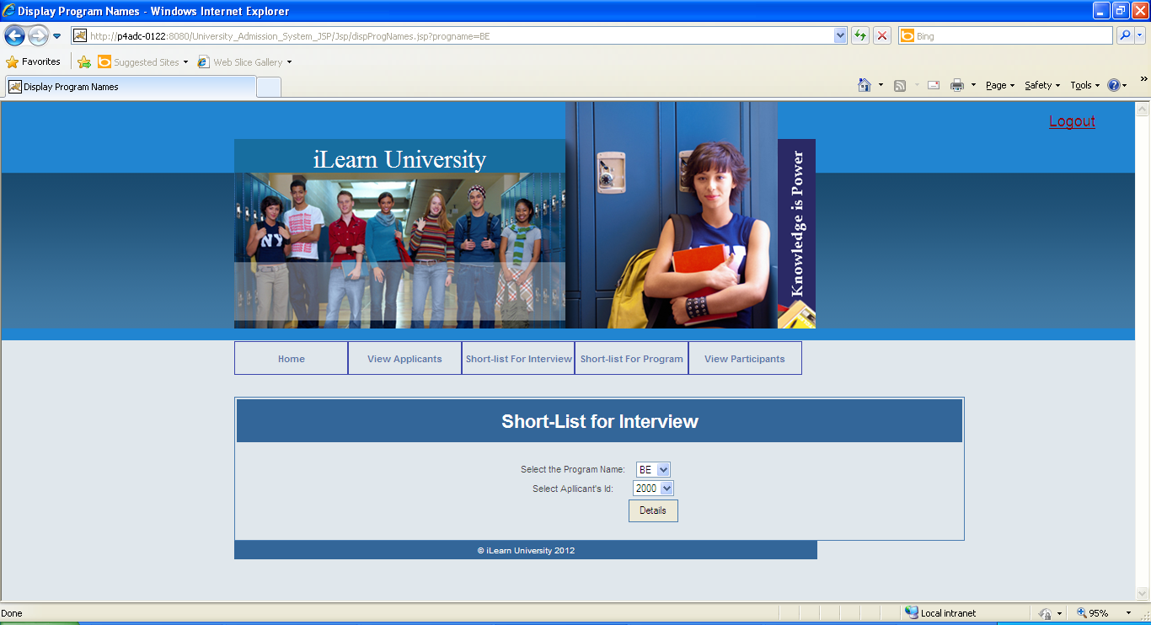
Test Cases for MAC
MAC cases.xls

Slide 13
Test Cases: MAC
MAC cases.xls
Filtering
Pre Interview Filtering
Post Interview Filtering

Slide 14
Test Cases: MAC
MAC cases.xls
LOGIN
Invalid Credentials
Mandatory Fields Missing

Slide 15
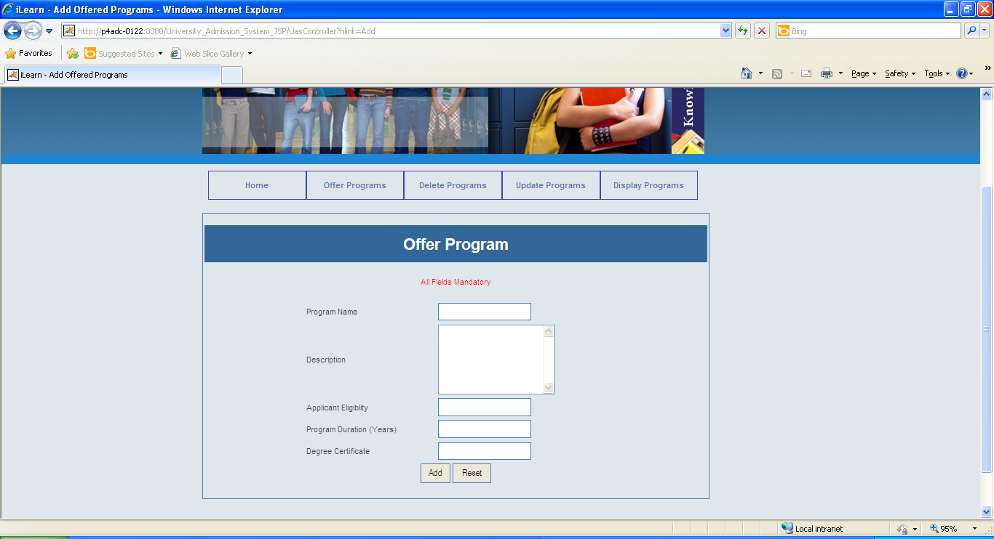
Test Cases: Admin
Add Program Page
Admin Testcases.xls

Slide 16
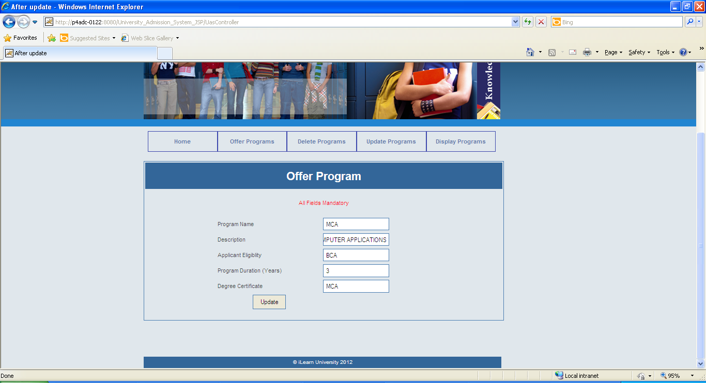
Test Cases: Admin
Update Program Page
Admin Testcases.xls

Slide 17
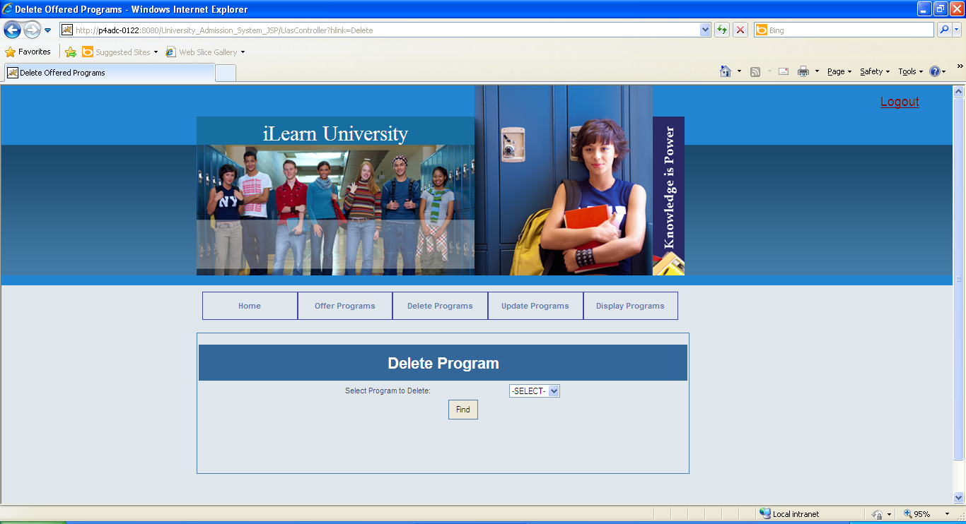
Test Cases: Admin
Admin Testcases.xls
Delete Program Page

Slide 18
Test Cases: Admin
LOGIN
Admin Testcases.xls
Invalid Credentials
Mandatory Fields Missing

