Slide 1
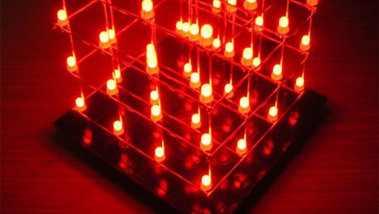
4*4*4 Led CUBE
Using Arduino UNO

Slide 2
Contents
Workflow
Challenges
Key Learnings
References

Slide 3
Workflow
1) Testing the LEDs with 150 ohm resistor and assembling the 1st layer.
2) Assembling includes using cardboard to make a frame of the LED mesh.
3) Punching 4 LEDs in four rows.
4)Short circuiting their cathodes using aluminium wire.
5) Creating four layers this way.
6) Short circuiting anode of 4 LEDs of every column.
7) Stacking the layers and the cardboard is ready.
8) Writing Arduino code for various patterns and testing them virtually on Tinkercad.
9) Designing of PCB and its connections with LED and Arduino.
10) Coding in the Arduino can be modified and better patterns can be created. Good mapping of 3D objects can be done.

Slide 4
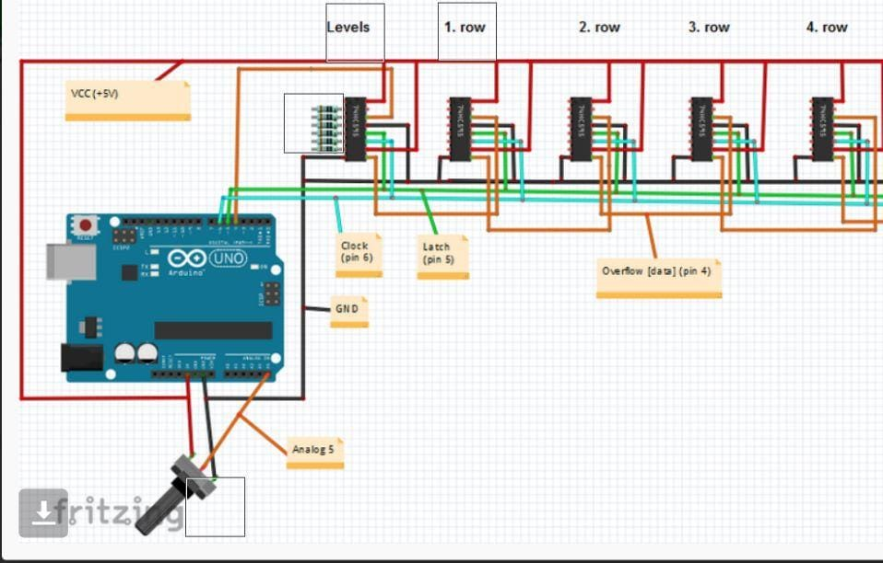
TINKERCAD
We made an exact model of the cube along with Arduino and the shift registers for testing our code.
There were 5 shift registers used. 4 for controlling the 4 levels and 1 for selection of the level.
The simulation gave us an idea regarding the resistances to be used and the changes we were supposed to make in the code

Slide 5
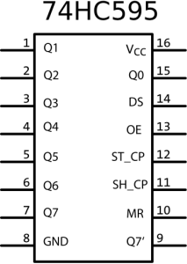
IC 74HC595
Shift Register IC 74HC595:- Sometimes we have a number of modules to connect over our Arduino
but Arduino UNO have 14 digital I/O pins, to avoid this problem we can use shift register IC.
Shift register IC is like a 3 input and 8 pin digital output decoder, where we use three pins of
arduino for our signal that will be fed to three input lines of IC and from the output of IC we can
decode it back into 8 output lines or bits.
SHIFT REGISTER IC 74HC595 PIN CONFIGURATION:- 15, 1, 2, 3, 4, 5, 6, 7 Output Pins (Q0 to Q7)- The 74hc595 has 8 output pins. 8 - Ground Connected to the Ground of the circuit 9 (Q7') - Serial Output This pin is used to connect more than one 74hc595 as cascading (Pin 9 is data out and used when we have to connect another shift register, Feed this pin to next Shift register IC, if connected) 10 (MR)- Master Reset Resets all outputs as low. Must be held high for normal operation 11 (SH_CP)- Clock This is the clock pin to which the clock signal has to be provided from MCU/MPU 12 (ST_CP)- Latch The Latch pin is used to update the data to the output pins. 13 (OE)- Output Enable The Output Enable is used to turn off the outputs. Must be held low for normal operation 14 (DS)- Serial Data This is the pin to which data is sent, based on which the 8 outputs are controlled 16 Vcc- This pin powers the IC, typically +5V is used.

Slide 6
Challenges
There were many issues while testing the code on Tinkercad.
While soldering, integrating the layers was quite challenging.
Controlling the LEDs on individual layers was very challenging.
Working on the code and obtaining the patterns was difficult.

Slide 7
Learnings
We got to learn about the working of Shift Register IC 74HC595.
Learnt about Arduino microcontroller
Improves knowledge of Digital Electronics.
Improves coding skills.

Slide 8
USES AND FUTURE SCOPE
The 4*4*4 LED Cube is a great source of entertainment and decorative purposes.
Codes can be modified and various beautiful patterns can be obtained, thus adding to the diversity.
The 3-D cube can act as a mood elevator and can divert your mind from stress causing problems for some time.

Slide 9
Team Members
Ankit Yadav
Karandeep Singh
Krish Shah
Sahil Patel

Slide 10
References
4*4*4 LED CUBE : 5 Steps (with Pictures) – Instructables.
How to Make a 4x4x4 LED Cube Using Arduino | by DiY Projects Lab | Medium
GITHUB LINK:-
Editing ARIES_4-4-4-LED-CUBE/README.md at main · Krish-Roorkee/ARIES_4-4-4-LED-CUBE · GitHub

Slide 11
THANK YOU!

