Slide 1


CodeWave – AI for Real India
Team Name : AlgoRhythm
Team Member Name : Anushka Bhandari
Ansh Bhat
Krishna Agarwal
Pratham Upadhayay
Which domain does your idea address? : AI in Education

Slide 2
Contents
INTRO
TECH STACK
INDEX
FLOWCHART
Problem Statement
FUTURE SCOPE
Proposed Solution
THANK YOU
Primary User

Slide 3
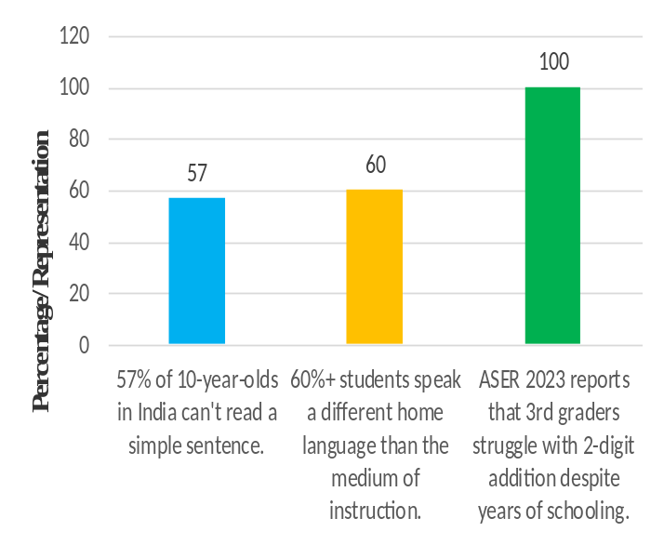
What is the problem you are solving?
Why Foundational Learning is Still Struggling ?
REAL-PAIN POINTS
Teachers often just read from slides or textbooks without explaining the concepts. Learning stops at “What is...” and never reaches “Why is it so?” Teachers in rural India face multiple challenges: Overcrowded classrooms Inadequate training Lack of tools for personalized teaching Students hesitate to ask questions in their local language.

Slide 4
Describe your solution. USP of the proposed solution? Impact of solution?
Gesture-based interface for drawing, undo, clear, and help
Gemini AI explains concepts in regional languages
Bilingual flashcards with images, audio, and text
Impact:
USP of the Solution
- Gesture input: Points to flashcards/objects
- Voice input: Asks in Hindi/local dialect
- AI explains with rural analogies
- Output: Visual + audio in native language
- Vernacular Voice – 60%+ students speak a different
home language
Boosts learning through images and voice
Support local language
Encourage parent-child learning
Empowers rural learners with accessible learning tools

Slide 5
Primary user of our solution and its scalability
Rural learners lack access to trained teachers, quality material, and interactive educational tools.
Language barriers and low digital literacy make traditional edtech solutions ineffective in rural areas.
The solution offers a gesture-based interface with vernacular voice input and bilingual output (Hindi + English).
Includes AI-powered flashcards showing images, simplified explanations, and audio in both languages for clear understanding.
Smartly detects topic types and responds with visuals, stories, and quizzes, making learning fun and relatable.
Highly scalable and modular, with support for multiple regional languages
“AlgoRhythm is designed to scale across Bharat — from remote villages to urban classrooms — with its language-flexible, device-light.”

Slide 6
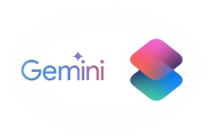


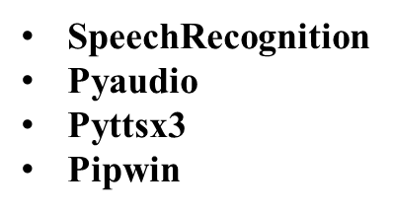
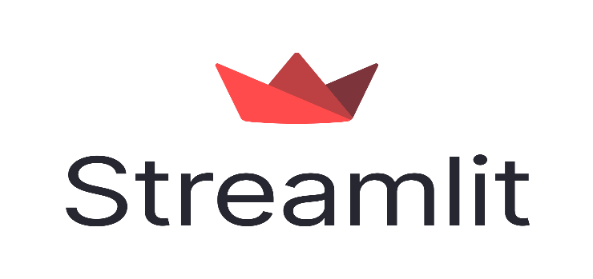


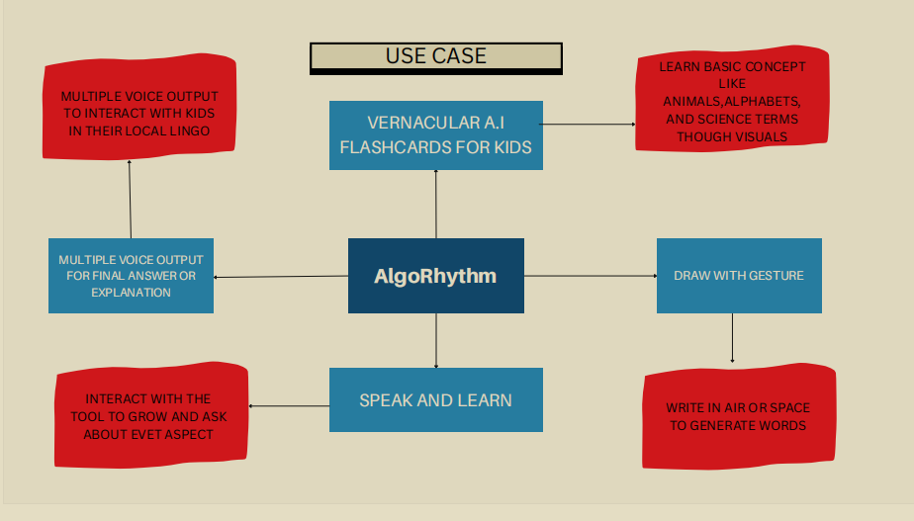


What open-source AI tools and technologies are being used to design the solution?
Python Modules Streamlit google-generativeai Numpy gTTS

Slide 7
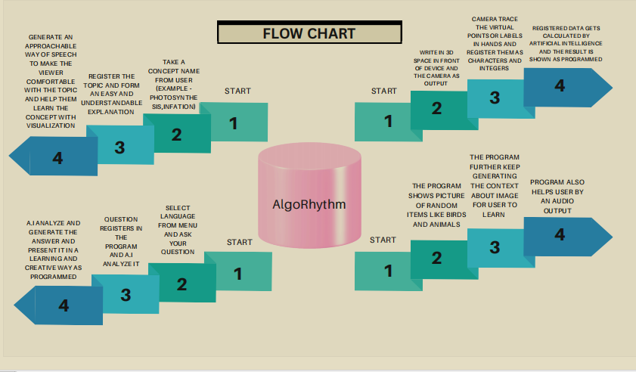
Flowchart/Mock Diagrams of the proposed solution.

Slide 8
Future Scope
1. Multi-Language Expansion Add support for regional languages: Marathi, Tamil, Bengali, Telugu, Punjabi, Odiya, etc. Uses IndicTrans2 and localized voice datasets Makes the platform accessible to 90%+ of Indian learners Bridges the gap between home language and school language 2. Intelligent Doubt Classification & Analytics Use AI to: Tag and classify student doubts by subject/topic Generate personalized feedback reports for teachers Help identify common learning gaps in classrooms

Slide 9
THANK YOU

