Slide 1

PROJECT REPORT
Open Source Software list all the security updates missing in your Window OS
SUBMITTED BY
Name: RAJA KRISHNARJUN SHUKLA
Registration No: 12002044
Roll No: B64
in partial fulfillment of INT301 for the award of the degree
of B.TECH (Computer Science & Engineering)
SUBMITTED TO
Rajeshwar Sharma
School of Computer Science &
Engineering Lovely Professional University,
Phagwara

Slide 2
STUDENT DECLARATION
To whom so ever it may concern
I, RAJA KRISHNARJUN SHUKLA, 12002044, hereby declare that the work done by me on “Open Source Software for OS” Project Report is a record of original work for the partial fulfilment of the requirements for the award of the degree, Computer science & Engineering.
Name of the Student (Registration Number) –
Raja Krishnarjun Shukla, 12002044
Signature of the student – Dated: 10th April 2023

Slide 3
Table Of Content
Student Declaration 2
2. Introduction of OSS 4
3. Types of OSS 5
4. OSS list all the security updates 6
5. Hardware and software information 12
6. Different Tools 13
7. References 16

Slide 4
What is Open Source Software
Open source software is software that has the source code available for anyone to view, edit, and improve.
Most computer users never view source code; it is the code that computer programmers edit to control how a programme or application acts.
Programmers with access to the source code can modify a programme by adding to it, modifying it, or correcting broken sections of it.
OSS usually comes with a licence that allows programmers to customise the software to their own needs and decide how the software is disseminated.
The concept of making source code freely accessible came from an informal ideological movement started in 1983 by MIT programmer Richard Stallman.
Stallman started disseminating open-source software under his own GNU Public License.

Slide 5
Types of Open Source Software
GNU/Linux.
Mozilla Firefox.
VLC media player.
SugarCRM.
GIMP.
VNC.
Apache web server.
LibreOffice.

Slide 6
Open Source Software list all the security updates missing in your Window OS
So there are various OSS that is used to list all the security Updates like :
Microsoft Security Essentials
Patch My PC
Automox
Iobit
UCheck
Microsoft Baseline Security Analyzer
Microsoft SCCM
GFI LanGuard
ManageEngine Patch Manager Plus

Slide 7
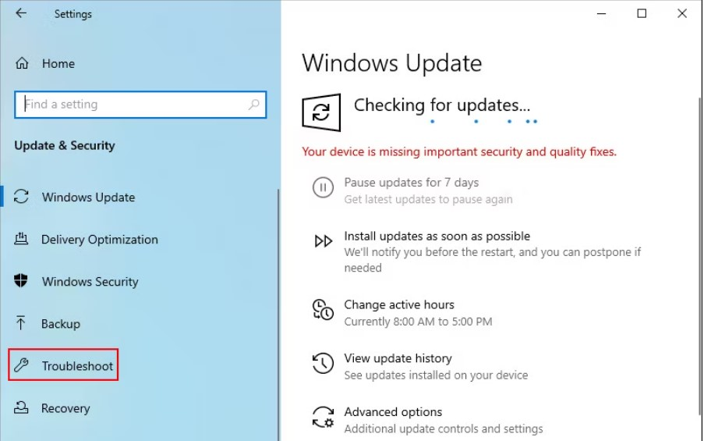
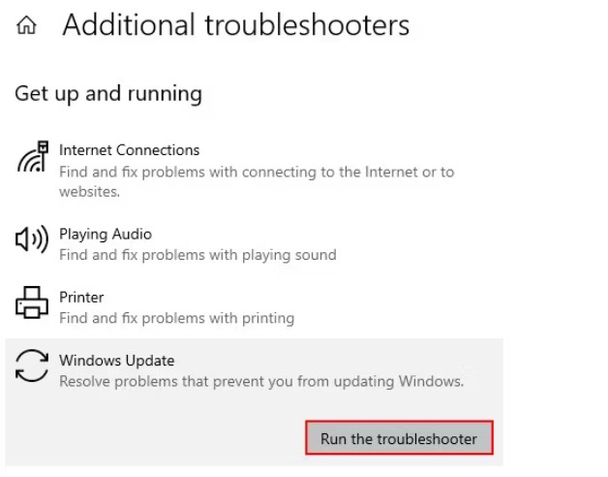
STEP 1
By Using Inbuit Security Updater :
So the Steps are as follows:
Checking missing Security Updates in OS
Run the Windows Update Troubleshooter
Press Win + I to open Windows Settings.
Navigate to Update & Security > Troubleshoot
click on the Additional troubleshooters option
Run the troubleshooter

Slide 8
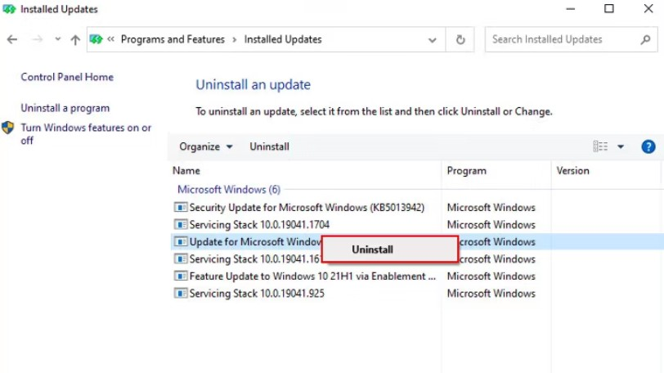
Another way to list all missing Updates
Type Control Panel in Windows search and click Open.
Click on Uninstall a program
3.Select View installed updates from the left panel
4.You can also uninstall them

Slide 9
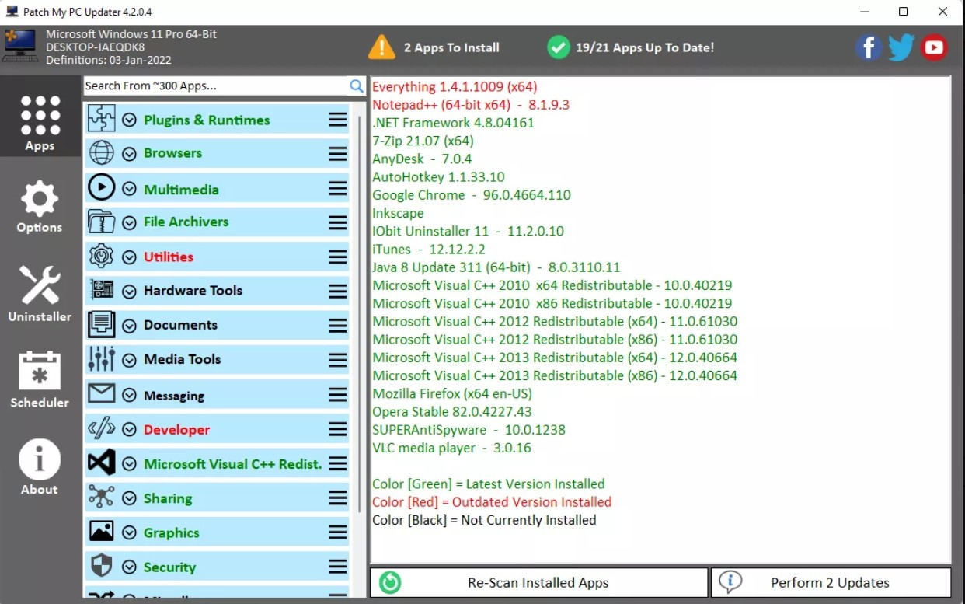
By Using desired Open Source Software
1. Patch My PC Updater v4.5
Patch My PC Updater is a free software updater utility that can not only accomplish that, but also automatically install the patches for you, unlike comparable programmes that often merely search for software updates.
You only need to choose one button to start downloading and installing all the updates it can discover, even if you don't want to utilise the automatic update option.

Slide 10
Details Regarding Patch My PC Updater
Some of the standout characteristics are as follows:
Utilizes Windows 11, Windows 10, Windows 8, Windows 7, and perhaps earlier iterations of Windows as well.
You don't need to seek for download links or access any download pages in your web browser since Patch My PC handles all software security upgrades.
Up-to-date programmes are displayed in green, and outdated programmes are identified by their red titles.
You don't need to click any buttons or go through an update procedure because updates are carried out discreetly.
It can also be used as a free program uninstaller.

Slide 11
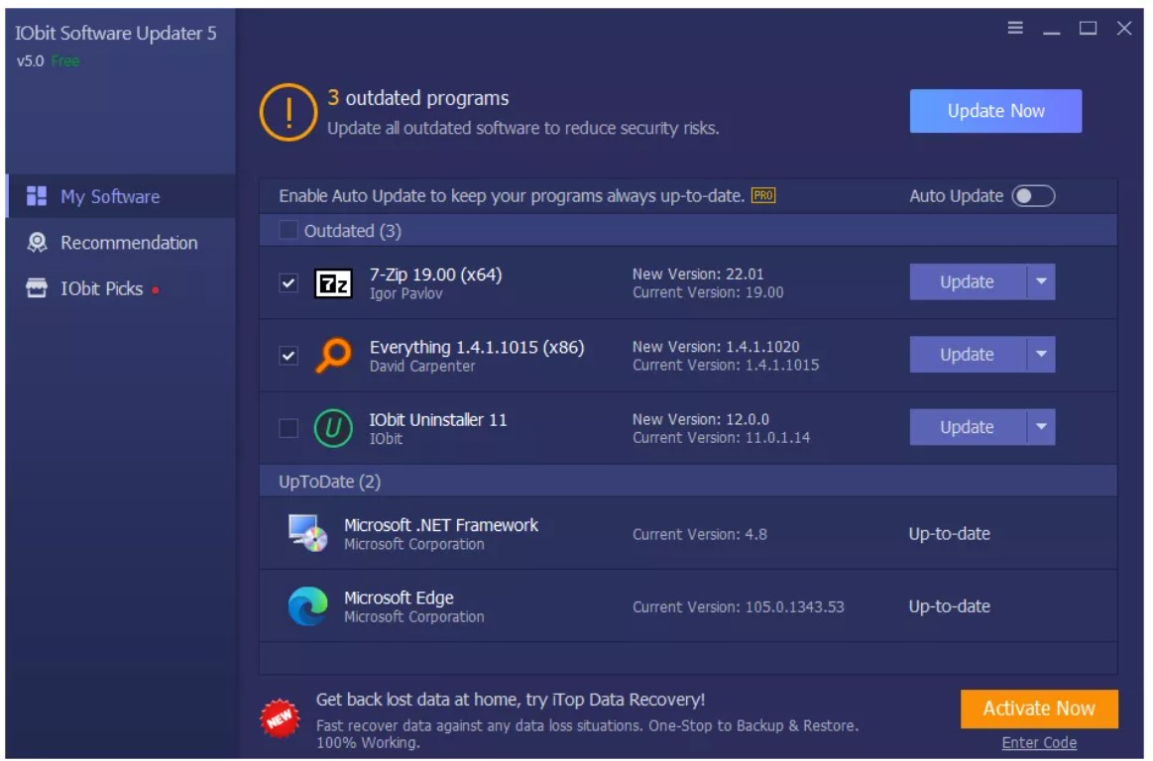
2. Iobit Updater
IObit has this really simple and easy to use software updater that has nearly all the features you need in one of these programs.
In the settings are options for when IObit Software Updater should check for new updates to itself; it can update automatically or just notify you when updates are available.
You can also control whether restore points are made automatically before every installation and if installer files should be deleted after setup finishes.
It works with new and old Windows versions, including Windows 11 and Windows 10, and older ones like Windows 7 and XP.

Slide 12
Listing all free system information about the hardware and software installed
It may be required to locate the hardware in your computer for a variety of reasons. Whether it's figuring out whether your computer satisfies the minimal system requirements, examining whether upgrades are compatible, contrasting your machine with another, or even selling the computer.
Choose your Windows version from the list below, then follow the instructions to verify your hardware specs..
There are different s tools for checking information about the hardware and software installed are as follows :
DxDiag
Msinfo32
Device Manager
Belarc Advisor

Slide 13
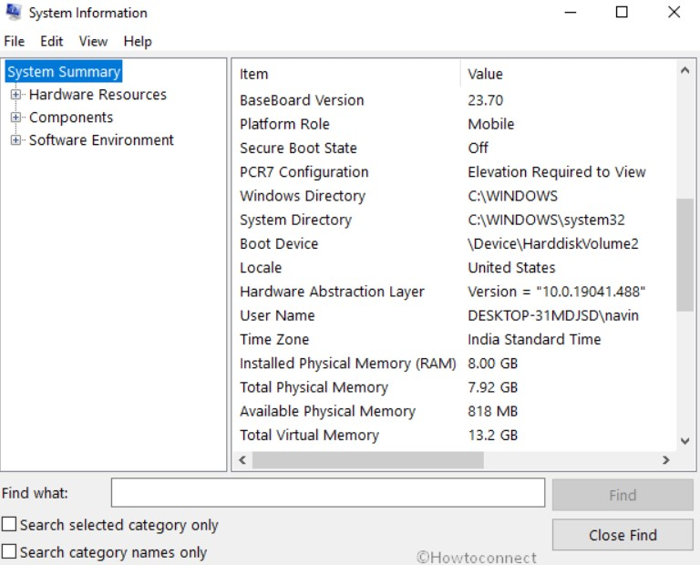
By Using DxDiag Tool
The DirectX Diagnostic Tool, often known as DxDiag, is a component of DirectX and enables you to view all system data and store it in a text file that is simple to understand.
Click Start, put "dxdiag" on the run line, then hit Enter to launch DxDiag.

Slide 14
By Using Msinfo32
System Information, often known as msinfo32, is an executable file that was initially included with Microsoft Windows 98 and has since been included with every version of Windows.
With the help of this tool, Windows users may view a complete list of their computer's details, including its hardware, resources, software, and Internet settings.
Windows 11 users
On the Windows taskbar, click the magnifying glass icon. In the text field at the top of the search window, type msinfo32 and press Enter.
Windows 8 and Windows 10 users
Click Start or press the Windows key, type msinfo32 or system information, and press Enter.
Windows Vista and Windows 7 users
Click Start and search for system information.
Windows XP, Windows ME, and Windows 98 users
Click Start, Programs, Accessories, System Tools, and System Information. Alternatively, you can open Run, type winmsd, and press Enter.

Slide 15
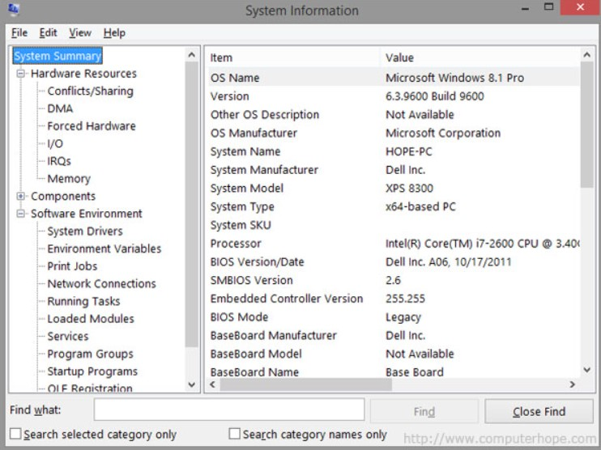

Slide 16
GITHUB Link
https://github.com/Krish-shukla/Opensource_Project.git

Slide 17
References
https://www.lifewire.com/free-software-updater-programs-2625200
Richard Adejumola(33 Articles Published)
Zainab Falak(145 Articles Published)
https://www.wired.com/story/wired-guide-open-source-software/
https://opensource.org/history
https://support.microsoft.com/en-us/windows/windows-update

Slide 18
Thank You

