Slide 1







Aurora AI
Hybrid Product Recommendation System
Recommendation Engine
A Hybrid Product Recommendation System combining Content-Based Filtering
and Collaborative Filtering to deliver smarter, personalized shopping.
Submitted by
Krish Verma | MCA
[L.P.U]
Hybrid · Personalized · Intelligent
01
Notes:
Welcome the panel and introduce yourself and your project title. Aurora AI is a hybrid recommendation engine built for online shopping. It combines two machine learning approaches to suggest better products. Briefly mention this presentation covers the problem, design, and results.

Slide 2







INTRODUCTION
What is a Recommendation System?
A recommendation system is a software tool that studies user behaviour and product
data to suggest items a customer is most likely to want — the same technology
behind “Customers who bought this also bought…” on major shopping platforms.
Where you already see it
Product suggestions while shopping
Movies & shows you might enjoy
User & Product Data
Learning Algorithm
Personalized Suggestions
Songs and playlists picked for you
Ads and content personalized to you
02
Notes:
Explain that a recommendation system predicts what a user will like. It works by learning from data such as past purchases and ratings. Give everyday examples — shopping sites, movies, and music apps. This sets up why our project focuses on product recommendations.

Slide 3





PROBLEM STATEMENT
Why Online Shopping Needs Smarter Guidance
Decision Fatigue
Thousands of Products
Time-Consuming Search
No Personalization
Too many similar choices leave shoppers overwhelmed and unable to decide.
Catalogs are enormous, making it hard to find genuinely relevant items.
Manual browsing and filtering wastes valuable shopper time.
Generic listings ignore individual taste and past behaviour.
03
Notes:
Online stores now list thousands of near-identical products. Shoppers face decision fatigue and spend too much time searching. Without personalization, results feel generic and irrelevant. This directly leads to visitors leaving without buying — a high bounce rate.

Slide 4



PROJECT OBJECTIVES
What Aurora AI Sets Out to Achieve
01
02
03
04
Personalized Recommendation
Reduce Search Time
Better User Experience
Improve Shopping Experience
Suggest products tailored to each user’s taste and browsing history.
Help shoppers find relevant items faster, with fewer clicks.
Make browsing feel intuitive, relevant, and enjoyable.
Increase engagement and conversion through smarter suggestions.
04
Notes:
Our main goal is to personalize product recommendations for each user. We also aim to reduce the time shoppers spend searching manually. A better experience keeps users engaged and satisfied. Together these objectives improve the overall shopping journey.

Slide 5

INDUSTRY CONTEXT
Why Recommendation Systems? Real-World Use
Recommendation engines power engagement and revenue across the industries
shoppers use every day — proof that this technology is a proven, high-impact field.
E-Commerce Platforms
Streaming Video
Music Streaming
Online Marketplaces
Product suggestions like “you may also like” drive a large share of online sales.
Personalized rows of shows and movies keep viewers watching longer.
Curated playlists and “discover” feeds are built entirely on recommendations.
Ranking and search results are personalized per shopper for higher conversion.
05
Notes:
Recommendation systems are used across many major industries. E-commerce platforms use them to suggest relevant products. Streaming video and music services use them to personalize content feeds. This shows the technology is proven and valuable at large scale.

Slide 6











TECHNOLOGY STACK
Technologies Used
Python
Flask
SQLite
HTML5
Tailwind CSS
JavaScript
Pandas
NumPy
Scikit-learn
Surprise Library
GitHub
06
Notes:
Aurora AI is built with Python and the Flask web framework. Data is stored in SQLite and processed using Pandas and NumPy. Scikit-learn and the Surprise library power the recommendation models. The interface uses HTML, Tailwind CSS, and JavaScript, hosted on GitHub.

Slide 7





DATA FOUNDATION
Dataset Overview
The product catalog is structured into the following core fields, forming the
foundation for both content-based and collaborative recommendation models.
Rows
Columns
Ratings
Each row represents one unique product listing in the catalog.
Structured attributes describing every product record.
User-given scores that reflect satisfaction and quality.
Categories
Brand
Description
Product groupings used for filtering and similarity.
Manufacturer or seller identity for each product.
Free-text details used for content-based similarity.
07
Notes:
Our dataset is organized as a structured product catalog. Each product has attributes such as category, brand, and description. User ratings provide the signal used for collaborative filtering. Text descriptions power content-based similarity matching.

Slide 8







SYSTEM DESIGN
System Architecture
User
Website
Flask Backend
Recommendation Engine
TF-IDF
SVD
+
Hybrid Recommendation
Recommended Products
08
Notes:
A user request flows from the website into the Flask backend. The backend calls the recommendation engine to process the request. The engine runs TF-IDF and SVD models together as a hybrid approach. The final output is a ranked list of recommended products.

Slide 9

PROCESS FLOW
Project Workflow
1
2
3
4
5
6
User
Search
Database
Machine Learning
Recommendation
Website
Every search request is logged, matched against the trained model, and returned
as a ranked set of recommendations — all within a single Flask request cycle.
09
Notes:
The workflow begins when a user searches on the website. The search query checks the database for matching products. The machine learning model then generates recommendations. These recommendations are displayed back to the user on the website.

Slide 10



MODELING APPROACH
Machine Learning Models Compared
Content-Based
Collaborative
Hybrid (Aurora AI)
Recommends items similar in attributes
to what the user already liked.
Recommends items liked by users
with similar rating patterns.
Combines both approaches for
accurate, well-rounded suggestions.
Uses TF-IDF + Cosine Similarity
Uses SVD (Matrix Factorization)
Best of both worlds
10
Notes:
Content-based filtering recommends items similar to what a user already likes. Collaborative filtering recommends items liked by similar users. Each approach has strengths, but also individual limitations. Aurora AI combines both into a single hybrid recommendation model.

Slide 11
MODEL DEEP DIVE
Content-Based Filtering
How it works
Example
TF-IDF
User selects an iPhone
Converts product descriptions into weighted keyword vectors.
Cosine Similarity
Measures closeness between product vectors to rank matches.
Recommend Similar Phones
In short: it recommends items that share qualities with what you already viewed or liked.
11
Notes:
Content-based filtering looks at product attributes, not other users. TF-IDF turns text descriptions into numeric feature vectors. Cosine similarity finds products with the closest matching vectors. Example: choosing an iPhone recommends other similar smartphones.

Slide 12
MODEL DEEP DIVE
Collaborative Filtering
How it works
From Ratings to Recommendation
SVD (Matrix Factorization)
Shared Rating Patterns
Decomposes the user-item rating matrix to uncover hidden taste patterns.
Similar Users
User Ratings
Learns from what similar users rated highly in the past.
Hybrid Recommendation blends both
models for the most relevant results.
In short: it recommends items that people with similar taste to you also enjoyed.
12
Notes:
Collaborative filtering uses SVD to analyze the full user-rating matrix. It finds users with similar rating patterns to the current shopper. Products those similar users rated highly become recommendations. This complements content-based filtering inside the hybrid model.

Slide 13





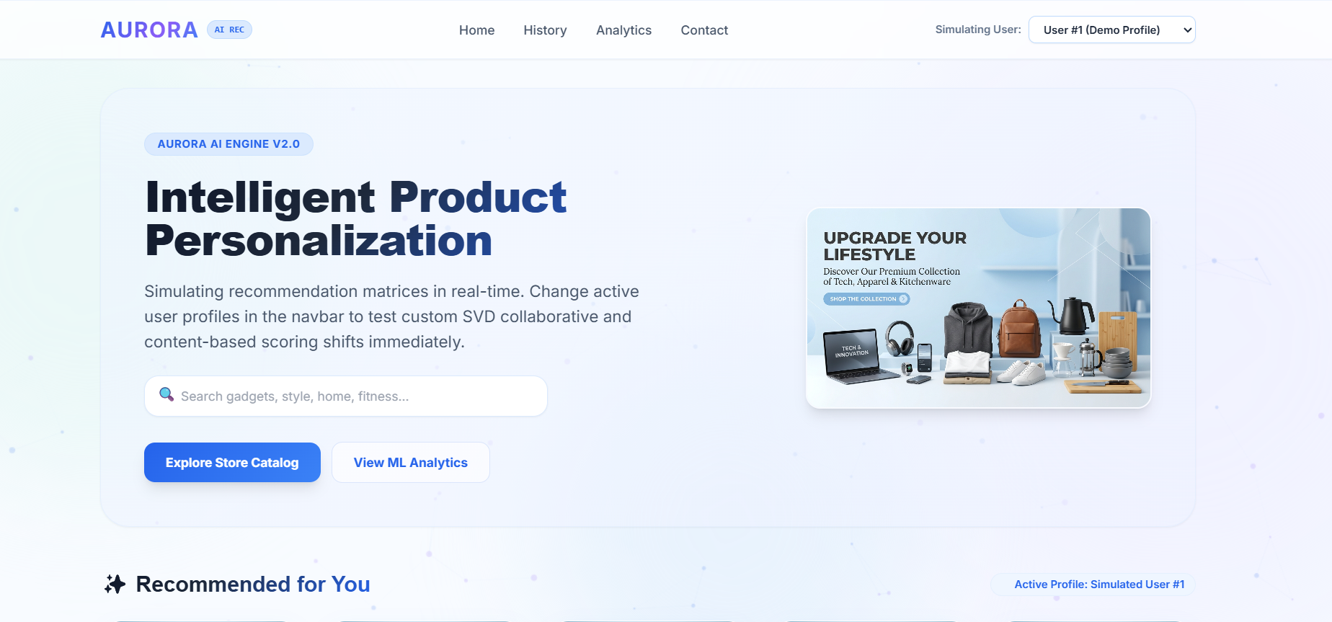
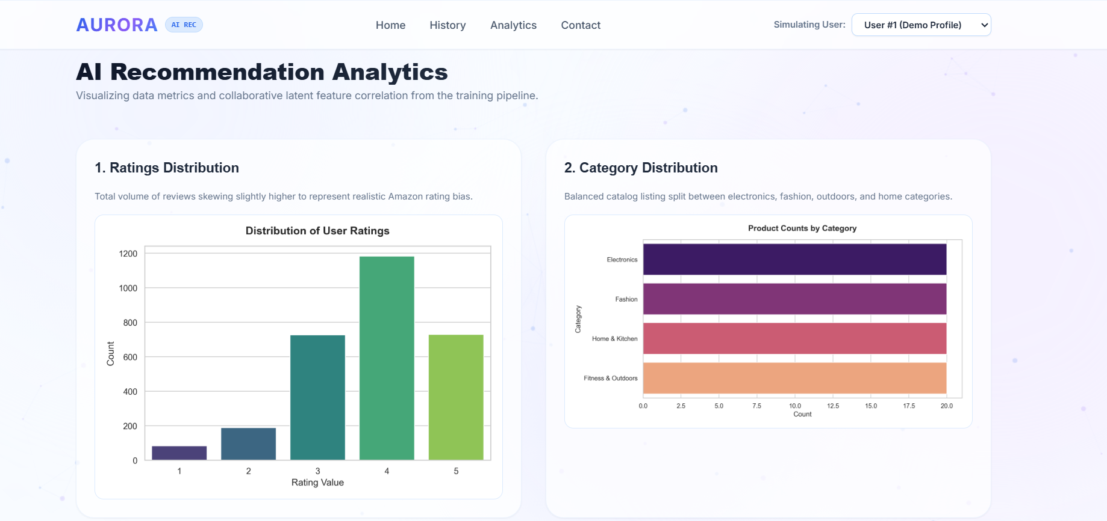

PRODUCT WALKTHROUGH
Website Features
Home
Search
Filters
Recommendation
Product Details
Analytics
Responsive Design
Home & Recommendation View — screenshot placeholder
Product Details & Analytics View — screenshot placeholder
13
Notes:
The website offers a full shopping experience from home to checkout. Users can search, filter, and view personalized recommendations. Product detail pages show analytics and related suggestions. The interface is fully responsive across devices.

Slide 14



OUTCOMES
Results & Performance
Qualitative outcomes observed during testing of the Aurora AI hybrid engine.
Replace this panel with your measured metrics (precision, RMSE, response time, etc.).
Relevant Recommendations
Fast Response
Positive User Experience
Hybrid model surfaces items closely aligned with user interest.
Recommendations are generated and returned with minimal delay.
Testers reported an easier, more guided browsing experience.
Add your real evaluation numbers here (e.g. Precision@K, RMSE, average response time) before presenting to the panel.
14
Notes:
Testing showed the hybrid model returns relevant, well-matched products. Response times remained fast enough for a smooth shopping experience. User feedback during testing was positive overall. Insert your actual measured metrics here before your final viva.

Slide 15



EVALUATION
Advantages & Limitations
Advantages
Limitations
Personalized results improve relevance for every user
Cold-start problem for brand-new users or products
Hybrid design overcomes weaknesses of a single method
Model quality depends heavily on rating data volume
Reduces search and decision time for shoppers
Periodic retraining is needed as the catalog changes
Scales to large, growing product catalogs
Content similarity alone cannot capture evolving taste
15
Notes:
Aurora AI improves personalization and reduces shopper search time. The hybrid design balances the weaknesses of each individual method. A key limitation is the cold-start problem for new users or products. Model performance also depends on having enough rating data.

Slide 16







WHAT'S NEXT
Future Scope
AI Chatbot
Voice Search
Mobile App
Deep Learning
Conversational shopping assistant for guided discovery.
Hands-free product search using natural speech.
Native app for on-the-go personalized shopping.
Neural models to capture richer taste signals.
Cloud Deployment
Admin Dashboard
Real-Time Recommendation
Scalable hosting for real-world traffic loads.
Analytics and control panel for store administrators.
Instant updates as user behaviour changes live.
16
Notes:
Future versions could add an AI chatbot and voice search. A dedicated mobile app would extend reach to more shoppers. Deep learning models could capture even richer user preferences. Cloud deployment and real-time updates would prepare it for production.

Slide 17
WRAPPING UP
Conclusion
Aurora AI demonstrates how combining content-based and collaborative filtering
creates a recommendation engine that is more accurate and useful than either
method alone — directly solving the decision fatigue and search-time problems
faced by today’s online shoppers.
Hybrid modeling delivers stronger accuracy
Better, faster shopping experience
Built to extend into a production-ready platform
17
Notes:
Aurora AI shows a working hybrid recommendation system in practice. It directly addresses decision fatigue and long search times. The project combines solid ML foundations with a usable web interface. It also lays the groundwork for future, production-ready expansion.

Slide 18


Thank You
Aurora AI — Hybrid Product Recommendation System
Questions?
[Student Name] · [College / University Name] · [Email / Contact]
18
Notes:
Thank the panel for their time and attention. Invite questions about the design, models, or results. Be ready to explain TF-IDF, SVD, and the hybrid approach in detail. Offer to demo the live website if time and setup allow.

