Slide 1
TITLE PAGE
• Project Name - FasalSuraksha
• Project Description - FasalSuraksha is an AI-powered web application that instantly detects plant diseases from leaf images and provides expert treatment recommendations through an intelligent chatbot fasalSuraksha is an AI-powered web application that instantly detects plant diseases from leaf images and provides expert treatment recommendations through an intelligent chatbot.

Slide 2
Member Details :
RAUNAK KUMAR | 11600723083 (IT/23/095)
RAHUL KUMAR SHAW | 11600723078 (IT/23/099)
KRISH BARMAN | 11600723054 (IT/23/105)
AKSHITA YADAV SNEHA JHA | 11600723016 (IT/23/118) 11600723105 (IT/23/107)

Slide 3
Problem Statement
Problem Statement
Farmers face major losses from late crop disease detection, causing poor yield, low-quality produce, and financial stress. The lack of accessible, real-time diagnosis tools leaves smallholder farmers vulnerable and threatens global food security.
Why this Problem Exist?
No simple, affordable early detection tools.
Poor or no internet access.
AI models fail on real farm images.
Existing apps are internet-dependent and not localized.
Limited technical knowledge.

Slide 4
Problem Statement
Current gaps in existing solutions:
Connectivity Reliance: Cloud-based tools fail in low-internet rural areas.
2. Limited Usability: No multilingual or voice support for non- literate farmers.
3. Low Actionability: Only diagnoses, without localized remedies or preventive guidance.
4. Poor Real-World Accuracy: AI models often misclassify crops in actual field conditions.
5. Reactive Approach: No early-warning or predictive disease detection.
Who faces this issue (target audience)?
1. Smallholder & Medium-Scale Farmers (Primary Users): Directly by crop diseases and yield loss.
2. Agricultural Experts & Extension Officers (Secondary Users): Monitor regional crop health and advise farmers.
3. Government & Agri-Organizations (Support Stakeholders): Use large-scale disease data for policy-making and awareness programs.
4. Agri-Businesses & Agri-Tech Startups (Tertiary Stakeholders): Companies providing seeds, fertilizers, insurance, or digital tools.

Slide 5
Solution Overview
One Liner Pitch:
FasalSuraksha – Empowering farmers with AI to detect crop diseases early and protect their harvest effortlessly.
Benefits:
Time Saved – Instant disease detection.
Cost Reduced– Reduces crop losses and minimizes unnecessary pesticide usage.
Improved User Experience– Easy-to-use interface with voice & multilingual support.
Accessibility Anywhere– ideal for areas with poor internet.
Better Crop Health & Yield.
Key Features:
AI Diagnosis – Detects crop diseases instantly.
Remedy Recommendations – Actionable treatments to save crops.
Voice & Multilingual Support – Reads results in local languages
Multi-Crop Ready – Supports selected crops now, scalable to many more.

Slide 6
Tech Stack & System Architecture
🖥 Backend Tech
Flask 3, Python 3.12
TensorFlow, Keras, NumPy
Gemini 2.5 Flash for chatbot
Firebase Admin SDK, PyJWT for auth
🎨 Frontend Tech
Bootstrap 5, Custom CSS
JavaScript (ES6)
Firebase Client SDK (Google login + Email/Password)
Google Fonts (Poppins), SVG Icons
🤖 ML Model
CNN model
Model format: .keras🔐 AuthenticationGoogle OAuthEmail/Password
Token verification + secure sessions🗄
StorageSession storage
Local image storage
Optional: Firestore for user data, feedback, history
🌐 APIs
Google Gemini API for chatbot
Firebase Authentication & Firestore.

Slide 7
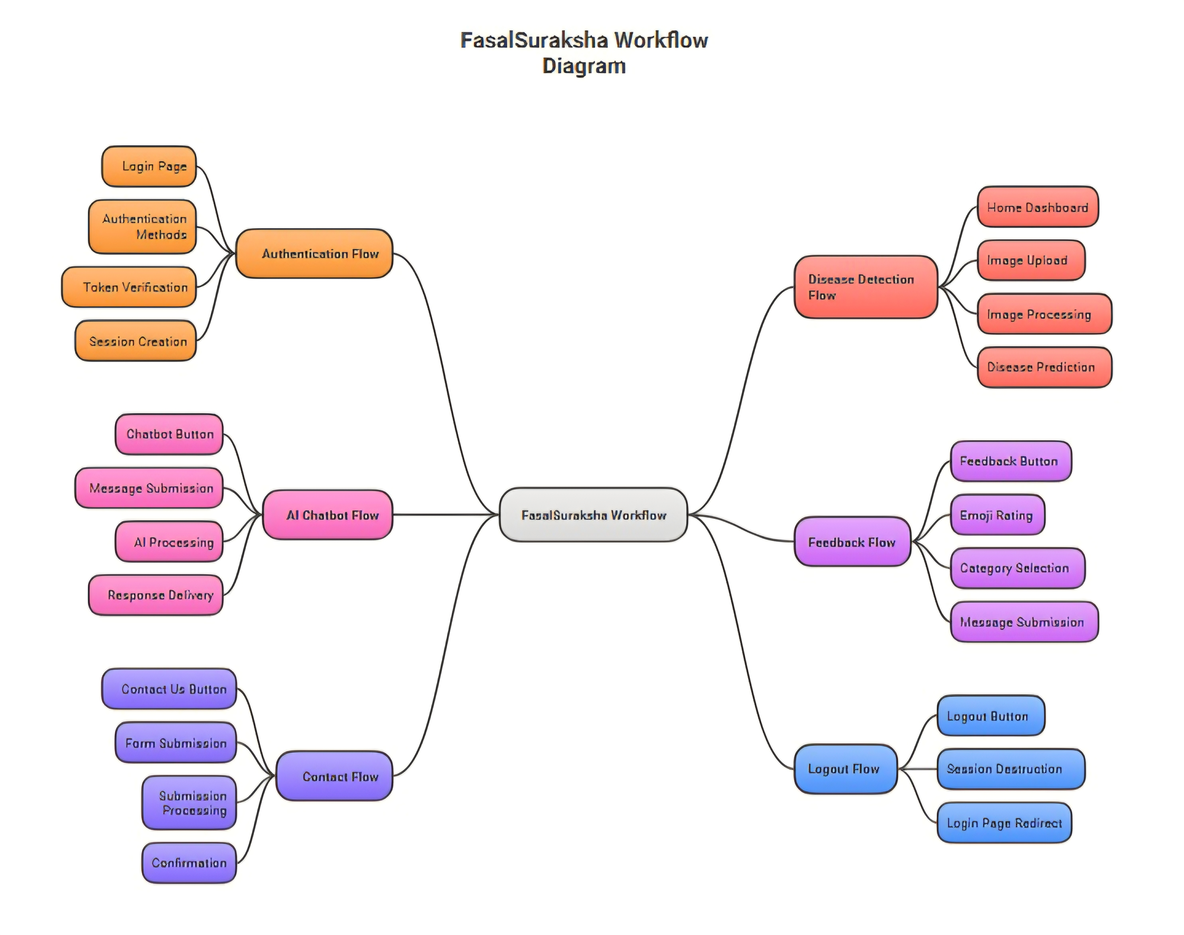
Workflow Diagram

Slide 8
Feasibility And Business Potential
Technical Feasibilty
Uses open-source tools, reducing development cost.
2. Easy to deploy on web or mobile platforms.
3. Works on lightweight CNN + Flask architecture.
Practical Viability
Low operational cost and easy maintaenance .
2. Suitable for farmers with basic smartphones.
3. Scalable for more crops , languages and features.
Key Challenges
Varying image quality in real farming conditions.
2. Internet connectivity issues in real areas.
3. Continuous dataset updates needed for accuracy.
Business Potential
Usable by farmers, agri-centres, and NGOs.
Scope for partnerships with agri-tech companies.
3. Possible subscription, premium advisory, or B2B model.

Slide 9
Impact and Benefits
Improved Crop Health
Early disease detection reduces crop damage.
Timely treatment helps prevent disease spread.
3.Increase overall yield quality.
Cost & Time Savings
Cut down losses from late disease identification.
Minimizes need for costly expert visits.
3. Saves effort through quick mobile/web access.
Potential Impact on the target audience
Improved Awareness- Helps the audience clearly understand the problem and solution.
Higher Engagement- Encourages interest and active participation.
3. Better Decision-Making- Enables the audience to make informed choices.
Accessible & User-Friendly
Simple interface designed for non-technical users.
Works on low-resource devices.
3. Available anytime,anywhere.

Slide 10
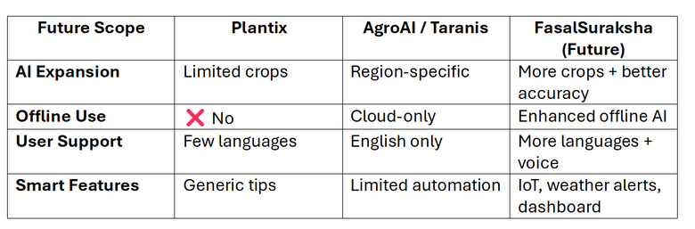
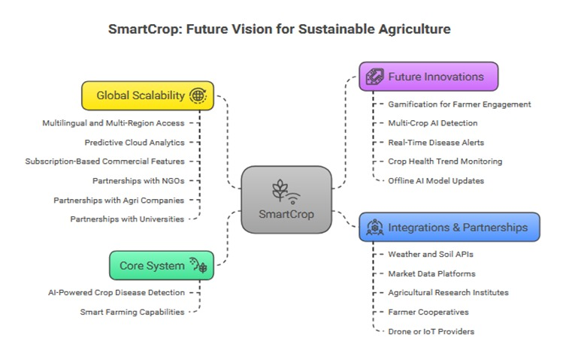
Future Scope
Advance Technology Integration
Drone-based monitoring for real-time field scanning.
IOT sensor integration for humidity , temperature & soil data.
3. Weather-based predictions for disease outbreak forecasting.
Future Scope-Comparison Table
Enhanced User Features
More Crop & Disease Classes to cover wider farming needs.
2. Farmer History Dashboard to track paste detections.
3. Community Support System for farmer-to-farmer learning.
Expansion of AI Capabilities
Multilingual chatbot to support regional languages.
2. Add more crop with local disease accuracy.

