Slide 1
Unicorn Prediction &
Startup - Investor RS
Group 12
Prathamesh Karve Nithin Gollanapally Pranav Dixit Sagar Bonde

Slide 2
The Problem
Predict Future Unicorns
Recommend potential startups to investors
Recommend potential investors to startups

Slide 3
Data collection

Slide 4
Web scraping
Direct data was not available so web scraping was used for data collection. BeautifulSoup used for it.
The names and basic information of startups was scraped from seeddb.com and angel.co
More information of each startup (like funding, location, investors) were scraped from cruncbase.com and angel.co
These websites prevent data scraping by automated scripts. So we had to manually save html pages and scrape them locally

Slide 5
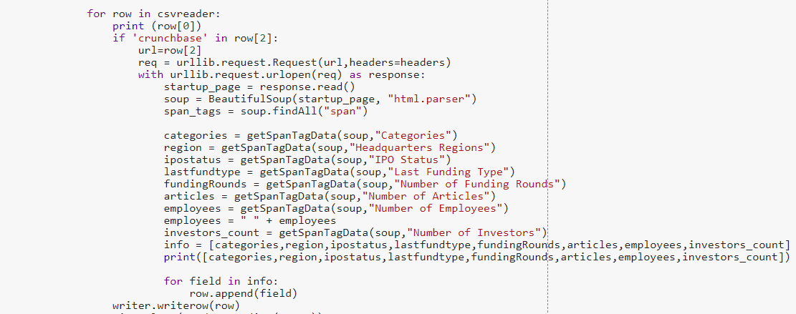
Web scraping

Slide 6
Data attributes
From the data scrapped following are the important attributes which are used for prediction and evaluation-
Startup location
Funding amount
Domain of the startup
Number of articles citing the startup

Slide 7
Data cleaning

Slide 8
Scrapped data had many inconsistencies and missing values. Data cleaning necessary.
Drop data which have missing attribute values.
Removing unnecessary punctuations and characters from the attributes

Slide 9
Data preprocessing

Slide 10
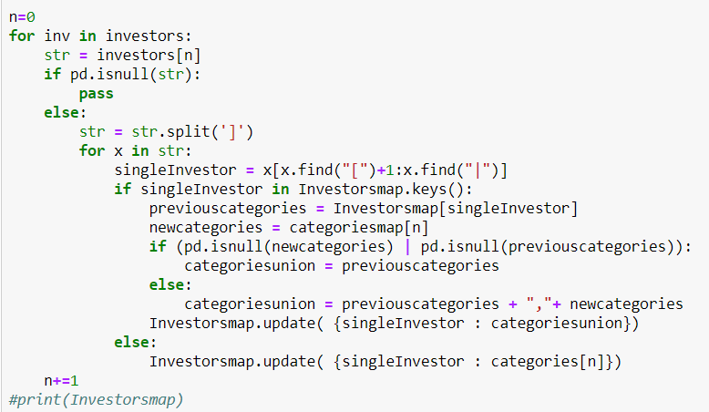
MultiLabelBinarizer
Investors list was collected in the form of lists from cleaned raw data.

Slide 11
Unicorn Prediction
Success of startups depend on the following factors-
Uniqueness of idea
Funding
Popularity and Marketing

Slide 12

Startup categories
Crunchbase provides each startup with categories or domains in which the startup is working
eg- Saas, E-commerce, Bitcoin, Biotechnology etc.
Tf-Idf is used on these categories to get a vector for each startup
Cosine similarity is used to find the similarity between one startup with all the other startups in the database
Average of each startup’s similarity with all other is taken as the general similarity index.
Let N = total number of startups , x = startup whose similarity index is to be found

Slide 13

Funding amount
The weightage of funding amount depends on the time duration in which it was secured.
A startup securing a $10 Million is 2 years is impressive that a startup which collects the same money in 10 years.
Decay function is used to normalize the funding amount.
Let x be the funding amount and t be the time duration

Slide 14
Number of Articles
The number of articles published related to a startup define the popularity of the startup. It can be used to generate a popularity index.
Let x be the number of articles published for a startup

Slide 15
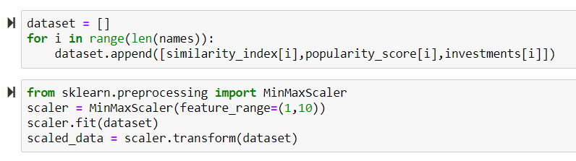
Feature scaling
Similarity index is in the range of 0-1 while funding amount is in dollars and can have any value above 0. So Feature scaling required
MinMaxScaler used to scale all the values of data in the range of 1 to 10.

Slide 16
Modeling

Slide 17
Unicorn Prediction
It uses a hybrid approach for predicting unicorns
Approach similar to content based recommendation system is used to get similarity index of each startup. Inverse of similarity index generates uniqueness index.
A custom ranking function is used to rank the startups based on their probability of becoming unicorn

Slide 18
Unicorn Prediction
Success of startups depend on the following factors-
Uniqueness of idea
Funding
Popularity and Marketing

Slide 19
Unicorn Prediction
Success of startups depend on the following factors-
Uniqueness of idea
Funding
Popularity and Marketing
Similarity Index
Normalized Amount
Popularity Index

Slide 20
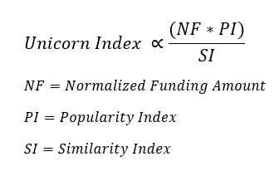
Unicorn Prediction Index

Slide 21
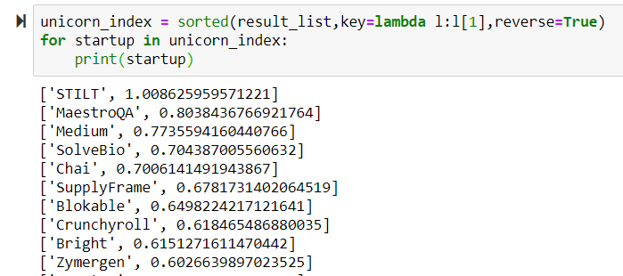
Unicorn Prediction Index

Slide 22
Startup/Investor Recommendation
We are using pipelined hybrid recommendation system.
Phase -1 :
Phase -2 :
Collaborative filtering with rows as Startups and Investors as columns.
User -User Based Similarity for Investors
User -User Based Similarity for Startups
Go - No go
Thus generating a [Startup * Investor] matrix

Slide 23
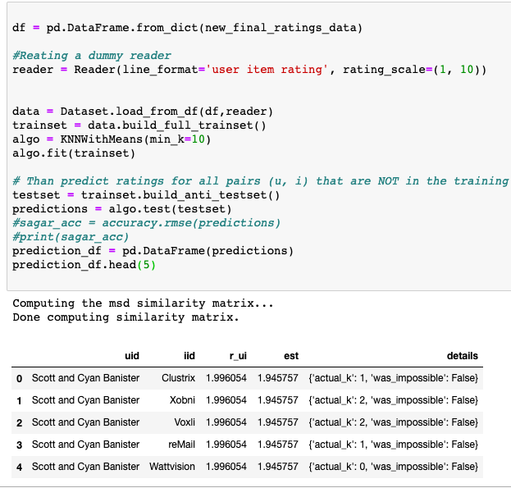
Startup/Investor Recommendation
Phase -1 :
Collaborative filtering with K - Nearest Neighbour Algorithm
Pearson Baseline is used as a Distance Function for finding similarity
Say For investors we have chosen User- Based Similarity, where items being the Startups
The Ratings score generated by parameters like
Funding Raised, No. of Funding Rounds & Popularity

Slide 24
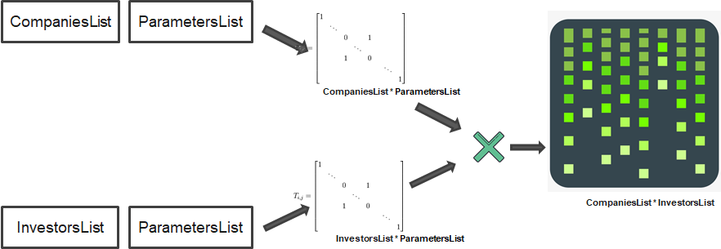
Startup/Investor Recommendation
Phase -2 : GO - NO Approach
Multiplying both phase-1 matrix and phase-2 matrix gives our desired result.

Slide 25
Model Evaluation

Slide 26

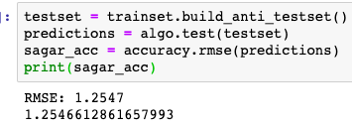
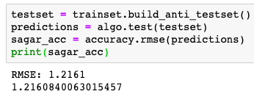
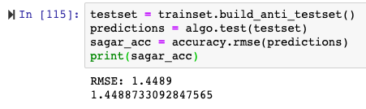
Startup-Investor Recommender System
Evaluation: RMSE value
K = 5
K = 10
K = 2

Slide 27
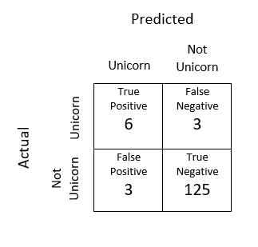


Unicorn Prediction - Confusion matrix

Slide 28
Deployment

Slide 29
2-stage Prediction Server
Offline processing
Runs as a nightly cron job. Does all the heavy-lifting
U * U Similarity matrix and list of top-N generated
Unicorn prediction model

Slide 30
2-stage Prediction Server
Online processing
‘Add to Portfolio’ action captured as positive feedback
Cookies used to track which startups are added in this session
Re-computes top-N using already computed similarity scores

Slide 31
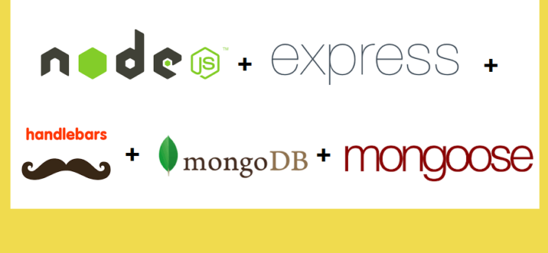
Website

Slide 32
RS Explanations
Handled by Online processing module
Responsiveness - Recommend startups based on recent choices When user adds a startup to portfolio, startups similar to it are recommended
Trustworthiness - Recommend based on user’s location

Slide 33
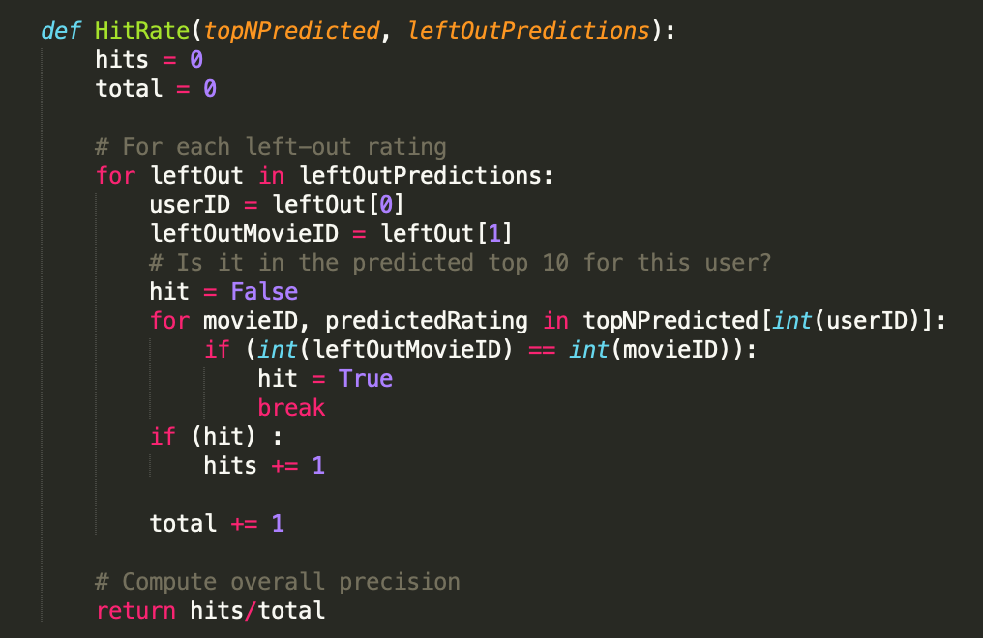
Evaluation
Unicorn Prediction - Confusion Matrix
Offline Recommendation System - RMSE
Online Recommendation System -
Leave-One_Out Cross Validation
Hit Rate = 0.7352

