Slide 1
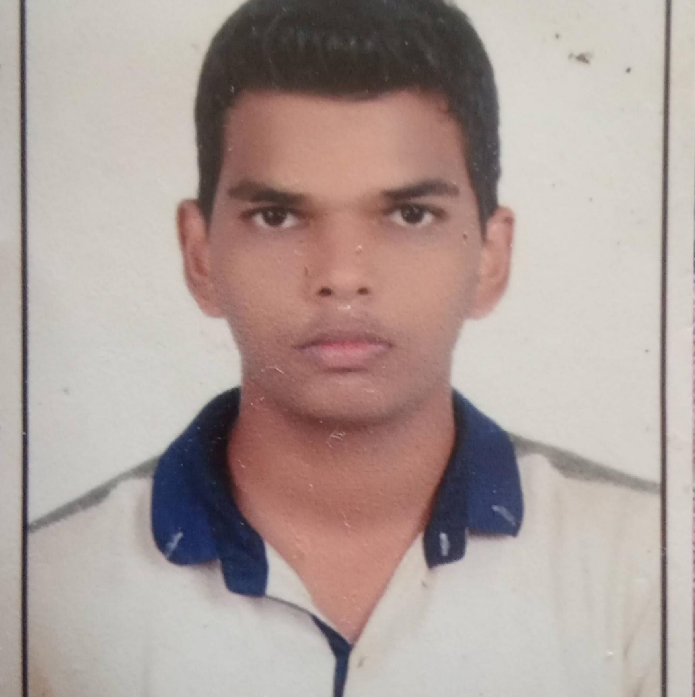


Krishna Nandlal Gupta
Analyst/Software Engineer
Bachelor of Engineering
Mechanical : 2018 - 2021
Skills
Java 8 /J2EE | Java Basics, OOPS, Collections, Arrays, Loops, Lambda Exp, Stream API, Exception Handling.
Spring core | IOC & Dependency Injection, Autowire..
Spring REST | REST controllers, Implementation of GET, POST, PUT & DELETE, Bean Validation & Exception Handling, Testing Services, Controller & Repository layer.
Spring Data JPA | Implement DAO layer using spring Data repositories, Transaction Management..
React | Components, Hooks, Event handling, Redux.
Database | MongoDB No-Sql Basics. My SQL,Postgres SQL RDBMS
UI Tech | HTML 5 & CSS 3,JavaScript, ES6 & TypeScript.
Tools | Git, Postman, Maven, Eclipse IDE
Add On skills | Communications, Team management. Peer learning.
Mumbai
krishna-nandlal.gupta@capgemini.com
+91 9702893924
A4
Full Stack Developer
Having a good knowledge on Spring core, Spring MVC , Spring boot.
Having a good knowledge in developing Web pages using HTML, CSS, JavaScript.
Having a good knowledge in creating the single page Web applications using React.
Currently improving my skills on the i-Transform platform.
Ready to learn the new Technologies and implement them for future knowledge improvement.
Name Board Gift (Springboot Project)
Created Name Board Gift is an online shopping portal wherein customer purchases the gifts based on different filter conditions as like price, ratings. CRUD operations can be performed as like adding of a particular gift, removing the particular gift by the customer.
Expense Tracker (React Project)
Created an expense Tracker which keeps the track of the expense of an items on the particular date and we can also see total expense for the particular month . Also the expenses could be added and removed for the particular month.
Check out my work on GitHub

