Slide 1
Employee Data Analysis using Excel
STUDENT NAME: KRISHNAVENI T
REGISTER NO:312216782
DEPARTMENT: B.Com(A&F)
COLLEGE: SHRI KRISHNASWAMY COLLEGE FOR WOMAN, ANNA NAGAR, CHENNAI

Slide 2
PROJECT TITLE
Employee Performance Analysis using Excel

Slide 3


AGENDA
Problem Statement
Project Overview
End Users
Our Solution and Proposition
Dataset Description
Modelling Approach
Results and Discussion
Conclusion
3/21/2024 Annual Review

Slide 4

PROBLEM STATEMENT
To identify the problems in the management.
To reduce the time require to identify the problem.
Anlyze the employee performance in order to identify the trends and problems in different fields.

Slide 5

PROJECT OVERVIEW
The employee data sheet is a critical tool for managing and organizing employee information within our organization. However, several challenges have emerged regarding the accuracy, accessibility, and usability of this data.

Slide 6

WHO ARE THE END USERS?
Multi network companies who are facing a issues related to employees.
Industrials
Schools and colleges
Employers of organization

Slide 7

OUR SOLUTION AND ITS VALUE PROPOSITION
Conditional formatting- find the missing values
Slicing- to remove the null values
Sort and filtering- to check all the details
Graph-Data visualization- Represent the results in the easy manner
Formula- performance calculation

Slide 8
Dataset Description
Employee dataset- downloaded from kaggle
There are 26 features in data set
I considered only 7 features.
Emp id-num
Name- text
Emp type
Employee status
Performance level
Gender
Employee rating

Slide 9

THE "WOW" IN OUR SOLUTION
Conditional formatting
Formula’s
Data visualization
3/21/2024 Annual Review
9

Slide 10
MODELLING
Data collection
Data from kaggle
Feature collection
7 features taken from the 26 features
Data cleaning
Clean the null values present in the data sheet
Performance level
Num values changed to text using formulas’s
Summary
The selected data sett is further taken into data visualization
Pivot table
In pivot table rows
Gender code is given to filters
Employee performance is given to columns
Business unit is given to rows
Performance score is given to count of values
10

Slide 11
MODELING
Pivot table
In pivot table rows
Gender code is given to filters
Employee performance is given to columns
Business unit is given to rows
Performance score is given to count of values
Data visualization
Pie chart
Trendline
Bar chart
Line charts

Slide 12
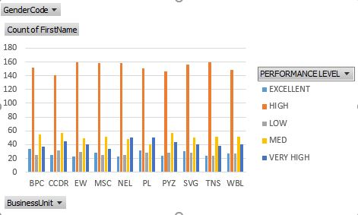
RESULTS
12

Slide 13
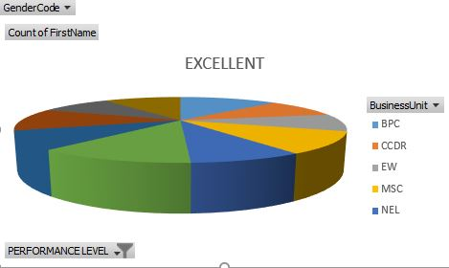
results

Slide 14
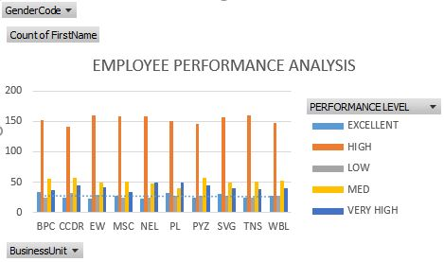
results

Slide 15
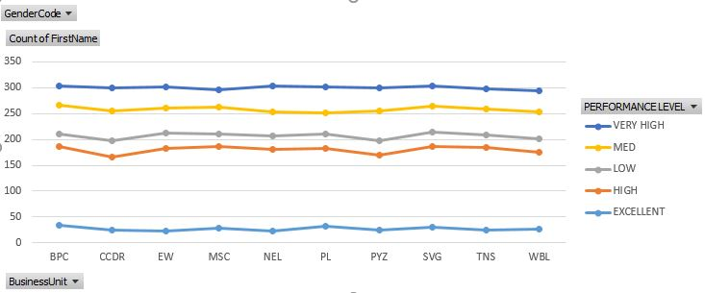
results

Slide 16
conclusion
The employees from high levels are more compared to very high and excellent employees. In order to improve the very high and excellent level employees we have to give the work according to their strength to improve the organization or industry in very good manner. It will boost the employees. We have to give some compensation for the employees who are working very hard to improve the organization.

Slide 17
Thank you

