Slide 1


Hand-drawn Sketch Recognition

Slide 2
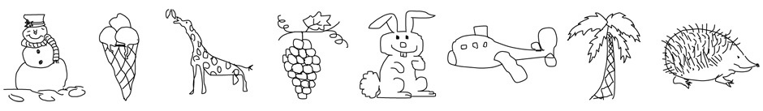
1
2
Introduction
3
4
Skribix is an intelligent handdrawn sketch recognition tool designed to interpret and classify sketches of everyday objects. Leveraging a dataset of 250 distinct categories, Skribix focuses on identifying simplified, human-drawn illustrations that reflect real-world items. The tool bridges the gap between human creativity and machine understanding, making it useful for educational tools, creative apps, and human-computer interaction systems.
5
6
7
8
9

Slide 3

Dataset Collection
1
2
About Dataset
The dataset used in Skribix is derived from the research project “How Do Humans Sketch Objects?”. This collection contains 20,000 handdrawn sketches gathered through crowd-sourcing platforms like Amazon Mechanical Turk (AMT). The sketches span 250 object categories and were created by non-professional participants using a structured and quality-controlled process. Emphasis was placed on simplicity, realism, and variety to reflect everyday sketching behavior.
3
4
5
6
Collection Process
Participants sketched objects based on random category names within a 30-minute time window.
Only outlines were to be drawn, excluding backgrounds or extra context.
A stroke-based digital canvas with undo, redo, clear, and delete functions was provided.
Sketches were manually reviewed post-collection to remove incorrect or offensive content, while retaining imperfect yet valid sketches.
7
8
9

Slide 4
Dataset Collection
1
Crowd-Sourcing Details
2
1,350 unique workers contributed sketches.
Total drawing time: 741 hours.
Median time per sketch: 86 seconds
Median strokes per sketch: 13
Drawing typically followed a coarse-to-fine pattern, starting with longer strokes.
3
4
Data Verification & Cleaning
5
Visual inspection was done using a custom interactive tool.
Around 6.3% of sketches were removed due to category mismatch or quality issues.
Final dataset was standardized to include exactly 80 sketches per category for uniformity.
6
7
8
Project Datasets
Two sets of datasets are created, thus forming two versions of the project
The first implementation includes all 250 categories, consisting of 20,000 images.
In the second implementation, we took a subset of 15 classes: Airplane, Book, Cup, Envelope, Fan, Fork, Hat, Key, Laptop, Leaf, Moon, Pizza, T-shirt, Traffic light, and Wineglass.
9

Slide 5
Feature Extraction
1
Transform raw sketch images into numerical vectors for machine learning models.
2
1. S-HOG (Sketch-specific Histogram of Oriented Gradients)
3
Converts grayscale images to 256×256
Uses Sobel filters to compute gradients
Divides image into patches (e.g., 28×28)
Computes gradient orientation histograms per patch
Normalizes to reduce bias
Feature vector size: 500 dimensions
Captures line direction, curvature, and shape orientation
4
5
6
7
2. Hard Quantized Descriptors (BoVW with Hard Assignment)
8
Extracts local descriptors from sketch patches
Uses K-Means clustering (e.g., 500 clusters)
Assigns each descriptor to nearest visual word
Forms a histogram of visual word frequencies
Produces compact and interpretable feature vectors
Used in Version 2.0 of Skribix with strong performance
9

Slide 6
Feature Extraction
1
Transform raw sketch images into numerical vectors for machine learning models.
2
3. Soft Quantized Descriptors (BoVW – Soft Assignment)
3
Assigns descriptors to multiple clusters using Gaussian weighting
Produces smooth, detailed histograms
Reduces errors from sketch noise and stroke variation
Feature size: 1200 × 500
Used in Version 2.1 for better generalization
4
4. Edge Detection-Based Features (Version 2.2)
5
Uses pre-trained CNNs (e.g., VGG16) on augmented sketch images
Extracts abstract and hierarchical features
Captures stroke groupings, contours, and spatial structure
Feature vector size: 16,384 dimensions
Can be used with ML models like SVM or KNN
6
7
8
5. Deep Features via CNNs (Version 2.3)
9
Uses ImageDataGenerator for real-time image augmentation (rotation, shift, zoom)
Augmented images passed through a pre-trained CNN (e.g., VGG16)
CNN extracts abstract and hierarchical features
Captures stroke groupings, contours, and spatial structure
Feature vector size: 16,384 dimensions
Features reused with classical ML models like SVM or KNN

Slide 7

Project Versions
1
The project has been divided into 2 versions which are :
2
Version 1 – Full Dataset (250 Classes)
3
Used full dataset: 20,000 images, 250 categories
Feature extraction via S-HOG
Faced challenges:
Low inter-class separability
Overlapping structures & sketch styles
Moderate training accuracy
Poor generalization on unseen data
4
5
6
7
Version 2 – Reduced Dataset (15 Classes)
Dataset reduced to 1,200 sketches across 15 distinct classes
Achieved higher accuracy and less category confusion
Feature extraction:
Soft/hard quantization, edge detection, CNN-based features
Enabled real-time recognition system hosted on Google Cloud
Users draw on a web interface, get instant predictions (Version 2.1 model)
🔗 Live Demo: http://34.131.175.227
8
9

Slide 8
Methodology and Models
1
From classical pipelines to optimized recognition – evolving strategies for sketch classification
2
Version 1: Full Dataset (250 Classes × 80 Sketches)
3
Model Approaches
PCA + Naive Bayes
PCA reduced feature redundancy
Naive Bayes assumed feature independence
Train: 70.30%, Test: 45.00%
SVM
Sought optimal decision boundaries
Good training accuracy but overfitting
Train: 76.02%, Test: 51.68%
ANN
Shallow network captured non-linearity
Struggled with sparse sketch data
Train: 77.01%, Test: 51.23%
GMM + KNN
GMM formed soft clusters
KNN used cluster distances for classification
Train: 74.00%, Test: 52.01%
4
5
6
7
8
9
Takeaway:
High complexity of sketch-based 250-class classification
Classical models struggled with generalization due to inter-class visual similarity

Slide 9
Methodology and Models
1
From classical pipelines to optimized recognition – evolving strategies for sketch classification
2
3
Version 2 – Reduced Dataset (15 classes × 80 sketches)
4
Version 2.0 – Hard Quantized Features (BoVW)
Version 2.2 – Edge Detection Features
5
Feature:
K-Means (500 clusters), hard visual word assignment
Models:
KMeans + SVM → Train: 100%, Test: 78.75%
PCA + Naive Bayes → Train: 92.40%, Test: 58.75%
Feature:
Canny edges (8100-dim vectors)
Models:
KMeans + SVM → Train: 100%, Test: 84.16%
ANN → Train: 100%, Test: 80.03%
6
7
8
Version 2.1 – Soft Quantized Features
Version 2.3 – Deep Features via CNNs
Feature:
Soft assignment via Gaussian weights
Models:
KMeans + SVM (k=45) → Train: 100%, Test: 81.25%
GMM + KNN → Train: 84.20%, Test: 61.05%
Feature:
VGG16 outputs (16,384-dim)
Models:
Fine-tuned CNN Head → Train: 94.65%, Test: 73.67%
SVM → Test: 56.25%
PCA + SVM → Test: 46.25%
9

Slide 10
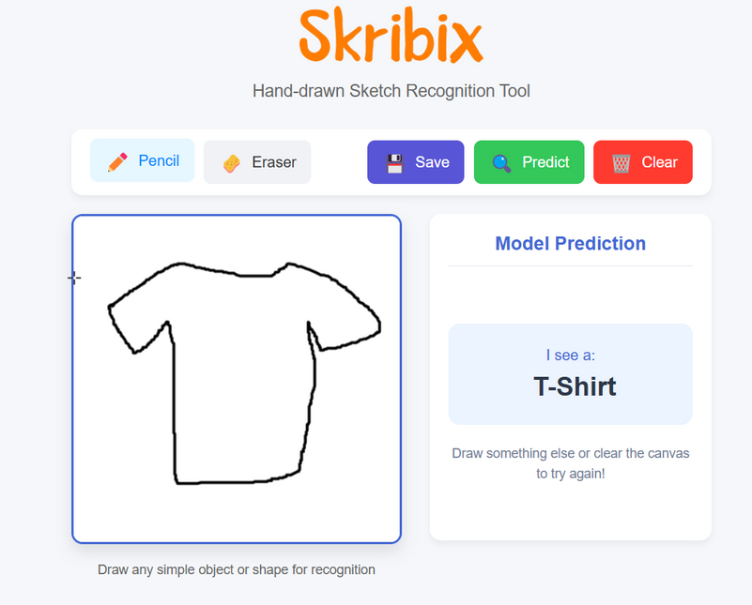
Real-time Application & Future Scope
Deploying CNN-based sketch recognition in a live system
1
2
3
Real-time Application (Version 2.4)
Users draw sketches on a canvas interface
A feature extraction pipeline processes the sketch
An optimized CNN model predicts the class
Results are displayed instantly
Integrated with Google Cloud for seamless storage and deployment
4
5
6
7
Future Improvements
8
Hybrid models: Combine CNN features with traditional classifiers
Advanced data augmentation: Improve generalization
Incremental learning: Add new classes dynamically
Dynamic dataset: Adapt based on user inputs for continuous improvement
9

Slide 11
1
2
3
Thank you
4
5
6
Thank you for your attention. Through this project, we explored how different feature extraction methods and modeling approaches impact sketch classification. We learned that while traditional models offer interpretability, deep learning methods provide superior accuracy with the right data and architecture. Our final real-time application demonstrated the practical utility of these insights, combining technical depth with user-centric design.
7
8
9

