Slide 1

Fake News Detection
This presentation explores the problem of fake news, its impact, and a machine learning-based solution for detection.
by Krish Sahu 22BLC1171

Slide 2


What is Fake News?
1
Intentional Deception
2
Distorting Facts
3
Real-World Consequences
Fake news refers to intentionally false or misleading information spread via news outlets and social media, designed to deceive or manipulate.
It creates confusion and distorts facts, influencing public opinion and decision-making.
Fake news can lead to serious real-world consequences, including political and social instability.

Slide 3


Problem Definition
Challenge
Identifying fake news is a critical challenge due to the subtle differences between real and fake news.
Solution
Develop a machine learning-based fake news detector that automatically classifies news articles as either "Real" or "Fake."

Slide 4
Types of Fake News Patterns
Sensationalism
Lack of Sources
Clickbait Headlines
Use of exaggerated, emotional language to provoke reactions.
Fake news often lacks credible sources or proper citations.
Catchy headlines designed to attract clicks, but misleading in nature.

Slide 5

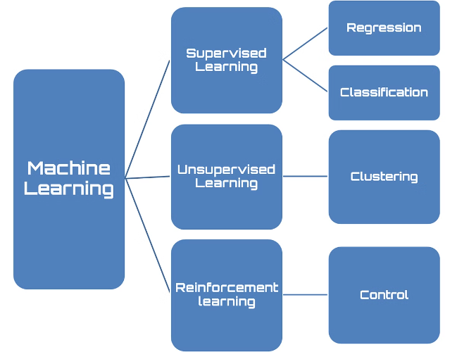
Methodology
1
Text Collection
Gather large amounts of news articles from various sources.
2
Text Processing
Preprocess the text to make it suitable for machine learning models.
3
Text Extraction
Extract relevant features from the text using techniques like Bag of Words (BoW), TF-IDF, or Word Embeddings.
4
Modeling
Train machine learning algorithms (e.g., Logistic Regression, Naive Bayes) to classify articles.

Slide 6


Text Collection
Data Sources
News articles collected from various news platforms, using datasets like Kaggle’s Fake News dataset.
Features Collected
Title, Author (optional), Main Text.
Challenges
Handling missing data, ensuring a balanced dataset.

Slide 7


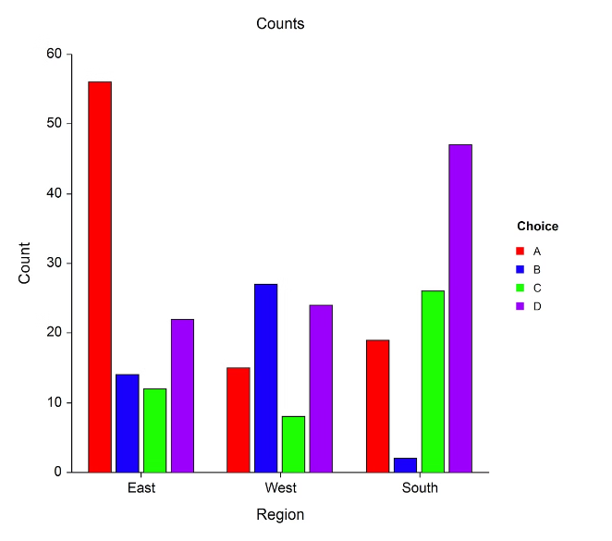



Result and Analysis
Accuracy
Percentage of correctly classified articles (real or fake).
Precision
Proportion of true positive predictions out of all predicted positives.
Recall
Proportion of true positive predictions out of all actual positive cases.
F1-Score
The harmonic mean of precision and recall, providing a balanced measure.

Slide 8


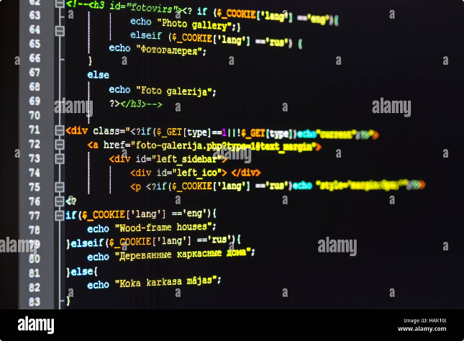


Implementation and Result
Implementation
Used Python with Google-Collab for building machine learning models.
Model Used
[Best Performing Model Name, e.g., Logistic Regression, Random Forest, etc.]
Results
The model will be able to classify fake news with high accuracy, showing robust performance in distinguishing between real and fake articles.

