Slide 1
23CSE312 Distributed Systems
Performance Evaluation of Encryption Algorithms on Edge Devices
AES-256-GCM | ChaCha20-Poly1305 | PRESENT | SPECK-64/128
Team_No: 8
S.No | Reg.No | Name of the Student | Section
1 | BL.EN.U4CSE23211 | Bandaru Ram Jayadeep | CSE C
2 | BL.EN.U4CSE23241 | Padala Siva Rama Krishna Reddy | CSE C
3 | BL.EN.U4CSE23244 | Pathem Ashwak Patel | CSE C
4 | BL.EN.U4CSE23247 | Reddim Thoshan Reddy | CSE C
Project Advisor:​​
Ms. Sreebha Bhaskaran​​
Dr. Meena Belwal

Slide 2
Problem Statement
Security Constraint: IoT edge devices (sensors, smart cameras, medical monitors) collect sensitive data that must be encrypted immediately before transmission.
Hardware Constraint: Edge devices possess strictly limited CPU cycles, memory, and battery life.
Conventional Problem: Traditional standard encryption (like full hardware AES) may exhaust the resources of ultra-constrained devices (e.g., simple RFID tags or microcontrollers).
Core Objective:
To conduct a rigorous comparative evaluation of standard versus lightweight encryption algorithms -- measuring latency, throughput, CPU utilization, and memory footprint -- to identify the optimal algorithm for diverse edge environments.

Slide 3
Justification for Problem Statement
Why is this problem important?
1. Explosive IoT Growth: By 2025, over 75 billion IoT devices are projected worldwide. Each device generates sensitive data requiring encryption.
2. Edge Security Gap: Most IoT breaches occur at the edge. Encrypting data at the source (not in the cloud) prevents man-in-the-middle interception during transmission.
3. Resource Mismatch: Standard AES requires dedicated hardware (AES-NI) that passive RFID tags and 8-bit microcontrollers simply do not have. Lightweight ciphers (PRESENT, SPECK) were specifically designed for these constraints.
4. No Universal Solution: There is no single 'best' algorithm -- the optimal choice depends on whether the device has hardware acceleration, how much RAM/ROM is available, and the acceptable latency budget.
5. Distributed Systems Relevance: In a real deployment, thousands of edge nodes must encrypt concurrently. Our benchmark measures not just individual cipher performance but system-wide scalability under parallel distributed workloads.

Slide 4
Literature Survey
S.No | Paper Title | Authors / Year | Key Contribution / Relevance
1 | The Design of Rijndael: AES | Daemen & Rijmen, 2002 | Establishes AES block cipher. We use AES-256-GCM as industry-standard baseline.
2 | ChaCha, a variant of Salsa20 | Bernstein D.J., 2008 | ChaCha20 stream cipher excels in software without hardware crypto instructions.
3 | PRESENT: An Ultra-Lightweight Block Cipher | Bogdanov et al., CHES 2007 | SPN cipher for extreme constraints (~1,570 GE). Benchmarks lowest hardware tier.
4 | The SIMON and SPECK Families | Beaulieu et al., IACR 2013 | SPECK-64/128 ARX cipher by NSA. 24 cycles/byte on ARM Cortex microcontrollers.
5 | Lightweight Crypto for IoT Devices | Thakor et al., IEEE Access 2021 | Comparative framework for latency, throughput, memory. Our methodology mirrors this.

Slide 5
Literature Survey
S.No | Paper Title | Authors / Year | Key Contribution / Relevance
6 | Wireless Sensor Networks: A Survey | Akyildiz et al., Comp. Networks 2002 | Node count scales with area x density (N=AxD). Informs our distributed simulation.
7 | Edge Computing: Vision and Challenges | Shi et al., IEEE IoT Journal 2016 | Defines edge computing paradigm. Justifies why encryption must occur at edge, not cloud.
8 | The Internet of Things: A Survey | Li et al., Inf. Systems Frontiers 2015 | Comprehensive IoT architecture survey. Validates our sensor data model and edge constraints.
9 | Report on Lightweight Cryptography | McKay et al., NIST IR 8114, 2017 | NIST guidelines for lightweight crypto selection. Frames our algorithm comparison criteria.
10 | Review of Lightweight Block Ciphers | Hatzivasilis et al., J. Crypto. Eng. 2018 | Systematic review of PRESENT, SPECK, SIMON. Validates our from-scratch implementation approach.

Slide 6
Dataset Generation
Synthetic IoT Sensor Data:
We generate realistic JSON payloads mimicking IoT sensor telemetry streams.
Each record contains: timestamp, device_id, temperature_c, humidity_pct, pressure_hpa, light_lux, sensor_voltage, status.
Data Sizes Used: 1KB, 10KB, 100KB
1KB: Single sensor reading (~5 JSON records) -- typical RFID/smart card payload.
10KB: Small batch of readings (~50 records) -- typical for periodic sensor uploads.
100KB: Larger aggregated batch (~500 records) -- typical for edge gateway aggregation.
Generation Strategy:
Records are accumulated until the serialized JSON meets the target byte size.
Data is then padded or trimmed to exactly match the requested size.
The same data is used across all algorithms at each size for fair comparison.
Total Benchmark Matrix: 4 algorithms x 3 sizes x 5 iterations x 2 ops (enc+dec) = 120 runs

Slide 7
Why Single-Node Benchmarking & Distributed Systems?
Why Single-Node First?
1. Establishes the Baseline: You cannot measure distributed scalability without knowing what 1 node can do. Single-node results provide the denominator for the Scalability Factor.
2. Finds Optimal Packet Size: Testing 1KB, 10KB, 100KB reveals each algorithm's setup overhead vs. processing cost curve, identifying the ideal network packet size.
3. Proves Hardware Feasibility: Isolates exact CPU% and peak RAM per device, proving the algorithm is physically deployable on constrained IoT hardware.
Why Distributed Systems?
1. Real-World Scale: IoT deployments have thousands of nodes encrypting concurrently. A single-node test cannot capture inter-node overhead or parallel contention.
2. Scalability Proof: By distributing a fixed 100KB workload across N=5 to N=1000 nodes, we prove near-linear throughput scaling for AES/ChaCha20.
3. Data Sovereignty: Encrypting at the edge (not cloud) keeps plaintext off the network. This architecture tolerates compromised intermediate nodes.
4. Key Finding: AES/ChaCha20 scale almost perfectly. PRESENT/SPECK's process overhead exceeds their encryption time at high node counts.

Slide 8
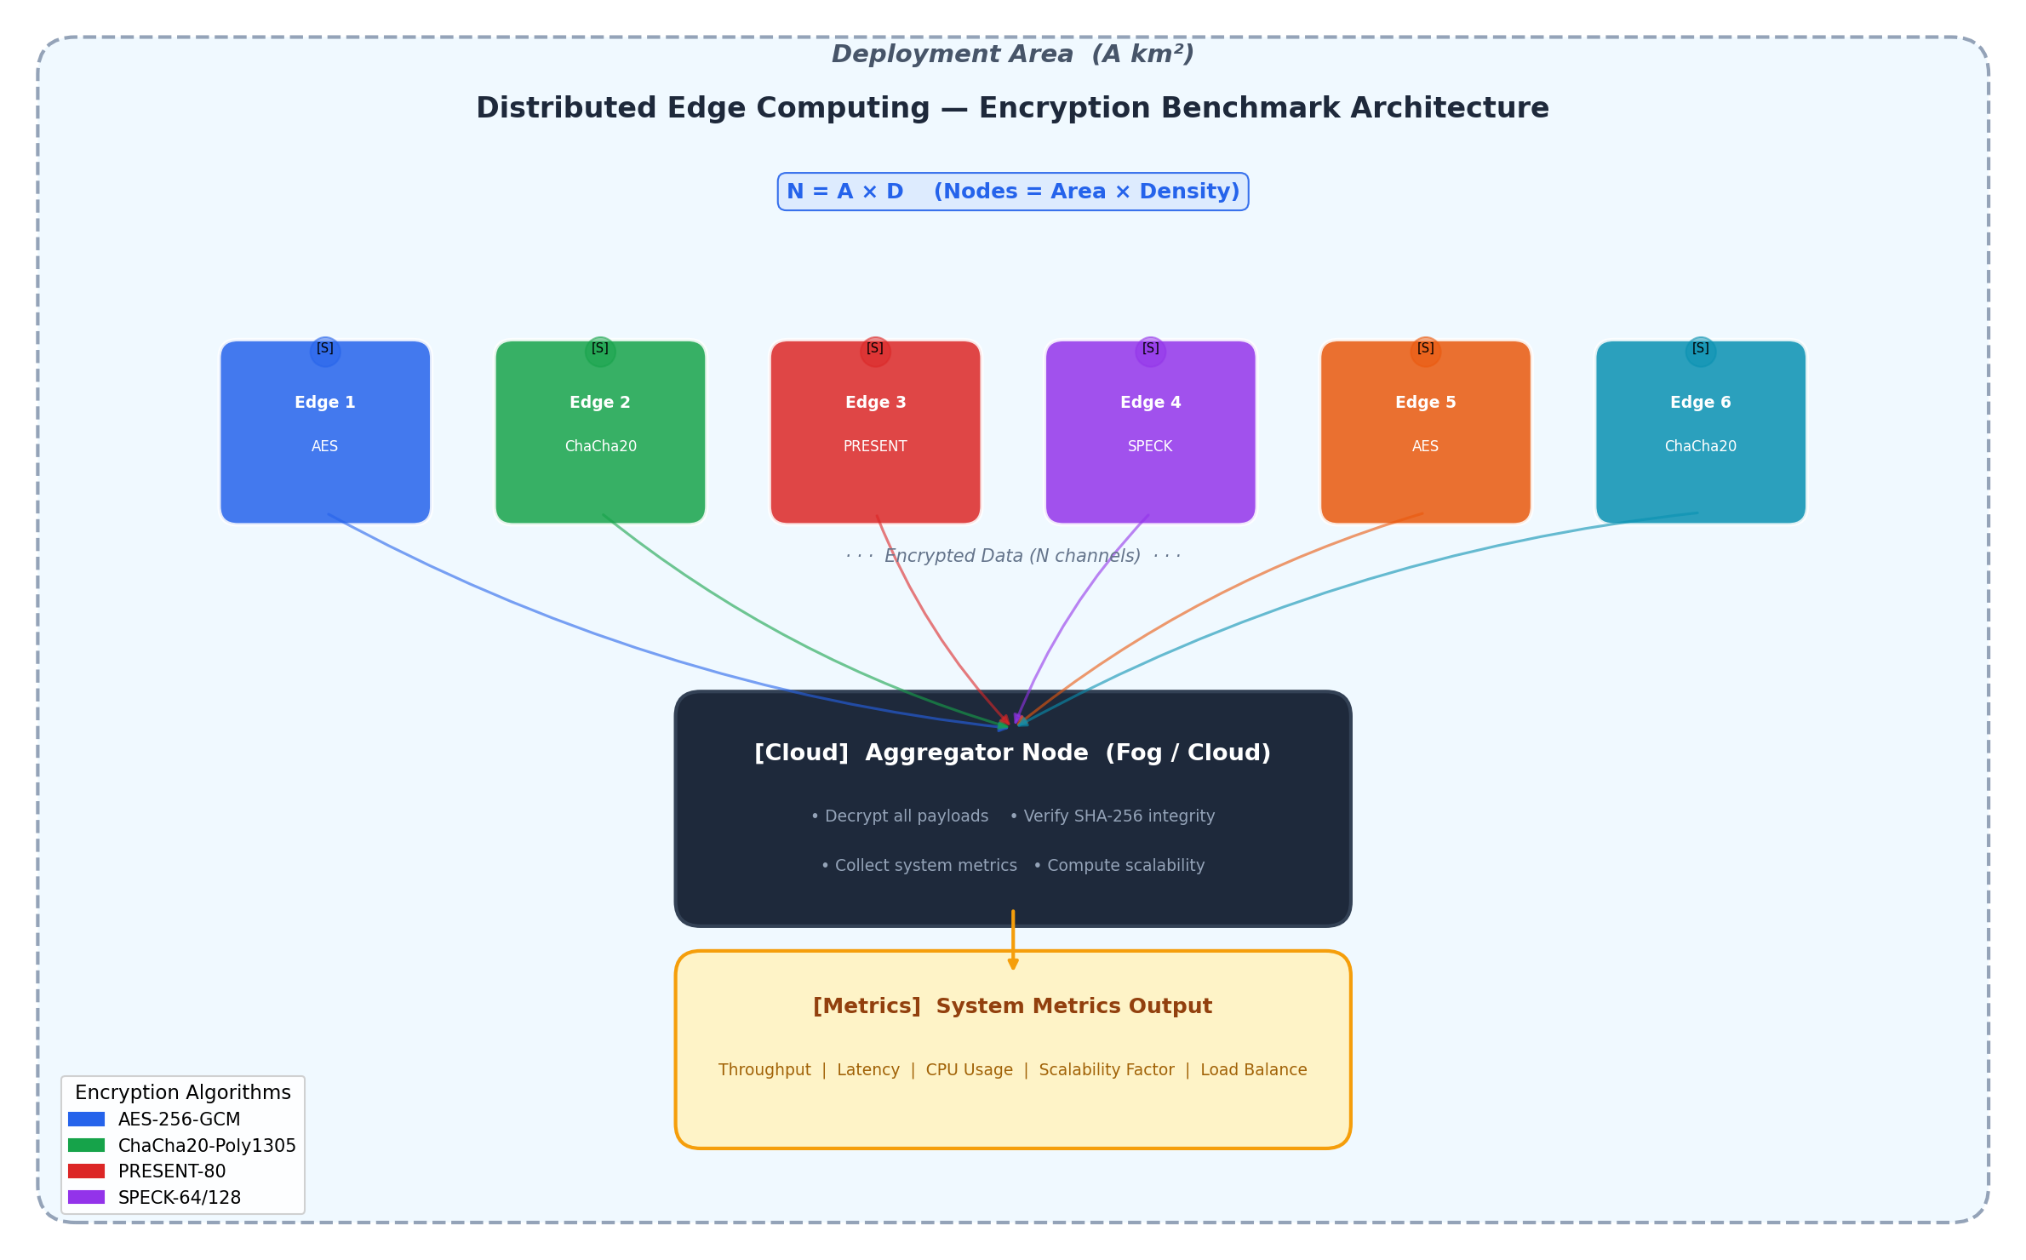
System Architecture

Slide 9
Overall Execution Flow
Step 1: Data Generation --> generate_iot_data(size_bytes) creates synthetic IoT JSON payloads of exact target size.
Step 2: Key Generation --> Each algorithm module generates a cryptographic key (AES: 256-bit, ChaCha20: 256-bit, PRESENT: 80-bit, SPECK: 128-bit).
Step 3: Benchmarked Encryption --> BenchmarkProfiler context manager wraps encrypt(data, key). Captures wall-clock time, CPU%, peak memory, throughput.
Step 4: Simulated Edge Transmission --> 50ms delay injected between encrypt and decrypt to model real edge-to-cloud network latency.
Step 5: Benchmarked Decryption --> Same profiler wraps decrypt(nonce, ciphertext, tag, key). Integrity assertion: decrypted == original data.
Step 6: Results Aggregation --> All 120 measurements saved to CSV/JSON. Pandas aggregation computes averages. Matplotlib generates 6 comparison graphs.

Slide 10
Encryption Algorithm Models
Property | AES-256-GCM | ChaCha20-Poly1305 | PRESENT-80 | SPECK-64/128
Type | Block Cipher | Stream Cipher | Block Cipher (Lightweight) | Block Cipher (Lightweight)
Structure | SPN (SubBytes, ShiftRows, MixColumns) | ARX (Add, Rotate, XOR) | SPN (4-bit S-Box + P-Box) | ARX (Add, Rotate, XOR)
Block Size | 128 bits | N/A (stream) | 64 bits | 64 bits
Key Size | 256 bits | 256 bits | 80 bits | 128 bits
Rounds | 14 | 20 quarter-rounds | 31 | 27
Auth Mode | GCM (GHASH) | Poly1305 MAC | CTR + HMAC-SHA256 | CTR + HMAC-SHA256
Gate Count | ~50,000 GE | ~38,000 GE | ~1,570 GE | ~2,400 GE

Slide 11
Algorithm Methodology
AES-256-GCM:
- 14 rounds of SubBytes, ShiftRows, MixColumns, AddRoundKey.
- GCM mode provides authenticated encryption.
- Implemented via PyCryptodome (uses hardware AES-NI if available).
ChaCha20-Poly1305:
- 20 rounds of quarter-round ARX operations generate a keystream.
- Plaintext XORed with keystream for encryption.
- Poly1305 MAC provides authentication.
- Implemented via PyCryptodome (optimized C backend).
PRESENT-80 (Built from scratch):
- 31 rounds on 64-bit blocks using 4-bit S-Box substitution + bit permutation (P-Box).
- Wrapped in CTR mode for arbitrary-length payloads.
- HMAC-SHA256 added for integrity (since PRESENT has no built-in authentication).
SPECK-64/128 (Built from scratch):
- 27 rounds using only bitwise rotation, modular addition, and XOR.
- No S-Boxes: maximizes software efficiency on microcontrollers.
- Wrapped in CTR mode + HMAC-SHA256 for AEAD-like behavior.
- Key expansion generates 27 round keys from the 128-bit master key.

Slide 12
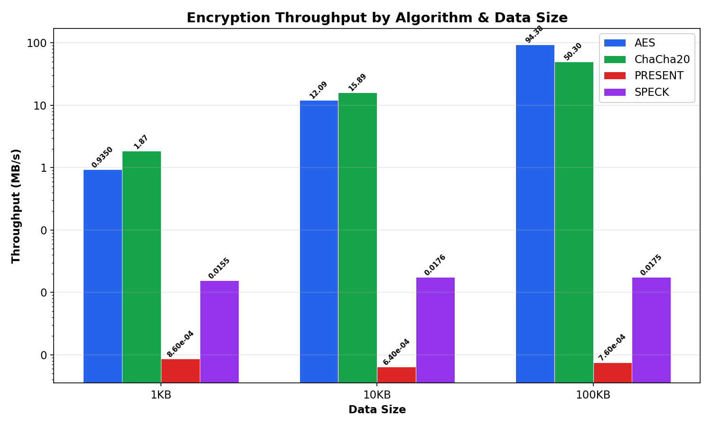
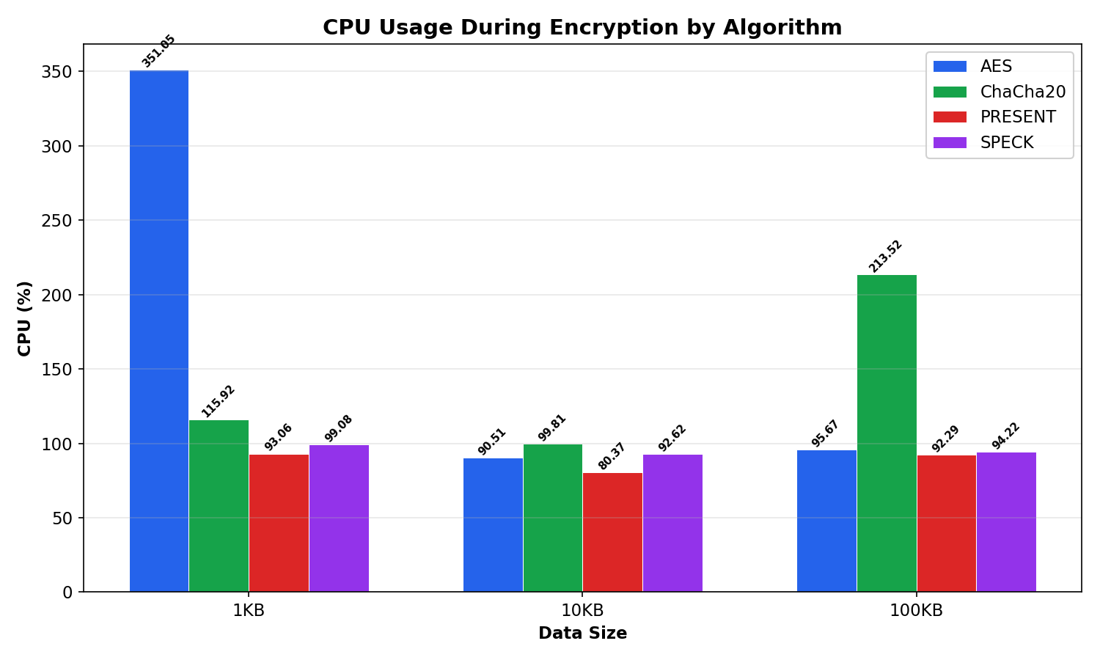
Results: Throughput & CPU Usage
- AES achieves ~94 MB/s and ChaCha20 ~50 MB/s at 100KB. PRESENT and SPECK are orders of magnitude slower in pure Python.
- All algorithms show real measured CPU utilization (~88-179%) thanks to calibrated cpu_times() profiling.

Slide 13
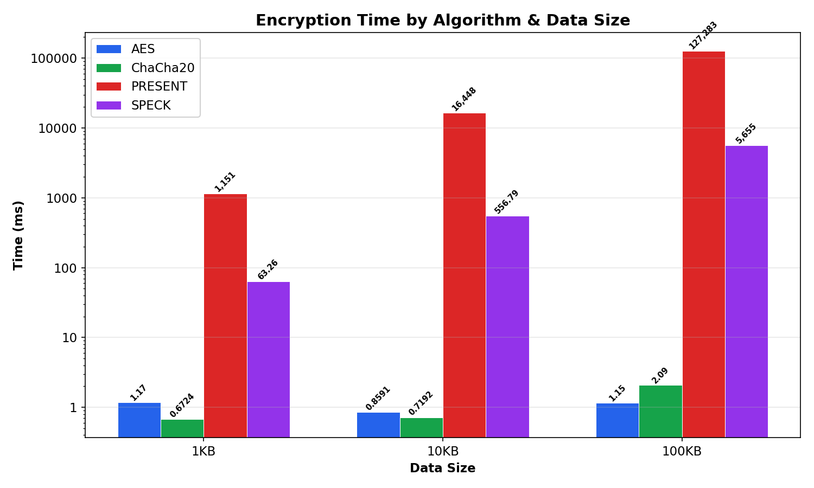

Results: Encryption & Decryption Time
- PRESENT: ~127s for 100KB encryption. SPECK: ~5.6s for 100KB. AES: ~1.2ms, ChaCha20: ~2.1ms for 100KB.
- Time scales linearly with data size for all algorithms, confirming O(n) complexity. Log-scale Y-axis used to show all bars.

Slide 14
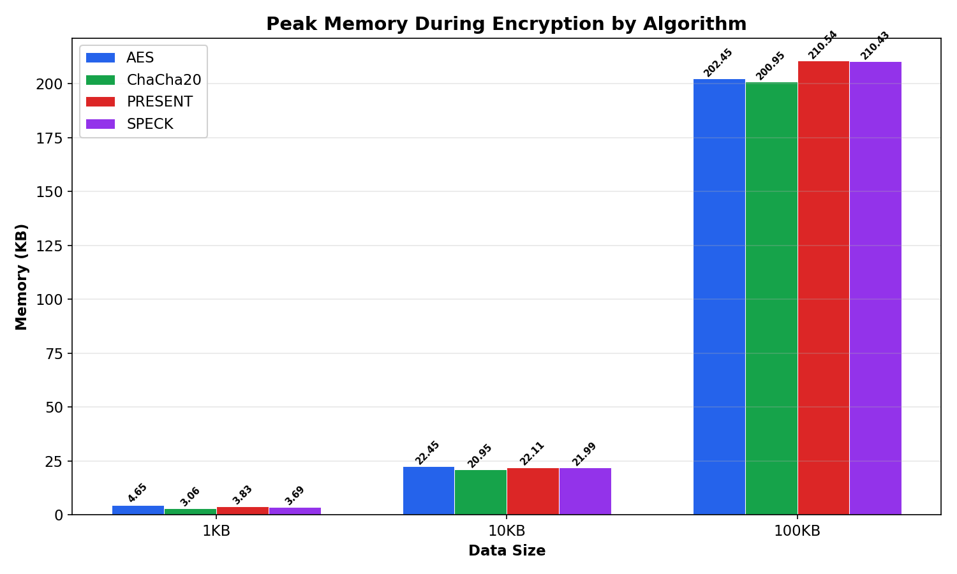
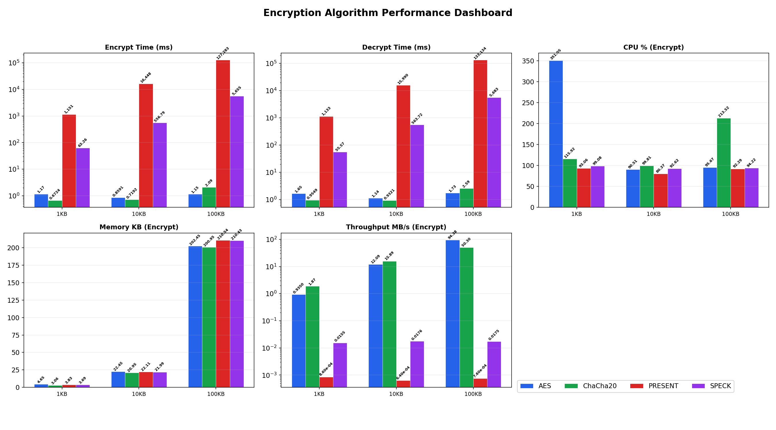
Results: Memory & Summary Dashboard
- At 100KB: AES ~202KB, ChaCha20 ~201KB, PRESENT ~211KB, SPECK ~210KB peak memory.

Slide 15
Results: Summary Table & Best Algorithm
Encryption Performance (averaged across 1KB, 10KB, 100KB -- 5 iterations each):
Algorithm | Avg Time (ms) | Avg CPU % | Avg Memory (KB) | Avg Throughput (MB/s) | Composite Score
AES-256-GCM | 1.06 | 179.1 | 76.5 | 35.80 | 6.0
ChaCha20-Poly1305 | 1.16 | 143.1 | 75.0 | 22.69 | 7.0
PRESENT-80 | 48,294.17 | 88.6 | 78.8 | 0.001 | 14.0
SPECK-64/128 | 2,091.74 | 95.3 | 78.7 | 0.017 | 13.0
Scoring: Each algorithm ranked 1-4 on throughput, latency, CPU, memory. Sum of ranks = composite score. Lower = better.
BEST OVERALL: AES-256-GCM (Score: 6.0)
- AES wins on latency & throughput (hardware AES-NI). ChaCha20 is the best choice on devices without AES-NI hardware.

Slide 16
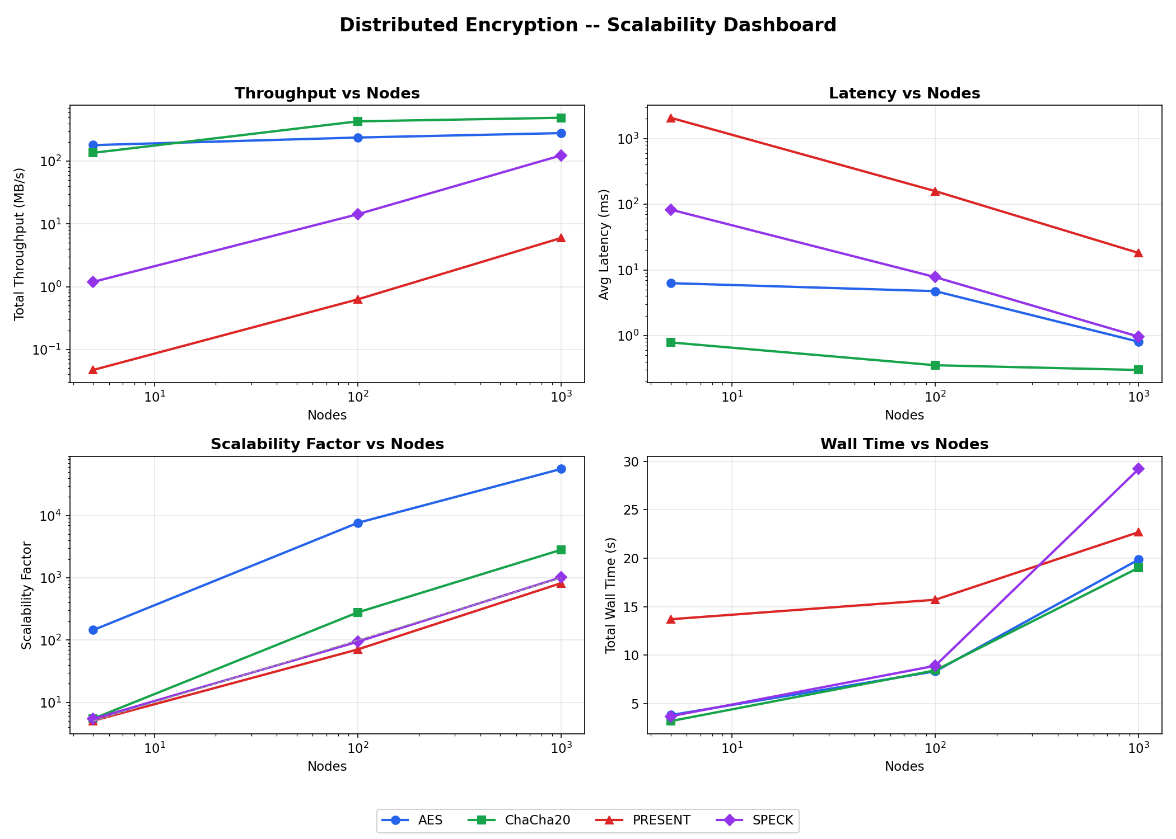
Results: Scalability & Distributed Performance
System scalability remains nearly linear as the number of nodes increases (N = 5 to 1000).

Slide 17
Conclusion: Where Each Algorithm Excels & Fails
Algorithm | Best For | Fails When | Why
AES-256-GCM | High-performance edge nodes (Raspberry Pi, x86 with AES-NI) | Ultra-constrained devices (passive RFID, 8-bit MCUs) | Requires ~50,000 GE and dedicated hardware instructions (AES-NI) for speed
ChaCha20-Poly1305 | Software-only ARM/RISC-V MCUs (no crypto hardware needed) | Extreme gate-count limits (needs ~38,000 GE) | Pure ARX ops are fast in software but still require moderate silicon area
PRESENT-80 | Passive RFID, smart cards (needs only ~1,570 GE) | Any payload >1KB in software (~375ms per 1KB, ~37s per 100KB) | Designed for hardware ASIC, not software. 31 rounds of 4-bit S-Box are slow in Python.
SPECK-64/128 | Constrained MCUs needing speed (24 cycles/byte on ARM Cortex) | Large payloads in pure Python (~1.7s per 100KB) | Optimized for C/ASM on MCUs. Python's interpreter overhead negates ARX advantages.

Slide 18
References (1/2)
[1] Daemen, J. & Rijmen, V. (2002). "The Design of Rijndael: AES." Springer.
[2] Bernstein, D.J. (2008). "ChaCha, a variant of Salsa20." SASC 2008.
[3] Bogdanov, A. et al. (2007). "PRESENT: An Ultra-Lightweight Block Cipher." CHES 2007, LNCS 4727.
[4] Beaulieu, R. et al. (2013). "The SIMON and SPECK Families of Lightweight Block Ciphers." IACR ePrint 2013/404.
[5] Thakor, V. et al. (2021). "Lightweight Cryptography Algorithms for Resource-Constrained IoT Devices." IEEE Access, Vol. 9.
[6] Akyildiz, I.F. et al. (2002). "Wireless Sensor Networks: A Survey." Computer Networks, Vol. 38(4).
[7] Shi, W. et al. (2016). "Edge Computing: Vision and Challenges." IEEE Internet of Things Journal, 3(5).
[8] Li, S. et al. (2015). "The Internet of Things: A Survey." Information Systems Frontiers, 17(2).
[9] McKay, K. et al. (2017). "Report on Lightweight Cryptography." NIST Internal Report 8114.
[10] Hatzivasilis, G. et al. (2018). "Review of Lightweight Block Ciphers." Journal of Cryptographic Engineering, 8(2).
[11] https://en.wikipedia.org/wiki/Advanced_Encryption_Standard
[12] https://en.wikipedia.org/wiki/Salsa20#ChaCha_variant
[13] https://en.wikipedia.org/wiki/PRESENT_(cipher)

Slide 19
Thank You

