Slide 1
Aurora Music: Cloud-Native Music Streaming &
Audio Identification Platform
23CSE363 - Cloud Computing
Team_No: 8
S.No | Reg.No | Name of the Student | Section
1 | BL.EN.U4CSE23247 | Reddim Thoshan Reddy | CSE C
2 | BL.EN.U4CSE23249 | S.J.L Vamsi | CSE C
3 | BL.EN.U4CSE23258 | Vundela Lasya | CSE C

Slide 2
Introduction
This project presents a cloud-native music application that enables users to upload, stream, search, and identify audio tracks through a web interface.
The system is designed using a containerized backend architecture and deployed in a scalable cloud environment. Audio files are securely stored in cloud object storage, while metadata and user information are maintained in a managed database service.

Slide 3
Literature Survey (LR Summary)
S.No | Author Name(s) | Full title of the paper with year | Inference from the paper (based on methodology, technology) | Open problem (for your proposed work)
1 | B. Pahl | "Containerization and the PaaS Cloud" (2015) | Containerization provides lightweight virtualization, improving portability and consistency across infrastructures. | Distributed configurations and secrets security in containers.
2 | B. McFee et al. | "Librosa: Audio and Music Signal Analysis" (2015) | Provides digital signal processing (DSP) for waveform analysis, beat tracking, and audio feature extraction. | Stateless processing and media file retrieval latency.
3 | R. Buyya et al. | "Market-Oriented Cloud Computing" (2009) | Presents utility cloud computing paradigms for allocating resources dynamically on-demand. | Secure caching, user session integrity, and content distribution networks.

Slide 4
Software & Hardware Requirements
• Frontend: HTML5, CSS3 (Glassmorphism & Dark Mode UI), JavaScript (Web Audio API for real-time visualizer)
• Backend: Python 3.12, Flask Framework, SQLAlchemy ORM, Librosa, Ffmpeg
• Cloud Stack (AWS): EC2, RDS MySQL, S3, IAM, SSM Parameter Store, ECR, CloudWatch Logs, ALB, CloudFront CDN, Route 53 DNS
• Deployment: Docker, Docker Compose, Git

Slide 5
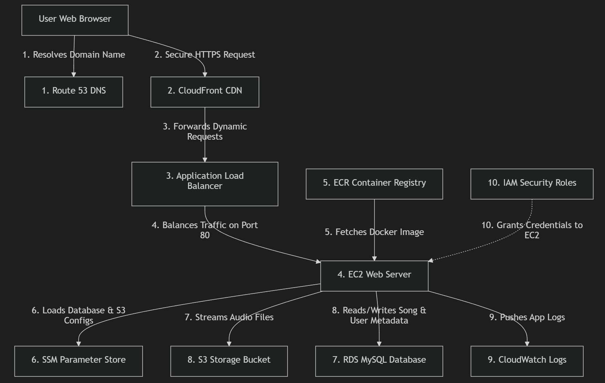
System Architecture & Design

Slide 6
System Architecture & Design
• Traffic Entry: Route 53 (DNS) resolves domain name to CloudFront CDN
• Content Delivery: CloudFront CDN forces HTTPS redirect and routes requests to Application Load Balancer (ALB)
• Load Balancing: ALB checks EC2 health and balances web traffic to the EC2 container on Port 80
• App Engine: EC2 runs the Flask application inside a Docker container (orchestrated by Gunicorn)
• Storage & Databases:
- Structured data (users, song details) is stored in Amazon RDS MySQL
- Large audio media files are uploaded to and streamed from Amazon S3
• Security: IAM Instance Profile secures service calls, and SSM Parameter Store manages RDS credentials.

Slide 7
Audio Identification & DSP Analysis
• Input Source: User-uploaded .mp3 and .wav files
• Processing Engine: Librosa & FFmpeg are utilized inside the Docker container
• Feature Extraction:
- Extracts Mel-Frequency Cepstral Coefficients (MFCCs) to model vocal/timbral features
- Extracts Chroma vectors to model harmonic and pitch profiles
- Computes Spectral Centroid and Spectral Roll-off to measure brightness and signal bandwidth
• Frontend Visualization: User browser reads the S3 audio stream and uses the HTML5 Web Audio API to render interactive frequency graphs in real-time

Slide 8
Implementation: DB & Object Storage
• Amazon RDS (Relational Database):
- Provisioned a db.t4g.micro instance running MySQL
- Handled data queries via SQLAlchemy ORM (User, Song, Favorite, RecentlyPlayed models)
- Securely isolated: Port 3306 is open ONLY to the EC2 host Security Group
• Amazon S3 (Object Storage):
- Bucket: 'aurora-music-storage-team8' stores audio files
- Files are renamed to random UUIDs upon upload to prevent conflicts
- Streaming logic: App requests a secure pre-signed URL from S3 (1-hour expiry) to stream music to the user browser
- CORS configured to allow cross-domain requests for visualizer

Slide 9
Implementation: Security & Secrets
• AWS Systems Manager (SSM) Parameter Store:
- Holds 'DATABASE_URL' and 'S3_BUCKET_NAME' parameters securely
- The application configuration fetches parameters at runtime. No secrets are hardcoded in the codebase
• AWS IAM Instance Profile:
- Attached the role 'aurora-music-ec2-role' directly to the EC2 server
- Grants EC2 read/write access to S3, SSM, and CloudWatch Logs without saving static Access Keys in code
• Container Log Management:
- Implemented Docker's 'awslogs' driver to pipe stdout/stderr into CloudWatch logs stream 'aurora-music-logs'

Slide 10
Results & Performance Analysis
• Functional Completeness: The website successfully performs user registration, login, audio uploading, play history tracking, and audio recognition
• High Availability & Load Balancing:
- The Application Load Balancer (ALB) can manage traffic distribution to EC2
- The EC2 security group allows traffic only from the ALB, blocking malicious port scans
• CDN Caching and SSL Optimization:
- CloudFront CDN forces HTTP to HTTPS redirect, securing user credentials
- CachingDisabled setting guarantees that session state, CSRF tokens, and dynamic login cookies pass directly to Flask

Slide 11
Conclusion & Future Enhancements
• Conclusion:
- Successfully built a cloud-native, containerized audio streaming platform (Aurora Music) integrating 10 distinct AWS services.
- Solved container dependencies, MySQL caching-sha2 password protocols, and CORS streaming blocks.
• Future Enhancements:
- AI-based Recommendations: Recommend songs using user-based collaborative filtering.
- ACM SSL Certificate: Bind custom SSL/TLS certificates to the CloudFront distribution.
- Auto Scaling Groups: Automatically adjust EC2 instance capacity based on CPU utilization and request throughput.

Slide 12
Key References
[1] B. Pahl, 'Containerization and the PaaS Cloud,' IEEE Cloud Computing, 2015.
[2] B. McFee et al., 'Librosa: Audio and Music Signal Analysis in Python,' SciPy, 2015.
[3] A. Balalaie et al., 'Microservices Architecture Enables DevOps,' IEEE Software, 2016.
[4] Amazon Web Services, 'Amazon EC2, S3, and RDS Documentation,' AWS online docs.
[5] D. Merkel, 'Docker: Lightweight Linux Containers for Consistent Development/Deployment,' Linux Journal, 2014.
[6] N. Dragoni et al., 'Microservices: Yesterday, Today, and Tomorrow,' 2017.
[7] R. Buyya et al., 'Market-Oriented Cloud Computing,' FGCS, 2009.
[8] W. Vogels, 'A Head in the Clouds: The Power of Infrastructure as a Service,' Queue, 2008.

Slide 13
THANK YOU!

